Slide 1


Steven Sanderson
@StevenSanderson

Slide 2




https://...
JS

Slide 3



https://...
DOM
Client-side
(Blazor WebAssembly)

Slide 4


https://...
https://...
SignalR
DOM
DOM
Client-side
(Blazor WebAssembly)
Server-side
(Blazor Server)

Slide 5
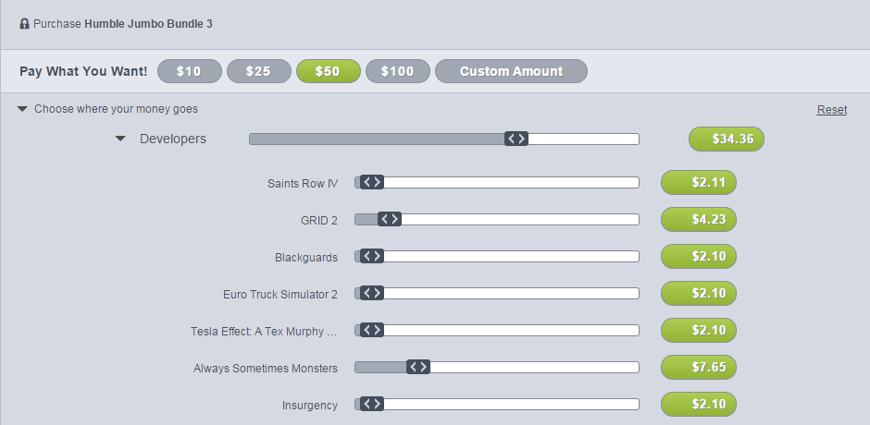
INTERACTIVE WEB UI FOR .NET
A BIGGER APP ON WEBASSEMBLY

Slide 6
WITH
FUTURE
FEATURES
INTERACTIVE WEB UI FOR .NET
A BIGGER APP ON WEBASSEMBLY

Slide 7
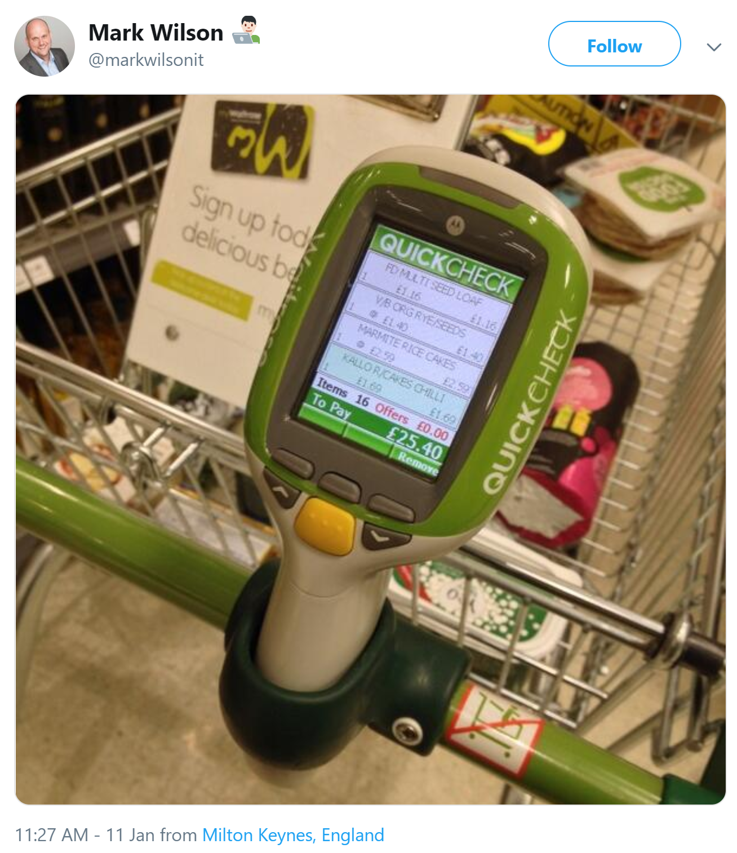

Slide 8

1
2
3
PIN
* * * *
CART
Item 1
£3.95
Item 2
£12.00
Total: £15.95
0000 0000 0000 0000

Slide 9
WITH
FUTURE
FEATURES
A BIGGER APP ON WEBASSEMBLY
BLAZOR EVERYWHERE
gRPC
Testing
PWA

Slide 10
WITH
FUTURE
FEATURES
A BIGGER APP ON WEBASSEMBLY
BLAZOR EVERYWHERE
gRPC
Testing
PWA

Slide 11
https://...
https://...
SignalR
DOM
DOM
Client-side
(Blazor WebAssembly)
Server-side
(Blazor Server)

Slide 12
Client-side
(Blazor WebAssembly)
Server-side
(Blazor Server)
Preview now
Release target: May 2020
Shipped
Released in .NET Core 3.0
Great for:
- Offline support / PWA
- Zero latency UI
- Static-files hosting
Great for:
- Thin client
- Full runtime
- All code on server

Slide 13
Client-side
(Blazor WebAssembly)
Server-side
(Blazor Server)
Preview now
Release target: May 2020
Shipped
Released in .NET Core 3.0
Blazor Hybrid
(Desktop app with web rendering)
Blazor + Native UI
(Mobile/desktop with native OS UI)
Uncommitted. Samples:
aka.ms/blazor-electron aka.ms/webwindow
Uncommitted. Samples: aka.ms/mobile-blazor-bindings

Slide 14
LEARN MORE & GET STARTED
blazor.net
Steven Sanderson
@StevenSanderson

Slide 15
LEARN MORE & GET STARTED
blazor.net
CODE & SLIDES
aka.ms/sanderson-london-2020
== https://github.com/SteveSandersonMS/presentation-2020-01-NDCLondon
Steven Sanderson
@StevenSanderson

