Slide 1


Review of Standard Rotor Configurations for a Micro Unmanned Aerial System
ROBMECH ~ November 2015
Angus Steele
A Collaboration between the CSIR and The University of Stellenbosch’s ESL
Notes:
Hi, my name is Angus Steele and I submitted this paper to this conference as part of my Masters project.
I am a full time employee at the CSIR in Pretoria and I’m currently doing my masters part time through the University of Stellenbosch.
And as stated this is a joint project between both institutions.

Slide 2
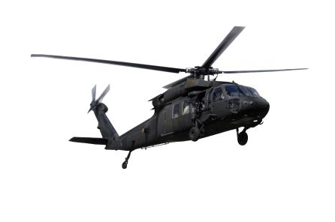
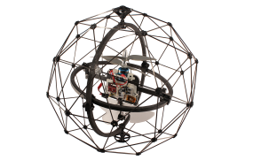
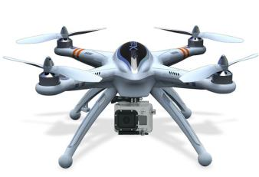
Contents
Introduction
Fundamentals of Flight Theory
Selection Parameters
Discussion of Standard Rotorcraft Configurations
Concept Designs
Notes:
The more I looked the more frustrated I got. Some of the information was so difficult to find and when I found it, it was encoded behind 2-3 years worth of university math courses!
So the paper I wrote is effectively the first section of my literature review and is all about choosing the correct configuration for your micro unmanned aerial system application.
First I’ll first introduce you to some of the reasons why this paper was written and why the project is being done.
Then I’ll cover some of the fundamentals of flight theory focusing on particular to rotorcraft.
After that I will expand on these theories by using them to isolate some of the core parameters that are pertinent to a rotorcraft configuration decision
Then I will use these parameters and compare them to some of the standard configurations that already exist; while also mentioning the ideal use case for each of these designs.
Finally to end off I will show you 2 concepts I am currently looking at for my masters.
Sounds like fun? Cool let’s go.

Slide 3
Introduction
Why Drones?
Easy to navigate complex terrains safely and quickly
Computing power now allows for complex control
More freedom in 3D space than ever before
Issues
Close quarter environments
Limited flight times
Notes:
Just to put everything into context for you. I am developing a drone that can handle interactions with a close quarter environment, this includes knocks and bumps as well as just maintaining flight when close to the walls.
My unit at the CSIR has a lot of experience with mining robotics and platform development. So this platform was seen as a great tool to do inspections, safety tests and even mapping in underground mines.

Slide 4
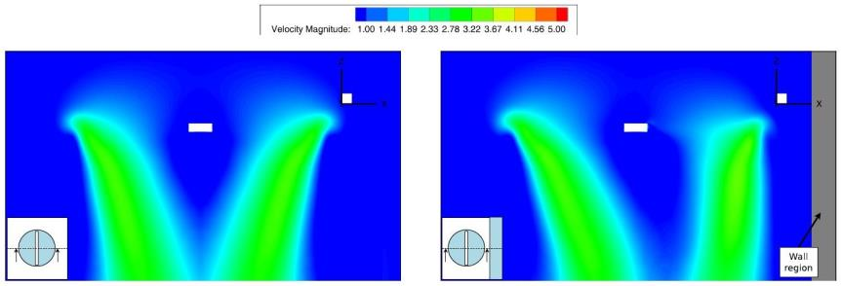
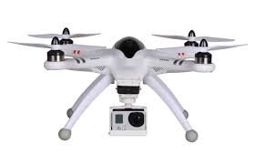
Introduction
Near Wall Effect
D.C. Robinson, Hoam Chung, and K. Ryan.
Computational investigation of micro rotorcraft nearwall
hovering aerodynamics.
In Unmanned Aircraft Systems 2014 International Conference on
Notes:
Explain what happens when close to a wall.

Slide 5
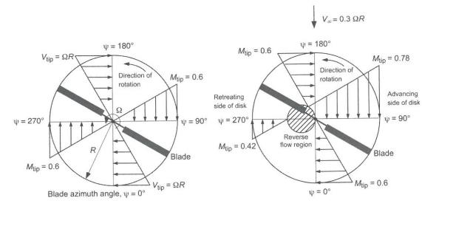
Fundamentals of Flight Theory
Velocity Components of a Rotor
Air Flow Due to Translations
Leading Edge
Rotor Spinning
Clockwise
Tip Speed
Tip Speed
Tip Speed
Air Speed
Total Speed
Retreating Edge
J. Gordon Leishman. Principles of Helicopter Aerodynamics. Cambridge Aerospace Series. Cambridge
University Press, 2nd edition edition, 2006.
Helicopter Speed Due to Translations
Notes:
Please remember that this presentation is a brief overlook and summary of a paper that summarised these ideas from textbooks and papers that also summarised the topics. So maybe try and download my dissertation in a year’s time if you need a fuller explanation. But essentially:
Rotor velocities are at a maximum at the end of the blade.
Max speed limitation
Stall condition

Slide 6
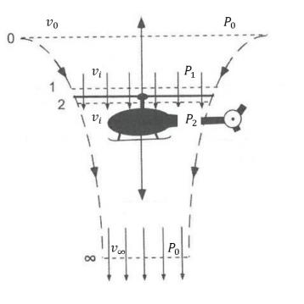
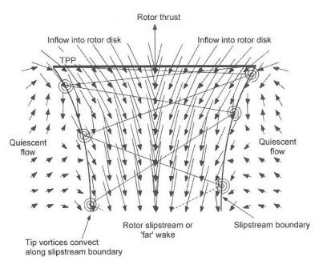







Fundamentals of Flight Theory
Momentum Theory in Hover
Wake Boundary
$$V_{0}$$
$$P_{0}$$
$$P_{1}$$
$$V_{i}$$
$$P_{2}$$
$$V_{∞}$$
$$P_{∞}$$
J. Gordon Leishman. Principles of Helicopter Aerodynamics. Cambridge Aerospace Series. Cambridge
University Press, 2nd edition edition, 2006.
Notes:
Air flowing through the blade is smoothed out and can be quantified. Air Outside is quiescent.
Imagine the blade as infinitely small.
Subscripts: 0 = Quiescient
1 = Just before rotor
2 = Just after rotor
inft = Far wake (one rotor diameter)
No velocity change across the blade. Introduced as a pressure difference.

Slide 7
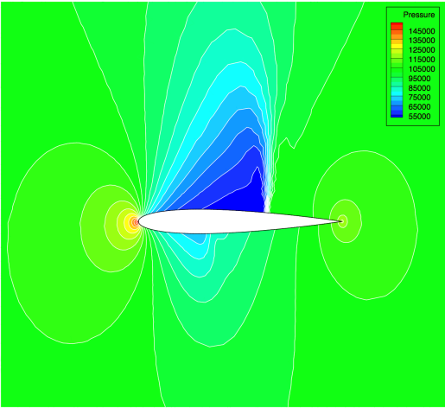

Fundamentals of Flight Theory
Mathematical Expressions for Thrust
$\dot{m}=ρAv_{i}$ Mass flow
$T=\dot{m}a$ Thrust
$∴T=ρAv_{i}v_{∞}$ ($∵a =v_{∞}−v_{0}$)
$T=A\left(P_{2}−P_{1}\right)$ $Δ$Pressure
$P_{2}−P_{1}=\frac{1}{2}ρ(v_{∞}^{2}−v_{0}^{2})$ Bernoulli’s Equation
Image Taken from: http://adl-public.stanford.edu/,
Stanford Aerospace Design Lab
Notes:
Mass flow of air.
Newton 3.
Substitute mass flow in, to get the relationship between Area and air speeds
Power into the system takes the form of a pressure differential. But due to Bernoulli’s equation, this energy will create flow.
*Click*
The pressure change is explained through Basic Air Foil Technology, lower pressure on top than on bottom.

Slide 8
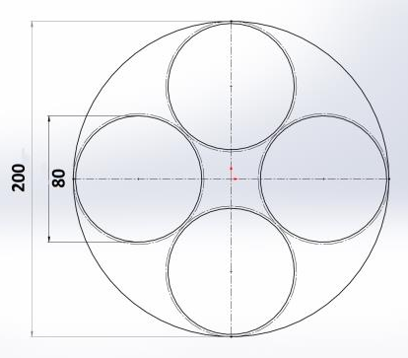
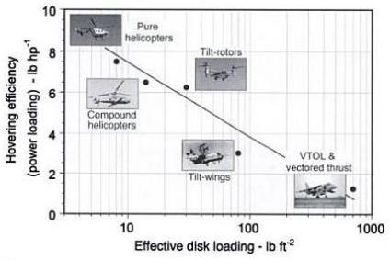

Fundamentals of Flight Theory
Disk and Power Loading
$DL=\frac{T}{A}=\frac{1}{2}ρv_{∞}$
Uniform in multi rotors
$∧DL= ∨Efficiency_{Hover}$
Bigger blades leads to a better hover efficiency
$P=2ρAv_{i}^{3}$
J. Gordon Leishman. Principles of Helicopter Aerodynamics. Cambridge Aerospace Series. Cambridge
University Press, 2nd edition, 2006.
Notes:
Disk Loading is an important ratio between the area created by a rotor and the thrust being supplied by that rotor.
Often in rotorcraft we use a craft’s parameters at hover to preliminarily judge a craft’s efficiency.
Of course bigger blades also leads to: Large rotational inertia, severely limited flight speed, bigger geometry, less immune to gusts.
Induced Power, area is the only aspect you have control of. A higher disk loading value results in larger values for induced velocities as well as the required power
to hover.

Slide 9
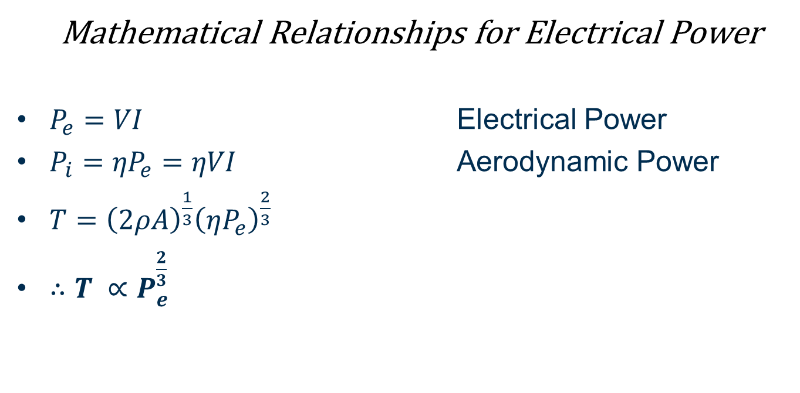
Fundamentals of Flight Theory
Mathematical Relationships for Electrical Power
$P_{e}=VI$ Electrical Power
$P_{i}={ηP}_{e}=ηVI$ Aerodynamic Power
$T={\left(2ρA\right)}^{\frac{1}{3}}{\left(ηP_{e}\right)}^{\frac{2}{3}}$
$∴T ∝P_{e}^{\frac{2}{3}}$
Notes:
Increasing the electrical power only increases the thrust by about 1.5 where, increasing Rotors doubles both the power into the system as well as the thrust.

Slide 10
Selection Parameters
Efficiency, Payload and Flight Time
Geometry, Size and Mechanical Complexity
Flight time linked to efficiency
Single rotor has better hover efficiency than a multi rotor of a similar size
Multi rotors can handle bigger payloads and accelerate more efficiently
Design for light weight
Functional weight distribution
Symmetrical weight distribution
Inertia tensor reduction
Notes:
Start with the parameters.
Flight time linked to efficiency.
It starts to get complicated here early because of all the dependencies in an aerial system.
Obviously keeping the craft as light weight as possible is important, but the geometry is important for a few reasons. Functional weight distribution, as in setting certain functional blocks a specific amount of weight percentage of your system. To tailor your platform to be more specific for your application. Symmetry helps eliminate disturbances and makes the control more predictable.

Slide 11
Selection Parameters
Drone Manoeuvrability and Control – Reference Frames
Body Reference
Earth Reference

Slide 12
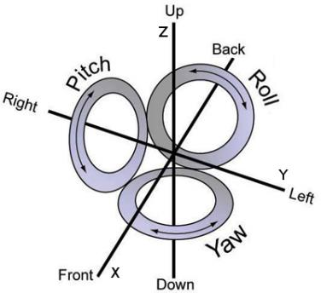
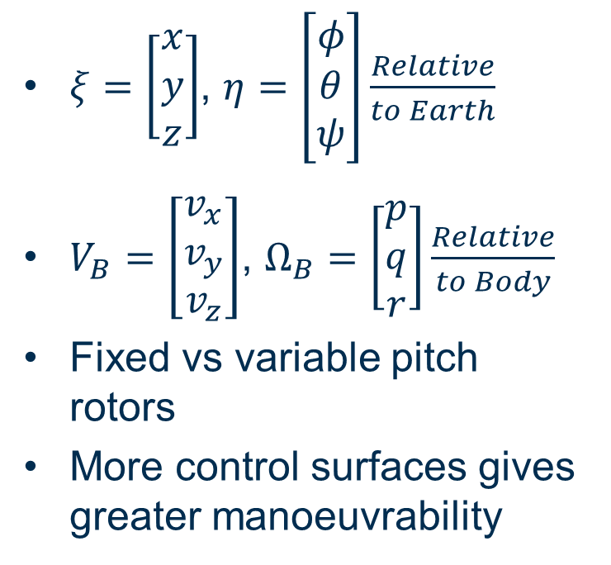
Selection Parameters
Drone Manoeuvrability and Control
$ξ=\left[\begin{matrix}x \\ y \\ z\end{matrix}\right]$, $η=\left[\begin{matrix}φ \\ θ \\ ψ\end{matrix}\right]\frac{Relative}{to Earth}$
$V_{B}=\left[\begin{matrix}v_{x} \\ v_{y} \\ v_{z}\end{matrix}\right]$, $Ω_{B}=\left[\begin{matrix}p \\ q \\ r\end{matrix}\right]\frac{Relative}{to Body}$
Fixed vs variable pitch rotors
More control surfaces gives greater manoeuvrability
Instructor's Handbook, chapter Chapter 5, page 183. US Department of Transportation, Oklahoma, 2012.
Notes:
Talk about the two different axes
Rotation Matrix links them up. Through Euler angles
6 DOF, 4 Primary are Z, and orientation.
Explain pitch. As pitch increases, drag increases, power consumption similar to speeding up rotors. Micro Aerial vehicle the couplings are very small to be designing a cyclic control system.

Slide 13
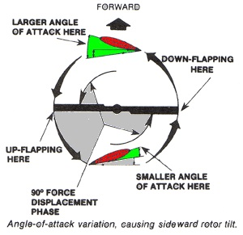
Selection Parameters
Stability and Disturbance Rejection
Big design specification for my MSc project
Inherent yaw instability
Multiple blades increases disturbance immunity
Rotor loss fail safe
Gabriel M Homann, Claire J Tomlin,
Haomiao Huang, and Steven L Waslander.
Quadrotor Helicopter Flight Dynamics and Control : Theory and Experiment . The American Institute of
Aeronautics and Astronautics
Notes:
Massive factor for the design to handle disturbances.
Due to counter torque, each individual blade has inherent yaw instability.
Multiple blades makes it easier to counter disturbances.
Not pertinent for this project, but multiple blades allows for a fail safe design that handle loss of rotors.

Slide 14
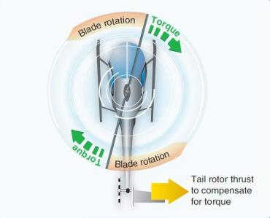
Standard Configurations
Traditional Helicopter
Low disk loading
High efficiency
Lengthy craft
High level of mechanical complexity
Very susceptible to disturbances
Limited payload
Instructor's Handbook, chapter Chapter 5, page 183. US Department of Transportation, Oklahoma, 2012.

Slide 15
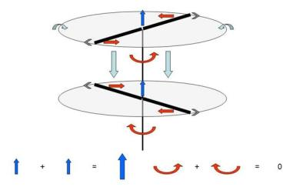
Standard Configurations
Coaxial Rotors
Very low disk loading
Overlap introduces inefficiencies
Compact craft
Weak lateral control
High drag during translations
Limited payload
Taken from www.simhq.com
Notes:
Total disk area = sum or two rotors.
Neglecting overlap until power considerations come in. Lots of disparity between different professionals.
Very compact
Talk about flaps used as lateral control
No streamline against translational drag in any direction
Limited pay load.

Slide 16
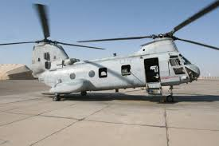
Standard Configurations
Tandem Rotors
Not a commonly used design for micro aerial applications
“Jack of all trades”
Taken from: http://www.iso-group.com/

Slide 17
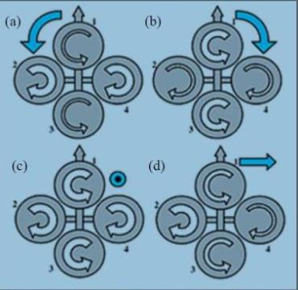
Standard Configurations
Multi Rotors
Very common design
Robust and simple control
Low hover efficiency – large base electrical power requirement
High payload capabilities
High disturbance rejection
Large and heavy craft
Yogianandh Naidoo, R Stopforth, and Glen Bright.
Rotor Aerodynamic Analysis of a Quadrotor for Thrust Critical Applications.
Technical Report November, UKZN, Durban, 2011.
Notes:
Such great manoeuvrability. Easy control. Now that we have enough computing speed.
*Click*
Explain total Area
Abig = 100% Asmall = 64%

Slide 18
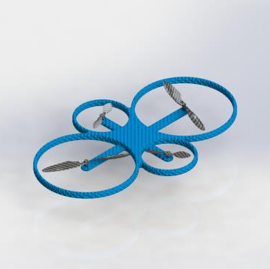
Concept Designs
Concept Design 1 – Unlike Size Quad
Pros
High stability
Quadcopter manoeuvrability
Compact design
Easy to control
Higher payload
High disturbance rejection
Cons
Lower efficiency than standard design
Notes:
Innovative Design

Slide 19
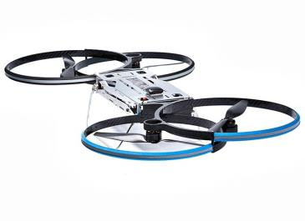
Concept Designs
Concept Design 2 – Overlapping Quad
Pros
High stability
Good manoeuvrability
Compact design
Higher payload
Good disturbance rejection
Cons
Lower efficiency due to overlap
Slightly more difficult to control
Taken From: http://www.hover-bike.com/MA/
Notes:
Same design used by Malloy Aeronautics
Massive payload capabilities. Overlap reduces efficiency.

Slide 20
Thank you
Angus Steele (ASteele@csir.co.za)

