Slide 1

Docker Container & Kubernetes
Modern Container Orchestration
SE 4458 - Software Architecture & Design
Ali Haktan SIĞIN – 21070001004
Ülkü Bartu SERBEST – 19070001037
Yaşar University, November 2025

Slide 2
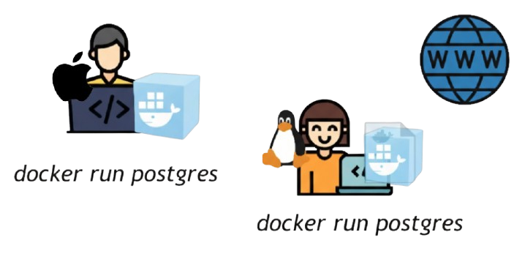
Why Do We Need Docker?
❌ The Problem
"It works on my machine, but not on production!"
When developers test apps on their own computers, everything works fine. But when the same app runs on the production server, it fails because the environments are not the same.
✅ What Docker Solves
Before: Each developer need to install and configure all services directly on their OS on their local machine.
Now: Start service as a Docker container using a 1 Docker command.
Commands are the same for all OS and all services.
This eliminates "works on my machine" problems.

Slide 3
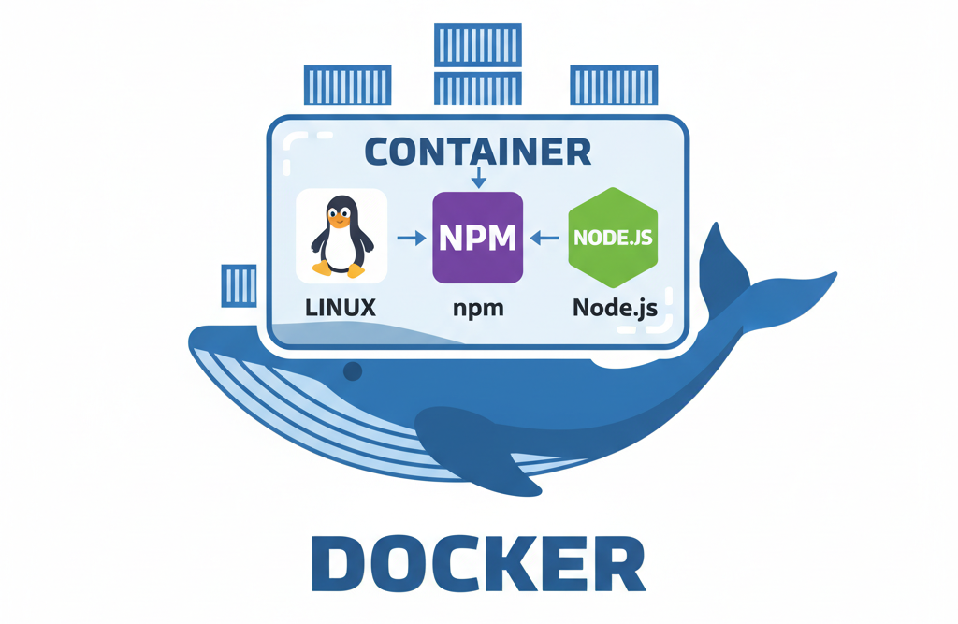
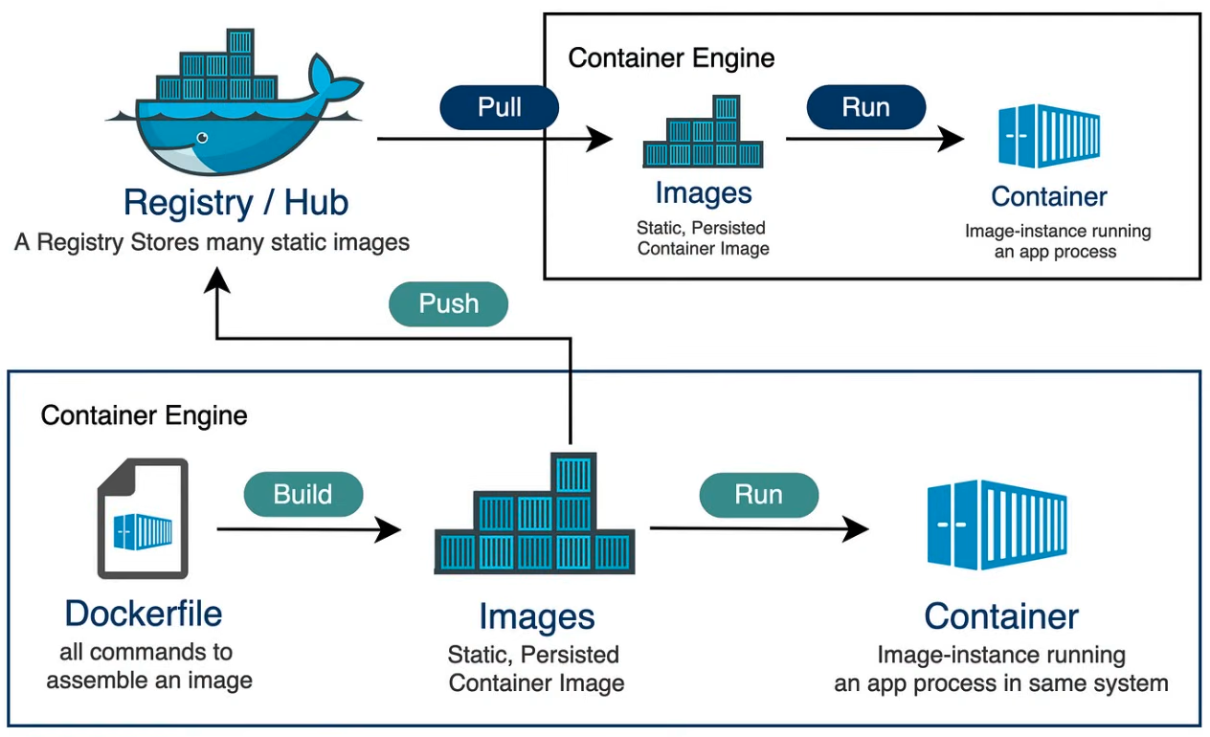
What is Docker?
Docker is a platform that packages applications with all the necessary dependencies, configuration, system tools and runtime.
Key Concepts
Dockerfile: Instructions to build an image
(e.g., FROM “OS”, COPY, RUN, CMD commands)
Image: Blueprint (template) for creating containers
(e.g., node:18-alpine)
Container: Isolated environment with app and dependencies
(e.g., a Node.js app with specific npm packages)
Registry: Storage for Docker images (Docker Hub)
(e.g., pull official images like nginx, postgres)
"Package once, run anywhere"

Slide 4
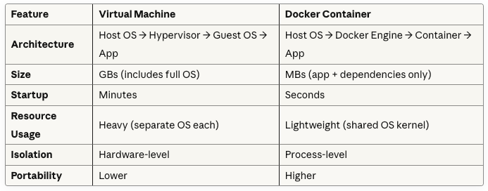
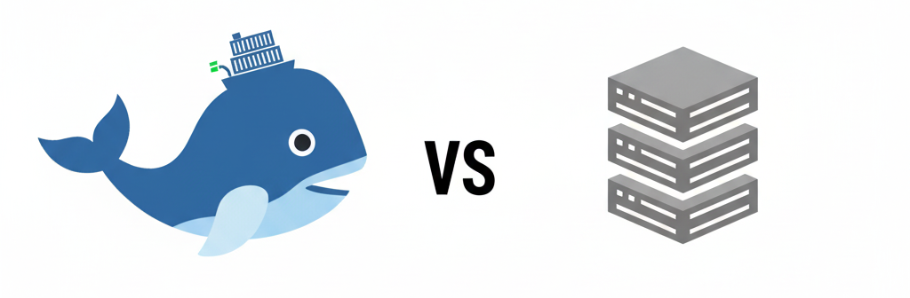
Docker Container vs. Virtual Machines
When to Use?
Virtual Machines:
Need different operating systems
Complete isolation required
Legacy applications
Docker Containers:
Microservices architecture
Fast deployment and scaling
Development consistency

Slide 5
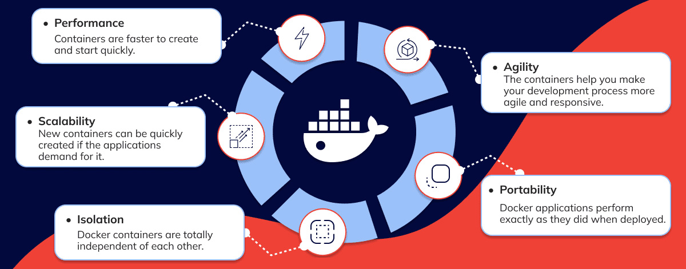
Benefits of Docker

Slide 6
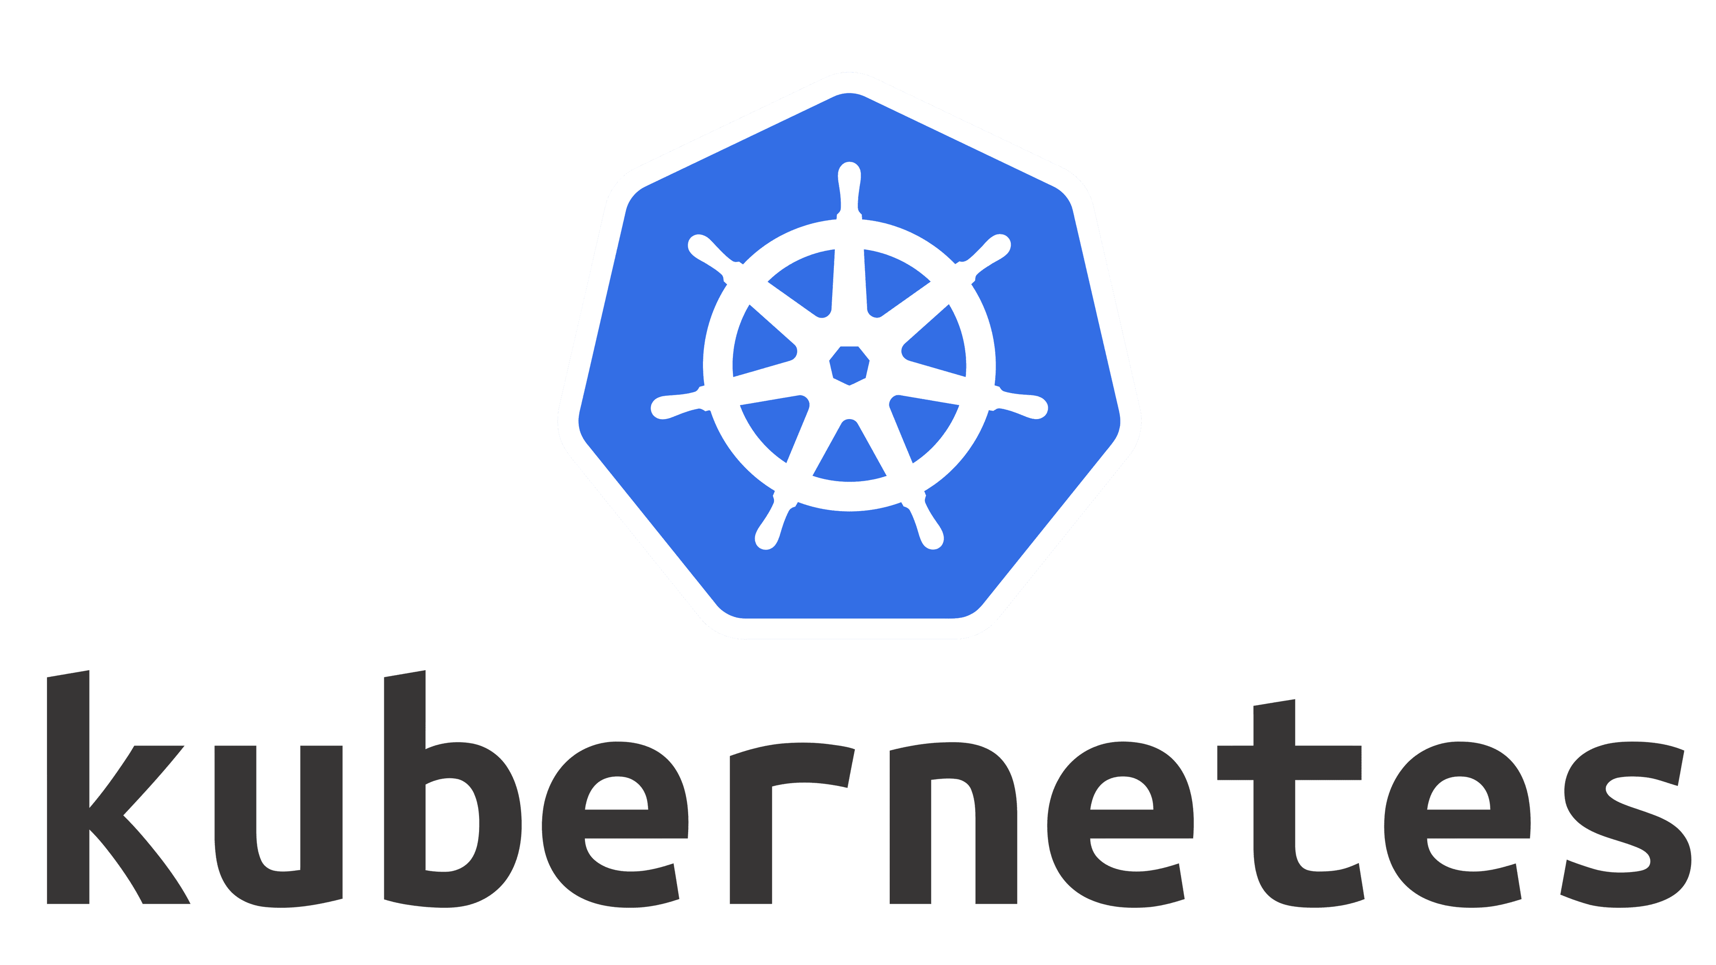
What is Kubernetes?
Kubernetes (K8s) is an open-source platform for automating deployment, scaling, and management of containerized applications.
Core Components
Pods: Smallest deployable units
Ex: A pod running a web server container and a logging sidecar container together
Deployments: Manage pod replicas
Ex: Running 3 replicas of your application for high availability and load balancing
Services: Network access to pods
Ex: A LoadBalancer service exposing your web app on port 80 to external traffic
Nodes: Worker machines in cluster
Ex: Physical servers or VMs (like AWS EC2 instances) that run your containerized applications

Slide 7
Kubernetes Architecture
Control Plane
Worker Nodes
API Server
Scheduler
Controller Manager
etcd (database)
Kubelet
Container Runtime
Kube-proxy
Pods (containers)
Control Plane manages the cluster state, while Worker Nodes run the actual containerized applications.

Slide 8
Why Kubernetes?
🔄 Auto Management
📈 Scalability
Containers are automatically started and stopped
Easily increase or decrease pod count
🌐 Load Balancing
🛡️ High Availability
Distributes traffic across multiple pods
If one pod fails, others continue running
🔧 Self-Healing
⚙️ Resource Management
Automatically restarts failed containers
CPU and memory are automatically distributed

Slide 9
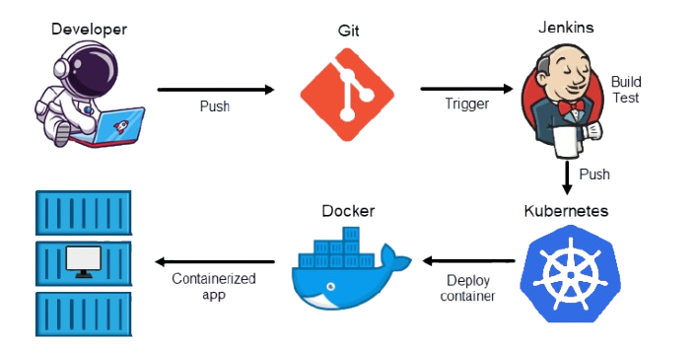

Perfect Use Cases
✅ Best For
Microservices architectures
High-traffic web applications
Cloud-native applications
DevOps and CI/CD pipelines
Containerized services at scale
🌍
📊
🚀
Used by large-scale companies like Spotify, Netflix, Airbnb etc.
Industry standard
Powers millions

Slide 10

🎬 Demo Time!
Live Docker & Kubernetes Demo
Base Image: node:18-alpine
Image Type: Node.js application container
Container OS: Alpine Linux (Much smaller than full Ubuntu/Debian images)
Language: Node.js (Express.js framework)
Purpose: Load balancing demonstration - each pod returns its unique hostname
Service Type: NodePort (exposes on random port 30000-32767)
Load Balancer: Kubernetes Service with 3 replicas distributing traffic

Slide 11
Thank You!
Questions?
🐳
☸️
🚀
Docker • Kubernetes • Modern DevOps
SE 4458 - Software Architecture & Design

