Slide 1

Google Protocol Buffers
( Protobuf )
Bartosz Gardziejewski 226128
Paweł Zaborowski 251679

Slide 2
Agenda
What is protobuf
Why protobuf
How protobuf works
Compilation
Example
Conclusion

Slide 3
What is protobuf
” Google's language-neutral, platform-neutral, extensible mechanism for serializing structured data – think XML, but smaller, faster, and simpler „
https://developers.google.com/protocol-buffers

Slide 4
What is protobuf
Data serialization mechanism to binary form

Slide 5
Why protobuf
Fast serialization and deserialization
Easy to implement
Cross-platform, cross-language
Serialized data are small ( binary format )

Slide 6
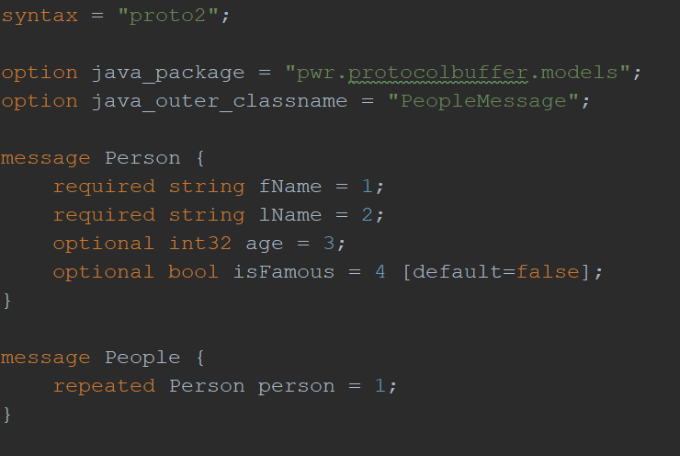
How protobuf works
Exemplary .proto file

Slide 7
How protobuf works
Options
Messages
Filed rules:
Required
Optional ( defaults )
Repeated
Enumerations

Slide 8
Compilation: Java
Protoc
protoc -I=$SRC_DIR --java_out=$DST_DIR $SRC_DIR/addressbook.proto

Slide 9
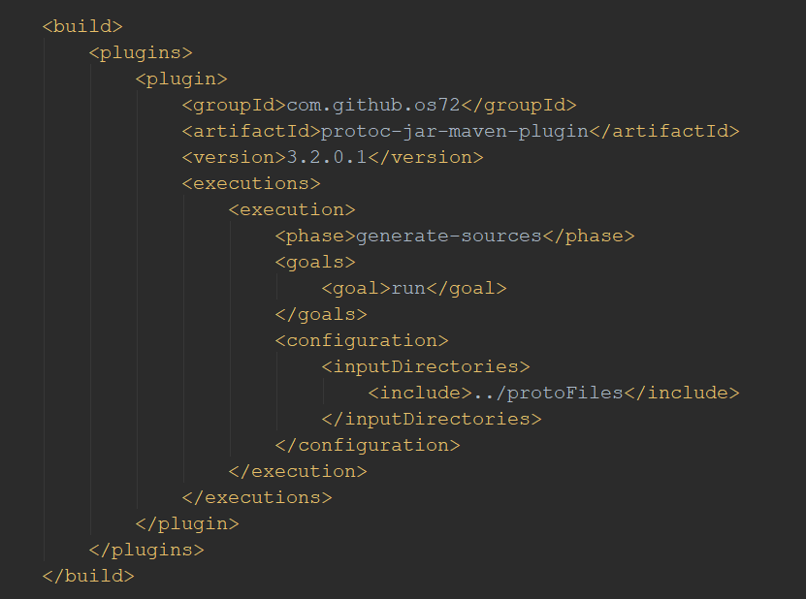
Compilation: Java
Maven

Slide 10
Compilation: Python
Protoc
protoc -I=$SRC_DIR --python_out=$DST_DIR $SRC_DIR/addressbook.proto

Slide 11
Compilation
Java
Person.prot
PeopleMessage.java
From Person.proto file containing 15 lines of code, we obtain java classes containing about 1700 lines
Python
Person.prot
Person_pb2.py
From same Person.proto file, we obtain python file containing about 130 lines of code

Slide 12
Example: Java
Creating Person instance with builder
PeopleMessage.Person person =
PeopleMessage.Person.newBuilder()
.setFName("Bill")
.setLName("Gates")
.setAge(64)
.setIsFamous(true)
.build();

Slide 13
Example: Java
Creating People instance with builder
PeopleMessage.People people =
PeopleMessage.People.newBuilder()
.addPerson(person01)
.addPerson(person02)
.addPerson(person03)
.build();

Slide 14
Example: Java
Serializing data
FileOutputStream fos = new FileOutputStream(filePath);
people.writeTo(fos);

Slide 15
Example: Java
Desrializing data
FileInputStream fis = new FileInputStream(filePath);
PeopleMessage.People people =
PeopleMessage.People.newBuilder()
.mergeFrom(fis)
.build();

Slide 16
Example: Python
Creating Person instance with builder
person = Person_pb2.Person()
person.fName = "Bill"
person.lName = "Gates"
person.age = 64
person.isFamous = 1

Slide 17
Example: Python
Serializing data
f = open(filePath, "wb")
f.write(people.SerializeToString())
f.close()

Slide 18
Example: Python
Desrializing data
people = Person_pb2.People()
f = open(filePath, "rb")
people.ParseFromString(f.read())
f.close()

Slide 19
Conclusion
Protocol Buffer is fast and easy to use serialization/deserialization tool
Dependent on used language, files generated by protoc my be very big
Using protobuf requires having .proto file and protoc (compiler) for given language
After serialization files are very small but unreadable due to binary format

Slide 20
Sources
https://www.baeldung.com/google-protocol-buffer
https://dzone.com/articles/protobuf-for-lazy-java-coders
https://developers.google.com/protocol-buffers/docs/javatutorial
https://www.appbrain.com/stats/libraries/details/protobuf/google-protocol-buffers

