Slide 1

Google Protocol Buffers
( Protobuf )
Bartosz Gardziejewski 226128
Paweł Zaborowski 251679

Slide 2
Agenda
What is protobuf
Why protobuf
How protobuf works
Java example
Conclusion

Slide 3
What is protobuf
” Google's language-neutral, platform-neutral, extensible mechanism for serializing structured data – think XML, but smaller, faster, and simpler „
https://developers.google.com/protocol-buffers

Slide 4
What is protobuf
Data serialization mechanism to binary form

Slide 5
Why protobuf
Fast serialization and deserialization
Easy to implement
Cross-platform, cross-language
Serialized data are small ( binary format )

Slide 6
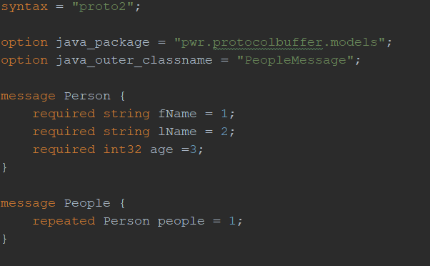
How protobuf works
Exemplary .proto file

Slide 7
How protobuf works
Options
Messages
Filed rules:
Required
Optional ( defaults )
Repeated
Enumerations

Slide 8
Java example
Protoc

Slide 9
Python example

Slide 10
Conclusion

Slide 11
Sources
https://www.baeldung.com/google-protocol-buffer
https://dzone.com/articles/protobuf-for-lazy-java-coders
https://developers.google.com/protocol-buffers/docs/javatutorial
https://www.appbrain.com/stats/libraries/details/protobuf/google-protocol-buffers

