Slide 1

Bartosz Leczycki

Slide 2
Plan of presentation
1. What is Gatling?
2. Types of tests
3. The most popular tools
4. Gatling vs JMeter
5. Steps for the test scenario
6. Recording and playback of tests
7. A simple project using Gatling + InteliJ + Scala

Slide 3
Gatling
Is a highly capable load testing tool. It is designed for ease of use high performance.
Gatling comes with excellent support of the HTTP protocol that makes it a tool of choice for load testing any HTTP server
Test scenarios are maintainable and easy-to-read
Easy integration with performance reporting

Slide 4
Types of tests
Functional
Based on specifications
Non-functional
How does the system work?
Structural (white box)
Code coverage
Related to the change
Confirmatory tests (retests)
security tests
compatibility tests
Regression test
Efficiency, usability, reliability
instructions vs decisions
Performance

Slide 5
Performance, Load, Stress tests

Slide 6



The most popular tools

Slide 7
Steps of performance tests
Use scenario
The path to navigate the site
Procedure for performing specific activities
Motion simulation
Time requirements
The time at which a given number of users performs the scenario.
The number of users following by planned use scenario.

Slide 8
JMeter vs Gatling
 | Jmeter (1998) | Gatling (2012)
Construction | Java (60%) + XML + HTML | Scala (90%) + HTML
Scripting | UI coding | Coding (Scala)
Performance | One thread = One user | One thread = Many Users (Akka implementation)
Supported protocols | HTTP, HTTPS, WebSocket , Rest Api , Soap Services | HTTP, HTTPS, WebSocket , Rest Api
Report | HTML,CSV | HTML
Recorder | + | +

Slide 9
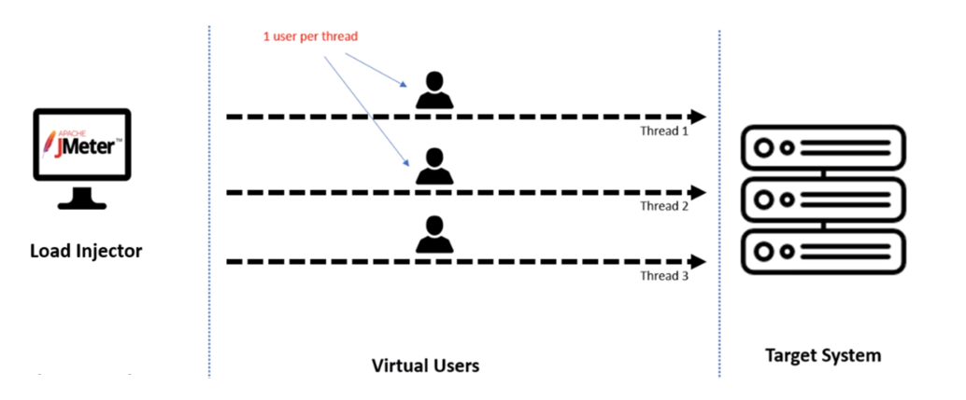

Slide 10
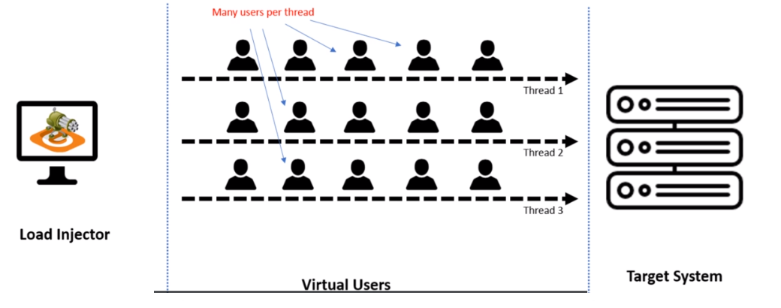

Slide 11

Official Enterprise version , Price from 400€ / month
✅ Managment
✅ Unlimited virtual users
✅ Unlimited testing

Slide 12
Record and playback
http://computer-database.gatling.io/computers

Slide 13
Gatling project – what we need to start?
JDK
Gatling
Intelij Idea (IDE)
Scala plugin
Maven

Slide 14
Summary
Tailored to market needs
Good in maintenance
Supported

