Slide 1



Functional Linear Data Structures in F#
Jack Fox
Bibliography
jackfoxy.com ➔ craftyThoughts
@foxyjackfox
jackfoxy.com/Lambda_Jam_fsharp_bibliography Sample Code
github.com/jackfoxy/FunctionalLinearDataStructures
Notes:
Bibliograhy and sandbox projects of all sample code.
Rich Hickey Value Oriented Programming ➔ yet isolated value rarely interesting
Linear is not just a powerful abstraction,
it’s the most common raw organization
e.g. Observable in reactive programming
it’s also the most efficient physical organization
Call attention to obvious qualities of linear data along with linear primitives and performance considerations for functional
Consider how seq (IEnumerable) unifies functional linear structures
Richness of infinite sequences, joining finite and infinite, resolving repeatability requirement of functional

Slide 2

I don’t always use purely functional, but when I do…
--The World’s most interesting Coder
Notes:
If you prefer functional first coding, there’s a structure that will meet your need. And for the most part they are very performant.
Some structures (like specialized tools) get used more than others, some are highly specialized.
Look at some extensions of linear structures like data windowing and multiway trees.

Slide 3



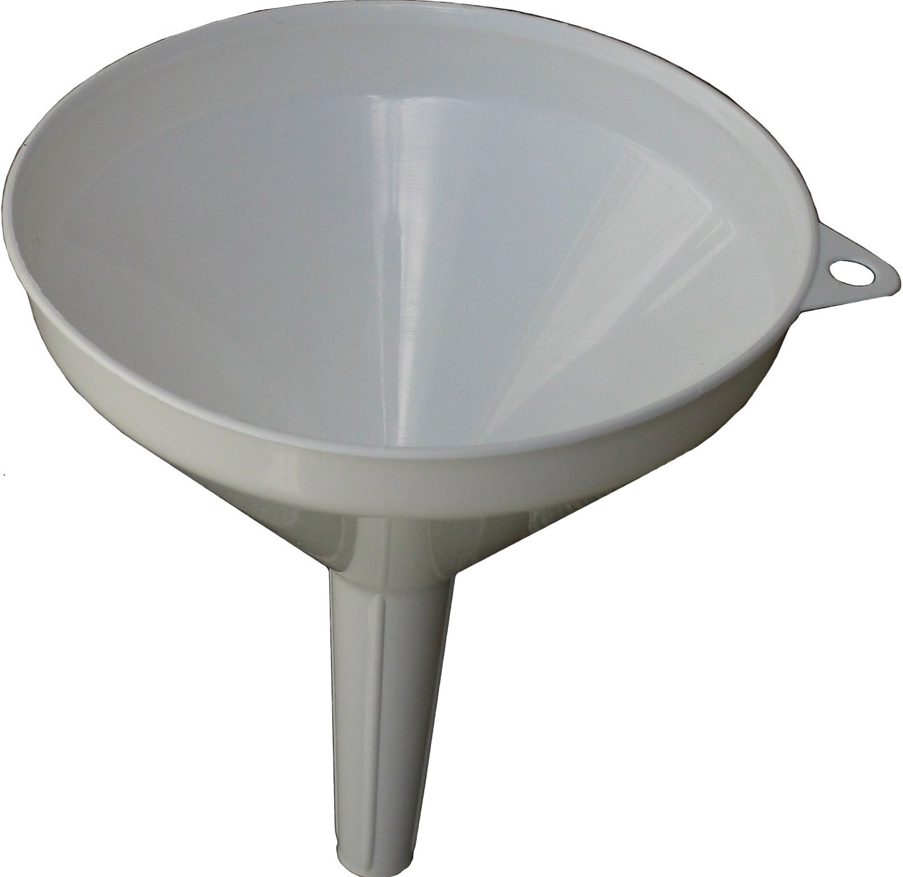

FSharpx.DataStructures
FSharpx.Collections.Experimental
FSharpx.Collections
Graphics: Cambridge University Press. Wikimedia Commons, Wikimedia Foundation
Notes:
Lots of work has been done creating composite functional data structures of all kinds. I’m going to focus mainly on work collected into the FSharpx open source library, available on GitHub. Talking just about the linear structures, we borrowed from our Clojure friends, which you will see shortly, we appropriated structures both from the F# compiler and the open source collections put together by the F# team, and of course the purely functional data structures from Chris Okasaki.
In fact things started getting a little crazy with so many implementations of often the logical structures, we reorganized earlier this year, obsoleting the original “DataStructures” namespace and replacing it with “Collections.Experimental”. Now we have a place for functional data structure enthusiasts to basically share their experiments.
Then we cranked-out essentially the best-of-breed for representative functional data structures that matter, published and applied formatting and documentation standards, and put the important stuff in the “Collections” namespace. Or I should say that is the goal. FSharpx depends on volunteers, and there are still gems in “Experimental” that deserve coming up to standard.
(Because of the re-orginization Git history incorrectly attributes much of “Collections.Experimental” and some items in “Collections” to me!)

Slide 4
(disregarding range operations)
Order by construction / sorted / random
Evaluation eager / lazy
Peek first / last / indexed
Construction first / last / insert
Remove first / last / indexed
choose 1
choose 1
choose 1 – 2, or #3
choose 0 – 2, or #3
choose 0 – 2, or #3
(insert only for sorted & random)
Notes:
We saw singly-linked list does not efficiently do everything we need it to do. Yet fundamentally it embodies everything that distinguishes linear data structures (whether functional or not).
Disregarding for the moment range operations, these are all the attributes of and actions on a linear data structure.
Order is usually by construction. Either representing the order of the sequence consumed to create the structure, and/or the order individual elements were added. A sorted or even a random order is however possible.
Evaluation in F# is eager by default, so you have to go out of your way to lazily evaluate anything (except sequences).
Construction, peeking, and removing (de-construction) are all the same for the singly-linked list, it always takes place at the beginning, but we might want a structure that mixes this up in any conceivable combination.

Slide 5
Think we missed something?
Update is deconstruction followed by construction
List.Length is O(n) peek at one element at a time equivalent of complete deconstruction
Notes:
Length more frequently used in imperative and OO programming, often an inefficient operation in functional.

Slide 6

List, Tuple
seq{ } (the phantom data structure)
Array (but it’s mutable)
∞
Graphics: unattributed, all over the internet
Notes:
Out of the box these are the primitives you get to work with for sequential structures. The singly-linked list and tuple are pretty common to functional programming.
Sequence is a stream-like thing. You can only ever move forward in it, you only ever have a hold of one element at a time, it’s the one part of F# that is lazy by default, and it can be used to represent infinite streams. So it’s not really a data structure, but we’ll see it’s a common component of linear (and sometimes even non-linear) F# structures, and allows us to compositionally glue together structures.
F# is a functional-first language, and the last primitive, Array, being mutable, is not a functional structure. The way it is implemented in F# however lends itself well to composition, and we can use it as an internal building block of composite functional data structures.

Slide 7
List Update
let rec loop i updateElem myList =
match (i, myList) with
| i', [] -> invalidArg
| 0, x::xs -> updateElem::xs
| i', x::xs -> x::(loop (i' - 1) y xs)
::
::
::
found it!
4
3
2
1
[ ]
Notes:
If you don’t already know, F# implements tail recursion, and this IS NOT an example of tail recursion. (Unlike Scala, there is no way to ask the F# compiler to catch this.)
But the non-tail recursive code better illustrates my point here. Singly-linked list is a powerful concept. You can do pretty much everything with it, but of course you can’t do everything efficiently with it.
Another side note about this code example, note the idiomatic pattern functions consuming a collection: always make the collection item the last parameter in a function to facilitate partial application in currying and functional compositions.

Slide 8

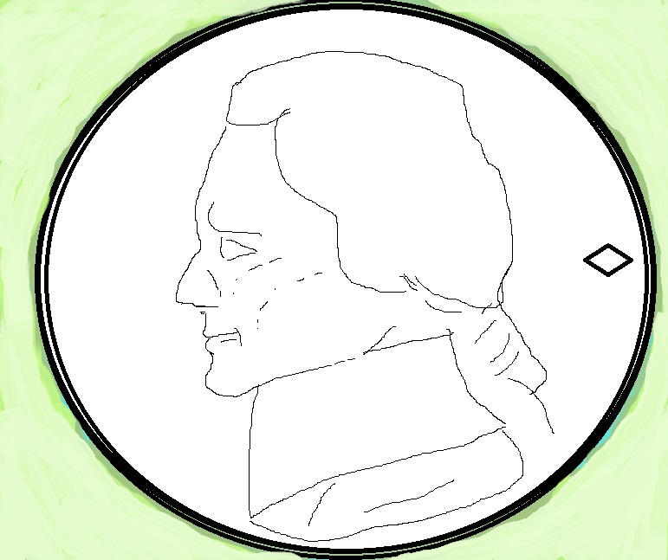
Performance
L
a
m
b
d
t
a
s
J
A
u
m
r
t
e
2
[]
0
w
1
JIT
l
3
i
n
i
Graphics : www.clker.com, jackfoxy
Notes:
Since the whole reason for alternate linear data structures is the cases where List is not performant, it’s worth talking about how to evaluate performance.
Don’t forget computing is a physical process. In the IL world (that’s Intermediate Language, Byte Code, if you will) no data structure is faster than an array. Well…maybe it’s actually a Tuple that’s faster. In any event IL is key to evaluating performance. It will tell you what code is going to execute (give or take the vagaries of the JIT). So, “In IL we trust”.
(Just to confuse the uninitiated, the symbol for Array and the empty List symbol we saw earlier are the same!)

Slide 9
[<Struct>]
type FlatList<'T> =
val internal array : 'T[]
internal new (arr: 'T[]) =
{ array = (match arr with null -> null
| arr -> if arr.Length = 0 then null else arr) }
member x.Item with get(n:int) = x.array.[n]
member x.Length = match x.array with null -> 0 | arr -> arr.Length
member x.IsEmpty = match x.array with null -> true | _ -> false
static member Empty : FlatList<'T> = FlatList(null)
interface IEnumerable<'T> with
member x.GetEnumerator() : IEnumerator<'T> =
match x.array with
| null -> Seq.empty.GetEnumerator()
| arr -> (arr :> IEnumerable<'T>).GetEnumerator()
interface IEnumerable with
member x.GetEnumerator() : IEnumerator =
match x.array with
| null -> (Seq.empty :> IEnumerable).GetEnumerator()
| arr -> (arr :> IEnumerable).GetEnumerator()
Notes:
FlatList is an invention of the F# compiler team, and while possibly the best performant functional linear data structure, I think it’s also a failed experiment, but one we can learn from.
You can see internally FlatList is an array, but it only exposes the getter. In other words we now have an immutable array. Among the advantages of an Array, Length is O(1), instead of O(n) as for a List. By implementing the Type as a Struct, it is stored in local Stack storage, instead of on the Heap. Finally notice the implementation of the IEnumerable interface. This is how we can use Seq as the unifying characteristic of linear data structures.
I believe this experiment failed on two counts. First this does nothing more than make an F# Array immutable, and I’m at a loss to think of any benefit this confers. Array by itself is already remarkably compositional within F#. If you can think of something FlatList can do that Array cannot, let me know.
Secondly, while putting the structure on the stack is an interesting idea, one I think deserves investigation for other immutable structures, the compiler does not know FlatList is immutable, so it creates IL code to make additional local copies. This can be solved, but requires post-process manipulation of the IL. There’s an example of this in the companion sandbox code on GitHub.

Slide 10
Performance Tip
Nothing beats Tuple
…and Record is Tuple with named Elements
…and Tuple/Record is heterogenous
Notes:
One thing we can learn from the previous example is local stack data is the fastest of all to access. So the fastest linear data structure is a tuple. Accessing tuple elements beyond the first two is a little clunky, so F# implements record types, which a little investigation in the IL reveals to be nothing more than tuples with named elements.
Another advantage of tuples, heterogeneous data elements.

Slide 11
The Downside
Tuple does not implement Seq
Notes:
Tuple does not implement Seq. And this limits is usefulness as a linear structure.

Slide 12
Seq lets you transform structures
let thisIsTrue =
seq {1..10}
|> Array.ofSeq
|> Deque.ofSeq
|> DList.ofSeq
|> FlatList.ofSeq
|> Heap.ofSeq false
|> LazyList.ofSeq
|> Queue.ofSeq
|> RandomAccessList.ofSeq
|> Vector.ofSeq
|> List.ofSeq = [1..10]
Notes:
The “banzai pipeline” of functional linear data structures. Only Heap potentially changes order (but not in this case).
Trivially, Seq lets you seamlessly transform every linear data structure into any other, allowing you to take advantage of the qualities of first one and then another structure.

Slide 13
…and apply any of 68 Seq Module functions
seq {1.0..10.0} |> Heap.ofSeq false |> Seq.average
seq {1..10} |> Deque.ofSeq |> Seq.fold (fun state t -> (2 * t)::state) []
seq {1..10} |> RandomAccessList.ofSeq |> Seq.mapi (fun i t -> i * t)
seq {1..10} |> Vector.ofSeq
|> Seq.reduce (fun acc t -> acc * t )
Notes:
Here’s another advantage of Seq. You have the entire repertoire of 68 module functions at your disposal for any linear data structure. The only reason you would ever want to natively implement one of these in your structure is if its internal representation lent itself to a faster native implementation. Note these functions don’t meet every need. Remember Seq is only forward processing, so foldback, for instance, is not available. Functions requiring anything but forward processing require a native implementation.

Slide 14

Unfold Infinite Sequences
unfold starts here
Notes:
Sequences serve not only as the common denominator of linear structures, but through the unfold function serve as data stream generators, and those sequences can be infinite. What would you do with this capability?

Slide 15
Markov chain
type Weather = Sunny | Cloudy | Rainy
let nextDayWeather today probability =
match (today, probability) with
| Sunny, p when p < 0.05 -> Rainy
| Sunny, p when p < 0.40 -> Cloudy
| Sunny, _ -> Sunny
| Cloudy, p when p < 0.30 -> Rainy
| Cloudy, p when p < 0.50 -> Sunny
| Cloudy, _ -> Cloudy
| Rainy, p when p < 0.15 -> Sunny
| Rainy, p when p < 0.75 -> Cloudy
| Rainy, _ -> Rainy
Notes:
How about Markov chains? We can take a real simple model of weather forecasting…

Slide 16
let NextState (today, (random:Random), i) =
let nextDay = nextDayWeather today (random.NextDouble())
printfn "day %i is forecast %A" i nextDay
Some (nextDay, (nextDay, random, (i + 1L)))
let forecastDays =
Seq.unfold NextState (Sunny, (new Random()), 0L)
printfn "%A" (Seq.take 5 forecastDays |> Seq.toList)
> day 0 is forecast Sunny
day 1 is forecast Sunny
day 2 is forecast Cloudy
day 3 is forecast Rainy
day 4 is forecast Cloudy
[Sunny; Sunny; Cloudy; Rainy; Cloudy]
Notes:
…and create an infinite lazy sequence. This particular sequence won’t go on forever because I put a 64-bit counter in for demonstration purposes, but it will take a long time to blow-up.
You’ll notice the demonstration print inside the generation function never fires until we actually instantiate the sequence into some kind of tangible data structure. This is what I mean by calling sequence a kind of phantom data structure.

Slide 17
printfn "%A" (Seq.skip 5 forecastDays |> Seq.take 5 |> Seq.toList)
> day 0 is forecast Sunny
…
day 9 is forecast Sunny
[Cloudy; Rainy; Sunny; Cloudy; Sunny]
printfn "don't try this at home! %i"
(Seq.length forecastDays)
printfn "don't try this at home either! %A"
(forecastDays |> List.ofSeq)
Notes:
And no matter how hard you try, there is no way to take a shortcut down the infinite road. To get to a segment further down requires executing the entire intervening sequence.
Since sequence can really represent an endless data stream, don’t instantiate the whole sequence or attempt to take its length.

Slide 18
So far:
Functional Data Structures
Linear Structures as an abstraction
Seq as the unifying abstraction
Next:
More choices

Slide 19
printfn "%A" (Seq.take 5 forecastDays |> Seq.toList)
printfn "%A" (Seq.take 7 forecastDays |> Seq.toList)
> day 0 is forecast Sunny
day 1 is forecast Cloudy
day 2 is forecast Sunny
day 3 is forecast Sunny
day 4 is forecast Cloudy
[Sunny; Cloudy; Sunny; Sunny; Cloudy]
day 0 is forecast Sunny
day 1 is forecast Sunny
day 2 is forecast Sunny
day 3 is forecast Sunny
day 4 is forecast Sunny
day 5 is forecast Sunny
day 6 is forecast Cloudy
[Sunny; Sunny; Sunny; Sunny; Sunny; Sunny; Cloudy]
Inconsistent!
Notes:
Here’s a quandary: reuse of my Markov Chain sequence will give inconsistent results because it is a probabilistic sequence. Yet if I instantiate it to save-off results, I lose the lazy advantage of an infinite sequence

Slide 20
LazyList: seq-like & List-like
let lazyWeatherList =
LazyList.unfold NextState (Sunny, (new Random()), 0L)
printfn "%A" (LazyList.take 3 lazyWeatherList)
> day 0 is forecast Sunny
day 1 is forecast Sunny
day 2 is forecast Cloudy
[Sunny; Sunny; Cloudy]
printfn "%A" (LazyList.take 4 lazyWeatherList)
> day 3 is forecast Cloudy
[Sunny; Sunny; Cloudy ; Cloudy]
Notes:
LazyList provides for infinite lazy streams, like sequence, but once computed an element’s result is cached. Beyond that LazyList functions like the standard singly-linked List.
But there is a performance penalty for implementing Lazy in a real F# structure, so only use LazyList when it makes sense.

Slide 21
Skip always evaluates
LazyList.ofSeq (seq {for i = 1 to 10 do
yield (nextItem i)})
|> LazyList.skip 2
|> LazyList.take 2
|> List.ofSeq
> item 1
item 2
item 3
item 4
Notes:
…and I attempted many different ways to circumvent this. Still no getting around executing intervening element cells.

Slide 22
O(1) Append
let observedWeatherList =
LazyList.ofList [Sunny; Sunny; Cloudy; Cloudy; Rainy;]
let combinedWeatherList =
LazyList.append observedWeatherList lazyWeatherList
printfn "%A" (LazyList.skip 4 combinedWeatherList
|> LazyList.take 3)
> day 0 is forecast Rainy
day 1 is forecast Cloudy
seq [Rainy; Rainy; Cloudy]
Observed
Predicted
Notes:
That being said, functional structures often have surprising efficiencies which come in handy. In this case LazyList does O(1) append. When would you use this? Well, think of joining observed and predicted data in your model.
Weather models, stock market, extrapolating any kind of observed series.
Note also F# type inference is labelling the LazyList collection data “seq”. This shows the versatility of implementing the seq interface, a.k.a. IEnumerable.

Slide 23
List - like
Construct
Deconstruct
…and the only data element accessible!
::
1
2
3
4
5
[ ]
Head
empty
Tail
Notes:
At this point you may be suspecting some shortcomings in the sequential qualities available in both singly-linked List and LazyList.
While consuming a data structure like observed and predicted weather progressing from beginning to end may feel natural, constructing a weather sequence by continually adding to the beginning is not the way you would probably want to do it. Imagine instead of appending predicted weather to observed weather, we cons’ed the observed weather onto the predicted weather LazyList. The observed weather series would have to be accessible in backwards order.
And jumping to a random element, while possible, is clumsy.

Slide 24
Vector
Construct
Deconstruct
;;
[ ]
1
2
3
4
5
empty
Last
Initial
Notes:
Enter the Vector. Picking up where FlatList left off, Vector is your go-to choice for extended linear functionality. Indexed lookup and update are pretty close to constant time, O(log32n) if you are keeping score, construction and deconstruction at the end of the sequence, more in line with how humans normally think of extending a linear sequence. You would probably construct days of observed weather this way, for instance.
FSharpx has Steffen Forkmann’s implementation of Vector from Clojure. I believe it implements a hash array mapped trie. (Don’t’ ask me to explain it.) It’s very fast.
Think back on the qualities of sequential structures (order, evaluation, construction, peek). The combination rules lead to hundreds of theoretical structures, but only a handful have proved interesting. The practicalities of lazy evaluation make LazyList the most common lazy evaluated structure.
Vector is probably the most versatile and performant structure for covering most of your needs involving eager evaluation.

Slide 25
Windowing a sequence
let windowFun windowLength =
fun (v : Vector<Vector<Weather>>) t ->
if v.Last.Length = windowLength
then
v |> Vector.conj (Vector.empty.Conj(t))
else
Vector.initial v
|> Vector.conj (Vector.last v |> Vector.conj t)
Notes:
Vector is perfectly suited for windowing a data sequence, for instance. Here’s the basic function to create a Vector of weather Vectors. If our last vector was of the required length, we append (or “conj”) a new Vector consisting of the current weather element. Otherwise we take the “initial” (all the elements except the last element) of the outer Vector and “conj” the last Vector with the current element “conj”ed.

Slide 26
Windowing a sequence
let windowedForecast =
Seq.unfold NextState (Sunny, (new Random()), 0L)
|> Seq.truncate 365
|> Seq.fold (windowFun 7)
(Vector.empty.Conj Vector.empty<Weather>)
Notes:
And here we kick-off our windowing function with the aid of some Seq helper functions. Fold is very useful for all kinds of sequential transforms. In this case we create a year’s worth of forecasts windowed into weeks.
This basic technique extends to any kind of windowing: sliding, interspersed, and of course this particular example will result in a jagged Vector.

Slide 27
Fold on Vector Windows
let initialFun =
fun (v : Vector<Vector<Weather>>) (t : Vector<Weather>)
-> Vector.conj t.Initial v
let sabbathRespectingForecast =
windowedForecast
|> Vector.fold initialFun Vector.empty<Vector<Weather>>
Notes:
Notice our composite windowing data structure, a Vector of Vectors, is fully functional, and we can perform transformations on it by folding over the outer Vector.
In this case we again take the inner Vector initial to give our forecast model a rest on the seventh day.

Slide 28
RandomAccessList
Construct
Deconstruct
::
1
2
3
4
5
[ ]
Head
empty
Tail
Notes:
But maybe we want to do some transformation not suited to Vector, like constructing and deconstructing at the front of the sequence.
There’s an immutable structure for that. RandomAccessList is the dual of Vector. Same high performance, same indexed access to all elements, except construction and deconstruction happens at the front of the sequence.

Slide 29
Multiway Tree
type 'a MultiwayTree = {Root: 'a; Children: 'a MultiwayForest}
with
…
and 'a MultiwayForest = 'a MultiwayTree Vector
let inline create root children = {Root = root; Children = children}
let inline singleton x = create x Vector.empty
Notes:
What else can we do with our sequenced windows?

Slide 30
Forest from the Windows
let inline forestFromSeq (s : #seq<#seq<_>>) (f : #seq<'a> -> 'a) =
let rec loop acc l =
match l with
| [] -> acc
| head::tail ->
let forest = Seq.fold
(fun s t -> Vector.conj(singleton t) s)
Vector.empty<_>
head
loop (Vector.conj (create (f head) forest) acc) tail
loop Vector.empty<MultiwayTree<_>> (List.ofSeq s)
Notes:
Generics, list, idiomatic recursive loop on a list (acc, l)

Slide 31
DList (append list)
Construct
Deconstruct
Construct
::
;;
1
2
3
4
5
Head
Tail
Notes:
If your are willing to settle for peek and deconstruct only at the beginning of your sequence, DList will not have those same performance issues. You can still do O(1) construction at the end of the sequence, in fact you can do O(1) appending of one DList to another.

Slide 32
Queue (FIFO)
Deconstruct
Construct
::
;;
1
2
3
4
5
Head
Tail
Notes:
Look familiar? (very similar to DList)

Slide 33
Breadth 1st Traversal
let inline breadth1stForest forest =
let rec loop acc dl =
match dl with
| DList.Nil -> acc
| DList.Cons(head, tail) ->
loop (Queue.conj head.Root acc)
(DList.append tail (DList.ofSeq head.Children))
loop Queue.empty (DList.ofSeq forest)
Notes:
Canonical recursive loop, again
Input forest is generic (note DList.ofSeq)

Slide 34
Deque (double-ended queue)
Construct
Deconstruct
Construct
Deconstruct
Init
Last
::
;;
1
2
3
4
5
Head
Tail
Notes:
…and if you want to construct and deconstruct at both ends? The double-ended queue does construct, deconstruct, and peek from both ends, but now we are pushing the envelope of purely functional performance. You only ever have direct access to the elements at both ends, giving up indexed peek for any element. There’s also an amortized time complexity price to pay in terms of the internal structure supporting this purely functional arrangement.
The functions on it however are perfectly symmetric.

Slide 35
match forecast with
| Rainy::tail -> printfn "tomorrow will be rainy"
| _::tail ->
match (LazyList.ofSeq tail) with
| LazyList.Nil -> printfn "only 1 day in the forecast"
| LazyList.Cons(Rainy, tail) -> printfn "the day after tomorrow will be rainy"
| LazyList.Cons(_, tail) ->
match (Deque.ofSeq tail) with
| Deque.Nil -> printfn "only 2 days in the forecast"
| Deque.Cons(Rainy, Deque.Conj(initial, Rainy)) -> printfn "3rd & last day rainy"
| x ->
match (DList.ofSeq x) with
| DList.NilDL -> printfn "only 3 days in the forecast"
| DList.Cons(_, DList.Cons(Rainy, _)) -> printfn "4th day to be rainy"
| x ->
match (Queue.ofSeq x) with
| Queue.Nil -> printfn "only 4 days in the forecast"
| Queue.Cons(_, tail) ->
match (RandomAccessList.ofSeq tail) with
| RandomAccessList.Nil -> printfn "only 5 days in the forecast"
| RandomAccessList.Cons(_, tail) ->
match (Vector.ofSeq tail) with
| Vector.Nil -> printfn "only 6 days in the forecast"
| Vector.Conj(initial, lastDay) -> printfn "last day is %A" lastDay
Notes:
Pattern matching mostly about deconstruction of structures.
It would be nice if the :: deconstruction operator available to List in pattern matching was available for the other structures implementing head/tail pattern matching.

Slide 36
We’ve seen
The right structure for the right job
What are
We Missing?

Slide 37
Deletions?
Notes:
Value Oriented Programming might argue no room for deleting information, but we may want to kick an element out of a linear sequence.
But so far everything has been O(1) or O(log₃₂N), which is practically O(1)

Slide 38

Heap (ordered)
Construct
Deconstruct
::
1
Head
Tail
Graphics: http://www.turbosquid.com/3d-models/heap-gravel-max/668104
Notes:
Okasaki delete using 2 heaps (one positive, one negative) as an “exercise for the reader”. This allows “future” deletes. One implementation in companion sandbox code.

Slide 39
The Future?
Data Frames
Random Stack
Purely Functional Circular Buffer
Keep on experimenting
Notes:
Random Stack and Circular Buffer left as “exercise for the reader”.

