Slide 1

ClinicOS
Patient care and clinic operations,
in one workspace
For medical and cosmetic dermatology clinics in Iraq
A client introduction
01
Notes:
ClinicOS brings patient care and the daily business of a dermatology clinic into one workspace. This introduction focuses on how the clinic team can use connected records, clear responsibilities and local language and currency support.
Present the product as a demonstration of implemented workflows. Discuss clinic-specific deployment and acceptance before making a live-use commitment.
Sources: README.md; docs/operations.md

Slide 2
A clinic day depends on clear handoffs
At reception
During care
At the end of the day
The right patient
The right appointment
The current visit status
Previous visits and history
Reports, consent and photos
The next clinical task
What patients owe
What the clinic received
What needs attention
ClinicOS keeps these records connected to the patient and the clinic.
02
Notes:
A clinic day involves many handoffs. Reception needs accurate identity and scheduling information, clinicians need patient context, and management needs clear financial records.
ClinicOS provides connected workflows for these needs. Describe the intended value as easier coordination rather than a measured time-saving or revenue claim.
Sources: docs/user-guide.md, reception, clinical, billing and finance workflows; README.md

Slide 3
One patient journey connects the team
01
02
03
04
05
Find the
patient
Book and
check in
Record
the visit
Review
and sign
Invoice
and receive
Search or register
Appointment or walk-in
History and care plan
Signed record
and prescription
Payment
and receipt
Each step stays connected to the patient
Reception and clinicians work through their own accounts.
03
Notes:
Follow a single fictional patient through a typical visit. Reception finds or registers the patient and prepares the appointment. The clinician records and reviews the visit, and reception handles invoicing and payment.
This is an example of a typical workflow, not a claim that every clinic must perform each action in this exact order. Follow-up work continues after the visit.
Sources: docs/user-guide.md, Reception: start and manage a visit; Doctor: clinical records; Reception: billing and payments

Slide 4
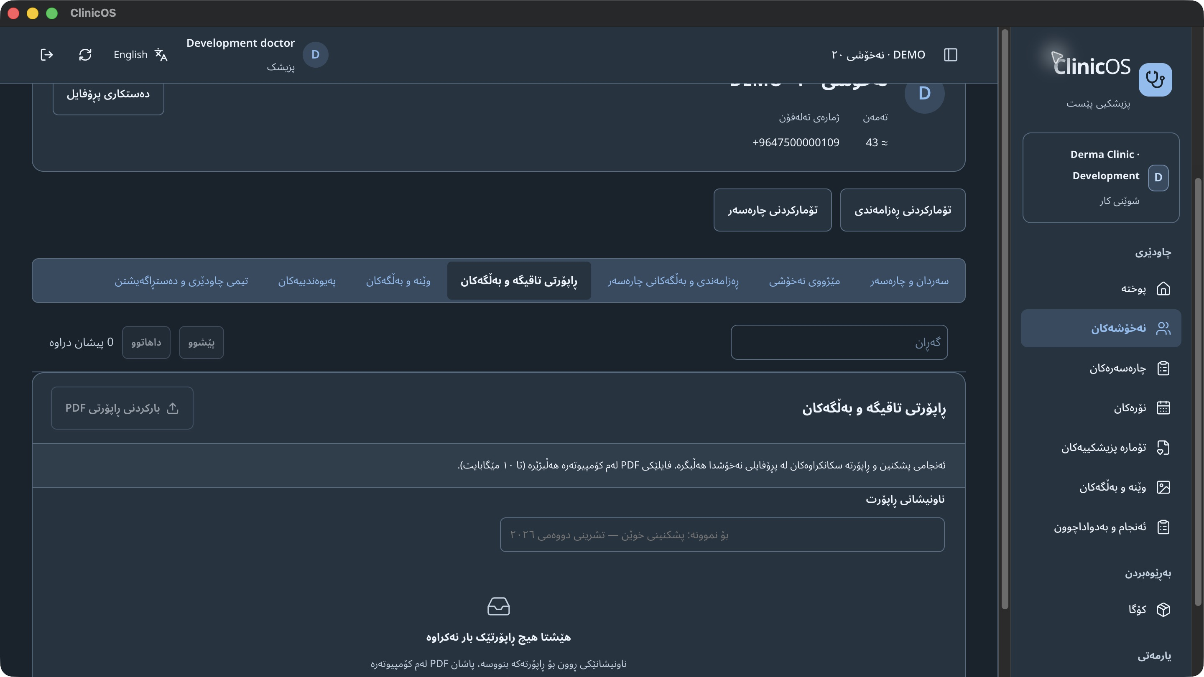
Patient context at the next visit
History the team can find
Visits, allergies, diagnosis and treatment plans.
Reports and documents
Consents, prescriptions, care documents and named PDF reports.
ClinicOS demonstration screen with a fictional patient
04
Notes:
The patient profile provides a place for visits, ongoing history, care documents, reports and photographs. The clinical team can return to the patient record when preparing for the next visit.
The screen shows a fictional patient in the Sorani interface. Scanned paper reports must first be saved as PDFs using the computer scanner software, then uploaded. Existing clinical media consent and file scanning checks apply.
Sources: src/App.tsx, patient profile sections; src/features/media.tsx; docs/user-guide.md, Clinical photographs and documents. Image: local ClinicOS synthetic demonstration screenshot captured 4 November 2026.

Slide 5
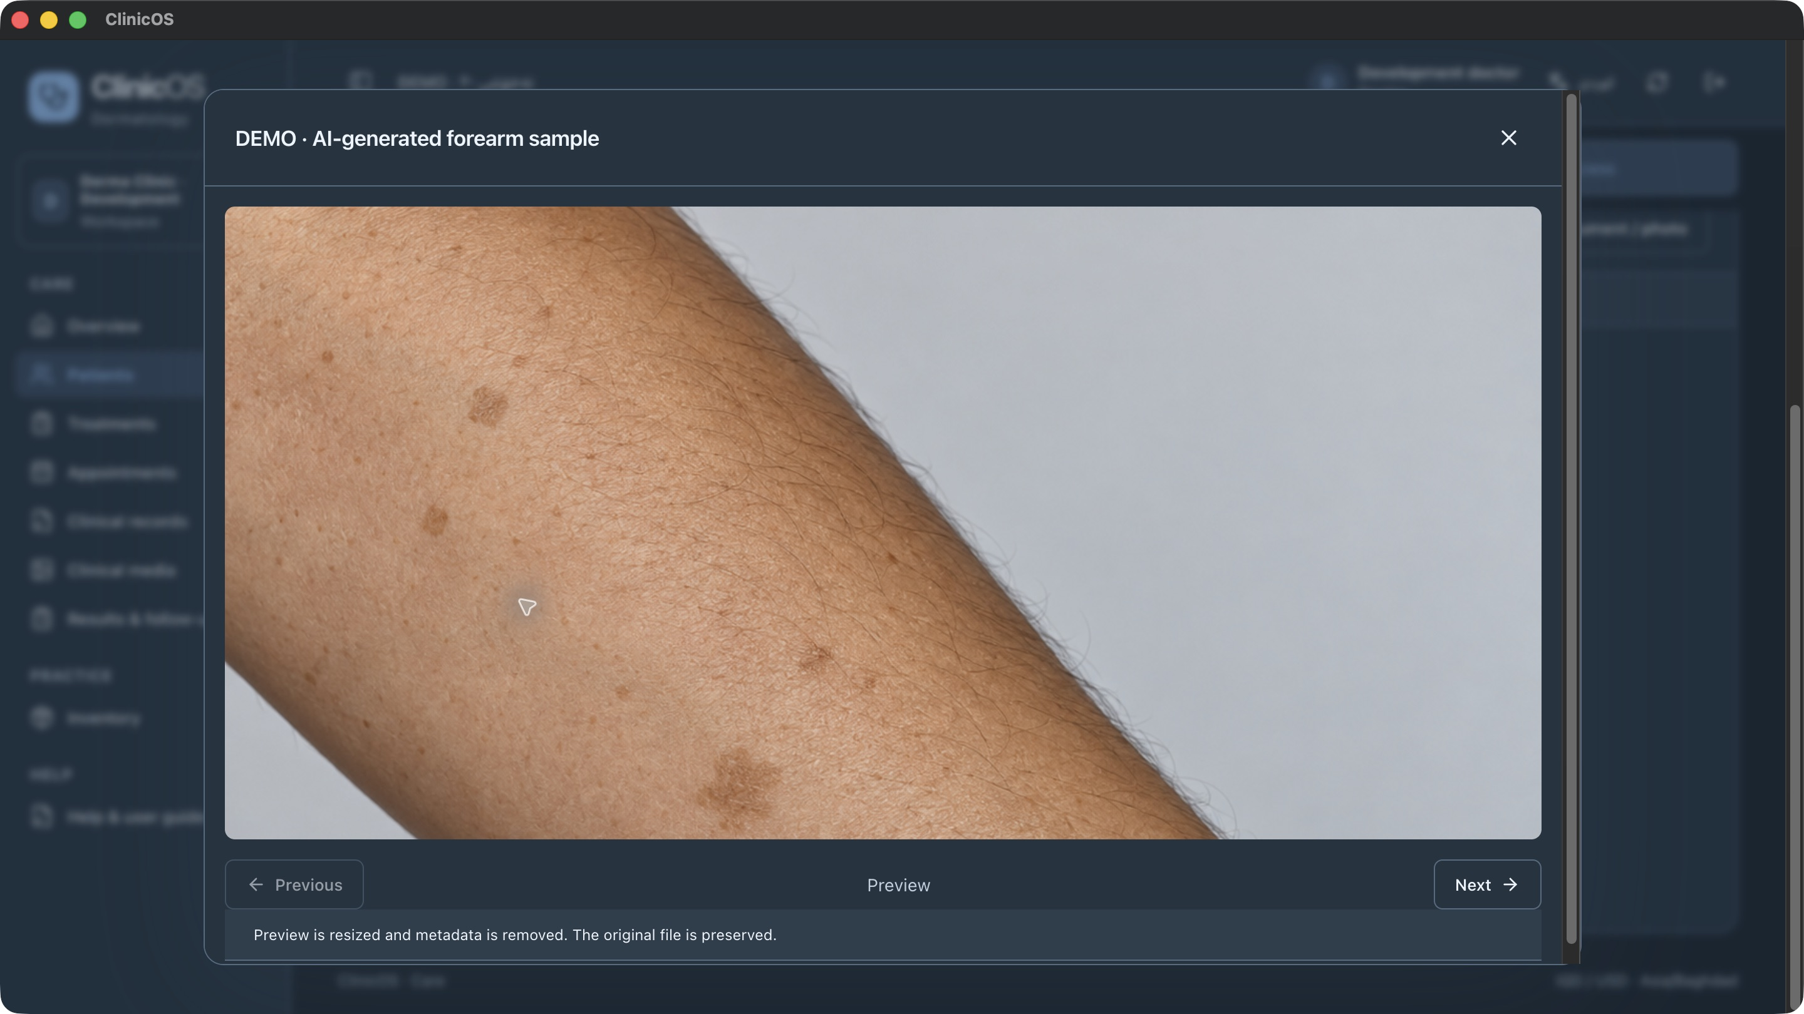
Reports and photos stay with the patient
Named reports
Lab tests and scanned PDFs linked to the patient.
Photo gallery
Thumbnail browsing, larger views and preserved original files.
Synthetic demonstration image
05
Notes:
Clinical files remain linked to the patient rather than becoming loose files on a shared desktop. Staff can give a PDF a useful name and browse photographs in a thumbnail gallery with a larger viewer.
Files use private authorized access. Images and PDFs pass the existing scanning workflow. The displayed image is AI-generated synthetic demo content, not a real patient case or a treatment outcome claim. The PDF upload limit is 10 MB.
Sources: src/features/media.tsx; docs/user-guide.md, Clinical photographs and documents; docs/operations.md, Private image processing. Image: local synthetic ClinicOS gallery screenshot captured 4 November 2026.

Slide 6
A clearer view of clinic finances
IQD
USD
Separate currency totals
Recorded exchange rates
Review balances and activity in each original currency.
Keep the rate used for a cross-currency payment.
Invoices, payments, deposits, packages and refunds
06
Notes:
ClinicOS supports the payment patterns the intended clinic context requires, including IQD, USD, partial payments, deposits, packages and refunds. Separate currency totals make each balance easier to interpret.
When a receipt crosses currencies, the operator records the historical IQD-per-USD rate. Never imply the system adds IQD and USD without a defined conversion. The finance features provide operational bookkeeping and exports, not certified statutory statements or automatic tax and payroll calculations.
Sources: docs/user-guide.md, Reception: billing and payments; Finance: close, report and reconcile; docs/operations.md, Scope and financial boundaries

Slide 7
Daily follow-through beyond the consultation
Follow-up work
Inventory
Management
Orders and received results
Review and patient notification
Due follow-up tasks
Product lots and expiry dates
Stock use and adjustments
Low-stock and expiry alerts
Receivables and expenses
Cash and till differences
Reports and accounting exports
07
Notes:
The clinic also needs visibility into what happens outside the consultation. Results and follow-up tasks support clinical continuity. Inventory records lots, expiry and use. Management can review receivables, expenses, cash movements and till differences.
Patient notification and reminder-call outcomes are recorded by staff. The current app does not send automatic SMS, WhatsApp or email messages. Stock alerts are operational tools, and the clinic still defines its purchasing and stock-unit policies.
Sources: docs/user-guide.md, Results & follow-up, Inventory, Finance and Accounting; docs/development-status.md, stock management and reminders

Slide 8
Clear responsibility for each staff member
Individual accounts
Each person signs in under their own identity.
Clinical access
Permissions and care assignments control patient records.
Recorded changes
Audit records help review who did what.
Original records
Signed care and posted finances retain their history.
08
Notes:
Separate staff identities support clear responsibility. Clinical access follows permissions and can also follow assigned care teams. Business administration does not automatically include access to clinical records or photographs.
Signed clinical records and posted financial events preserve the original, using addenda, credits, refunds or authorized corrections. Do not describe these controls as a legal-compliance certification or a guarantee that every operational risk disappears.
Sources: AGENTS.md; docs/user-guide.md, Owner and administrator; docs/operations.md, Credentials and identity; README.md

Slide 9
Built around the clinic's local working context
English and Sorani
Right-to-left layouts and Baghdad time
IQD and USD
Medical and cosmetic dermatology workflows
09
Notes:
ClinicOS is designed for the intended Iraqi dermatology-clinic context, with English and Sorani Kurdish, right-to-left layouts, Baghdad time and IQD/USD workflows. These details are part of everyday staff use, rather than an optional translation layer.
Native Sorani users and clinic staff still need to validate terminology and documents during acceptance. The current scope is one clinic organization and its initial branch, not a completed multi-branch operating system.
Sources: README.md; docs/operations.md, Scope and production activation requirements; src/lib/i18n.ts

Slide 10
A clinic pilot makes the fit clear
A tailored demonstration around your workflow
01
02
03
Your daily workflow
A fictional patient journey
Clinic setup and staff acceptance
Let's plan your clinic demonstration
Setup, onboarding scope and pricing are agreed for your clinic.
Demonstration version. Clinic-specific setup and production acceptance required.
10
Notes:
Close by proposing a practical evaluation using a fictional case. Discuss the clinic workflow, staff roles, patient records, report/gallery use and billing, then agree what the clinic needs for setup and acceptance.
The demonstration is not a production activation claim. Before live use, agree hosting, private media processing, independent recovery, access configuration, clinical/accounting approval and accepted devices and desktop distribution. Pricing, service commitments and onboarding terms must come from the clinic-specific proposal. No price or guaranteed business outcome is supplied here.
Sources: docs/operations.md, Production activation requirements and current verification limits; docs/development-status.md, Decisions/configuration still needed

