Slide 1
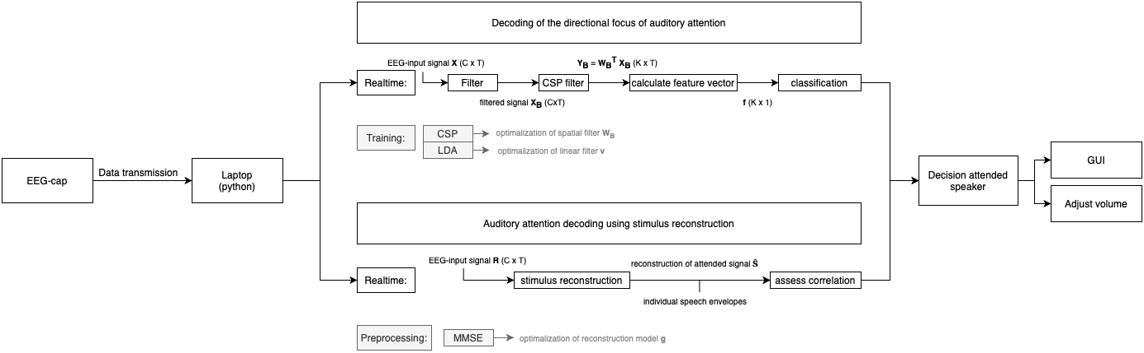

Slide 2

Data transmission
Bluetooth:
RST:

Slide 3
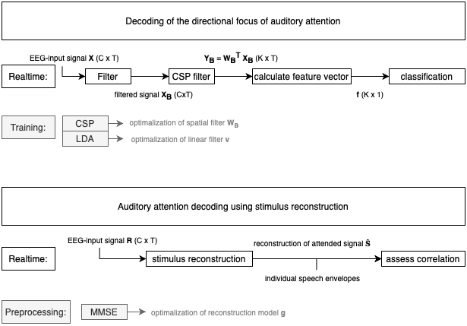

Slide 4
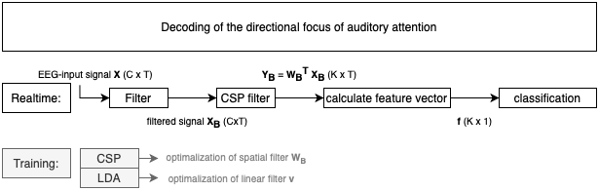
What is already present in the framework?
How many data will be necessary to make a correct decision (while minimalizing the decision window)?

Slide 5
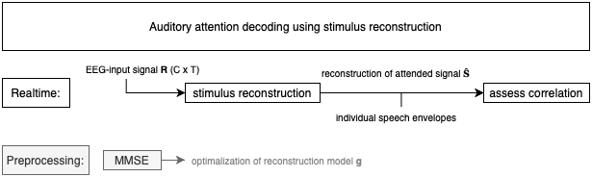
What is already present in the framework?

Slide 6
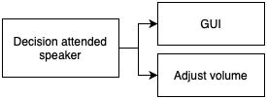
GUI: which speaker is attended
realtime EEG-signal
filtered signal
Adjust volume:
What percentage in increase and/or decrease of volume is optimal?

