Slide 1
Core value proposition?
Unique value proposition?
Why would a customer choose us over competitors?

Slide 2
Entities
Processes

Slide 3
Non-functional requirements
Localization
Regulatory requirements
Response time
Bandwith constraints
Scale of Data
Concurrency (burst/ sustained)
Uptime (can we have scheduled outages)
Time (to market, sunset)
Branded Experience
Security

Slide 4
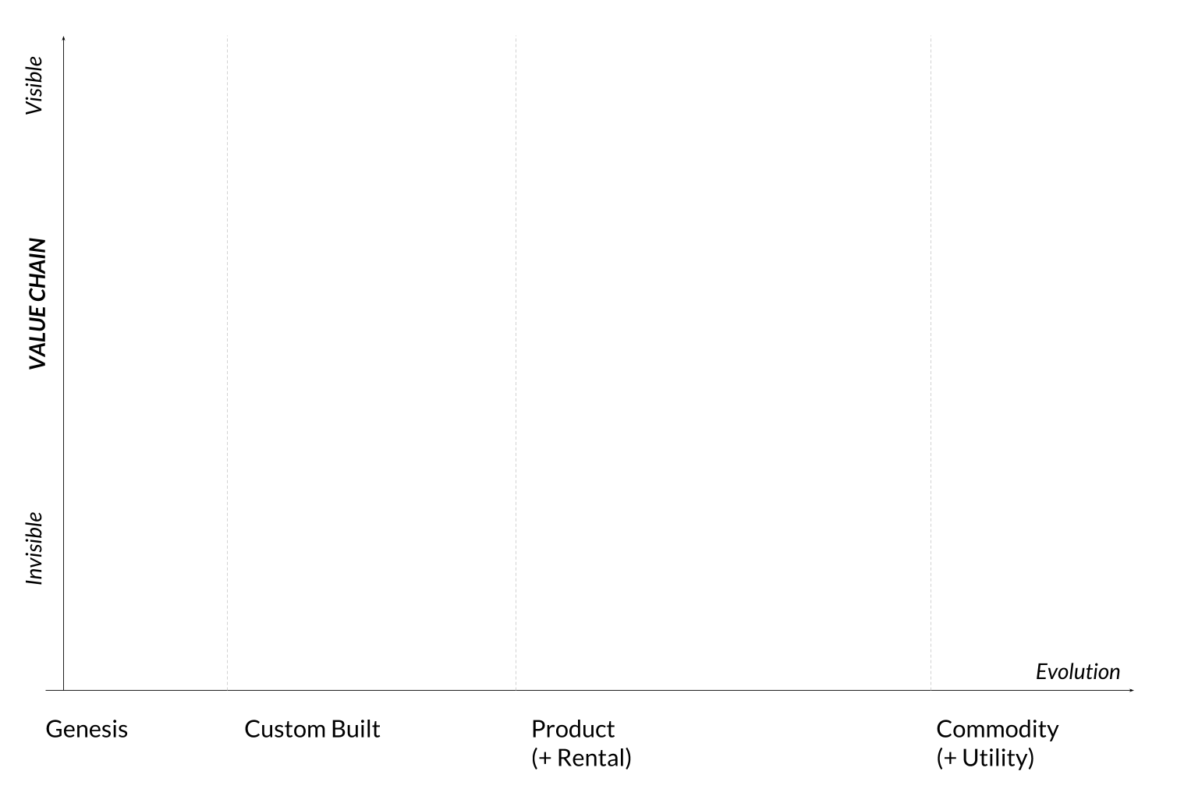
Build
Buy
Cut?
Wardley map

