Slide 1
Multi-robot Transport System
Decentralized design
Pitch 22-05-2017
Minor Adaptive Robotics
Fontys 2017

Slide 2
Table of Contents
Mechanical design
Software
Goals
Minor Progress

Slide 3
Mechanical design
Physical test gripper build
  3D Printed
  Functional
  Tolerances too tight
Lead time for materials

Slide 4
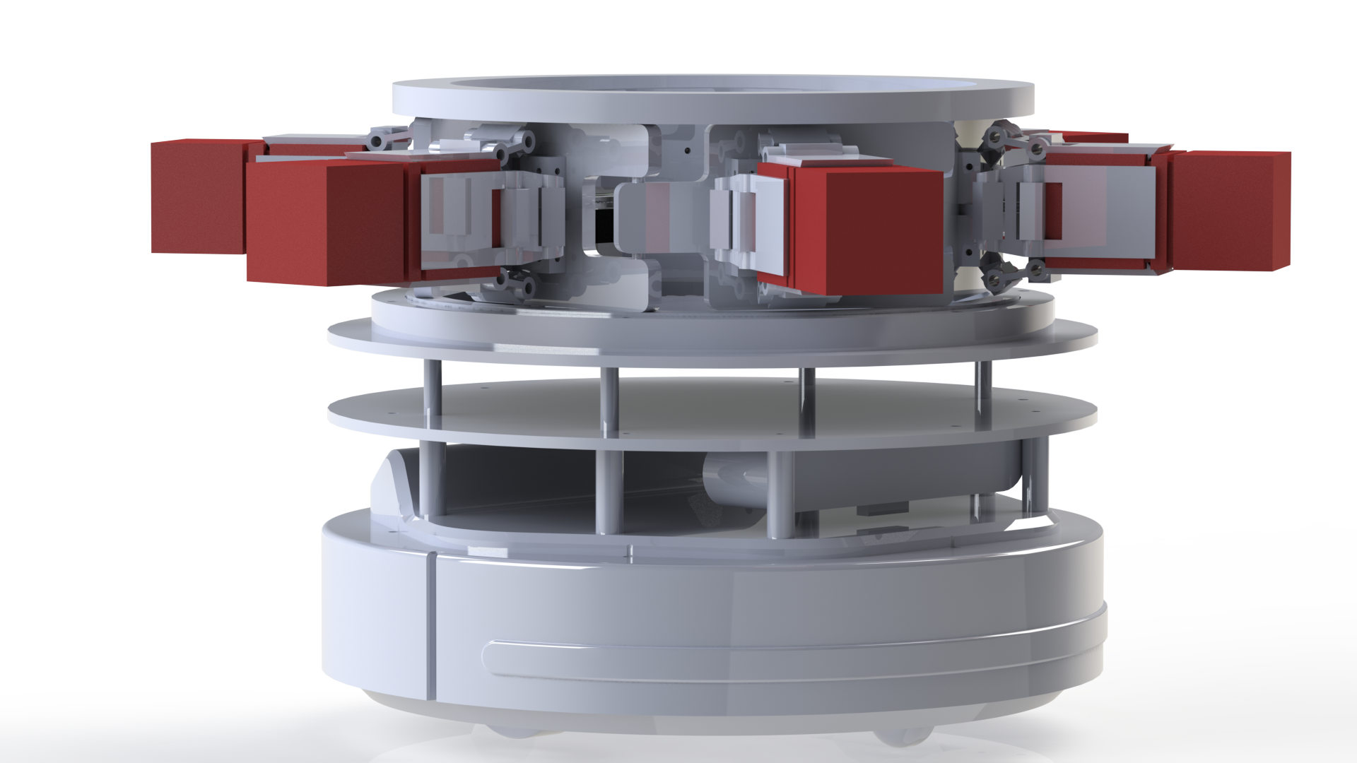

Slide 5
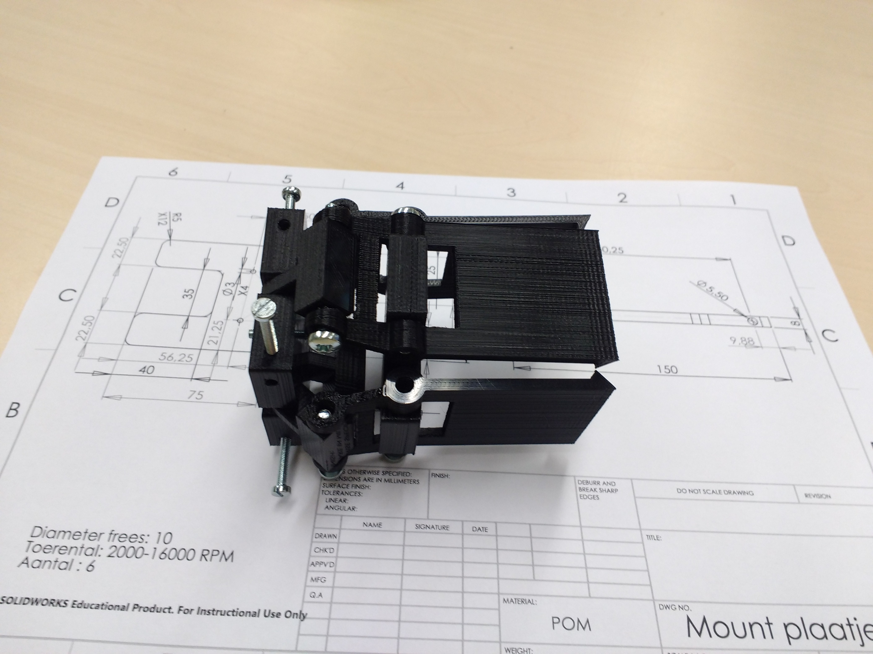
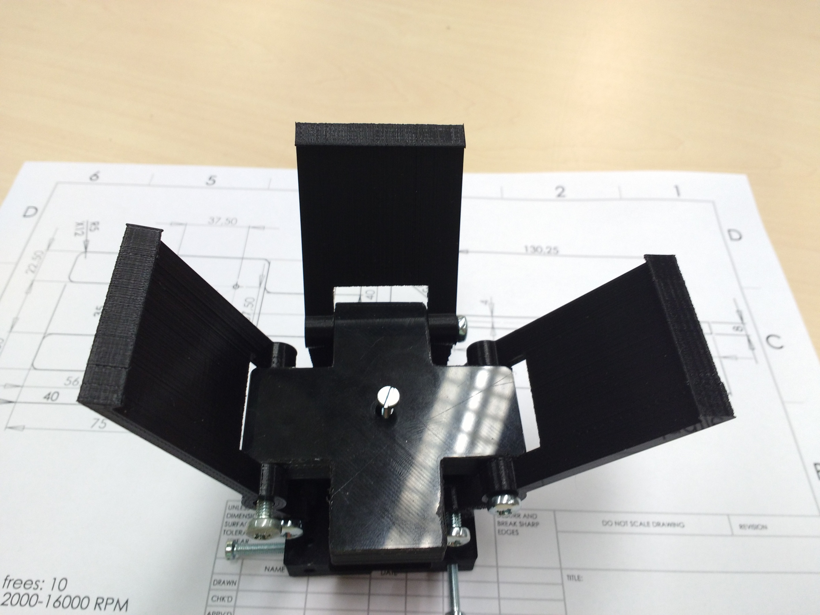

Slide 6
Software
Robot-Robot Communication
  Stuck in callback function
Multi-master Setup
  Name-spacing the robots
Decision logic
  Multi-threaded design
  Inventory check
Simulation Demo

Slide 7
Software

Slide 8
Goals
Prototype of the loader
Simulated behavior
Real world test
Paper
Poster

Slide 9
Minor Progress

