Slide 1


CREDIT CARD
WEEKLY STATUS
REPORT

Slide 2
OBJECTIVES
To develop a comprehensive credit card weekly dashboard that provides real-time insights into key performance metrics and trends, enabling stakeholders to monitor and analyze credit card operations effectively.
RANA BASAK

Slide 3
IMPORT DATA TO SQL DATABASE
Prepare csv file
Create tables in SQL
Import csv file into SQL
RANA BASAK

Slide 4
DAX Queries
age_group = SWITCH(
TRUE(),
'public cust_details'[customer_age] < 30, "20-30",
'public cust_details'[customer_age] >=30 && 'public cust_details'[customer_age] < 40, "30-40",
'public cust_details'[customer_age] >=40 && 'public cust_details'[customer_age] < 50, "40-50",
'public cust_details'[customer_age] >=50 && 'public cust_details'[customer_age] < 60, "50-60",
'public cust_details'[customer_age] >= 60, "60+",
"unknown“
)
income_group = SWITCH(
TRUE(),
'public cust_details'[income] < 35000,"low",
'public cust_details'[income] >= 35000 && 'public cust_details'[income] < 70000, "med",
'public cust_details'[income] >= 70000,"high",
"unknown"
)
RANA BASAK

Slide 5
DAX Queries
week_num2 = WEEKNUM('public cc_detail'[week_start_date].[Date])
revenue = 'public cc_detail'[annual_fees] + 'public cc_detail'[total_trans_amt] + 'public cc_detail'[interest_earned]
current_week_revenue = CALCULATE(
SUM('public cc_detail'[revenue]),
FILTER(
ALL('public cc_detail'),
'public cc_detail'[week_num2] = MAX('public cc_detail'[week_num2])))
Pre_week_revenue = CALCULATE(
SUM('public cc_detail'[revenue]),
FILTER(
ALL('public cc_detail'),
'public cc_detail'[week_num2] = MAX('public cc_detail'[week_num2])-1))
RANA BASAK

Slide 6
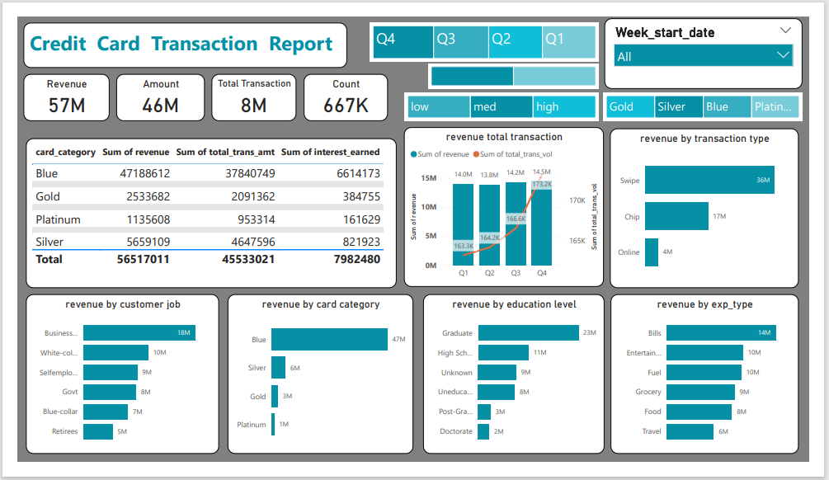
Credit Card Transaction Dashboard
RANA BASAK

Slide 7
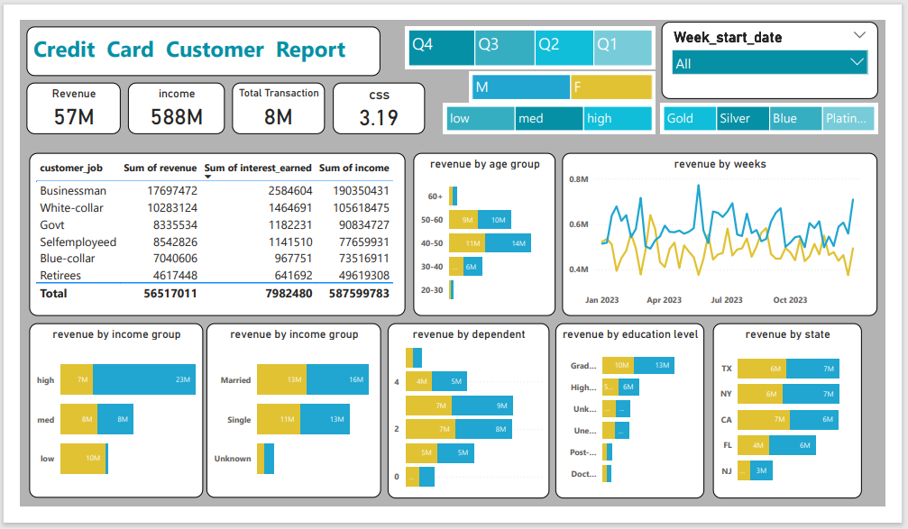
Credit Card Customer Dashboard
RANA BASAK
RANA BASAK

Slide 8
Insights
Overall revenue is 57M
Total interest is 8M
Total transaction amount is 46M
Male customers are contributing more in revenue by 31M , Female 26M
Blue & Silver credit card are contributing to 93% of overall transactions
TX,NY & CA is contributing to 68%
Overall activation rate is 57.5%
Overall delinquent rate is 6.06%
RANA BASAK

Slide 9
THANKING YOU
CREATED BY RANA BASAK
RANA BASAK

