Slide 1

FURNIZONE
GRADUATION PROJECT
Furnizone
A modern full-stack e-commerce platform for furniture — built on Angular, ASP.NET Web API, and MongoDB.
PROJECT TEAM
Mina Sabir
Basant Ali
Mahmoud Amr
Fatema Mohamed
Software Engineering Graduation Project • 2026
Notes:
Welcome the audience. Introduce the project name, your team, and that this is your graduation project — a full-stack furniture e-commerce platform.

Slide 2

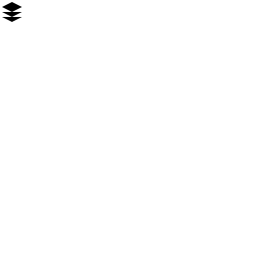
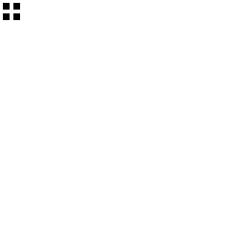


WHAT WE'LL COVER
Agenda
01
The Problem & Our Solution
Why furniture shopping needed a better platform
02
System Architecture
How the frontend, API, and database work together
03
Features & User Journey
Catalog, cart, checkout, and admin tools
04
Security & Technology
Authentication and the stack behind Furnizone
05
Challenges & What's Next
Lessons learned and the roadmap ahead
FURNIZONE
2
Notes:
Give a 10-second preview of the story: problem, solution, architecture, features, security, and what you learned.

Slide 3

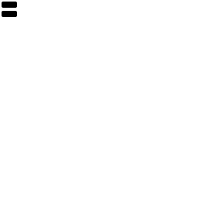


PROJECT OVERVIEW
About Furnizone
Furnizone is a full-stack e-commerce web application built for browsing and purchasing furniture online — designed and engineered end-to-end as a graduation project spanning frontend, backend, database, and deployment.
WHAT MAKES IT REAL
End-to-end system — not a template
Angular
ASP.NET Web API
RESTful API secured with JWT
Frontend framework
Backend framework
Document-based data modeling in MongoDB
SQL Server
Vercel
SQL database
Frontend deployment
Deployed frontend on Vercel
FURNIZONE
3
Notes:
Summarize Furnizone in one sentence, then walk through the four core technology choices before diving deeper.

Slide 4
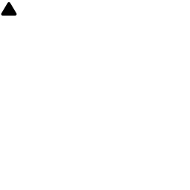

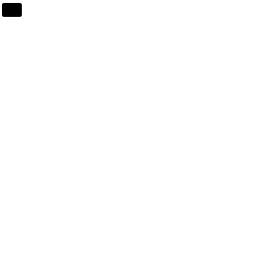

THE PROBLEM
Buying Furniture Online
Is Still Frustrating
Cluttered, generic storefronts
Weak search & filtering
Most furniture sites bury products behind slow, unfocused catalogs.
Shoppers struggle to narrow down by category, price, or style.
Inconsistent experience
Security as an afterthought
Desktop and mobile journeys often feel like two different products.
Account and checkout data isn't always handled with modern safeguards.
FURNIZONE
4
Notes:
Set up the pain points that motivated the project — keep this grounded in real online furniture-shopping frustrations.

Slide 5
WHY IT MATTERS
The Stakes Are Higher
Than They Look
Furniture is a considered, high-value purchase. A confusing or untrustworthy online experience doesn't just lose a sale — it loses the customer permanently.
High
Low
1st
Average order value
Tolerance for friction
Impression = trust
Furniture purchases carry more financial weight than typical e-commerce items
Shoppers abandon carts quickly when navigation or checkout feels clunky
A clean, secure, responsive storefront signals credibility instantly
FURNIZONE
5
Notes:
Explain why these problems are worth solving — furniture is a high-consideration purchase, so trust and usability matter more than average.

Slide 6

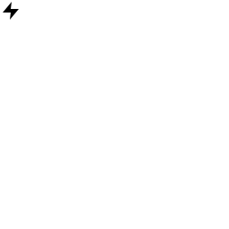
OUR SOLUTION
Furnizone: Furniture Shopping,
Built the Right Way
Focused catalog
Consistent across devices
Clean browsing with real search and filtering that surfaces the right pieces fast.
A single Angular front end delivers the same polished experience everywhere.
Security by design
Fast, decoupled architecture
JWT-based authentication protects accounts and checkout from day one.
A dedicated REST API keeps the frontend and backend independently scalable.
FURNIZONE
6
Notes:
Introduce Furnizone as the direct answer to each problem raised on the previous two slides.

Slide 7

PROJECT OBJECTIVES
What We Set Out to Build
01
02
03
04
Deliver a complete storefront
Apply clean architecture
Secure user data
Design for scale
From product discovery to checkout, covering the full shopping journey.
Separate concerns across frontend, API, and data layers for maintainability.
Protect accounts and sessions with industry-standard JWT authentication.
Choose technologies (MongoDB, REST API, Vercel) that scale with demand.
FURNIZONE
7
Notes:
Walk through what the team aimed to achieve technically and functionally — this frames the rest of the technical deep-dive.

Slide 8

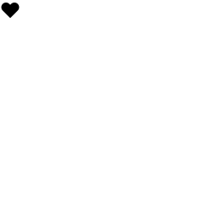

WHO WE BUILD FOR
Target Users
Everyday Shoppers
Returning Customers
Store Administrators
Browse, search, and buy furniture for their homes with a fast, trustworthy experience.
Save favorites to a wishlist and check out quickly on future visits.
Manage products, categories, and orders through a dedicated admin dashboard.
FURNIZONE
8
Notes:
Briefly describe who uses the platform and how their needs differ — shoppers vs. returning customers vs. admins.

Slide 9
SYSTEM OVERVIEW
How Furnizone Fits Together
Three independently deployable layers, communicating over a secured REST API.
HTTPS / JSON
Mongo Driver
Angular Frontend
ASP.NET Web API
MongoDB
Client UI · Deployed on Vercel
REST API · JWT Auth
Document Database
Frontend and backend deployed and scaled independently
Stateless API authenticated via JWT bearer tokens
Flexible, schema-light data model suited to a growing catalog
FURNIZONE
9
Notes:
This is the 30,000-foot view. Explain that Angular, the API, and MongoDB are three separate, independently deployable pieces communicating over HTTPS.

Slide 10
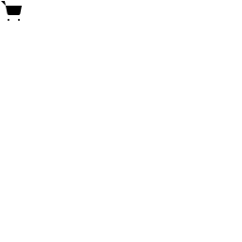
MAIN FEATURES
What Shoppers Can Do
Product Catalog, Search & Filters
FLAGSHIP FEATURE
The core of Furnizone — a fast, filterable catalog by category, price, and style, so shoppers find the right piece in seconds.
Shopping Cart
Wishlist
Admin Dashboard
Secure Accounts
Add, update, and review items before checkout.
Save favorite products for later.
Manage products, categories, and orders.
JWT-protected login and registration.
FURNIZONE
10
Notes:
Lead with the flagship feature (catalog/search) since that was flagged as the standout capability, then cover the supporting features.

Slide 11


USER JOURNEY
From Browsing to Checkout
1
2
3
4
5
6
Browse
Search & Filter
Product Details
Add to Cart
Checkout
Order Confirmed
Every step after "Add to Cart" requires authentication — protecting order and payment data end-to-end.
FURNIZONE
11
Notes:
Walk the audience through a real user session end to end, noting where authentication kicks in.

Slide 12


FRONTEND ARCHITECTURE
Angular, Structured for Growth
Components
WHY THIS STRUCTURE
Pages & reusable UI — product cards, cart, nav, forms.
Modular components stay easy to test and reuse
Services
API calls, state, and business logic, injected via DI.
Services centralize API logic — no duplicated fetch code
Routing Module
Interceptors auto-attach JWT tokens to every request
Client-side navigation between catalog, cart, and account views.
Route Guards & Interceptors
TypeScript catches integration errors before runtime
Attach JWT tokens and protect authenticated routes.
FURNIZONE
12
Notes:
Explain the Angular project structure — components, services, routing, and how interceptors handle auth tokens automatically.

Slide 13
BACKEND ARCHITECTURE
A Clean, Layered ASP.NET API
Controllers
Handle HTTP requests & responses, define API routes
Services
Business logic — validation, workflows, orchestration
Repositories
Data access layer — talks to MongoDB collections
MongoDB
Persisted documents — products, users, orders, carts
Requests flow top-down; each layer only talks to the one directly below it.
FURNIZONE
13
Notes:
Walk top-to-bottom through the layered backend: Controllers receive requests, Services hold logic, Repositories talk to MongoDB.

Slide 14
DATABASE DESIGN
Document Modeling in MongoDB
Furnizone uses a schema-flexible, document-oriented model — collections map naturally to how the app thinks about data.
Products
Users
Categories
Carts
Orders
name, description, price
name, email (unique)
name, slug
userId (ref)
userId (ref)
category, images[]
hashed password
parent category (optional)
items: [{productId, qty}]
items[], total, status
stock quantity
roles: customer / admin
shipping address
Orders and Carts reference Users and Products by ID — relationships are resolved in the application layer rather than via SQL joins.
FURNIZONE
14
Notes:
Explain why MongoDB fits this domain — flexible product attributes, no rigid schema, and references instead of joins.

Slide 15
API ARCHITECTURE
A Predictable, RESTful API
ENDPOINT
METHOD
PURPOSE
REQUEST FLOW
/api/products
GET
List, search & filter products
1
Client sends request + JWT
/api/products/{id}
GET
Product details
2
Middleware validates token
/api/cart
GET / POST
View & update the cart
3
Controller routes to Service
/api/orders
POST
Place an order
4
Service calls Repository
/api/auth/login
POST
Authenticate & issue JWT
5
MongoDB returns data
/api/admin/products
POST / PUT
Manage catalog (admin only)
6
JSON response sent back
FURNIZONE
15
Notes:
Show a few representative endpoints, then walk through the numbered request flow on the right to explain the full round trip.

Slide 16

AUTHENTICATION & SECURITY
Securing Every Session with JWT
User logs in
Identity validates
JWT issued
Token stored
Access granted
Email + password sent to /api/auth/login
ASP.NET Identity checks credentials against MongoDB
A signed token is generated and returned to the client
Angular stores the token and attaches it to requests
API middleware verifies the token on every protected route
Passwords hashed — never stored in plain text
Tokens expire and must be refreshed
Role claims (customer / admin) embedded in the token
FURNIZONE
16
Notes:
This is a good slide to slow down on — walk through each of the five steps in the JWT flow, and call out the security practices at the bottom.

Slide 17
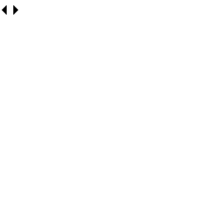
TECHNOLOGY STACK
Built With
Angular
TypeScript
ASP.NET Web API
MongoDB
Frontend framework — component-based SPA
Type-safe application logic
RESTful backend framework (.NET)
NoSQL document database
JWT
Vercel
Git & GitHub
Swagger / OpenAPI
Stateless authentication tokens
Frontend hosting & deployment
Version control & collaboration
Interactive API documentation
FURNIZONE
17
Notes:
Quickly run through the stack — this slide is mostly for reference, don't over-explain each item.

Slide 18
DEPLOYMENT
Shipping Frontend & Backend
Independently
Frontend — Vercel
Backend — ASP.NET API
Continuous deployment from Git on every push
Hosted independently from the Angular frontend
Global CDN for fast static asset delivery
Connects to MongoDB Atlas over a secured connection
Automatic HTTPS and preview deployments per branch
CORS configured to trust only the Vercel frontend origin
FURNIZONE
18
Notes:
Explain the deployment split: Vercel handles the Angular frontend, the .NET API is hosted separately and talks to MongoDB Atlas.

Slide 19
CHALLENGES
Challenges We Faced
Modeling relations in a document DB
Cross-origin communication
Representing orders, users, and products without SQL-style joins required careful reference design.
Connecting a Vercel-hosted Angular app to a separately hosted API meant getting CORS and environment configs right.
Token lifecycle management
Search performance at scale
Handling JWT expiry and refresh cleanly on the client without disrupting the user experience.
Keeping catalog search and filtering fast as the product collection grows.
FURNIZONE
19
Notes:
Be honest and specific here — pick 1-2 of these to talk about in more depth with a real anecdote from development.

Slide 20
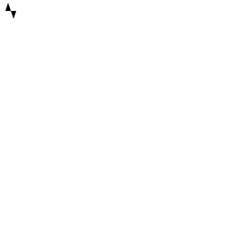
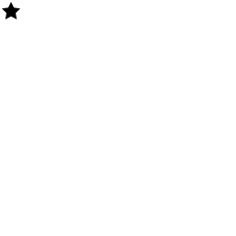
WHAT'S NEXT
Future Improvements
Online payment integration
Order tracking
Add Stripe or PayPal for real transactions.
Real-time status updates for placed orders.
Product reviews & ratings
Refresh token rotation
Let customers rate and review purchases.
Strengthen session security further.
FURNIZONE
20
Notes:
Frame this as vision, not promises — these are the logical next steps if development continued.

Slide 21
KEY ACHIEVEMENTS
What We Delivered
Full-Stack System
Secure Authentication
Real Catalog Experience
Live Deployment
Frontend, backend, and database engineered from scratch.
JWT-based auth protecting every user session.
Working search, filtering, cart, and wishlist.
Frontend shipped and accessible via Vercel.
FURNIZONE
21
Notes:
This is your highlight reel — deliver these with confidence, they are the proof points for your grade.

Slide 22
CONCLUSION
Furnizone: A Complete,
Secure Shopping Experience
We set out to fix a cluttered, inconsistent furniture-shopping experience — and built a focused, secure, full-stack platform to prove it's solvable.
Focused product discovery
Clean, layered architecture
Furnizone
From problem to product — a graduation project built like production software.
Security-first authentication
Independently deployed layers
FURNIZONE
22
Notes:
Bring the story full circle: restate the problem in one line, then the solution, then invite questions.

Slide 23
Thank You
Questions & Discussion
Mina Sabir
Basant Ali
Mahmoud Amr
Fatema Mohamed
FURNIZONE • SOFTWARE ENGINEERING GRADUATION PROJECT
Notes:
Thank the audience, and open the floor. Be ready to go deeper on the architecture, database schema, or security flow if asked.

