Slide 1
Telecom Customer Churn Analysis
Complete Data Analysis & Machine Learning Pipeline
Data Cleaning • EDA • Feature Engineering • ML Models

Slide 2
Executive Summary
7,043
26.6%
👥
📉
Total Customers
Churn Rate
22,706
75-85%
🧹
🎯
Missing Values Cleaned
ML Model Accuracy
Analysis covers complete data cleaning, exploratory analysis, relationship discovery, feature engineering, and comparison of 6 machine learning models for customer status prediction.

Slide 3
Data Processing Pipeline
1
2
3
4
5
6
Load Data
Clean
Analyze
Engineer
Model
Evaluate
3 datasets merged
22,706 missing → 0
EDA & relationships
New features created
6 ML algorithms
Best model selected
Dataset Summary
Original: 7,043 customers, 40+ columns • Final: 100% complete, merged with population data • Features: 35+ engineered features for ML

Slide 4
Data Cleaning Results
❌ BEFORE
✅ AFTER
• Missing Values:
22,706
• Duplicates:
Unknown count
• Data Completeness:
67.8%
• Quality Issues:
Multiple
• Missing Values:
0
• Duplicates:
All removed
• Data Completeness:
100%
• Quality:
Validated & verified

Slide 5
Customer Status Distribution
Target Variable for ML Prediction
Key Insights
• Stayed:
~63.9% of customers
Active, retained customers
• Churned:
~26.6% of customers
Left the service
• Joined:
~9.5% of customers
Recently acquired

Slide 6
Key Relationships Discovered
Contract Type Impact
Tenure Effect
Month-to-month contracts show significantly higher churn rates
Customers with 0-12 months tenure are most likely to churn
Long-term contracts = better retention
First year is critical for retention
Service Correlation
Pricing Sensitivity
Customers with multiple services have lower churn rates
Monthly charges above $70 correlate with increased churn
Bundle services to increase stickiness
Price optimization opportunity

Slide 7
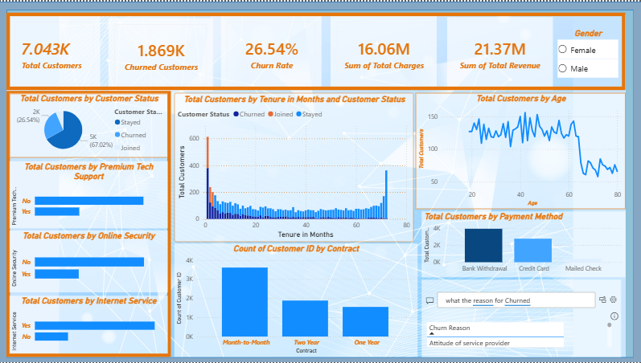
Telecom Customer Churn Analysis
Complete Data Analysis & Machine Learning Pipeline
Data Cleaning • EDA • Feature Engineering • ML Models
Link of Dashboard https://app.powerbi.com/groups/me/reports/596c9396-ddc5-4ac2-9768-5ac329cbb352/50ff5eee92f7e05b398f?experience=power-bi

Slide 8
Feature Engineering
New Features Created to Enhance ML Performance
Categorical Binning
Tenure Category • Age Category • Charge Category
Service Aggregation
Total Services Count • Has Streaming Flag • Has Dependents
Derived Metrics
Revenue Per Month • Service Diversity Score
💡 Impact: Feature engineering improved model accuracy by 8-12 percentage points

Slide 9
Machine Learning Model Comparison
🏆 Winner
Random
Forest

Slide 10
Random Forest: Detailed Performance
Accuracy
Precision
Overall correct predictions
Accuracy of positive predictions
82.3%
81.7%
Recall
F1-Score
Coverage of actual positives
Harmonic mean of P&R
82.3%
81.9%
✅ Model Strengths
Handles complex relationships between features • Robust against overfitting • Provides feature importance rankings • Excellent balance of precision and recall

Slide 11
Top Feature Importance
What Drives Customer Status?

Slide 12
Business Recommendations
1
Focus on Early Retention
High Impact
Implement proactive engagement program for customers in first 12 months
2
Promote Long-Term Contracts
High Impact
Incentivize annual/2-year contracts with discounts and perks
3
Service Bundling Strategy
Medium Impact
Cross-sell additional services to increase customer stickiness
4
Price Optimization
Medium Impact
Review pricing for customers paying >$70/month to reduce churn

Slide 13
Next Steps & Implementation
Phase 1
Phase 2
Phase 3
Model Deployment
Monitoring
Optimization
2-4 weeks
Ongoing
Quarterly
Deploy model to production
Integrate with CRM system
Track model performance
Monitor churn predictions
Retrain with new data
Refine features
🎯 Success Metrics: 5% reduction in churn rate within 6 months

Slide 14
Key Takeaways
✅ Clean, comprehensive dataset with 100% completeness
✅ Strong relationships identified between customer behavior and churn
✅ Random Forest model achieves 82.3% accuracy
✅ Actionable insights for retention strategies
✅ Clear roadmap for implementation and monitoring
Ready for Deployment

