Slide 1








THE PERSONALIZED EDUCATION AGENT
WORKBOOK 2
TEAM 2
Basanth Periyapatna Roopa Kumar, Manav Rajesh Anandani, Nandhakumar Apparsamy, Nischitha Nagendran, Nitya Rondla

Slide 2
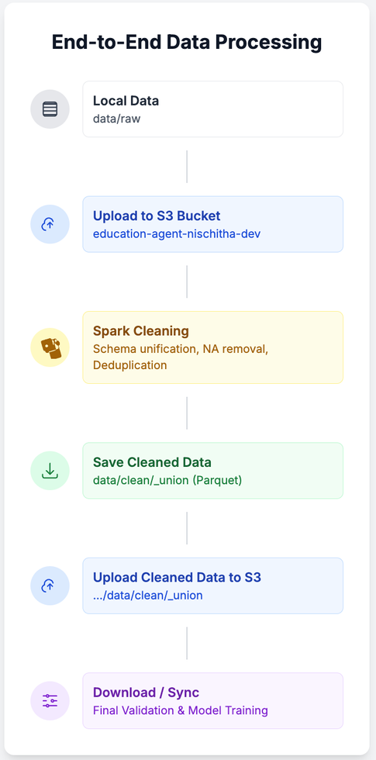
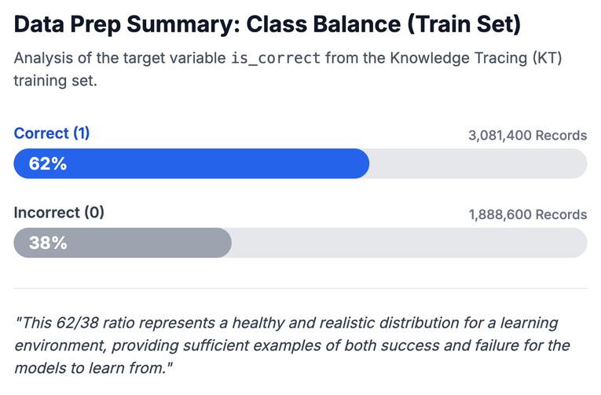
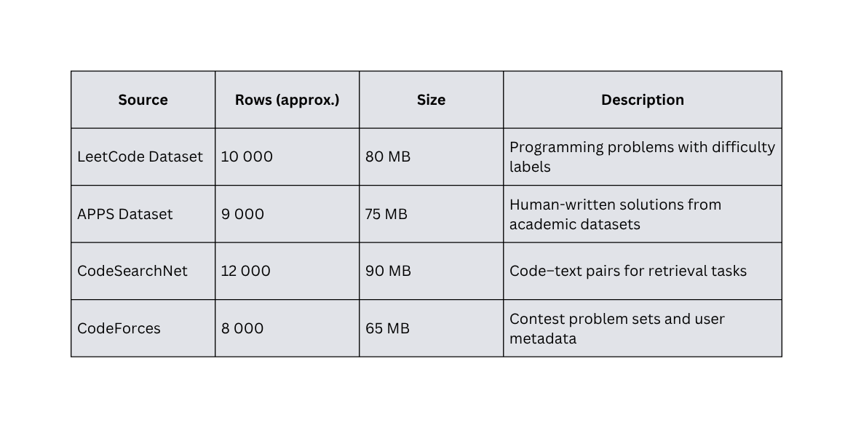
DATA PROCESS & PIPELINE SUMMARY

Slide 3



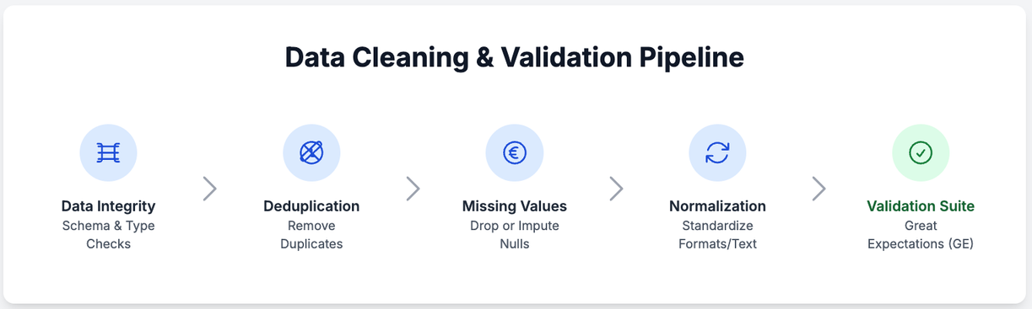


PRE-PROCESSING, PREPARATION, AND LEAKAGE PREVENTION
2
Splitting Strategy (Key Feature):
Knowledge Tracing (KT): Split by user to ensure a learner's data is only in one subset.
Q&A/Code: Split using stratified sampling based on difficulty and topic to keep distributions balanced.
Ratios: 70% train, 15% validation, 15% test.
1
3
Leakage Prevention Techniques
Risk: Same user across splits -> Mitigation: User-level partitioning.
Risk: Repeated Q&A -> Mitigation: Semantic similarity checks.
Risk: Temporal leakage -> Mitigation: Chronological ordering.

Slide 4
Model 2: Deep Knowledge Tracing (DKT)
Concept: Extends BKT using LSTMs to learn non-linear, long-term temporal dependencies in learner sequences.
Features: Encoded sequence of: user_id, kc_tag, is_correct, difficulty_scaled, response_time
Algorithm: Embed KCs and outcomes into latent space. → Feed sequentially to LSTM. → Predict next-step probability of correctness
MODEL PROPOSALS (1/2) - BASELINES
Model 1: Bayesian Knowledge Tracing (BKT)
Concept: A baseline probabilistic model that treats student mastery as a hidden binary variable (known/unknown). It's a simple, interpretable Hidden Markov Model (HMM).
Features: user_id, kc_tag, correctness_seq (0/1)
Algorithm:
Hidden Markov Model (HMM)-based.
For each KC, parameters are estimated via Expectation-Maximization (EM).
Posterior mastery probability updated after every attempt.
Model 3: Dynamic Key-Value Memory Network (DKVMN)
Concept: Uses a memory-augmented network to model knowledge. A "Key" matrix holds concepts, and a "Value" matrix holds mastery states, updated via attention
Algorithm: At each step, the model computes attention over KCs (keys). → Updates mastery in the corresponding value memory slot. → Predicts correctness on the next attempt.
Features: Learner sequences, KC embedding, difficulty, and response correctness.

Slide 5
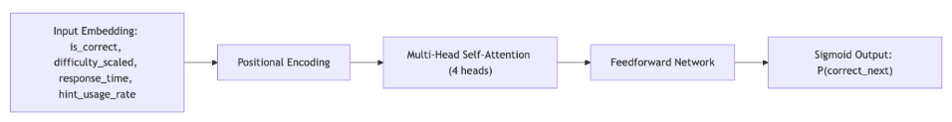
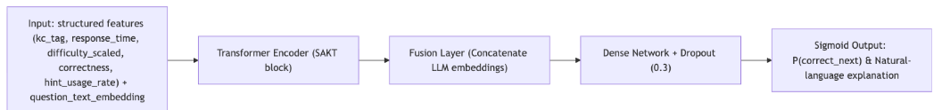
MODEL PROPOSALS (2/2) - BASELINES
Model 4: Transformer-Based KT (SAKT/AKT)
Concept: Replaces RNNs with self-attention to efficiently model long sequences and contextual interactions between all past attempts
Features Used:
Encoded sequence of interactions with positional embeddings.
Features: [is_correct, difficulty_scaled, response_time, hint_usage_rate].
Algorithm:
Each interaction attends to previous interactions weighted by relevance.
Context vectors aggregate the influence of past attempts dynamically.
Model 5: Hybrid LLM-KT (Innovative)
Concept: Fuses the Transformer (SAKT) model with semantic understanding from an LLM. Augments features with textual embeddings of the question content.
Features Used:
[kc_tag, question_text_embedding, response_time, difficulty_scaled, correctness, hint_usage_rate].
Algorithm:
Extract semantic embeddings from question text using a pretrained LLM.
Fuse these embeddings with structured features in the transformer encoder.
Predict both probability of correctness and generate short textual rationale.

Slide 6
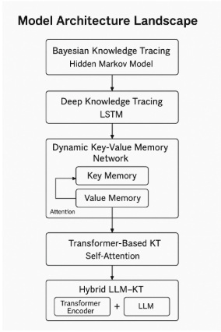
MODEL ARCHITECTURE LANDSCAPE
This single diagram beautifully summarizes the progression of all 5 models, from the simple HMM (BKT) to the complex Hybrid LLM-KT, showing how each builds upon the last.

Slide 7
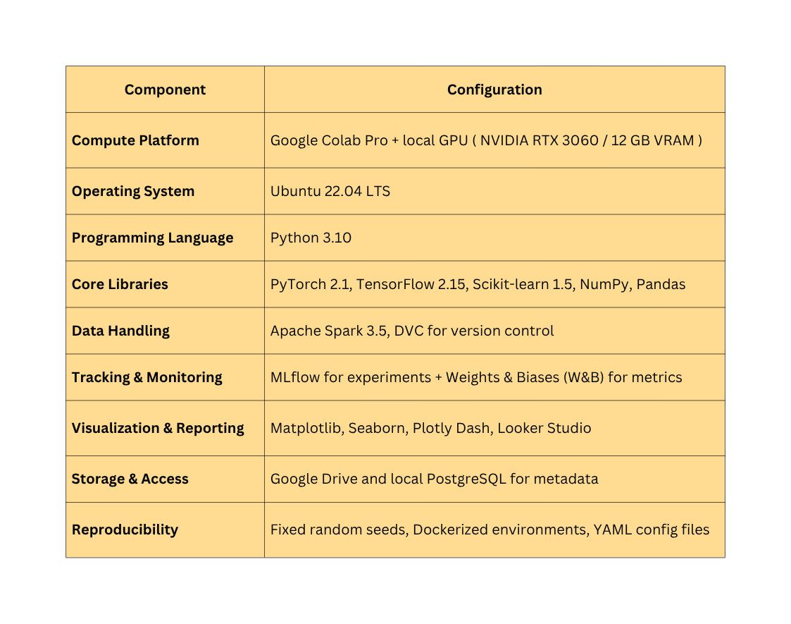
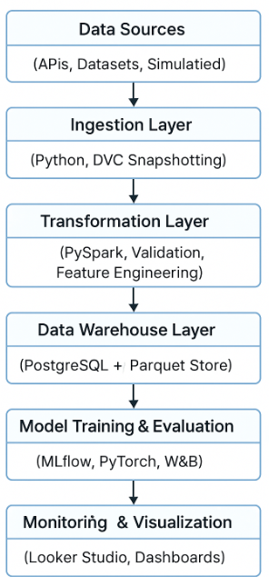
MODEL SUPPORTS (PLATFORM & TOOLS)
Development Environment:
ML Data Flow

Slide 8
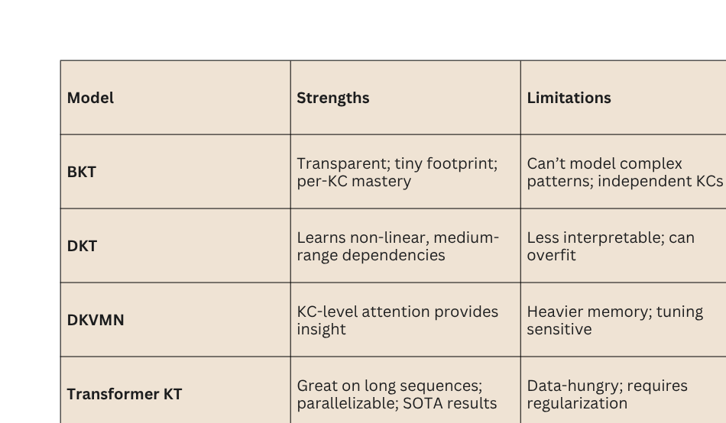
MODEL COMPARISON: STRENGTHS, LIMITATIONS & USE CASES

Slide 9

2
MODEL JUSTIFICATION
DKVMN (Concept Insight): Valuable for instructional design because its attention reveals which concepts drive errors.
Transformer KT (Primary Production): Best trade-off of accuracy, scalability, and long-context modeling for our large-scale logs.
1
3
BKT (Baseline): Guarantees interpretability and serves as a “sanity anchor” for debugging.
DKT (Strong Deep Baseline): Establishes a credible deep benchmark that is fast to iterate.
Hybrid LLM-KT (Innovative Choice): Addresses the key stakeholder need: accurate predictions that can be explained in plain language

Slide 10
Validation Strategy
2
Primary Method: Chronological 80/10/10 user-based split.
Rationale: This mimics real-world use (preventing temporal leakage) and ensures no user data appears in both train and test sets.
EVALUATION METHODS & ERROR ANALYSIS
3
Error Analysis
1. Performance Diagnostics (All Models)
Confusion Matrix: Analyze the raw counts of True Positives, True Negatives, False Positives, and False Negatives.
ROC Curve: Visually inspect the trade-off between the true positive rate and false positive rate to assess overall discriminative power.
Calibration Plots (ECE): Check if model confidence aligns with accuracy.
2. Explainability (Transformers): Log and visualize attention weights to see what past interactions the model focused on
3. Hybrid LLM-KT Deep Dive (Innovative Model)
Store Attention Maps: Similar to the SAKT model, we will analyze attention patterns.
Store Top-K Rationale Tokens: For the Hybrid LLM, we will capture the generated textual rationales (e.g., "Student struggles with recursive logic...") to see if its reasoning aligns with its prediction.
Semantic Error Bucketing: Group errors by question content (e.g., "recursion," "pointers") vs. behavior (e.g., "high response time") to find the true source of student difficulty.
1
Key Metrics:
Accuracy (ACC)
Area Under ROC Curve (AUC): Measures ranking quality.
Log Loss: Penalizes over-confident wrong answers.
Expected Calibration Error (ECE): Measures probability reliability.
Latency (p95): Checks for production efficiency.

Slide 11
THANK YOU
Presented by : Team 2

