Slide 1
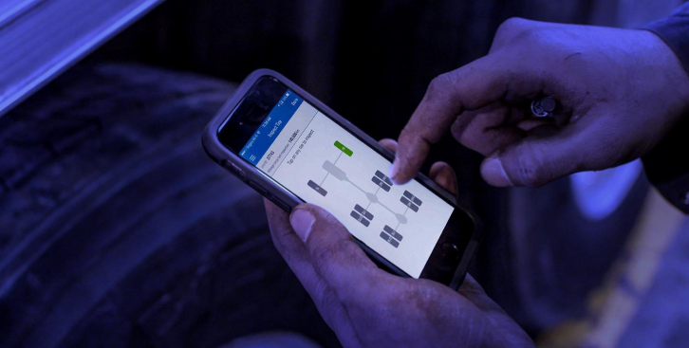
Tata Motors - Bridgestone Scope
Solutions on Tire, Battery & Vehicle Dynamics
Date: 01.08.2018

Slide 2
Commercial Vehicles
Tire thread wear solution – To monitor thread wear rate
Tire wear model in webfleet/Optidrive – Tire’s life prediction, breaking distance correlation with remaining thread, load analysis & driving behavior correlation
Tire damage model – Tire wear health report/alerts prediction, tire correlation with vehicle dynamics
Tire brand’s solution agnostic – Wheel misalignment/worn suspension prediction, alerts on puncture, worn out, overload, unbalanced load
Battery model – Battery health prognostics
Digital garage – Digital inspection/troubleshoot diagnostics, maintenance, tire replacement, tire rotation & tire supply
Advanced analytics – Pothole detection, obstacles, road hazards, road status, mileage management & tire know how

Slide 3
Passenger Vehicles
Tyre life monitoring and providing details to customer for tyre replacement
Road profile indication and guidance to customer based on speed and acceleration data, if their TPMS can have accelerometer.

