Slide 1
TEXT TRANSLTOR AND TEXT TO SPEECH
USER-GUIDE

Slide 2
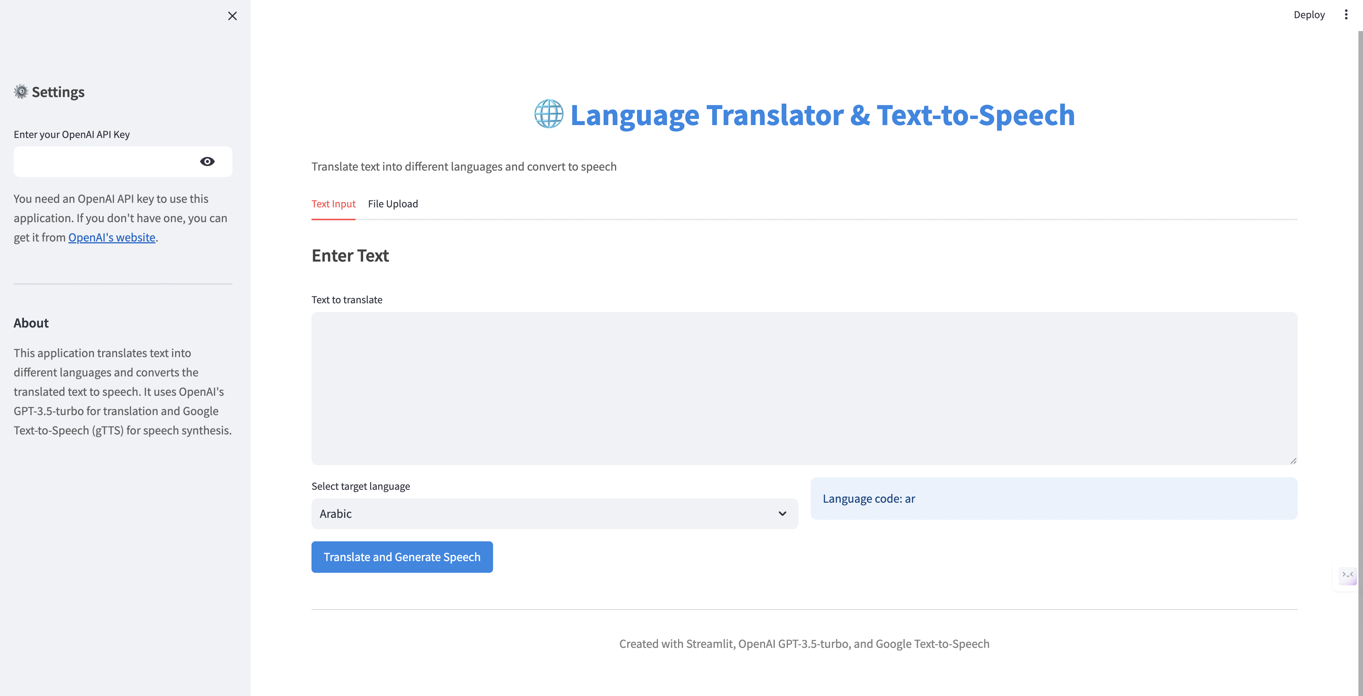
STEP-01: ADD OPEN API KEY

Slide 3
STEP-02: ENTER TEXT

Slide 4
STEP-03: SELECT LANGUAGE

Slide 5
STEP-04: HIT TRANSALTE

Slide 6
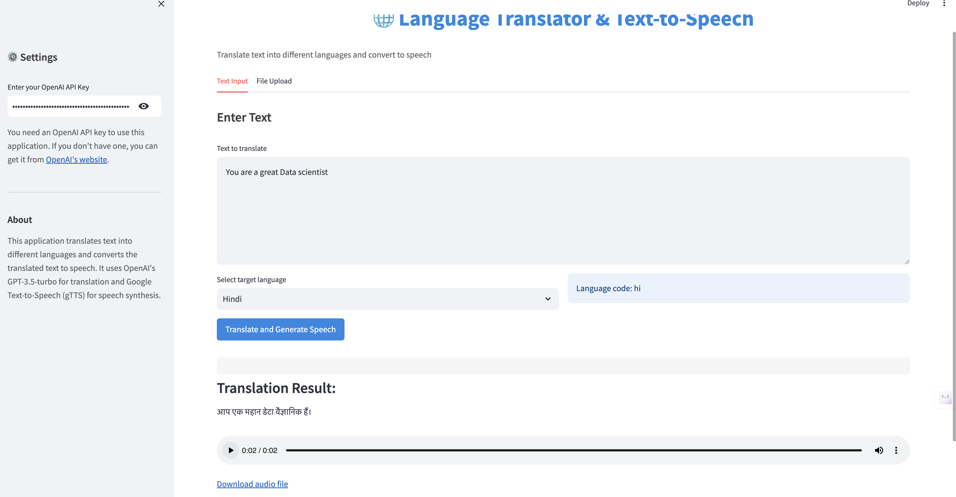
STEP-06: GET TRANSLATED RESULT

Slide 7
STEP-06: DOWNLOAD THE TEXT FILE

Slide 8
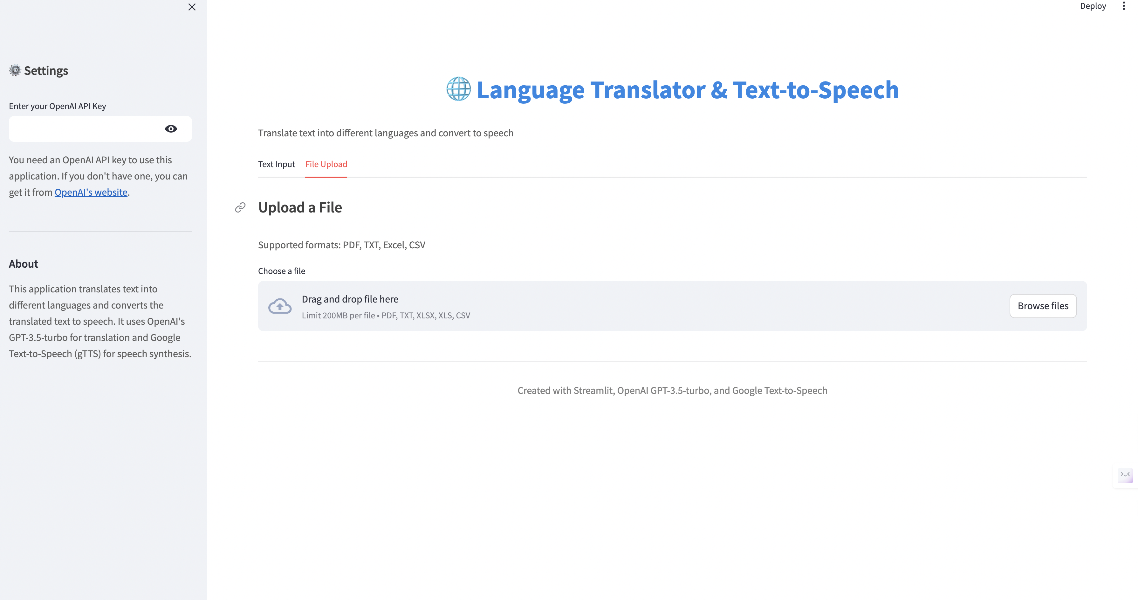
STEP-07: YOU CAN ADD TEXT FILE ALSO

