Slide 1
A Hybrid Machine Learning Framework for Smartphone Addiction Detection
Guided By,
Presented by,

Slide 2
ABSTRACT
📌 Smartphone addiction has become a widespread issue, impacting mental health, productivity, and social interactions. Machine learning techniques offer a data-driven approach to identifying individuals at risk based on behavioral and psychological patterns.
📌 Traditional assessment methods rely on self-reported surveys, often lacking accuracy and real-time evaluation. The challenge lies in developing a robust predictive model that effectively classifies addiction levels with high precision.
📌 A hybrid machine learning framework utilizing ensemble learning enhances predictive accuracy by integrating multiple classifiers, including Stacking, CatBoost, and ExtraTrees, reducing biases and improving generalization.

Slide 3
OBJECTIVES
📌 To analyze smartphone usage patterns and identify behavioral indicators of addiction.
📌 To develop a hybrid machine learning framework for accurate addiction classification.
📌 To integrate ensemble learning techniques for improved prediction performance.
📌 To provide a reliable tool for early detection and personalized intervention strategies.

Slide 4
Introduction
📌 Smartphone addiction has become a significant concern, affecting mental health, productivity, and social interactions.
📌 Excessive phone usage leads to dependency, anxiety, and reduced real-world engagement, making early detection essential.
📌 Machine learning techniques offer a data-driven approach to analyzing usage patterns and predicting addiction tendencies.
📌 A hybrid machine learning framework with ensemble learning enhances accuracy, providing a reliable solution for addiction assessment.

Slide 5
Literature Survey
📌 Smartphone addiction among children poses risks to mental health, productivity, and social interactions, requiring automated identification solutions.
📌 Existing methods rely on face biometrics or specialized applications, raising privacy concerns and limiting user experience.
📌 A novel implicit system collects behavioral data in real-time using deep learning-based classifiers, ensuring continuous and accurate child identification.
📌 Achieving an Equal Error Rate (EER) of 4.38%, the approach outperforms conventional models, providing a reliable tool for smartphone addiction assessment.

Slide 6
Existing System
📌 Most smartphone addiction detection methods rely on self-reported surveys, which may lack accuracy and real-time monitoring.
📌 Biometric-based approaches like facial recognition and fingerprint scanning require additional hardware, raising privacy concerns.
📌 Some models use single-finger touch interactions or simple behavioral patterns, limiting their effectiveness in complex scenarios.
📌 Conventional machine learning models such as SVM and Random Forest struggle with large-scale real-time classification tasks.

Slide 7
Drawbacks of the Existing System
📌 Limited Accuracy: Traditional methods may misclassify users due to generalized behavioral patterns and lack of deep learning insights.
📌 Privacy Concerns: Face and biometric-based authentication methods raise security and ethical issues.
📌 Poor Real-Time Performance: Existing models do not support continuous monitoring and often require user interaction.
📌 Lack of Generalization: Many approaches fail to adapt across different applications, smartphone models, and usage scenarios.

Slide 8
Proposed System
📌 A hybrid machine learning framework utilizing ensemble learning for smartphone addiction detection.
📌 Integrates Stacking Classifier, CatBoost Classifier, and ExtraTrees Classifier to improve accuracy and generalization.
📌 Collects behavioral and psychological usage patterns for real-time and privacy-preserving addiction assessment.
📌 Implements Flask-based web architecture for seamless interaction between the frontend and backend.

Slide 9
Advantages of the Proposed System
📌 High Accuracy: Achieves superior performance with ExtraTrees Classifier providing 100% test accuracy.
📌 Privacy-Preserving: Eliminates the need for biometric data, using implicit behavior-based identification.
📌 Real-Time Monitoring: Continuously tracks smartphone usage patterns without requiring user intervention.
📌 Scalable & Adaptive: Works across different smartphone models and app usage scenarios for broad applicability

Slide 10
System Requirements
Hardware Requirements
📌 Processor: Intel Core i5/i7 or equivalent (minimum 2.5 GHz)
📌 RAM: 8GB (Recommended: 16GB for better performance)
📌 Storage: Minimum 20GB free disk space
Software Requirements
📌 Operating System: Windows 10/11
📌 Programming Language: Python 3.8+
📌 Frameworks & Libraries: Flask, Scikit-Learn, TensorFlow, CatBoost, NumPy, Pandas
📌 Development Tools: Jupyter Notebook, PyCharm, VS Code

Slide 11
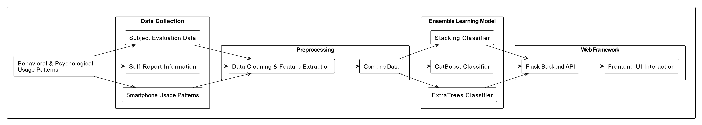
Architecture Diagram

Slide 12
System Modules
📌 Data Collection Module – Gathers smartphone usage data, including screen time, app usage, and behavioral patterns.
📌 Data Preprocessing Module – Cleans, normalizes, and transforms raw data for efficient model training and analysis.
📌 Machine Learning Module – Implements ensemble learning classifiers (Stacking, CatBoost, ExtraTrees,Random forest,XGBoost) for addiction prediction.
📌 Prediction & Analysis Module – Classifies users as addicted or non-addicted based on learned patterns and behavioral insights.
📌 User Interface Module – Provides a web-based dashboard using Flask, HTML, CSS, and JavaScript for interaction and visualization.

Slide 13
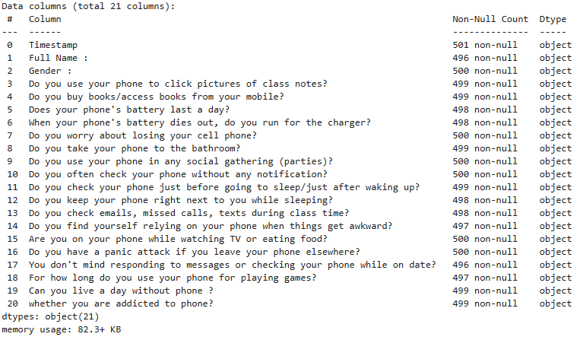
System Implementation- Data Collection Module
This screenshot shows the interface or backend logs capturing smartphone usage data such as screen time, app access frequency, and user interaction patterns.

Slide 14
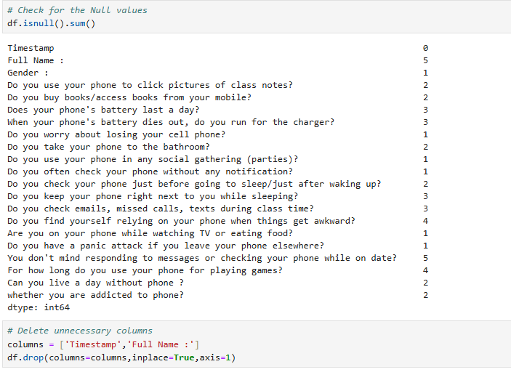
System Implementation- Data Preprocessing Module
The screenshot highlights data cleaning operations such as handling missing values, normalization, and feature transformation before feeding into the model.

Slide 15
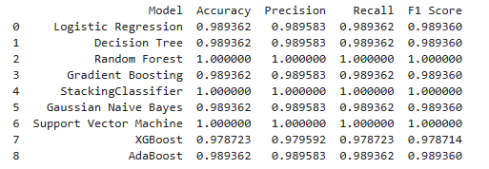
System Implementation- Machine Learning Module
This screenshot illustrates the training pipeline using ensemble classifiers like Stacking, GradientBoost, ExtraTrees, Random Forest, and XGBoost, with accuracy metrics.

Slide 16
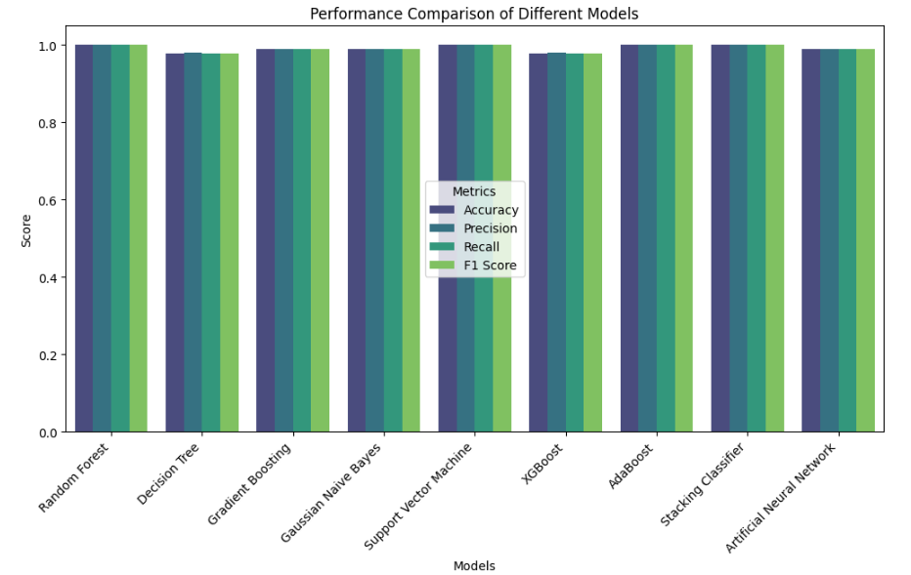
System Implementation- Prediction & Analysis Module
The screenshot displays prediction results where users are classified as addicted or non-addicted, including graphical analysis of key usage behaviors.

Slide 17
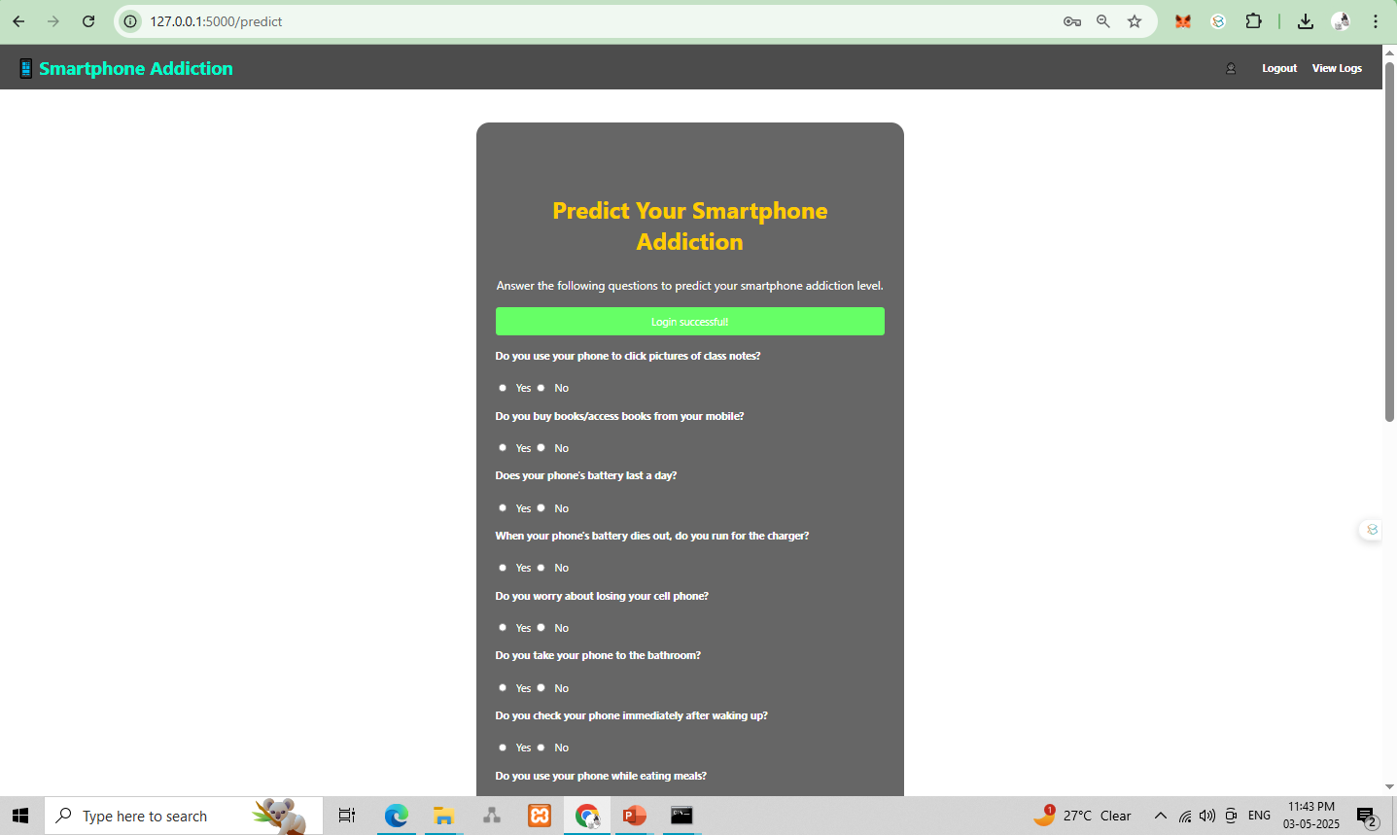
System Implementation- User Interface Module
This screenshot shows the responsive Flask web dashboard where users can view addiction status and trends through interactive graphs and user-friendly layouts

Slide 18
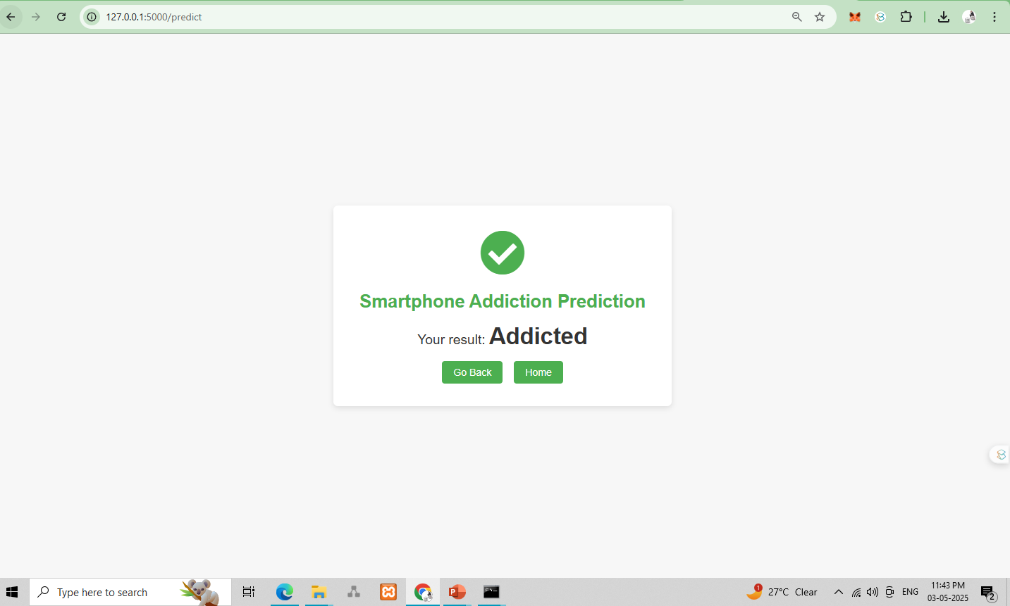
System Implementation- User Interface Module

Slide 19
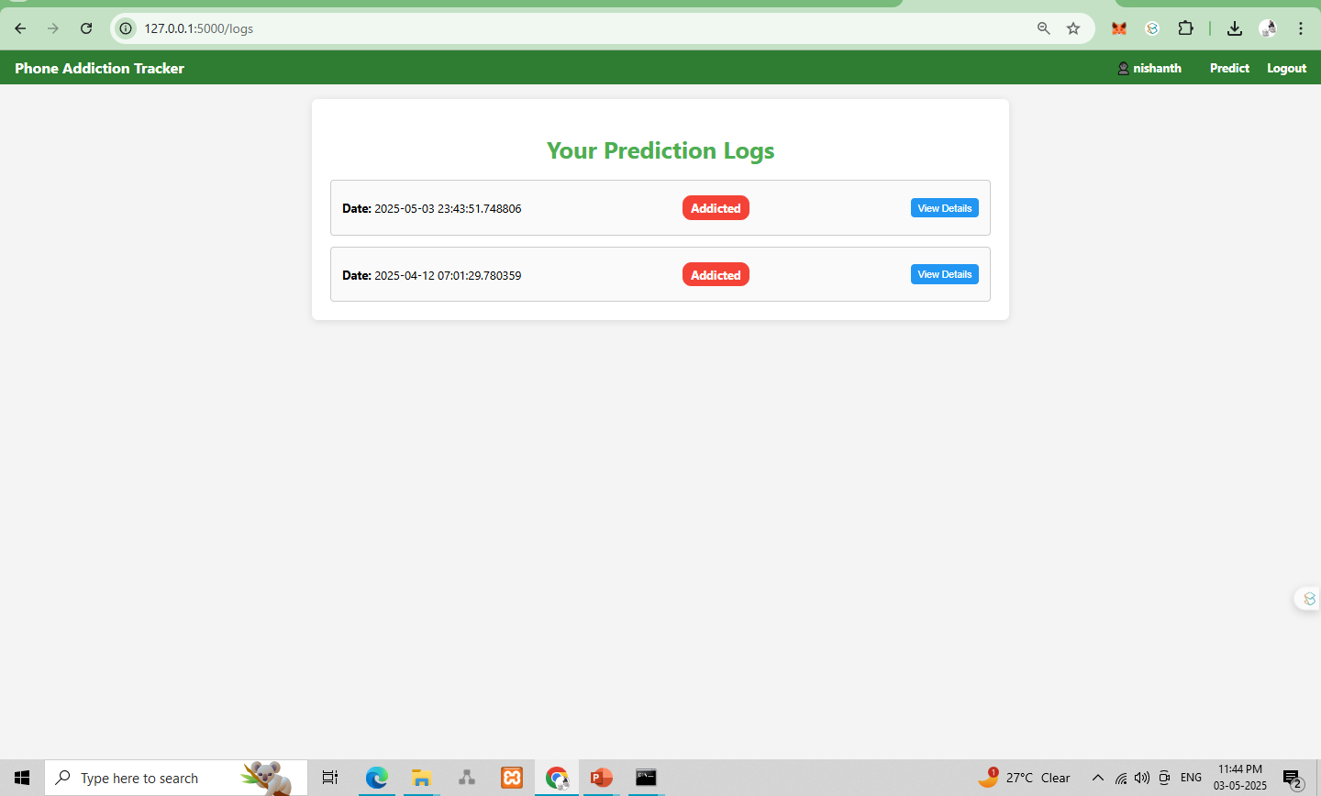
System Implementation- User Interface Module

Slide 20
References
[1] C. Lin, T. Song, Y. Miao, J. He, M. Yang, H. Wang, and C. Shen, **"ChildShield: An Implicit and Continuous Child Identification System on Smartphones,"** *IEEE Transactions on Dependable and Secure Computing*, vol. 21, no. 4, pp. 2257-2271, Jul./Aug. 2024.
[2] Y. Cheng, W. Zhang, H. Zhou, and M. Li, **"Identifying Child Users via Touchscreen Interactions,"** *ACM Transactions on Sensor Networks*, vol. 16, no. 4, pp. 1-25, 2020.
[3] A. Pentel, **"Predicting Age and Gender by Keystroke Dynamics and Mouse Patterns,"** in *Proceedings of the 25th Conference on User Modeling, Adaptation, and Personalization*, 2017, pp. 381-385.
[4] R.-D. Vatavu, G. Cramariuc, and D. M. Schipor, **"Touch Interaction for Children Aged 3 to 6 Years: Experimental Findings and Relationship to Motor Skills,"** *International Journal of Human-Computer Studies*, vol. 74, pp. 54-76, 2015.
[5] T. Min, Z. Wang, and P. Yang, **"Smartphone Sensor-Based User Behavior Analysis for Mental Health Monitoring,"** in *Proceedings of IEEE International Conference on Pervasive Computing and Communications (PerCom)*, 2021, pp. 123-130.

