Slide 1

Quick Hire – A Job Board SPA
Quick Hire is a modern job board built with the MERN stack. It offers a seamless experience for job seekers and employers. Our platform connects talent with opportunities effortlessly.

Slide 2

Quick Hire Team
Pavan Kumar
Nasrin Begam
Anik Saha
Basavaraj S Biradar
Team Lead & Full Stack Developer
Full Stack Developer
Full Stack Developer
Full Stack Developer
Ankit Dey
Soumyadeep Mandal
Full Stack Developer
Full Stack Developer

Slide 3
Project Overview & Key Features
QuickHire is a modern job board single-page application built with the MERN stack. It provides a simple, responsive interface for job posting and application.
Post a job
List all jobs
View job details
Filter/search for jobs
Apply to a job

Slide 4

Project Development Phases
Phase 1: Setup & Design
React project setup, CSS, React Router, MongoDB schema design, and UI wireframes.
Phase 2: Backend Development
Express.js server implementation, MongoDB with Mongoose, and Postman API testing.
Phase 3: Frontend Development
Component building (JobForm, JobList, JobDetails, FilterBar), Axios API integration, and responsive CSS styling.
Phase 4: Testing
Unit tests for components and API routes, integration tests, and manual UI/UX testing.

Slide 5
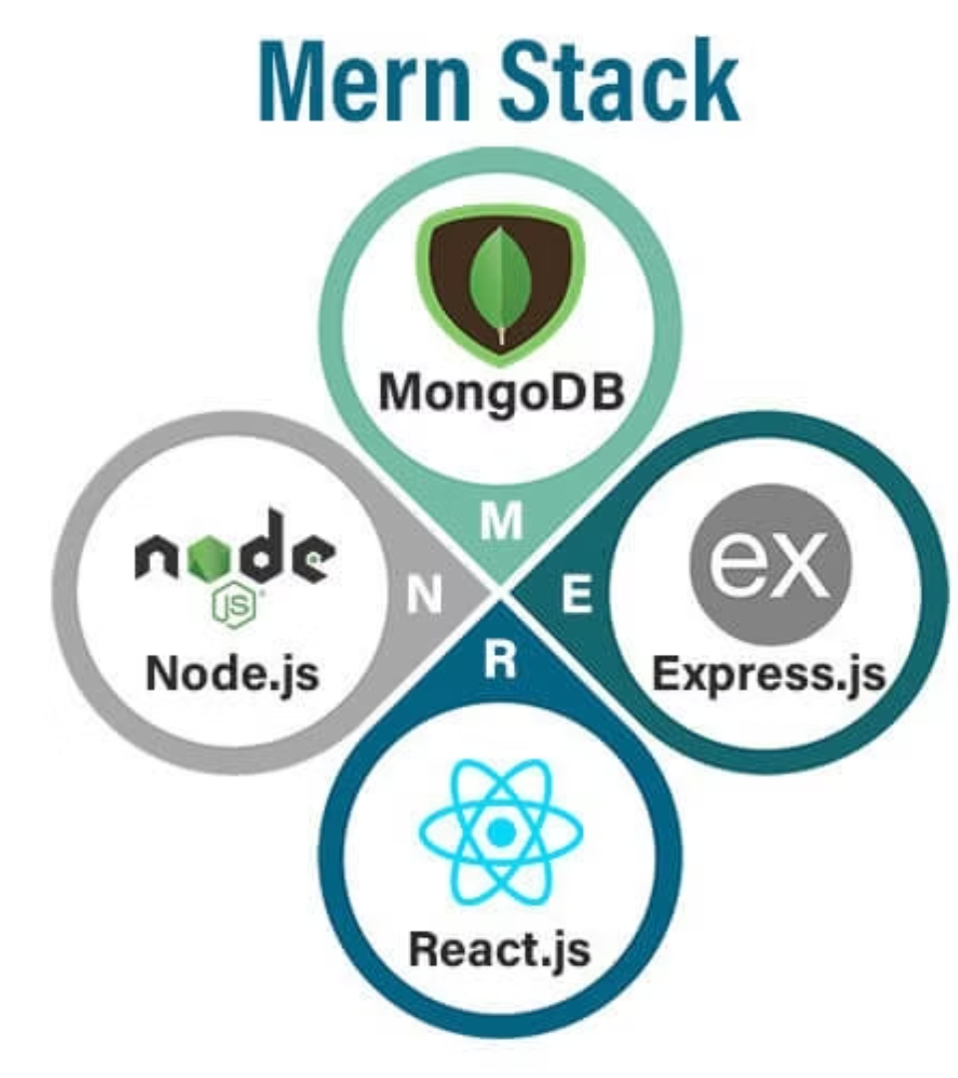
Technology Stack & Tools
MERN Stack
React.js for UI
Node.js for backend runtime
Express.js for web framework
MongoDB for database
Development Tools
VS Code for coding
GitHub for version control
Postman for API testing
MongoDB Atlas/Compass for database management

Slide 6






Backend Development Assignments
Nasrin Begam
MongoDB/Atlas/Cloud
Soumyadeep Mandal
MongoDB Cloud to Node.js connection
Ankit Dey
Controllers & Routes
Basavaraj S Biradar
Models, Controllers & Routes
Anik Saha
Middleware implementation
Pavan Kumar N R
Middleware implementation

Slide 7






Frontend Development Assignments
Ankit Dey
Login & Sign Up pages
Basavaraj S Biradar
Dashboard & Job Post forms
Soumyadeep Mandal
Job List & Job Filter functionality
Anik Saha
Job Details page display
Pavan Kumar N R
Navigation bar UI
Nasrin Begam
Navigation/Routes management

Slide 8
Thank You

