Slide 1

Problems with Search
By Karthik S

Slide 2

Questions to be answered:
In what percent of sessions is search being used? (Consider a sequence of activities done by a user without a 10-minute break between any two activities as one session. If there's a gap of more than 10 minutes between a new activity and previous activity, consider the new activity to be in a new session.)
Are users able to find what they search for?
Does the ordering algorithm of search results need tuning? In other words, do users have to scroll to the bottom to find what they seek?
Are users able to search at all? Is the search button working fine?
Do users face any errors after running a search query?
Are the autocomplete suggestions helpful for users?

Slide 3
Answers to each question following analysis
1. In 45.28% of sessions, search is being used.
2. Users are able to find what they search for with a click-through rate of 28.22%.
3. The average position of clicked search results is 2.93.
4. The search button appears to be working fine.
5. Users are facing search errors, and further investigation may be required.
6. Autocomplete suggestions have a click-through rate of 100.00%.

Slide 4
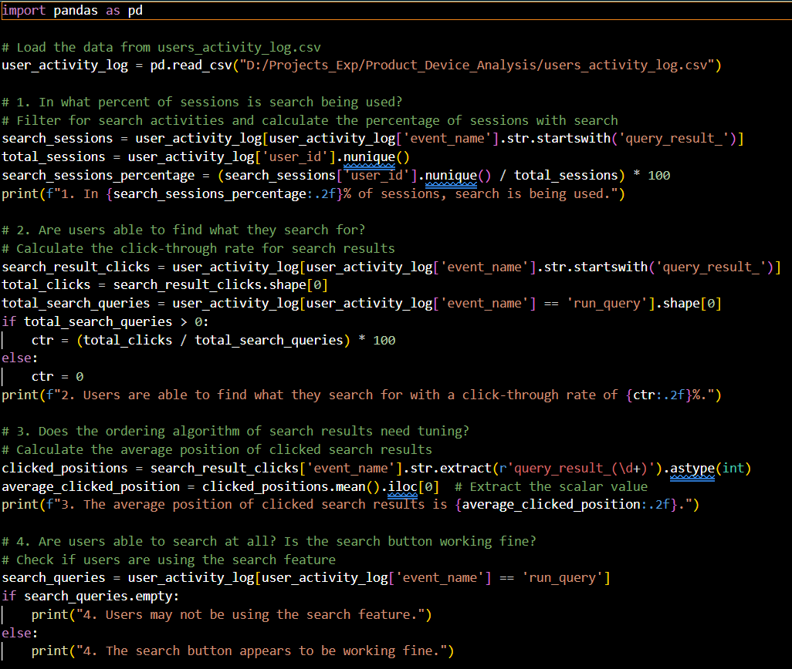
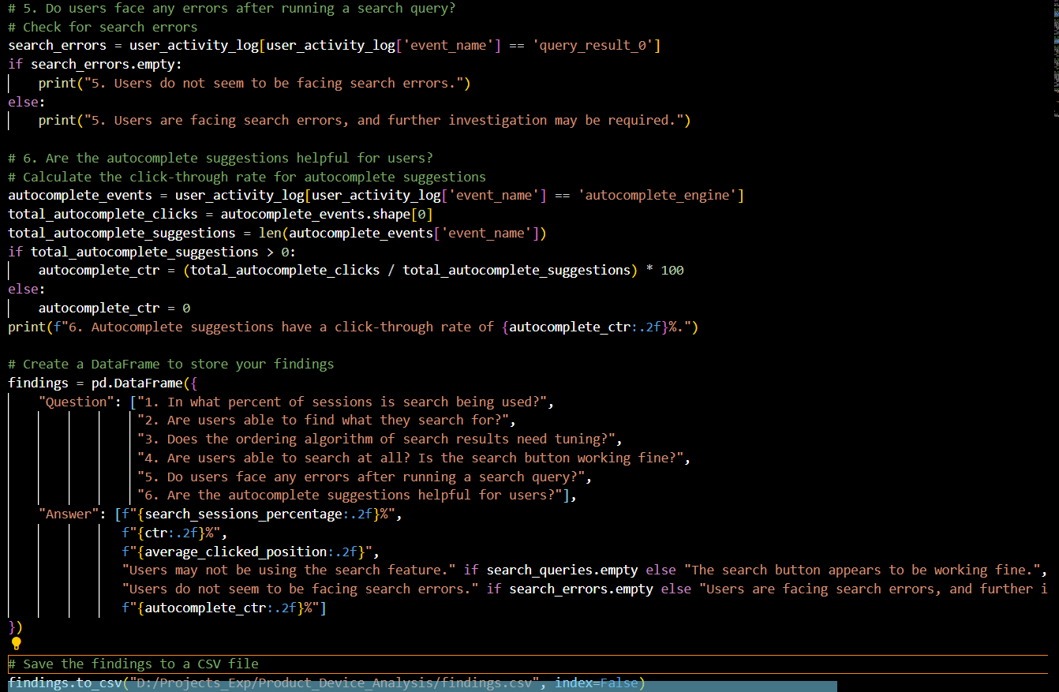
Python code used:

