Slide 1
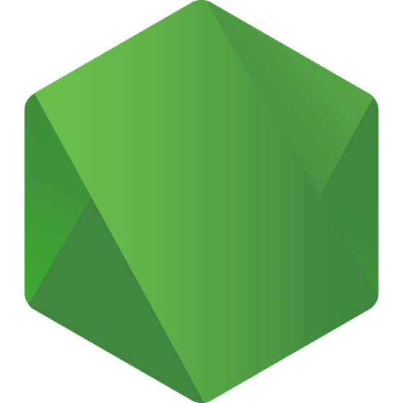
Hello and welcome, everyone!
Global Summit for Node js, 2023
JANUARY 25-26, 2023

Slide 2

Global Summit for Node js, 2023
JANUARY 25-26, 2023
How NPM or Yarn are working; Going to create our own package manager
Seyyed Ali Mohammadiyeh (Max Base)
Faculty of Mathematics, University of Kashan
Open-Source Maintainer, GitHub
CTO, Asrez
maxbasecode@gmail.com

Slide 3
WHO I AM
Global Summit for Node js, 2023
JANUARY 25-26, 2023
ALI, (Aka Max Base)
GitHub and Open-Source world (^_^)
Open-Source Maintainer
Software Engineer, Programming more then 10 years
Mathematics background
@basemax on GitHub

Slide 4
Introduction
Global Summit for Node js, 2023
JANUARY 25-26, 2023
As a developer, it's important to understand how package managers work because they play a vital role in managing dependencies and streamlining the development process.
In this presentation, we will take a deep dive into how NPM and Yarn, the most popular package managers in the JavaScript ecosystem, work and understand the process of creating our own package manager.
We will cover the basics of what a package manager is, how it's used, and the command-line interface.
By the end of this presentation, you will have a solid understanding of how package managers work and the knowledge to create your own package manager.
Let's begin!
4

Slide 5
What is a package manager?
Global Summit for Node js, 2023
JANUARY 25-26, 2023
A package manager is a software tool that helps developers manage and share libraries, modules, and other software components.
Two of the most popular package managers in the JavaScript ecosystem are NPM (Node Package Manager) and Yarn (Yet Another Resource Negotiator).
A package manager does the following:
- Manages dependencies, ensuring that all the required packages are installed and up to date.
- Automates the process of installing, updating, and removing packages.
- Provides a way for developers to share their own packages with the community.
5

Slide 6
How NPM and Yarn work
Global Summit for Node js, 2023
JANUARY 25-26, 2023
NPM and Yarn both work by keeping track of the packages that a project depends on in a file called package.json.
The package.json file lists the packages and their versions that the project depends on.
When a package is installed, it is placed in a directory called node_modules, which is located in the project's root directory.
NPM and Yarn have slight differences in their command-line interface and package installation process, but the overall concept is the same.
6

Slide 7
Installing packages
Global Summit for Node js, 2023
JANUARY 25-26, 2023
Installing packages using NPM or Yarn is a simple process.
To install a package using NPM, you would use the command npm install <package-name>.
To install a package using Yarn, you would use the command yarn add <package-name>.
Packages can be installed globally or locally. A global package can be used in any project on the same computer, while a local package is only available to the current project.
To install a package globally using NPM, you would use the command npm install -g <package-name>.
To install a package globally using Yarn, you would use the command yarn global add <package-name>.
7

Slide 8
Marketplace
Global Summit for Node js, 2023
JANUARY 25-26, 2023
https://www.npmjs.com/
https://yarnpkg.com/
8

Slide 9
Private packages
Global Summit for Node js, 2023
JANUARY 25-26, 2023
NPM and Yarn both provide a feature to create private packages.
Private packages can only be accessed and installed by the users who have been granted access to them.
To create a private package on NPM, you can use a paid plan, and for Yarn you can use a self-hosted solution called Yarn workspaces.
Private packages can be useful for organizations that want to keep their codebase private, or for developers who want to share a package with a specific group of people.
9

Slide 10
Security and vulnerabilities
Global Summit for Node js, 2023
JANUARY 25-26, 2023
Package managers rely on packages that are created by the community, and sometimes packages can have security vulnerabilities.
NPM and Yarn both have built-in security features, such as the ability to audit packages for known vulnerabilities.
To audit packages using NPM, you can use the command npm audit.
To audit packages using Yarn, you can use the command yarn audit.
It's important to regularly check your project's packages for vulnerabilities and update them when necessary.
10

Slide 11
Node API
Global Summit for Node js, 2023
JANUARY 25-26, 2023
https://registry.npmjs.org/
For checking a package with the name “node-fetch”:
https://registry.npmjs.org/node-fetch/
11

Slide 12
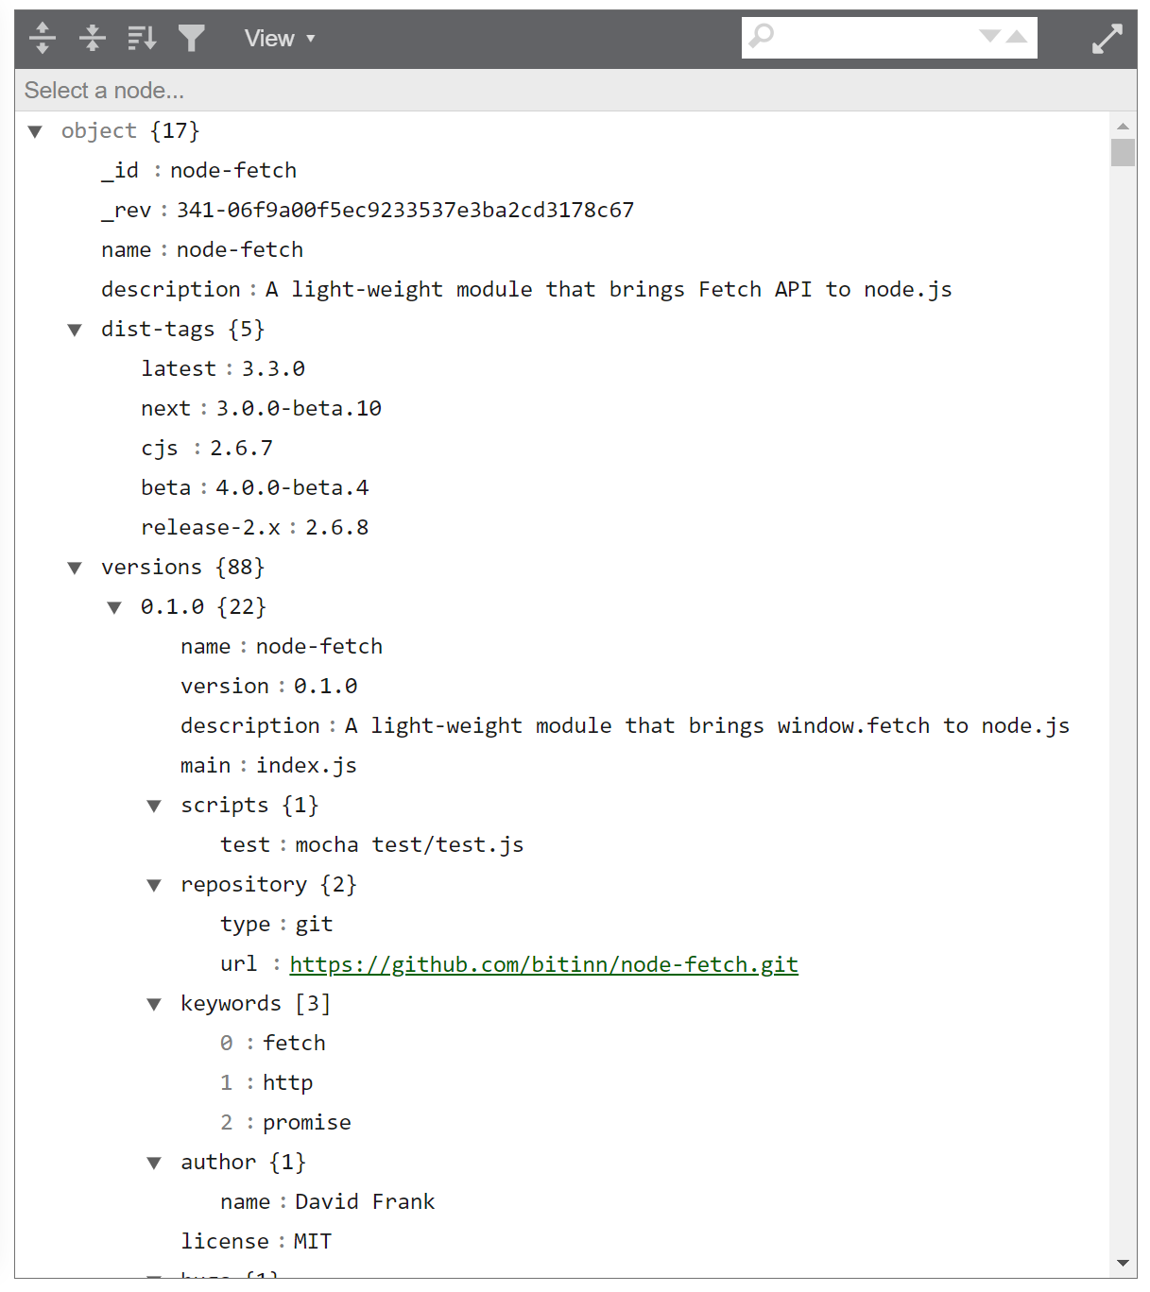
About “node-fetch” package
Global Summit for Node js, 2023
JANUARY 25-26, 2023
12

Slide 13
About “node-fetch-xxxxxx” package
Global Summit for Node js, 2023
JANUARY 25-26, 2023
https://registry.npmjs.org/node-fetch-xxxxxx
404
{"error":"Not found"}
13

Slide 14
Creating and publishing packages
Global Summit for Node js, 2023
JANUARY 25-26, 2023
Creating and publishing packages is a powerful feature of NPM and Yarn.
To create a package, you need to create a package.json file that contains information about the package.
To publish a package, you need to create an account on NPM or Yarn and then use the command npm publish or yarn publish.
Once a package is published, other developers can install it using the package name.
You can also unpublish packages using the command npm unpublish <package-name>.
14

Slide 15
Creating your own package manager
Global Summit for Node js, 2023
JANUARY 25-26, 2023
Creating your own package manager can be a challenging task, but it can also be a rewarding learning experience.
There are many open-source package managers that can be used as a starting point, such as Lerna. https://github.com/lerna/lerna
It's important to understand the various components of a package manager, such as the command-line interface, package installation process, and dependency management.
15

Slide 16
Commands
Global Summit for Node js, 2023
JANUARY 25-26, 2023
$ node cli.js
$ node cli.js help
$ node cli.js install
$ node cli.js install name1 name2 name3
$ node cli.js remove name1 name2 name3
$ node cli.js
$ node cli.js help
$ node cli.js install
$ node cli.js install name1 name2 name3
$ node cli.js remove name1 name2 name3
16

Slide 17
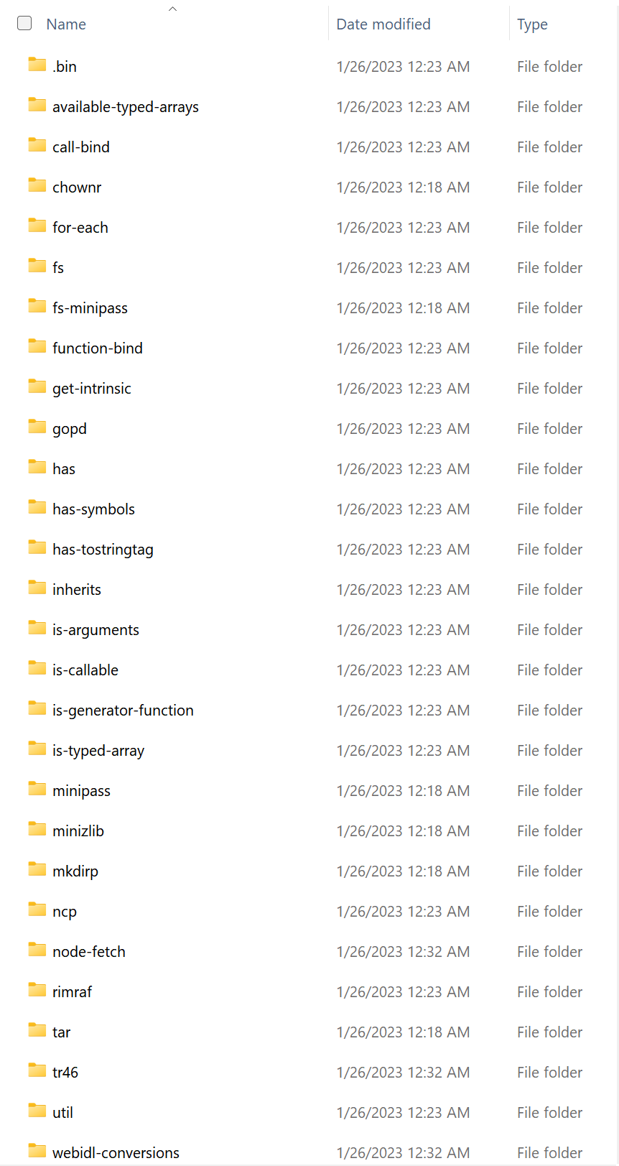
node_modules directory
Global Summit for Node js, 2023
JANUARY 25-26, 2023
17

Slide 18
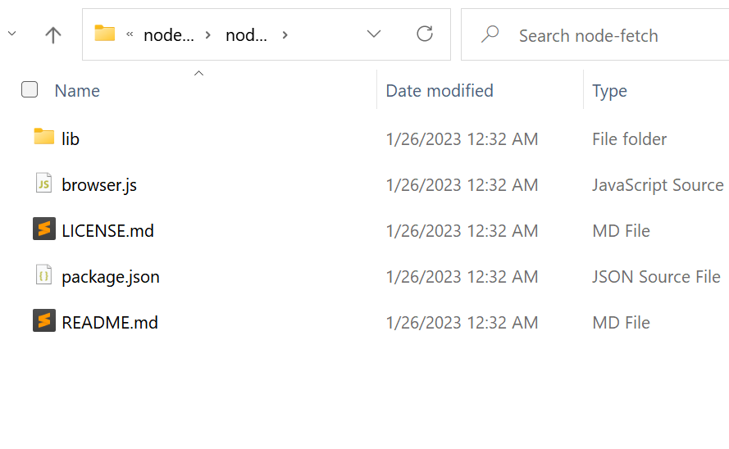
node_modules/node-fetch directory
Global Summit for Node js, 2023
JANUARY 25-26, 2023
18

Slide 19
Downloading package tgz
Global Summit for Node js, 2023
JANUARY 25-26, 2023
https://registry.npmjs.org/$name/-/$name-x.y.z.tgz
e.g: Version 1.1.0
https://registry.npmjs.org/node-fetch/-/node-fetch-1.1.0.tgz
19

Slide 20
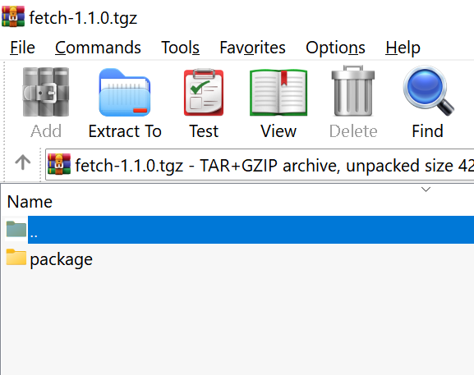
In a package .tgz file
Global Summit for Node js, 2023
JANUARY 25-26, 2023
20

Slide 21
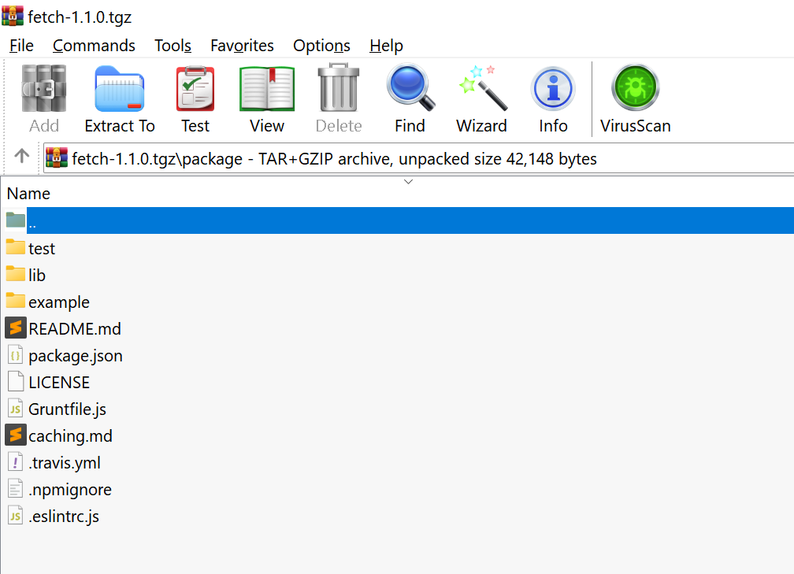
Files of a package tgz (inside the package dir)
Global Summit for Node js, 2023
JANUARY 25-26, 2023
21

Slide 22
Conclusion
Global Summit for Node js, 2023
JANUARY 25-26, 2023
Understanding how NPM and Yarn work and the process of creating your own package manager can be a valuable skill for developers.
Package managers play a vital role in managing dependencies and streamlining the development process.
By understanding how package managers work, you will be able to make better decisions when choosing a package manager for a project and troubleshoot issues more effectively.
Additionally, creating your own package manager can be a great learning experience and can open up new opportunities for contributing to open-source projects.
I hope this presentation has provided you with a deeper understanding of how NPM and Yarn work and the process of creating your own package manager.
22

Slide 23
References
Global Summit for Node js, 2023
JANUARY 25-26, 2023
https://maxbase.org
https://github.com/BaseMax/MyNodePackageManager
23

Slide 24

IN MEMORY TO
Global Summit for Node js, 2023
JANUARY 25-26, 2023
My supervisor, Iranian mathematician Prof. Ali Reza Ashrshi
Vice-President of the International Academy of Mathematical Chemistry
24

Slide 25



Tabatabaei Historical House, Kashan, I.R.
Global Summit for Node js, 2023
JANUARY 25-26, 2023
Thank you for your attention.

Slide 26
For any questions in the future: maxbasecode@gmail.com
Global Summit for Node js, 2023
JANUARY 25-26, 2023

