Slide 1

Kobe Bryant Shot Selection
STAT 348: Kaggle Competition Final Project

Slide 2
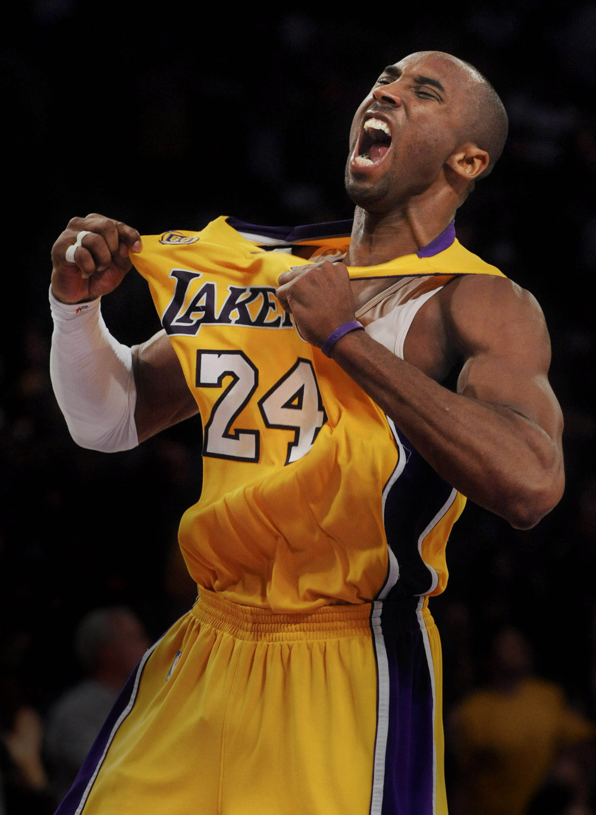
Background
Kobe Bryant is well regarded as one of the greatest basketball players of all time. His “Mamba Mentality” of chasing perfection governed his life on and off the court.
During his 20-year NBA career, Kobe put up over 30,000 shots.
The problem for this Kaggle competition: will Kobe make a shot?
The data for this competition come from the 30,697 shots he took during his career, split into a train and test set.
Model results are measured based on mean log loss.

Slide 3
Feature Engineering
Removed variables that may have confounding effects (such as lat and lon, when loc_x and loc_y already exist).
Converted minutes- and seconds_remaining to a single time_remaining variable.
Created a dummy variables for whether a game was home or away, the period of the game, the opponent, and whether a game was a playoff game.
Added a variable for euclidian shot distance.
Re-encoded the season variable to include numbered seasons instead of years.

Slide 4
Model Comparison
Penalized LOGISTIC Regression
K Nearest Neighbors
Random Forests
Used a cross-validated mixture and penalty (tuning parameters).
Best score: 0.61182
Used a cross-validated number of neighbors (tuning parameter).
Best score: 0.62364
Built 1000 trees and used cross-validated values for min_n and mtry (tuning parameters).
Best score: 0.60054

Slide 5
Best Model – Random Forests
Tuning parameters:
Trees: Number of trees: set by me at 1000.
Mtry: Number of randomly sampled predictors: cross-validated to 8.
Min_n: Minimum number of data points required for a split: cross-validated to 50.
Used a five-fold cross validation setup.
Ran in approximately 1 hour and 18 minutes.

Slide 6
0.60054
Final Kaggle Score

