Slide 1
Political Merder？

Slide 2
Conclusion of Paragraph C
Ben Weider believes that Napoleon is murdered by using arsenic .
Support to his hypothesis: Pascal Kintz detected Napoleon’s hair contains arsenic.

Slide 3
Conclusion of Paragraph D, E
David Jones discovered that the wallpaper also containing arsenic, which would be released due to the humid and warm air.
Other toxicologists also declared that the arsenic not only can be found in the wallpaper, but also can found in seafood, which was major food on the island.
Autopsy didn’t show any symptoms that is strongly related to arsenic poisoning.

Slide 4
Q&A
Q1
What is the main discussed element in these three paragraph
Q2
Are you convinced by these reasons? Why or Why not?

Slide 5
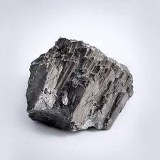
Arsenic Poisoning
Poisoned water, golden elixir… etc;
Short term exposure: headache, dizzy, abdominal pain
Long term exposure: darker skin, cancer, heart disease

