Slide 1
Metrics for Process and Projects [25]

Slide 2
Measurement
Provides a mechanism for objective evaluation
Assists in
  Estimation
  Quality control
  Productivity assessment
  Project Control
  Tactical decision-making
Acts as management tool

Slide 3
Metrics in the Process and Project Domains
Process metrics are collected across all projects and over long periods of time
Project metrics enable a software project manager to
  Assess the status of an ongoing project
  Track potential risks
  Uncover problem areas before they go “critical”
  Adjust work flow or tasks
  Evaluate the project team’s ability to control quality of software work products

Slide 4
Process Metrics and Software Process Improvement (1)
Product
Customer
characteristics
Business
conditions
Process
People
Development
environment
Technology
Fig: 22.1 - Determinants for s/w quality and organizational effectiveness

Slide 5
Process Metrics and Software Process Improvement (2)
We measure the efficacy of a s/w process indirectly, based on outcomes
Probable outcomes are
  Measures of errors uncovered before release of the s/w
  Defects delivered to and reported by end-users
  Work products delivered (productivity)
  Human effort expended
  Calendar time expended
  Schedule conformance etc.

Slide 6
Process Metrics and Software Process Improvement (3)
There are “private and public” uses for different types of process data [GRA92]
Software metrics etiquette [GRA92]
  Use common sense and organizational sensitivity when interpreting metrics data
  Provide regular feedback to the individuals and teams who collect measures and metrics
  Don’t use metrics to appraise individuals

Slide 7
Process Metrics and Software Process Improvement (4)
Software metrics etiquette [GRA92] (contd.)
  Work with practitioners and teams to set clear goals and metrics that will be used to achieve them
  Never use metrics to threaten individuals or teams
  Metrics data that indicate a problem area should not be considered “negative”. These data are merely an indicator for process improvement
  Don’t obsess on a single metric to the exclusion of other important metrics

Slide 8
Process Metrics and Software Process Improvement (5)
Statistical Software Process Improvement (SSPI)
Error
  Some flaw in a s/w engineering work product that is uncovered before the s/w is delivered to the end-user
Defect
  A flaw that is uncovered after delivery to the end-user

Slide 9
Project Metrics
Used during estimation
Used to monitor and control progress
The intent is twofold
  Minimize the development schedule
  Assess product quality on an ongoing basis
Leads to a reduction in overall project cost

Slide 10
Software Measurement
S/W measurement can be categorized in two ways:
  Direct measures of the s/w process (e.g., cost and effort applied) and product (e.g., lines of code (LOC) produced, etc.)
  Indirect measures of the product (e.g., functionality, quality, complexity, etc.)
Requires normalization of both size- and function-oriented metrics

Slide 11
Size-Oriented Metrics (1)
Lines of Code (LOC) can be chosen as the normalization value
Example of simple size-oriented metrics
  Errors per KLOC (thousand lines of code)
  Defects per KLOC
  $ per KLOC
  Pages of documentation per KLOC

Slide 12
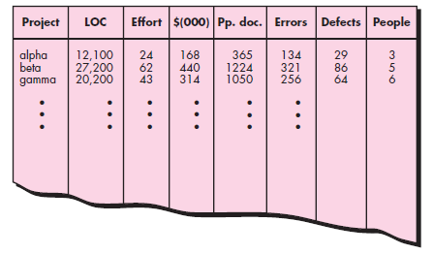
Size-oriented metrics

Slide 13
Size-Oriented Metrics (2)
Controversy regarding use of LOC as a key measure
  According to the proponents
    LOC is an “artifact” of all s/w development projects
    Many existing s/w estimation models use LOC or KLOC as a key input
  According to the opponents
    LOC measures are programming language dependent
    They penalize well-designed but shorter programs
    Cannot easily accommodate nonprocedural languages
    Difficult to predict during estimation

Slide 14
Function-Oriented Metrics (1)
Function-oriented software metrics use a measure of the functionality delivered by the application as a normalization value:
The most widely used function-oriented metric is the function point (FP)
Computation of the FP is based on characteristics of the software’s information domain and complexity

Slide 15
Function-Oriented Metrics (2)
Controversy regarding use of FP as a key measure
  According to the proponents
    It is programming language independent
    Can be predicted before coding is started
  According to the opponents
    Based on subjective rather than objective data
    Has no direct physical meaning – it’s just a number

Slide 16
Function points and LOC-based metrics have been found to be relatively accurate predictors of software development effort and cost. However, in order to use LOC and FP for estimation (Chapter 26), an historical baseline of information must be
established.

Slide 17
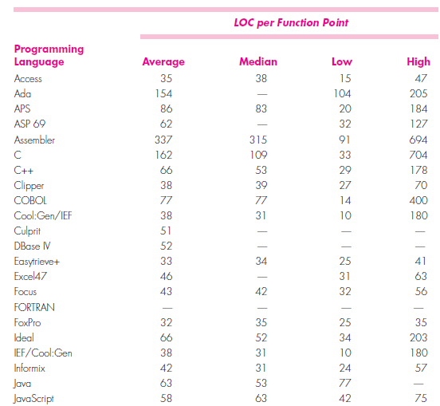
Reconciling LOC and FP Metrics

Slide 18
Object-Oriented Metrics
Number of Scenario scripts: A scenario script (analogous to use cases) is a detailed sequence of steps that describe the interaction between the user and the application.
Number of key classes (highly independent classes)
Number of support classes (not directly related to problem domain)
Average number of support classes per key class
Number of subsystems (aggregation of classes to support a function visible to the end user of a system)

Slide 19
Use-Case Oriented Metrics
Use cases describe (indirectly, at least) user-visible functions and features that are basic requirements for a system.
The use-case is independent of programming language
The no. of use-cases is directly proportional to the size of the application in LOC and to the no. of test cases
There is no standard size for a use-case
Its application as a normalizing measure is suspect

Slide 20
Web Engineering Project Metrics (1)
Number of static Web pages
Number of dynamic Web pages
Number of internal page links
Number of persistent data objects
Number of external systems interfaced
Number of static content objects
Number of dynamic content objects
Number of executable functions

Slide 21
Web Engineering Project Metrics (2)
Let,
  N_{sp} = number of static Web pages
  N_{dp} = number of dynamic Web pages
Then,
  Customization index, C = N_{dp}/(N_{dp} + N_{sp})
The value of C ranges from 0 to 1, As C grows larger, the level of WebApp customization becomes a significant technical issue.

Slide 22
Metrics for Software Quality
Goals of s/w engineering
  Produce high-quality systems
  Meet deadlines
  Satisfy market need
The primary thrust at the project level is to measure errors and defects

Slide 23
Measuring Quality
Correctness
  Defects per KLOC
Maintainability
Mean-time-to-change (MTTC): the time it takes to analyze the change request, design an appropriate modification, implement the change, test it, and distribute the change to all users.
Integrity
  Threat and security
  integrity = Σ [1 – (threat × (1 - security))]
Usability
Threat is the probability (which can be estimated or derived from empirical evidence) that an attack of a specific type will occur within a given time.
Security is the probability (which can be estimated or derived from empirical evidence) that the attack of a specific type will be repelled.

Slide 24
Defect Removal Efficiency (DRE)
Can be used at both the project and process level
DRE = E / (E + D), [E = Error, D = Defect]
Or, DRE_{i} = E_{i} / (E_{i} + E_{i+1}), [for i^{th} activity]
where Ei is the number of errors found during software engineering action i and Ei+ 1 is the number of errors found during software engineering action i + 1 that are traceable to errors that were not discovered in software engineering action i.
Try to achieve DRE_{i} that approaches 1

Slide 25
Integrating Metrics within the Software Process
Software
engineering
process
Software
project
Data
collection
Measures
e.g. LOC, FP, NOP, Defects, Errors
Software
product
Metrics
e.g. No. of FP, Size, Error/KLOC, DRE
Metrics
computation
Metrics
evaluation
Indicators
e.g. Process efficiency, Product complexity, relative overhead
Fig: 22.3 - Software metrics collection process

Slide 26
Managing variation: statistical process control
As the SW process and the product it produces both are influenced by many parameters, the metrics collected for one project or product will not be the same as similar metrics collected for another project.
A graphical technique is available for determining whether changes and variation in metrics data are meaningful.
1. The moving range control chart
2. The individual control chart

Slide 27
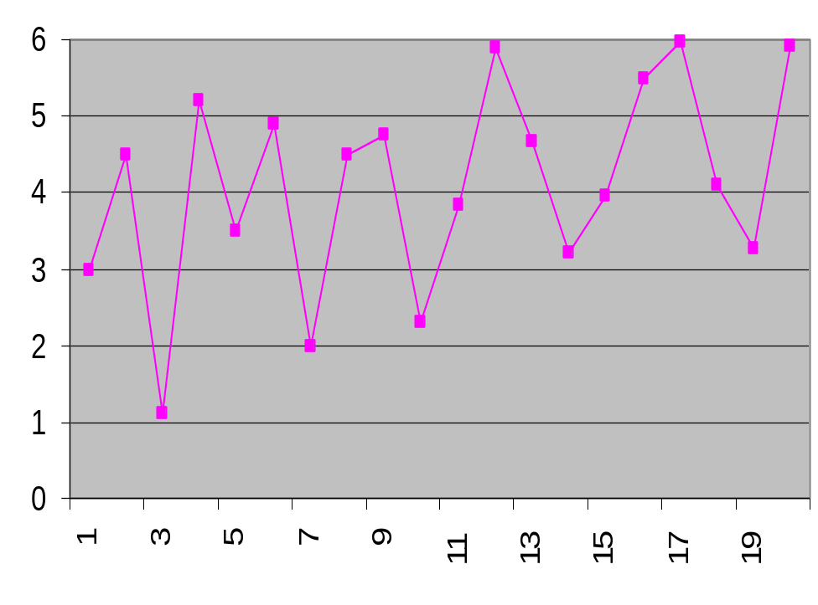
Error found /review hour
Projects

Slide 28
Moving average control chart
Calculate the moving ranges: the absolute value of the successive differences between each pair of data points…plot this moving ranges on your chart.
Calculate the mean of the moving ranges … plot this (“mR bar”) as the center line on your chart.
Multiply the mean by 3.268. Plot this line as the upper control limit (UCL). This line is three standard deviations above the mean.

Slide 29
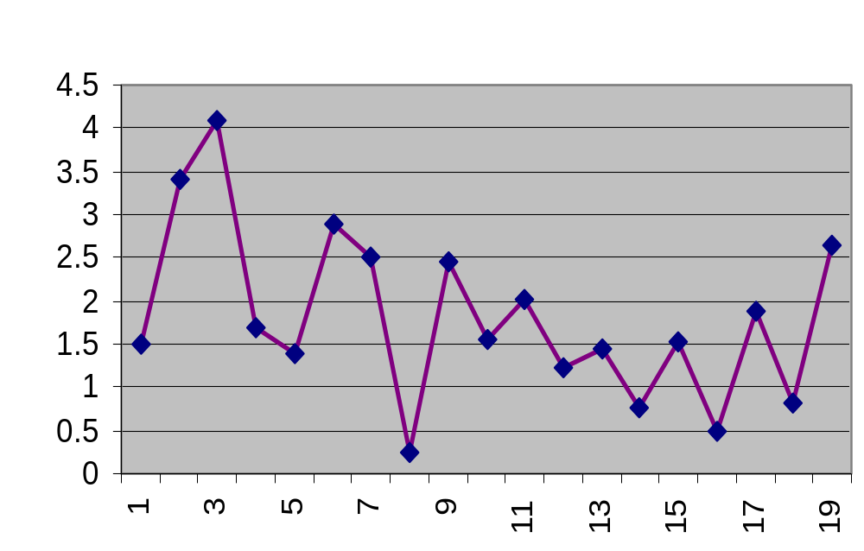
Differences in Successive Er value
UCL=5.58
mR bar
=1.71
Projects

Slide 30
Individual control chart
Plot individual metrics value
Compute the average value, Am, for the metrics values
Multiply the mean of mR values (the mR bar)by 2.660 and add Am computed in step 2. This results in the upper natural process limit (UNPL). Plot the UNPL.
Multiply the mean of the mR values by 2.660 and subtract this amount from Am computed in step 2. This results in the lower natural process limit (LNPL). If the LNPL is less than 0.0, it need not be plotted unless the mrtric being evaluated takes on values that are less than 0.0.
Compute a standard deviation as (UNPL-Am)/3. Plot lines one and two standard deviations above and below Am. If any of the standard deviation lines is less than 0.0, it need not be plotted unless the metric being evaluated takes on values that are les than 0.0.

Slide 31
+1sigma
Error found /review hour
Am
-1sigma
Projects

Slide 32
Zone rules: If any of the following conditions is true,the metrics data indicate a process that is out of control
A single metrics value lies outside the UNPL.
Two out of three successive metrics values lie more than two standard deviations away from Am
Four out of five successive metrics values lie more than one standard deviation away from Am
Eight consecutive metrics values lie on one side of Am.
Since all conditions fail for the values shown, the metrics data are derived from a stable process:
Variability of Er decreases after project 10
Mean of Er for projects 11-20 is 29% grater than that of 1-10.

Slide 33
Metrics for small organization
Time elapsed from the time a request is made until evaluation is complete, t_{queue}
Effort to perform the evaluation, W_{eval}
Time elapsed from completion of evaluation to assignment of change order to personnel, t_{eval}
Effort required to make the change, W _{change}
Time required to make the change, t_{change}
Errors uncovered during work to make change, E _{change}
Defects uncovered after change is released to the customer base, D_{change}

Slide 34
DRE=Echange/(Echange+Dchange)

Slide 35
Summary
Metrics are a tool which can be used to improve the productivity and quality of the software system
Process metrics takes a strategic view to the effectiveness of a software process
Project metrics are tactical that focus on project work flow and technical approach
Size-oriented metrics use the line of code as a normalizing factor
Function-oriented metrics use function points
Four quality metrics------correctness, integrity, maintainability, and usability were discussed

