Slide 1
Metrics for Process and Projects 2 [25]

Slide 2
Software Process and Project Metrics
Outline:
  In the Software Metrics Domain:
    product metrics
    project metrics
    process metrics
  Software Measurement
    size-oriented metrics
    function-oriented metrics
  Metrics for Software Quality

Slide 3
Software Quality
Software quality is
  conformance to explicitly stated functional and performance requirements,
  explicitly documented development standard, and
  implicit characteristics that are expected of all professionally developed software.
Software quality is complex mix of factors that will vary across different applications and the customers who request them.

Slide 4
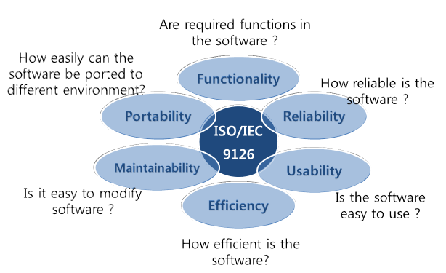
ISO 9126 Software Quality Characteristics

Slide 5
McCall’s Triangle of Quality
M
a
i
n
t
a
i
n
a
b
i
l
i
t
y
M
a
i
n
t
a
i
n
a
b
i
l
i
t
y
P
o
r
t
a
b
i
l
i
t
y
P
o
r
t
a
b
i
l
i
t
y
F
l
e
x
i
b
i
l
i
t
y
F
l
e
x
i
b
i
l
i
t
y
R
e
u
s
a
b
i
l
i
t
y
R
e
u
s
a
b
i
l
i
t
y
T
e
s
t
a
b
i
l
i
t
y
T
e
s
t
a
b
i
l
i
t
y
I
n
t
e
r
o
p
e
r
a
b
i
l
i
t
y
I
n
t
e
r
o
p
e
r
a
b
i
l
i
t
y
P
R
O
D
U
C
T
R
E
V
I
S
I
O
N
P
R
O
D
U
C
T
R
E
V
I
S
I
O
N
P
R
O
D
U
C
T
T
R
A
N
S
I
T
I
O
N
P
R
O
D
U
C
T
T
R
A
N
S
I
T
I
O
N
P
R
O
D
U
C
T
O
P
E
R
A
T
I
O
N
P
R
O
D
U
C
T
O
P
E
R
A
T
I
O
N
C
o
r
r
e
c
t
n
e
s
s
C
o
r
r
e
c
t
n
e
s
s
U
s
a
b
i
l
i
t
y
U
s
a
b
i
l
i
t
y
E
f
f
i
c
i
e
n
c
y
E
f
f
i
c
i
e
n
c
y
I
n
t
e
g
r
i
t
y
R
e
l
i
a
b
i
l
i
t
y
I
n
t
e
g
r
i
t
y
R
e
l
i
a
b
i
l
i
t
y

Slide 6
A Comment
McCall’s quality factors were proposed in the early 1970s. They are as valid today as they were in that time. It’s likely that software built to conform to these factors will exhibit high quality well into the 21st century, even if there are dramatic changes in technology.

Slide 7
Measure, Metrics, and Indicator
Measure -- Provides a quantitative indication of the extent, amount, dimensions, capacity, or size of some product or process attribute.
Metrics -- A quantitative measure of the degree to which a system, component, or process possesses a given attribute.
Software Metrics -- refers to a broad range of measurements for computer software.
Indicator -- a metric or combination of metrics that provide insight into the software process, a software project, or the product itself.
Notes:
People sometimes talk about a goal of metrics to improve the quality of a software product. Bull. Metrics provide information with which one may be able to improve the process.
Example metrics: SLOC, # errors found per day in test, # errors occurring when product is in the field. SLOC produced per year by a programmer,
Often, metrics will be combined with other information to help improve the process. For example, finding that teams that used formal design reviews had fewer errors occurring in test, might lead one to require formal design reviews.
Recall example of how many new GPCs to use. Looked at metric of number of errors found per OI with level of testing done.

Slide 8
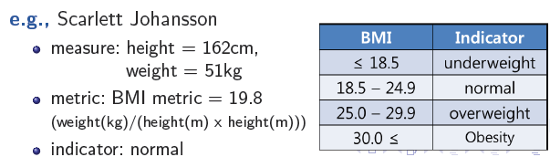
Measure, Metrics, and Indicator
Notes:
People sometimes talk about a goal of metrics to improve the quality of a software product. Bull. Metrics provide information with which one may be able to improve the process.
Example metrics: SLOC, # errors found per day in test, # errors occurring when product is in the field. SLOC produced per year by a programmer,
Often, metrics will be combined with other information to help improve the process. For example, finding that teams that used formal design reviews had fewer errors occurring in test, might lead one to require formal design reviews.
Recall example of how many new GPCs to use. Looked at metric of number of errors found per OI with level of testing done.

Slide 9
Measurement Principles
The objectives of measurement should be established before data collection begins;
Each technical metric should be defined in an unambiguous manner;
Metrics should be derived based on a theory that is valid for the domain of application (e.g., metrics for design should draw upon basic design concepts and principles and attempt to provide an indication of the presence of an attribute that is deemed desirable);
Metrics should be tailored to best accommodate specific products and processes [Bas84]

Slide 10
Measurement Process
Formulation. The derivation of software measures and metrics appropriate for the representation of the software that is being considered.
Collection. The mechanism used to accumulate data required to derive the formulated metrics.
Analysis. The computation of metrics and the application of mathematical tools.
Interpretation. The evaluation of metrics results in an effort to gain insight into the quality of the representation.
Feedback. Recommendations derived from the interpretation of product metrics transmitted to the software team.

Slide 11
Goal-Oriented Software Measurement
The Goal/Question/Metric Paradigm
  (1) establish an explicit measurement goal that is specific to the process activity or product characteristic that is to be assessed
  (2) define a set of questions that must be answered in order to achieve the goal, and
  (3) identify well-formulated metrics that help to answer these questions.
Goal definition template
  Analyze {the name of activity or attribute to be measured}
  for the purpose of {the overall objective of the analysis}
  with respect to {the aspect of the activity or attribute that is considered}
  from the viewpoint of {the people who have an interest in the measurement}
  in the context of {the environment in which the measurement takes place}.

Slide 12
Effective Metrics Attributes
Simple and computable. It should be relatively easy to learn how to derive the metric, and its computation should not demand inordinate effort or time
Empirically and intuitively persuasive. The metric should satisfy the engineer’s intuitive notions about the product attribute under consideration
Consistent and objective. The metric should always yield results that are unambiguous.
Consistent in its use of units and dimensions. The mathematical computation of the metric should use measures that do not lead to bizarre combinations of unit.
Programming language independent. Metrics should be based on the analysis model, the design model, or the structure of the program itself.
Effective mechanism for quality feedback. That is, the metric should provide a software engineer with information that can lead to a higher quality end product

Slide 13
Collection and Analysis Principles
Whenever possible, data collection and analysis should be automated;
Valid statistical techniques should be applied to establish relationship between internal product attributes and external quality characteristics
Interpretative guidelines and recommendations should be established for each metric

Slide 14
In the Process and Project Domains
Process Indicator
  enable insight into the efficacy of an existing process
  to assess the current work status
  Goal -- to lead to long-term software process improvement
Project Indicator
  assess the status of an ongoing project
  track potential risks
  uncover problem areas before they “go critical”
  evaluate the project team’s ability to control the product quality

Slide 15
Process Metrics and Software Process Improvement
Software quality and organizational effectiveness
Project
Customer characteristics
Business conditions
Process
People
Technology
Development environment

Slide 16
Measurement
What to measure?
  errors uncovered before release
  defects delivered to and reported by end users
  work products delivered
  human effort expended
  calendar time expended
  schedule conformance
At what level of aggregation?
  By team?
  Individual?
  Project?

Slide 17
Privacy Issues
Should they be used for personnel evaluation?
Some issues?
  Privacy?
  Is total assignment being measured?
  Are the items being measured the same as for other individuals being measured?
  Are the conditions of measurement the same across individuals?
However, they can be useful for individual improvement.

Slide 18
Use of Software Metrics
Use common sense and organizational sensitivity.
Provide regular feedback to individuals and teams.
Don’t use metrics to appraise individuals.
Set clear goal and metrics.
Never use metrics to threaten individuals or teams
Problems != negative. These data are merely an indicator for process improvement.
Don’t obsess on a single metric to the exclusion of other important metrics.
Do not rely on metrics to solve your problems.
Beware of people performing to metrics rather than product quality or safety.

Slide 19
Purpose of Product Metrics
Aid in the evaluation of analysis and design models
Provide an indication of the complexity of procedural designs and source code
Facilitate the design of more effective testing techniques
Assess the stability of a fielded software product

Slide 20
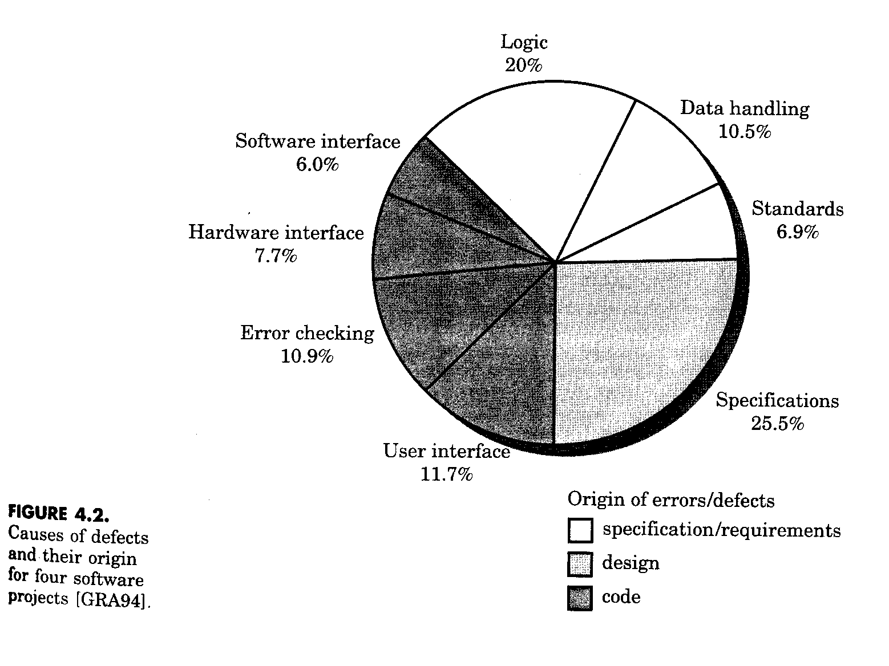
Typical Causes of Product Defects

Slide 21
Example of Defect Analysis
missing
ambiguous
specification defects
wrong customer queried
customer gave wrong infor.
inadequate inquiries
used outdated information
incorrect
changes

Slide 22
A Product Metrics Taxonomy

Slide 23
Project Metric Landscape: Analysis Metrics
Function-based metrics: use the function point as a normalizing factor or as a measure of the “size” of the specification
Specification metrics: used as an indication of quality by measuring number of requirements by type

Slide 24
Metrics for the Design Model
Architectural metrics
  Provide an indication of the quality of the architectural design
Component-level metrics
  Measure the complexity of software components and other characteristics that have a bearing on quality
Interface design metrics
  Focus primarily on usability
Specialized object-oriented design metrics
  Measure characteristics of classes and their communication and collaboration characteristics

Slide 25
Metrics for Source Code
Complexity metrics
  Measure the logical complexity of source code (can also be applied to component-level design)
Length metrics
  Provide an indication of the size of the software
“These metrics can be used to assess source code complexity,
maintainability, and testability, among other characteristics”

Slide 26
Metrics for Testing
Statement and branch coverage metrics
  Lead to the design of test cases that provide program coverage
Defect-related metrics
  Focus on defects (i.e., bugs) found, rather than on the tests themselves
Testing effectiveness metrics
  Provide a real-time indication of the effectiveness of tests that have been conducted
In-process metrics
  Process related metrics that can be determined as testing is conducted

Slide 27
Metrics for the
Analysis Model
Function Points

Slide 28
Introduction to Function Points
First proposed by Albrecht in 1979; hundreds of books and papers have been written on functions points since then
Can be used effectively as a means for measuring the functionality delivered by a system
Using historical data, function points can be used to
  Estimate the cost or effort required to design, code, and test the software
  Predict the number of errors that will be encountered during testing
  Forecast the number of components and/or the number of projected source code lines in the implemented system
Derived using an empirical relationship based on
  Countable (direct) measures of the software’s information domain
  Assessments of the software’s complexity

Slide 29
Information Domain Values
Number of external inputs
  Each external input originates from a user or is transmitted from another application
  They provide distinct application-oriented data or control information
  They are often used to update internal logical files
  They are not inquiries (those are counted under another category)
Number of external outputs
  Each external output is derived within the application and provides information to the user
  This refers to reports, screens, error messages, etc.
  Individual data items within a report or screen are not counted separately
(More on next slide)

Slide 30
Information Domain Values (continued)
Number of external inquiries
  An external inquiry is defined as an online input that results in the generation of some immediate software response
  The response is in the form of an on-line output
Number of internal logical files
  Each internal logical file is a logical grouping of data that resides within the application’s boundary and is maintained via external inputs
Number of external interface files
  Each external interface file is a logical grouping of data that resides external to the application but provides data that may be of use to the application

Slide 31
Function Point Computation
Identify/collect the information domain values
Complete the table shown below to get the count total
  Associate a weighting factor (i.e., complexity value) with each count based on criteria established by the software development organization
Evaluate and sum up the adjustment factors (see the next two slides)
  “F_{i}” refers to 14 value adjustment factors, with each ranging in value from 0 (not important) to 5 (absolutely essential)
Compute the number of function points (FP)
FP = count total * [0.65 + 0.01 * sum(F_{i})]
Information Weighting Factor
Domain Value Count Simple Average Complex
External Inputs _____ x 3 4 6 = _____
External Outputs _____ x 4 5 7 = _____
External Inquiries _____ x 3 4 6 = _____
Internal Logical Files _____ x 7 10 15 = _____
External Interface Files _____ x 5 7 10 = _____
Count total ________

Slide 32
Value Adjustment Factors
Does the system require reliable backup and recovery?
Are specialized data communications required to transfer information to or from the application?
Are there distributed processing functions?
Is performance critical?
Will the system run in an existing, heavily utilized operational environment?
Does the system require on-line data entry?
Does the on-line data entry require the input transaction to be built over multiple screens or operations?
(More on next slide)

Slide 33
Value Adjustment Factors (continued)
Are the internal logical files updated on-line?
Are the inputs, outputs, files, or inquiries complex?
Is the internal processing complex?
Is the code designed to be reusable?
Are conversion and installation included in the design?
Is the system designed for multiple installations in different organizations?
Is the application designed to facilitate change and for ease of use by the user?

Slide 34
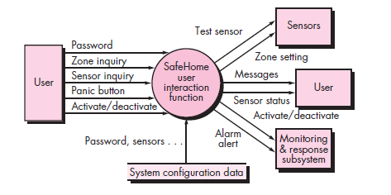
A data flow model for SafeHome software

Slide 35
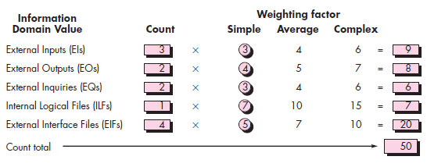

Slide 36
Function Point Example
Information Weighting Factor
Domain Value Count Simple Average Complex
External Inputs 3 x 3 4 6 = 9
External Outputs 2 x 4 5 7 = 8
External Inquiries 2 x 3 4 6 = 6
Internal Logical Files 1 x 7 10 15 = 7
External Interface Files 4 x 5 7 10 = 20
Count total 50
FP = count total * [0.65 + 0.01 * sum(F_{i})]
FP = 50 * [0.65 + (0.01 * 46)]
FP = 55.5 (rounded up to 56)

Slide 37
Interpretation of the FP Number
Assume that past project data for a software development group indicates that
  One FP translates into 60 lines of object-oriented source code
  12 FPs are produced for each person-month of effort
  An average of three errors per function point are found during analysis and design reviews
  An average of four errors per function point are found during unit and integration testing
This data can help project managers revise their earlier estimates
This data can also help software engineers estimate the overall implementation size of their code and assess the completeness of their review and testing activities

Slide 38
Metrics for the
Design Model

Slide 39
Architectural Design Metrics
These metrics place emphasis on the architectural structure and effectiveness of modules or components within the architecture
They are “black box” in that they do not require any knowledge of the inner workings of a particular software component

Slide 40
Hierarchical Architecture Metrics
Fan out: the number of modules immediately subordinate to the module i, that is, the number of modules directly invoked by module I
Structural complexity
  S(i) = f²_{out}(i), where f_{out}(i) is the “fan out” of module I
Data complexity
  D(i) = v(i)/[f_{out}(i) + 1], where v(i) is the number of input and output variables that are passed to and from module i
System complexity
  C(i) = S(i) + D(i)
As each of these complexity values increases, the overall architectural complexity of the system also increases
This leads to greater likelihood that the integration and testing effort will also increase

Slide 41
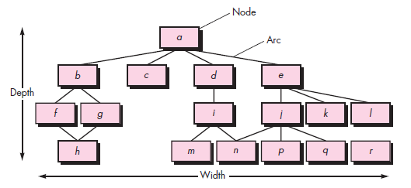
Morphology metrics

Slide 42
Hierarchical Architecture Metrics (continued)
Shape complexity
  size = n + a, where n is the number of nodes and a is the number of arcs
  Allows different program software architectures to be compared in a straightforward manner
Connectivity density (i.e., the arc-to-node ratio)
  r = a/n
  May provide a simple indication of the coupling in the software architecture

Slide 43
Metrics for Object-Oriented Design
Size
  Population: a static count of all classes and methods
  Volume: a dynamic count of all instantiated objects at a given time
  Length: the depth of an inheritance tree
  Functionality
Coupling
  The number of collaborations between classes or the number of methods called between objects
Cohesion
  The cohesion of a class is the degree to which its set of properties is part of the problem or design domain
Primitiveness
  The degree to which a method in a class is atomic (i.e., the method cannot be constructed out of a sequence of other methods provided by the class)

Slide 44
Specific Class-oriented Metrics
Weighted methods per class
  The normalized complexity of the methods in a class
  Indicates the amount of effort to implement and test a class
Depth of the inheritance tree
  The maximum length from the derived class (the node) to the base class (the root)
  Indicates the potential difficulties when attempting to predict the behavior of a class because of the number of inherited methods
Number of children (i.e., subclasses)
  As the number of children of a class grows
    Reuse increases
    The abstraction represented by the parent class can be diluted by inappropriate children
    The amount of testing required will increase
(More on next slide)

Slide 45
Specific Class-oriented Metrics (continued)
Coupling between object classes
  Measures the number of collaborations a class has with any other classes
  Higher coupling decreases the reusability of a class
  Higher coupling complicates modifications and testing
  Coupling should be kept as low as possible
Response for a class
  This is the set of methods that can potentially be executed in a class in response to a public method call from outside the class
  As the response value increases, the effort required for testing also increases as does the overall design complexity of the class

Slide 46
Specific Class-oriented Metrics (continued)
Lack of cohesion in methods
  This measures the number of methods that access one or more of the same instance variables (i.e., attributes) of a class
  If no methods access the same attribute, then the measure is zero
  As the measure increases, methods become more coupled to one another via attributes, thereby increasing the complexity of the class design

Slide 47
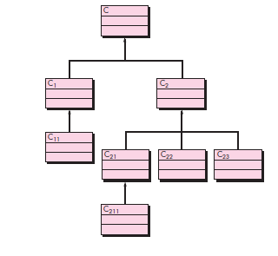
Weighted methods per class (WMC). Assume that n methods of complexity c1, c2, . . . , cn are defined for a class C. The specific complexity metric that is chosen
(e.g., cyclomatic complexity) should be normalized so that ominal complexity for a method takes on a value of 1.0.
WMC =SUM c_{i} , for i 1 to n.
A class hierarchy

Slide 48
Metrics for Maintenance

Slide 49
Metrics for Source Code

Slide 50

Metrics for Source Code
n1 =number of distinct operators that appear in a program
n2 = number of distinct operands that appear in a program
N1 = total number of operator occurrences
N2 =total number of operand occurrences
Halstead shows that length N can be estimated
and program volume may be defined

Slide 51
Metrics for Maintenance
Software maturity index (SMI)
  Provides an indication of the stability of a software product based on changes that occur for each release
SMI = [M_{T} - (F_{a} + F_{c} + F_{d})]/M_{T}
where
M_{T} = #modules in the current release
F_{a} = #modules in the current release that have been added
F_{c} = #modules in the current release that have been changed
F_{d} = #modules from the preceding release that were deleted in the current release
As the SMI (i.e., the fraction) approaches 1.0, the software product begins to stabilize
The average time to produce a release of a software product can be correlated with the SMI

