Slide 1
Estimation for Software Projects[26]

Slide 2
Software Project Planning
Steps to Software Planning
  Define Software Scope
  Determine Resources
  Create Project Estimates
  Make or buy decision

Slide 3
Observations on estimation
Estimation of resources , cost and schedule for a software development effort requires experience, access to good historical information, and the courage to quantitative measures when qualitative are all that exist. Risk and uncertainty.
Project complexity
Project size (interdependency )
Structural uncertainty (structuring)

Slide 4
Project planning objective
The objective of software project planning is to provide a framework that enables the manager reasonable estimates of RCS.
The estimates are made within a limited time frame at the beginning of the SW project and should be updated regularly as the project progresses.
The planning objective is achieved through a process of information discovery that leads to reasonable estimates

Slide 5
SW Scope: First activity of SW PP
What scope means:
  Functions
    Literally refers to all functions performed by a system
  Performance
    Refers to processing and response time requirements
  Constraints
    Limits placed on the software by external hardware, available memory or existing systems
  Interfaces
  Reliability

Slide 6
Obtaining Scope Information: Communication
Some typical questions (Context free question)
  Overall Goals and the benefits
    Who’s request; What benefit; Who else has solution
  Better understanding the problem
    What output; What Problem; What Issues; What Constraints
  Effectiveness of Meeting (meta question)
    Are answers official; Are my questions relevant; Other sources of Info.
“Break the Ice”, “Us and Them” mind set, “territory”, FAST

Slide 7
Feasibility
“Can we build SW to meet this scope? Is the project feasible?
[Putnam and Myers 97]
Technology: Technically feasible?
Finance: Financially feasible?
Time:
Resources:

Slide 8
Scope statement
Communication with the customer leads to a definition of the data,functions and behavior that must be implemented, the performance and constraints that bound the system and related information.

Slide 9
Scoping Example (CLSS)
Conveyor Line Motion
Bin 1
ID No.
ID No.
ID No.
ID No.
Bin 2
Bin 3
Shunt
Sorting
Station
Bin 4
Bar Code
Control connection
Bin 5

Slide 10
Project Decomposition
For our example:
  Read bar code input
  Read pulse tachometer
  Decode part code data
  Do database lookup
  Determine bin location
  Produce control signal for shunt
  Maintain record of box destinations

Slide 11
Discussion
Performance is dictated by conveyer line speed
Cost and effort would vary if for same functionality the performance has to be improved
Interfaces :HW and machines , already existing SW, Users, procedures that precedes or succeeds the software as a series of sequential operations.
Reliablity is the least precise aspect of scope e.g. MTBF
If system spec. has been properly developed nearly all information required to describe SW scope is available and documented.

Slide 12
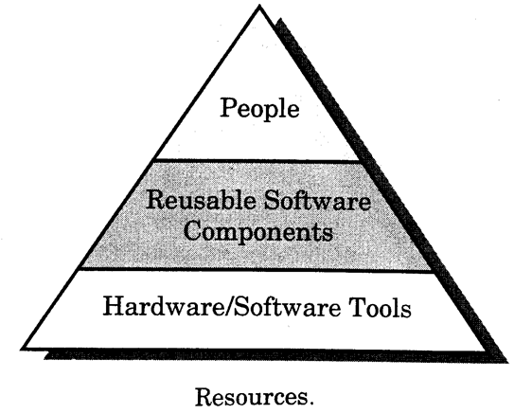
Resource Estimation: Second task in SW PP

Slide 13
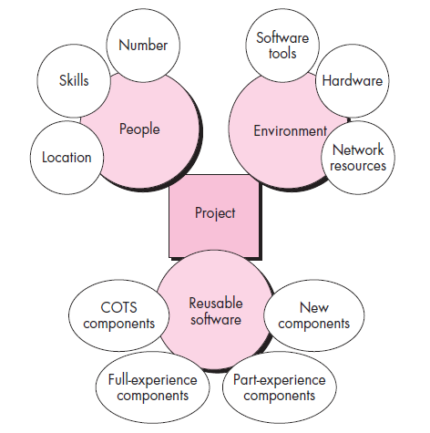

Slide 14
Resources cont.
For each type of resources, 4 characteristics are examined:
  Description of resource
  Availability
  Time resource needed
  Duration of time for which the resource is needed
t
Time window

Slide 15
Human Resources
Scope and skills required
Organizational position and specialty must both be considered
As estimate of development effort is essential to determine the number of people required for the project.

Slide 16
Reusable Software Resources
Bennatan [BEN92]
Off-the-shelf components- from third party or developed earlier.
  Fully validated
Full experience components: Specifications, designs, code or test data developed in past project which is similar to present one
  Modification is of low risk
Partial experience components : substantial modification reqd.
  Modification is of fair degree of risk
New components :

Slide 17
Guidelines for using reusable components
If off-the self components meet project requirements, acquire them
If full-experience components are available, their use for the current project with modification and integration is are generally accepted.
If partial-experience components are available their use for the current project must be analyzed in detail.

Slide 18
Environmental Resources (SWEE):HW and SW
Software Engineering Environment
  Compilers
  Editors
  Design tools
  Configuration management tools
  Management tracking tools
  Problem Reporting And Corrective Action (PRACA) tools
  Documentation tools
  Hardware resources
  Network support

Slide 19
Software Project Estimation
To achieve reliable cost and effort estimates a number of options arise
Delay estimation until late in the project
Base estimates on similar projects that have already been completed
Use relatively simple decomposition techniques to generate project cost and effort estimates
Use one or more empirical models for SW cost and effort estimation

Slide 20
Software Project Estimation (cont.)
Decomposition techniques 2. Empirical estimation models, 3. Automated estimation tools
  Use one or more empirical models, I.e.,
  d = f(v_{i})
Where d is one of a number of estimated values (e,g. effort, cost, project duration) and v_{i} are selected independent parameters.(e.g. LOC or FP)
  For example,
  # of people = LOC ÷(Duration*(LOC/PM))
Notes:
Significant errors are likely to mean that you either lose the job, or lose money on it.

Slide 21
Decomposition Techniques
Problem/process decomposition: Scope and estimate of its “size”
The accuracy of SW project estimate is predicted on a number of things:
The degree to which the planner has properly estimated the size of the product to be built
The ability to translate the size estimate into human effort, calendar time and dollars
The degree to which the project plan reflects the abilities of the SW team
The stability of product requirements and the environment that supports the SW Engineering effort.

Slide 22
Decomposition techniques: SW sizing
(Putnam and Myers)
“Fuzzy logic” sizing:Identify the type of application, establish its magnitude on a qualitative scale and then refine the magnitude within the original range.
FP sizing: Planner estimates info domain
Standard component sizing: Count the frequency of each standard components (e.g. subsystems, modules,screens, reports, interactive programs files, LOC). 18 reports size is 18times 967 lines Cobol code.
Change sizing:Reqd. when use of existing SW with modifications.

Slide 23
Problem-based estimation
LOC and FP is used to generate productivity metrics
They can also be used in SW project estimation
1. As an estimation variable that is used to size each element of the software
2. As baseline metrics collected from past projects and used in conjunction with estimation variables to develop cost and effort projections

Slide 24
Flow chart
SW Scope
Decomposition of individual functions
LOC or FP count for
each function
Apply LOC/pm or
FP/pm
Base line productivity metrics
Grand Total

Slide 25
Problem-based estimation
Precise estimation is difficult. So, make three estimates: optimistic, most likely, and pessimistic. Then combine as:
EV=(S_{opt} + 4S_{m} + S_{pess})/6
An example of expected value
  user interface and control facilities
  2-D geometric analysis
  3-D geometirc analysis
  database management
  computer graphics display
  peripheral control
  design analysis models
3-D opt = 4600
3-D m. likely = 6900
3-D pess. = 8600
=> (4600+4*6900+8600)/6
= 6800

Slide 26
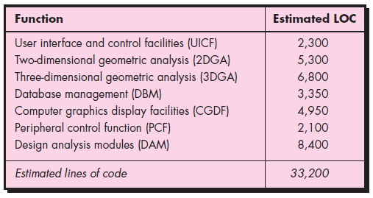
Estimation Table
Estimation
table for the
LOC methods
Suppose 620 LOC/PM, and $8,000/PM, based upon historical data. Then,
Est. Cost = 33,200*$8,000/620 = $431,000 and 54 pm

Slide 27
Function Point Based Estimation
Function Point Complexity Weighting Factors
  backup and recovery 4
  Data communications 2
  Distributed processing 0
  Performance critical 4
  Existing operating environment 3
  On-line data entry 4
  …
  Application designed for change 5
  Total 52

Slide 28
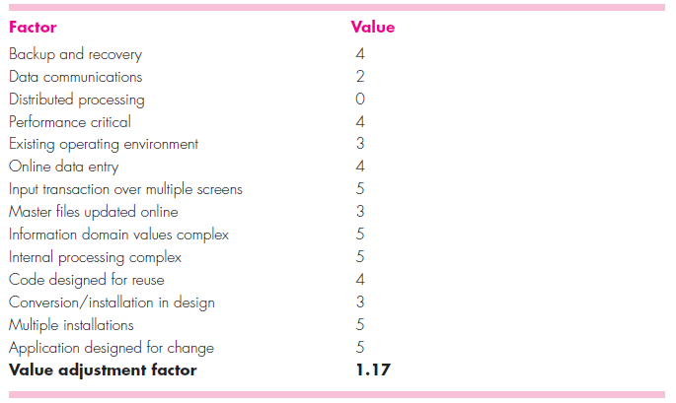
Each of the complexity weighting factors is estimated, and the value adjustment factor is computed.

Slide 29
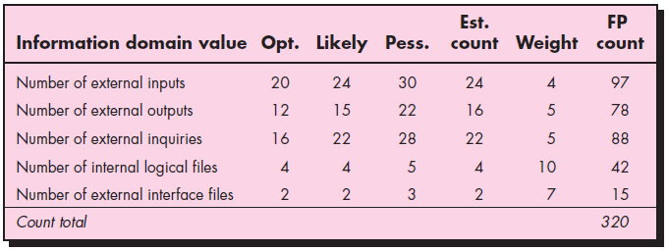

Function Point Based Estimation
Avg.
Estimating
information
domain values
Complexity factor =
= 0.65+0.01×52 = 1.17
FP estimate = count-total×
= 320 × 1.17 = 375
Then, if 6.5 FP/PM, cost = 372 × $8,000 ÷ 6.5 = $457,000

Slide 30
The organizational average productivity for systems of this type is 6.5 FP/pm
Based on a burdened labor rate of $8000 per month
the cost per FP is approximately $1230
Based on the FP estimate and the historical productivity data, the total estimated project cost is $461,000
and the estimated effort is 58 person-months.
Then, if 6.5 FP/PM, cost = 375 × $8,000 ÷ 6.5 = $461,000

Slide 31
Process Based Estimation
Decompose the process into a set of activities or tasks
Estimate effort or cost to perform each task
Estimate cost cost of each function
May be done using LOC and FP estimation or separately
If estimated separately, then there are two or three distinct cost estimates.
  Reconcile differences
  If radically different, perhaps problem is not well understood, or productivity data is obsolete, or the models have not been used correctly.

Slide 32
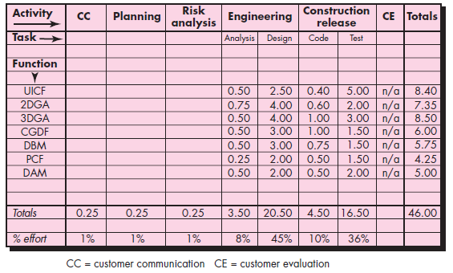
Process Based Estimation -- Example
CAD software
Process-based
estimation
table
Based on an average burdened labor rate of $8,000 per
month, the total estimated project cost is $368,000 and the
estimated effort is 46 person-months.!

Slide 33
Estimation with Use Cases
Use cases provide a software team with insight into software scope and requirements.
However, developing an estimation approach with use cases is problematic for the following reasons
Use cases are described using many different formats and styles—there is non standard form.
Use cases represent an external view (the user’s view) of the software and can therefore be written at many different levels of abstraction.
Use cases do not address the complexity of the functions and features that are described.
Use cases can describe complex behavior (e.g., interactions) that involve many functions and features.

Slide 34
Estimation with Use Cases
No proven estimation method has emerged to date
Smith argues that any level of this structural hierarchy can be described by no more than 10 use cases.
Each of these use cases would encompass no more than 30
distinct scenarios.
Empirical data to estimate LOC or FP per use cases
Historical data to estimate PM

Slide 35
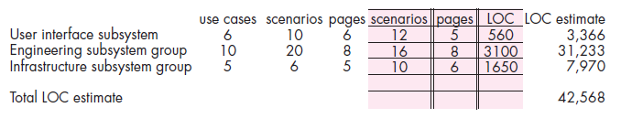
Use-case
estimation
Using 620 LOC/pm as the average productivity for systems of this type and a burdened labor rate of $8000 per month, the cost per line of code is approximately $13. Based on the usecase estimate and the historical productivity data, the total estimated project cost is $42,568*13 = $552,000 and the estimated effort is 68 person-months.!

Slide 36
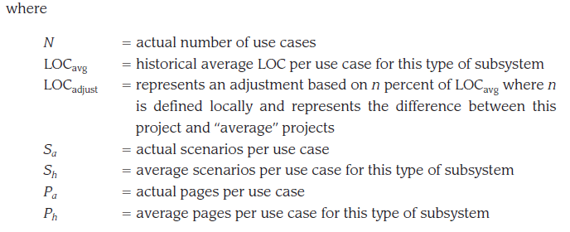

Slide 37
Empirical Estimation Models
Based on limited number of sample projects
  Typical form E = A + B×(ev)^{C} A,B,C empirically derived constant and E is the effort in person month, ev is estimation variable (LOC or FP)
Some examples
  E = 5.2×(KLOC)^{0.91} Walston-Felix Model
  E = 5.5 + 0.73×(KLOC)^{1.16} Bailey-Basili Model
  E = 3.2×(KLOC)^{1.05} Boehm simple model
  E = 5.288×(KLOC)^{1.047} Doty model for KLOC > 9
  E = -91.4 + 0.355×FP Albrecht & Gaffney
  E = -37+ 0.96×FP Kemerer Model
  E = -12.88 + 0.405×FP Small project regression model
Must calibrate for local conditions

Slide 38
The COCOMO (Constructive Cost Model) Model (Barry Boehm [BOE81])
The original COCOMO model became one of the most widely used and discussed software cost estimation models in the industry. COCOMOII is actually a hierarchy of estimation models that addresses:
Application composition model: Used during the early stages of SWE ,when prototyping of user interfaces, consideration of SW and system interaction, assessment of performance and evaluation of technology maturity is paramount
Early design stage model: Used once requirements have been stabilized and basic SW architecture has been established.
Post-architecture-stage model: Used during the construction of the SW.
Sizing Info options: object points, function points, LOC

Slide 39
COCOMOII
Like all estimation models for software, the COCOMO II models require sizing information. Three different sizing options are available as part of the model hierarchy: object points, function points, and lines of source code.

Slide 40
Object point
Like function points, the object point is an indirect software measure that is computed using counts of the number of (1) screens (at the user interface), (2) reports, and (3) components likely to be required to build the application.
complexity levels (simple, medium, difficult):
number and source of the client and server data tables that are required to generate the screen or report
number of views or sections presented as part of the screen or report.

Slide 41
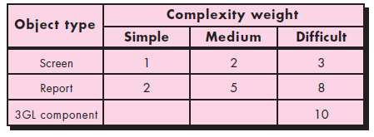


Object point
Complexity
weighting for
object types.
NOP=(Object Points)*[(100-%Reuse)/100] (New Object Point)

Slide 42
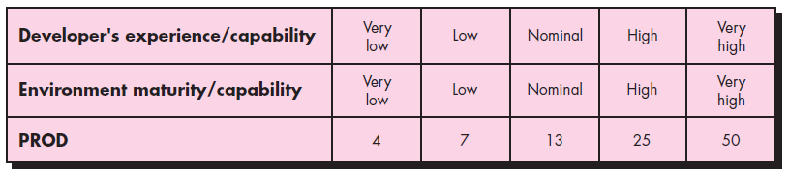
Object point
Productivity rate for object points.

Slide 43
“The Software Equation”
The software equation -- E=[LOC * B^{0.333}/P]³ * (1/t⁴), where
  E = effort in person months
  t = project duration in months
  B = “special skills factor” For KLOC (5, 15) use 0.16, for KLOC > 70, use B = 0.39
  P = “productivity parameter” reflecting
    overall process maturity and management practices
    extent to which good software engineering used
    state of software environment
    skill and experience of team
    complexlity of application
    e.g., 2,000 for real-time, 10,000 for tele-comm, 28,000 for business applications.

Slide 44
Software Equation Example
Typical productivity values
  e.g., 2,000 for real-time, 10,000 for tele-comm, 28,000 for business applications.
Simplified model suggested for t_{min}, E:
  t_{min} = 8.14(LOC/PP)^{0.43} in months for t_{min} > 6 months
  E = 180Bt³ for E >= 20 person months
For PP = 12,000 (typical scientific computation)
  t_{min} = 8.14(33,200/12,000)^{0.43} = 12.6 months
  E = 180(0.28)(1.05)³ = 58 person months
Study implications of these equations.
  Trying to get done too fast requires much more effort.

Slide 45
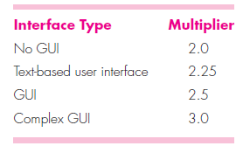
Estimation for OO Projects
Develop estimates using effort decomposition, FP analysis,and any other method that is applicable for conventional applications
Using object-oriented requirements modeling, develop use-cases and determine a count.
From the analysis model, determine the number of key classes
Categorize the type of interface for the application and develop a multiplier for support classes

Slide 46
Estimation for OO Projects
Multiply the total number of classes (key + support) by the average number of work units per class. Lorenz and Kidd suggest 15 to 20 person-days per class.
Cross-check the class-based estimate by multiplying the average number of work units per use case.

Slide 47
Resources - Make-Buy Decision
Develop specification for desired software
Estimate cost to develop internally and estimate delivery date
Select candidate applications that come closest to meeting specifications.
Select reusable components that could assist constructing the required application
Develop comparison matrix that compares key functions and costs. Possibly conduct benchmark tests

Slide 48
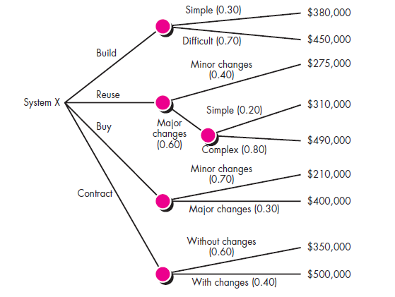
Decision Tree
EC = ∑(path prob)_{i} * (est. path cost)
A decision tree
to support the
make/buy
decision

Slide 49


Slide 50
For the build path
Expected cost_build=0.30($380K)+.70($450K)=$429K
Expected cost_reuse=0.40($275K)+.60[0.20($310K)+0.80($490K)]=$382K

Slide 51
Outsourcing
Is there a way that we can get the SW and systems we need at a lower price?
The decision to outsource can be either strategic or tactical. At the strategic level business managers consider whether a significant portion of all SW work can be contracted to others.
At the tactical level, a project manager determines whether part or all of a project can be best accomplished by subcontracting the SW work.

Slide 52
Summary
Project planner must estimate three things:
  how long project will take
  how much effort will be required
  how many people will be required
Must use decomposition and empirical modeling
  Most empirical techniques need to be calibrated to individual situations.
  Use multiple techniques to gain confidence in result

