Slide 1
Software Project Planning
Steps to Software Planning
  Define Software Scope
  Determine Resources
  Create Project Estimates
  Make or buy decision

Slide 2
Observations on estimation
Estimation of resources , cost and schedule for a software development effort requires experience, access to good historical information, and the courage to quantitative measures when qualitative are all that exist. Risk and uncertainty.
Project complexity
Project size (interdependency )
Structural uncertainty (structuring)

Slide 3
Project planning objective
The objective of software project planning is to provide a framework that enables the manager reasonable estimates of RCS.
The estimates are made within a limited time frame at the beginning of the SW project and should be updated regularly as the project progresses.
The planning objective is achieved through a process of information discovery that leads to reasonable estimates

Slide 4
SW Scope: First activity of SW PP
What scope means:
  Functions
    Literally refers to all functions performed by a system
  Performance
    Refers to processing and response time requirements
  Constraints
    Limits placed on the software by external hardware, available memory or existing systems
  Interfaces
  Reliability

Slide 5
Obtaining Scope Information: Communication
Some typical questions (Context free question)
  Overall Goals and the benefits
    Who’s request; What benefit; Who else has solution
  Better understanding the problem
    What output; What Problem; What Issues; What Constraints
  Effectiveness of Meeting (meta question)
    Are answers official; Are my questions relevant; Other sources of Info.
“Break the Ice”, “Us and Them” mind set, “territory”, FAST

Slide 6
Feasibility
“Can we build SW to meet this scope?Is the project feasible?
[Putnam and Myers 97]
Technology: Technically feasible?
Finance: Financially feasible?
Time:
Resources:

Slide 7
Scope statement
Communication with the customer leads to a definition of the data,functions and behavior that must be implemented, the performance and constraints that bound the system and related information.
See book.

Slide 8
Scoping Example (CLSS)
Conveyor Line Motion
Bin 1
ID No.
ID No.
ID No.
ID No.
Bin 2
Bin 3
Shunt
Sorting
Station
Bin 4
Bar Code
Control connection
Bin 5

Slide 9
Project Decomposition
For our example:
  Read bar code input
  Read pulse tachometer
  Decode part code data
  Do database lookup
  Determine bin location
  Produce control signal for shunt
  Maintain record of box destinations

Slide 10
Discussion
Performance is dictated by conveyer line speed
Cost and effort would vary if for same functionality the performance has to be improved
Interfaces :HW and machines , already existing SW,Users, procedures that precedes or succeeds the software as a series of sequential operations.
Reliablity is the least precise aspect of scope e.g. MTBF
If system spec. has been properly developed nearly all information required to describe SW scope is available and documented.

Slide 11
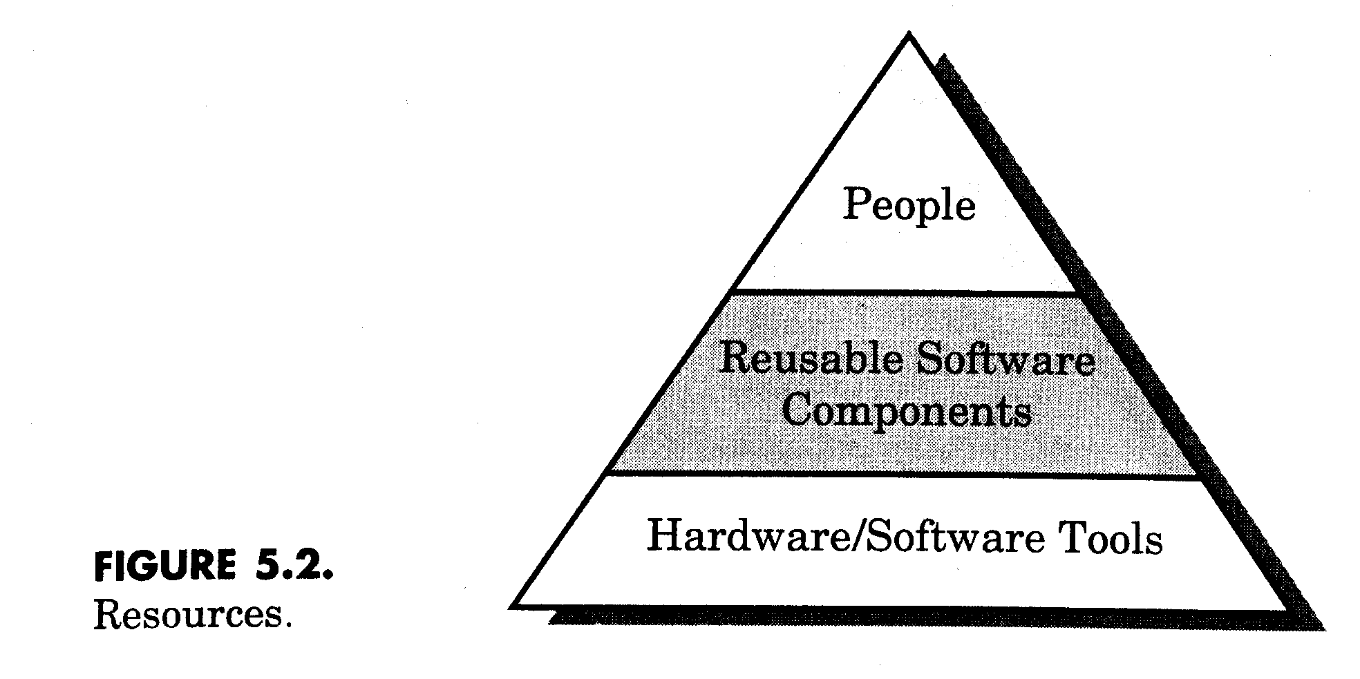
Resource Estimation: Second task in SW PP

Slide 12
Resources cont.
For each type of resources, 4 characteristics are examined:
  Description of resource
  Availability
  Time resource needed
  Duration of time for which the resource is needed
t
Time window

Slide 13
Human Resources
Scope and skills required
Organizational position and specialty must both be considered
As estimate of development effort is essential to determine the number of people required for the project.

Slide 14
Reusable Software Resources
Bennatan [BEN92]
Off-the-shelf components- from third party or developed earlier.
  Fully validated
Full experience components: Specifications,designs, code or test data developed in past project which is similar to present one
  Modification is of low risk
Partial experience components : substantial modification reqd.
  Modification is of fair degree of risk
New components :

Slide 15
Guidelines for using reusable components
If off-the self components meet project requirements, acquire them
If full-experience components are available, their use for the current project with modification and integration is are generally accepted.
If partial-experience components are available their use for the current project must be analyzed in detail.

Slide 16
Environmental Resources (SWEE):HW and SW
Software Engineering Environment
  Compilers
  Editors
  Design tools
  Configuration management tools
  Management tracking tools
  Problem Reporting And Corrective Action (PRACA) tools
  Documentation tools
  Hardware resources
  Network support

Slide 17
Software Project Estimation
To achieve reliable cost and effort estimates a number of options arise
-Delay estimation until late in the project
-Base estimates on similar projects that have already been completed
-Use relatively simple decomposition techniques to generate project cost and effort estimates
-Use one or more empirical models for SW cost and effort estimation

Slide 18
Software Project Estimation (cont.)
Decomposition techniques 2. Empirical estimation models,
3. Automated estimation tools
  Use one or more empirical models, I.e.,
  d = f(v_{i})
Where d is one of a number of estimated values (e,g. effort, cost, project duration) and v_{i} are selected independent parameters.(e.g. LOC or FP)
  For example,
  # of people = LOC ÷(Duration*(LOC/PM))
Notes:
Significant errors are likely to mean that you either lose the job, or lose money on it.

Slide 19
Decomposition techniques
Problem/process decomposition: Scope and estimate of its “size”
The accuracy of SW project estimate is predicted on a number of things:
The degree to which the planner has properly estimated the size of the product to be built
The ability to translate the size estimate into human effort, calendar time and dollars
The degree to which the project plan reflects the abilities of the SW team
The stability of product requirements and the environment that supports the SW Engineering effort.

Slide 20
Decomposition techniques: SW sizing
(Putnam and Myers)
“Fuzzy logic” sizing:Identify the type of application, establish its magnitude on a qualitative scale and then refine the magnitude within the original range.
FP sizing:
Standard component sizing: Count the frequency of each standard components (e.g. subsystems, modules,screens, reports, interactive programs files, LOC). 18 reports size is 18times 967 lines Cobol code.
Change sizing:Reqd. when use of existing SW with modifications.

Slide 21
Problem-based estimation
LOC and FP is used to generate productivity metrics
They can also be used in SW project estimation
1.As an estimation variable that is used to size each element of the software
2. As baseline metrics collected from past projects and used in conjunction with estimation variables to develop cost and effort projections

Slide 22
Flow chart
SW Scope
Decomposition of individual functions
LOC or FP count for
each function
Apply LOC/pm or
FP/pm
Base line productivity metrics
Grand Total

Slide 23
Problem-based estimation
Precise estimation is difficult. So, make three estimates: optimistic, most likely, and pessimistic. Then combine as:
EV=(S_{opt} + 4S_{m} + S_{pess})/6
An example
  user interface and control facilities
  2-D geometric analysis
  3-D geometirc analysis
  database management
  computer graphics display
  peripheral control
  design analysis models
3-D opt = 4600
3-D m. likely = 6900
3-D pess. = 8600
=> (4600+4*6900+8600)/6
= 6800

Slide 24
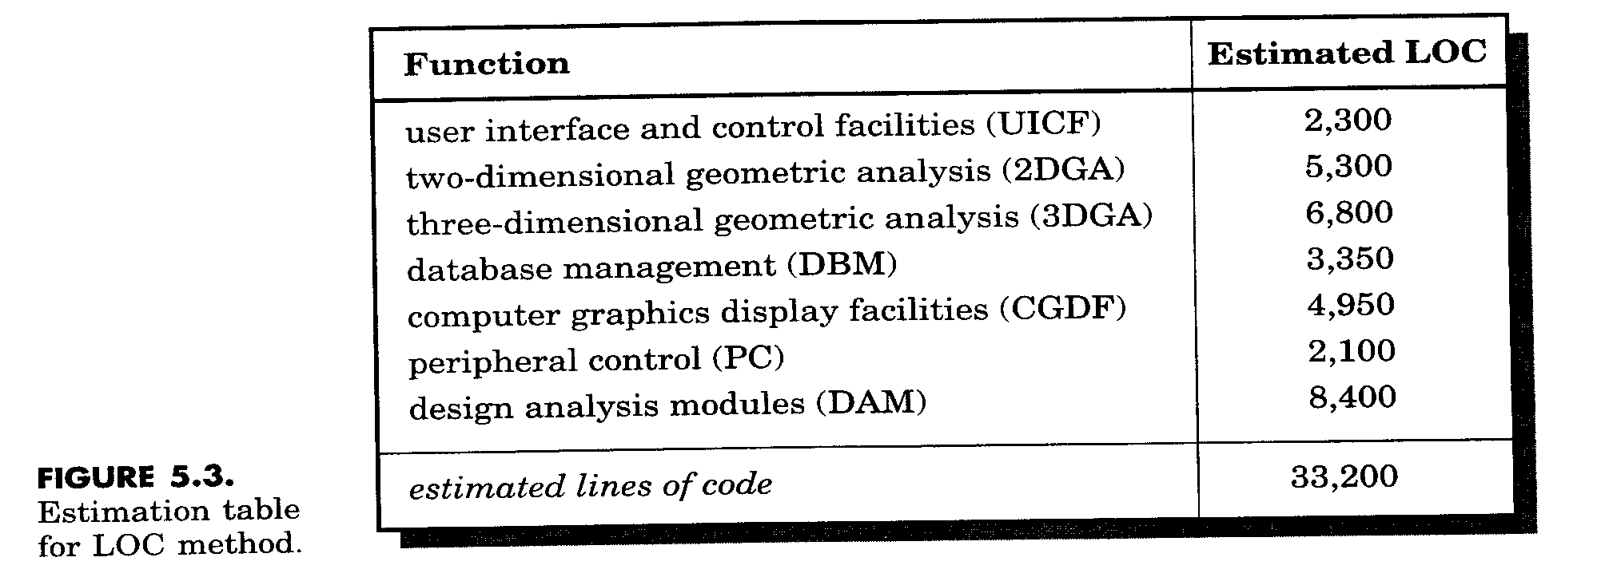
Estimation Table
Suppose 620 LOC/PM, and $8,000/PM, based upon historical data. Then,
Est. Cost = 33,200*$8,000/620 = $431,000 and 54 pm

Slide 25
Function Point Based Estimation
Function Point Complexity Weighting Factors
  backup and recovery 4
  Data communications 2
  Distributed processing 0
  Performance critical 4
  Existing operating environment 3
  On-line data entry 4
  …
  Application designed for change 5
  Total 52

Slide 26
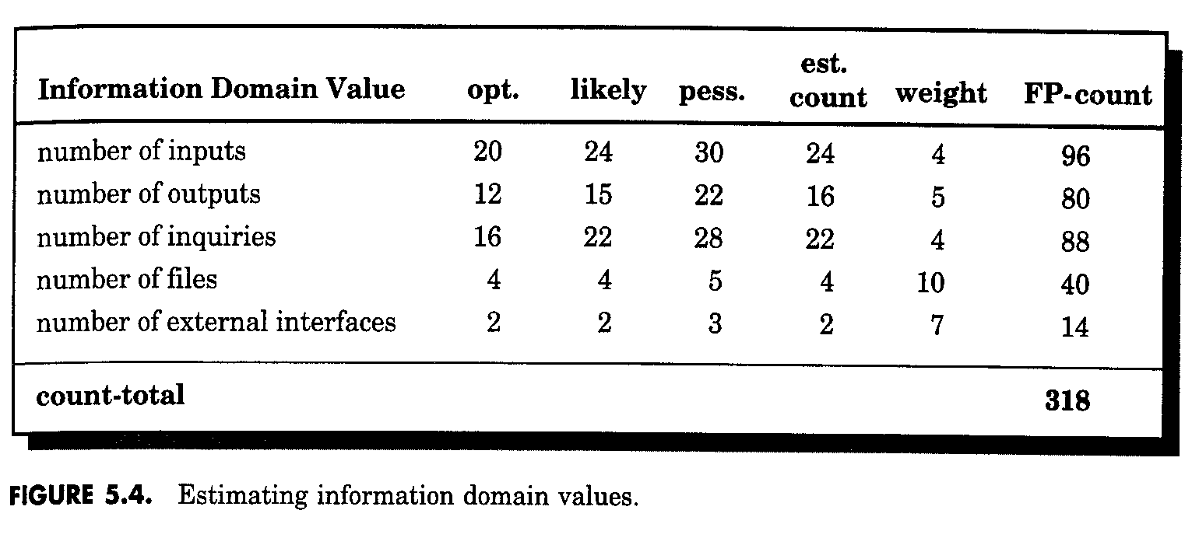

Function Point Based Estimation
Avg.
Complexity factor =
= 0.65+0.01×52 = 1.17
FP estimate = count-total×
= 318 × 1.17 = 372
Then, if 6.5 FP/PM, cost = 372 × $8,000 ÷ 6.5 = $457,000

Slide 27
Process Based Estimation
Decompose the process into a set of activities or tasks
Estimate effort or cost to perform each task
Estimate cost cost of each function
May be done using LOC and FP estimation or separately
If estimated separately, then there are two or three distinct cost estimates.
  Reconcile differences
  If radically different, perhaps problem is not well understood, or productivity data is obsolete, or the models have not been used correctly.

Slide 28
Process Based Estimation -- Example
Customer
Customer
Activity
Communication
Planning
Risk Analysis
Engineering
Construction Release
Evaluation
Task
Analysis
Design
Code
Test
Function
UICF
0.50
2.50
0.40
5.00
n/a
2DGA
0.75
4.00
0.60
2.00
n/a
3DGA
0.50
4.00
1.00
3.00
n/a
DSM
0.50
3.00
1.00
1.50
n/a
CGDF
0.50
3.00
0.75
1.50
n/a
PCF
0.25
2.00
0.50
1.50
n/a
DAM
0.50
2.00
0.50
2.00
n/a
Total
0.25
0.25
0.25
3.50
20.50
4.75
16.50
% effort
1%
1%
1%
8%
45%
10%
36%
If labor rate is $8,000/PM, then Est. cost = $368,000

Slide 29
Empirical Estimation Models
Based on limited number of sample projects
  Typical form E = A + B×(ev)^{C} A,B,C empirically derived constant and E is the effort in person month, ev is estimation variable (LOC or FP)
Some examples
  E = 5.2×(KLOC)^{0.91} Walston-Felix Model
  E = 5.5 + 0.73×(KLOC)^{1.16} Bailey-Basili Model
  E = 3.2×(KLOC)^{1.05} Boehm simple model
  E = 5.288×(KLOC)^{1.047} Doty model for KLOC > 9
  E = -13.39 + 0.0545×FP Albrecht & Gaffney
  E = 60.62 + 7.728×10⁻⁸FP³ Kemerer Model
  E = 585.7 + 15.12×FP Albrecht & Gaffney
Must calibrate for local conditions

Slide 30
The COCOMO (Constructive Cost Model) Model
Barry Boehm [BOE81]
COCOMOII is actually a hierarchy of estimation models that addresses:
Application composition model:Used during the early stages of SWE ,when prototyping of user interfaces, consideration of SW and system interaction, assessment of performance and evaluation of technology maturity is paramount
Early design stage model: Used once requirements have been stabilized and basic SW architecture has been established.
Post-architecture-stage model: Used during the construction of the SW.
Sizing Info options: object points, function points, LOC

Slide 31
COCOMOII
Complexity weighting for object types
Object type | Complexity Weight
 | simple | medium | Difficult
Screen | 1 | 2 | 3
Report | 2 | 5 | 8
3GL componenets |  |  | 10
NOP=(Object Points)*[(100-%Reuse)/100]

Slide 32
Productivity rates for object points
Developer’s experience/capability | Very Low | Low | Nominal | High | Very High
Environment maturity/capability | Very Low | Low | Nominal | High | Very High
PROD | 4 | 7 | 13 | 25 | 50
Estimated effort=NOP/PROD

Slide 33
“The Software Equation”
The software equation -- E=[LOC * B^{0.333}/P]³ * (1/t⁴), where
  E = effort in person months
  t = project duration in months
  B = “special skills factor” For KLOC (5, 15) use 0.16, for KLOC > 70, use B = 0.39
  P = “productivity parameter” reflecting
    overall process maturity and management practices
    extent to which good software engineering used
    state of software environment
    skill and experience of team
    complexlity of application
    e.g., 2,000 for real-time, 10,000 for tele-comm, 28,000 for business applications.

Slide 34
Software Equation Example
Typical productivity values
  e.g., 2,000 for real-time, 10,000 for tele-comm, 28,000 for business applications.
Simplified model suggested for t_{min}, E:
  t_{min} = 8.14(LOC/PP)^{0.43} in months for t_{min} > 6 months
  E = 180Bt³ for E >= 20 person months
For PP = 12,000 (typical scientific computation)
  t_{min} = 8.14(33,200/12,000)^{0.43} = 12.6 months
  E = 180(0.28)(1.05)³ = 58 person months
Study implications of these equations.
  Trying to get done too fast requires much more effort.

Slide 35
Resources - Make-Buy Decision
Develop specification for desired software
Estimate cost to develop internally and estimate delivery date
Select candidate applications that come closest to meeting specifications.
Select reusable components that could assist constructing the required application
Develop comparison matrix that compares key functions and costs. Possibly conduct benchmark tests

Slide 36
Decision Tree Support
EC = ∑(path prob)_{i} * (est. path cost)
simple (.30)
$380,000
difficult (.70)
Build
$450,000
minor changes (.40)
reuse
$275,000
major changes (.60)
simple (.20)
$310,000
System X
complex (.80)
buy
$490,000
minor changes (.70)
$210,000
major changes (.30)
$400,000
contract
without changes (.60)
$350,000
with changes (.40)
$500,000

Slide 37
For the build path
Expected cost_build=0.30($380K)+.70($450K)=$429K
Expected cost_reuse=0.40($275K)+.60[0.20($310K)+0.80($490K)]=$382K

Slide 38
Outsourcing
Is there a way that we can get the SW and systems we need at a lower price?
The decision to outsource can be either strategic or tactical. At the strategic level business managers consider whether a significant portion of all SW work can be contracted to others.
At the tactical level, a project manager determines whether part or all of a project can be best accomplished by subcontracting the SW work.

Slide 39
Summary
Project planner must estimate three things:
  how long project will take
  how much effort will be required
  how many people will be required
Must use decomposition and empirical modeling
  Most empirical techniques need to be calibrated to individual situations.
  Use multiple techniques to gain confidence in result

