Slide 1
PROJECT MANAGEMENT CONCEPTS

Slide 2
Project Management Concepts
Definition
Components
Importance
Steps
Guidelines

Slide 3
The Spectrum of Management Concerns
Effective Software management encompasses four main areas (4P’s):
  People
  The product
  The process
  The project

Slide 4
People
The people management capability maturity model (PM-CMM) has been developed by SW engineering institute to enhance the readiness of the SW organizations to undertake increasingly complex applications by helping to attract grow, motivate, deploy and retain the talent needed to improve their SW capability.

Slide 5
PM-CMM defines key practice areas for SW people
  Recruiting
  Selection
  Performance management
  Training
  Compensation
  Career development
  Organization
  Work design
  Team or culture development

Slide 6
Product
For a SW project planning
Product objective and scope should be established
Alternative solution should be considered
Management and technical constraints should be identified

Slide 7
Otherwise
Problems arise in
Reasonable and accurate cost estimation
Effective risk assessment
Breakdown of project tasks

Slide 8
People: the most important contributor
The Players -- It is important to recognize the different categories of people involved in a large software project.
    Senior Managers - who define business issues.
    Project Managers - who plan, motivate, organize and control the practitioners
    Practitioners - who deliver the technical skill that are necessary to engineer the project
    Customers - who specify the requirements
    End users - who interact with the software once it is released.

Slide 9
Team Leadership -- A Critical Item
  The best programmers often make poor team leaders.
    Different skills are required.
  Technical leadership model (Jerry Weinberg)
    Motivation - The ability to encourage technical people to produce to their best ability
    Organization - The ability to mold existing processes that will enable the initial concept to be translated into reality.
    Ideas and Innovation - The ability to invite creativeness even within a set of restrictions.

Slide 10
Project Manager’s characteristics [Edgemon 95]
Problem solving: Diagnose technical and organizational issues, systematically structure the solution, apply lessons learnt from past projects and be flexible enough to change directions
  Managerial identity
  Achievement
  Influence and team building

Slide 11
The Software Team
Scenario
  n individuals are assigned to m different functional tasks; relatively little coordination occurs
  n individuals are assigned to m different functional tasks (m<n); so that informal teams are established
  n individuals are assigned to t different functional tasks; each team is assigned one or more functional tasks.

Slide 12
Seven project factors Impacting SW team
Difficulty of problem to be solved.
Expected size of the resultant program.
The time the team will remain together.
The degree to which the problem can be modularized.
The required quality and reliability of the system.
The rigidity of the delivery date.
The degree of communication required for the project.

Slide 13
The Software Team
Marilyn Mantei model:
    Democratic decentralized (DD). -- Does not have a defined leader. “Task Coordinators” are appointed to assure that a particular job is to be executed. These are later replaced by other “Task Coordinators” as new tasks arise.
    Controlled decentralized (CD) -- Has a defined leader who coordinates tasks, and secondary leaders who carry out subtasks. Problem solving is done by the group, implementation is done by subgroups.
    Controlled Centralized (CC) - Top-level problem solving and team coordination managed by the team leader. The communication between the leader and members is vertical.

Slide 14
CD structure :Chief programmers team (earliest structure)
Senior Engineer (Chief programmer)
  Specialists
  Support staff
  Software librarian
Technical staffs
Backup Engineer

Slide 15
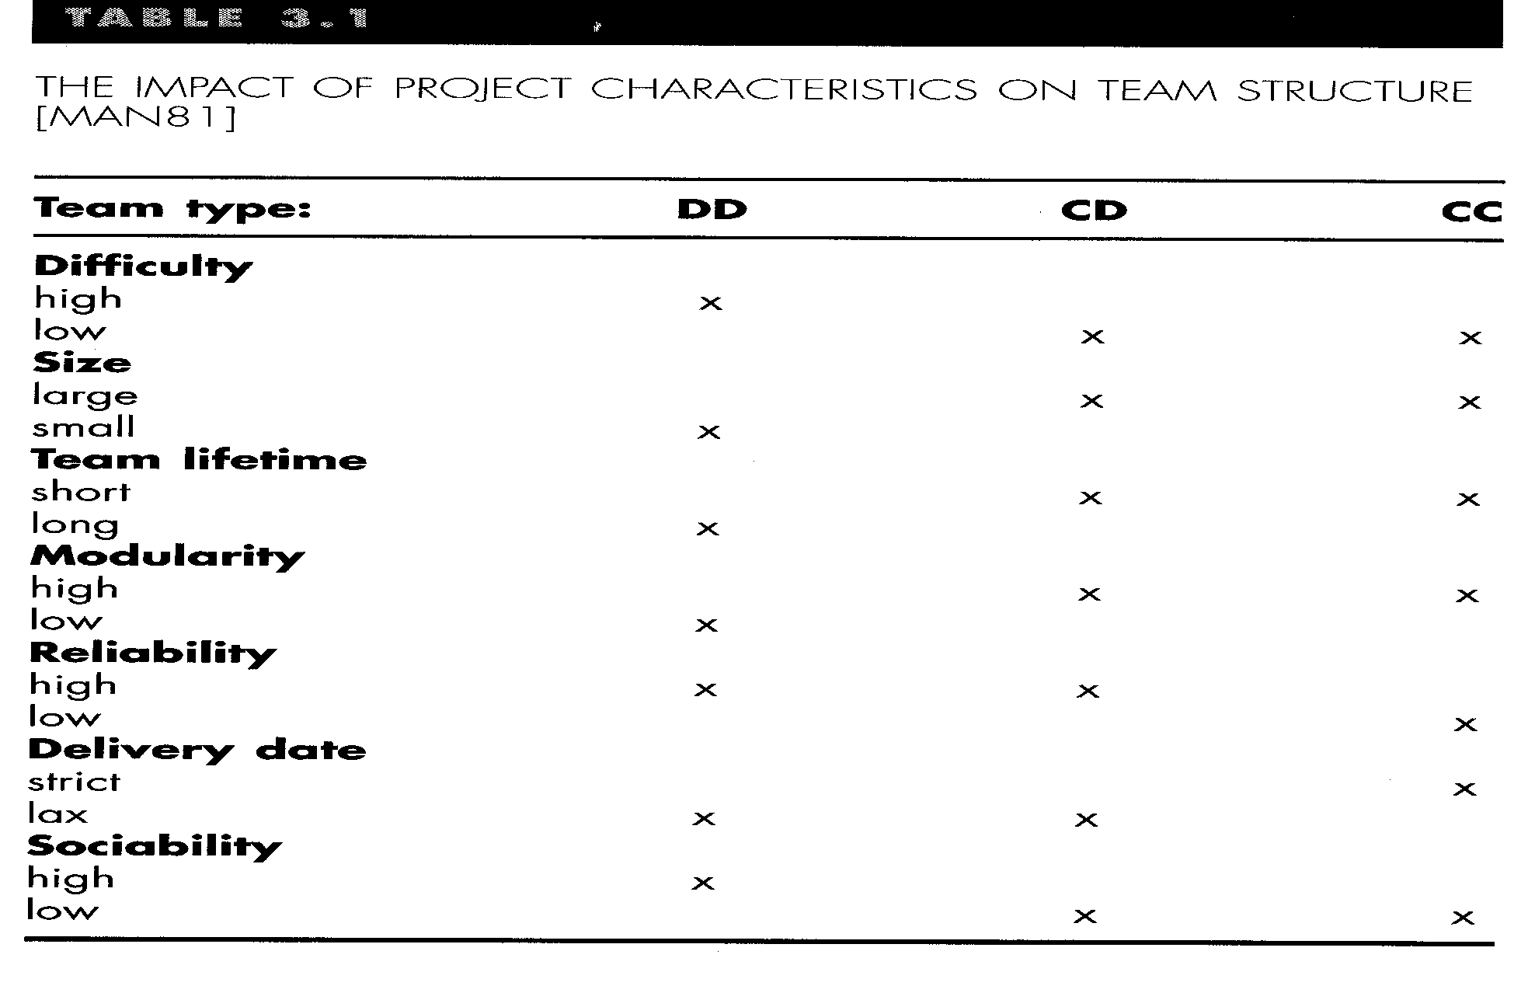
Features of SW team structures

Slide 16
Organizational paradigm of SW team
Closed paradigm: Silimar to CC (good in mechanical job)
Random paradigm: Structures a team loosely and depends on individual initiatives
Open paradigm: blend of 1&2
Synchronous paradigm: Based on natural compartmentalization of a problem and organizes team members to work on pieces of the problem with little active communication among themselves

Slide 17
To achieve a high performance team
Team members must have trust in one another
The distribution of skills must be appropriate to the problem
Maverick (rebel) may have to be excluded from the team, if team cohesiveness is to be maintained
Project manager is to help create a team that exhibits cohesiveness (Jelled team) (make firm)

Slide 18
Toxins and antitoxins [Jackman98]
Frenzied (mental illness) team atmosphere encourages members to waste their energy and losing focus on work objectives
Personal, business and technological factors create high frustration and friction
Poorly defined or improperly chosen process model become roadblock to accomplishments
Unclear definition of roles results in lack of accountability
Repeated exposure to failure causes loss of confidence and morales
Ensure members access to all relevant information and goals should not be modified
Give much responsibility over decision making
Be certain about the SW process model to be fit or let the team to choose
Establish own way of accountability
Use team-based technique to feedback and problem solving

Slide 19
How Do We Communicate?
  Informally – Good, phone/electronic service, a clear definition of group interdependencies and good relationships help encourage communication
  Meetings - Regular project meetings help alleviate minor misunderstandings
  Workbook - a formal project workbook must be started from the beginning.

Slide 20
Project Coordination Techniques
Formal, impersonal approaches - software engineering documents and deliverables, technical memos, project milestones, schedules and control tools
Formal interpersonal procedures - quality assurance activities - reviews and design and code inspections
Informal, interpersonal procedures - group meetings
Electronic communication - Email, bulletin boards, web sites, extension and video conferences
Interpersonal network - discussions with those outside of the project.

Slide 21
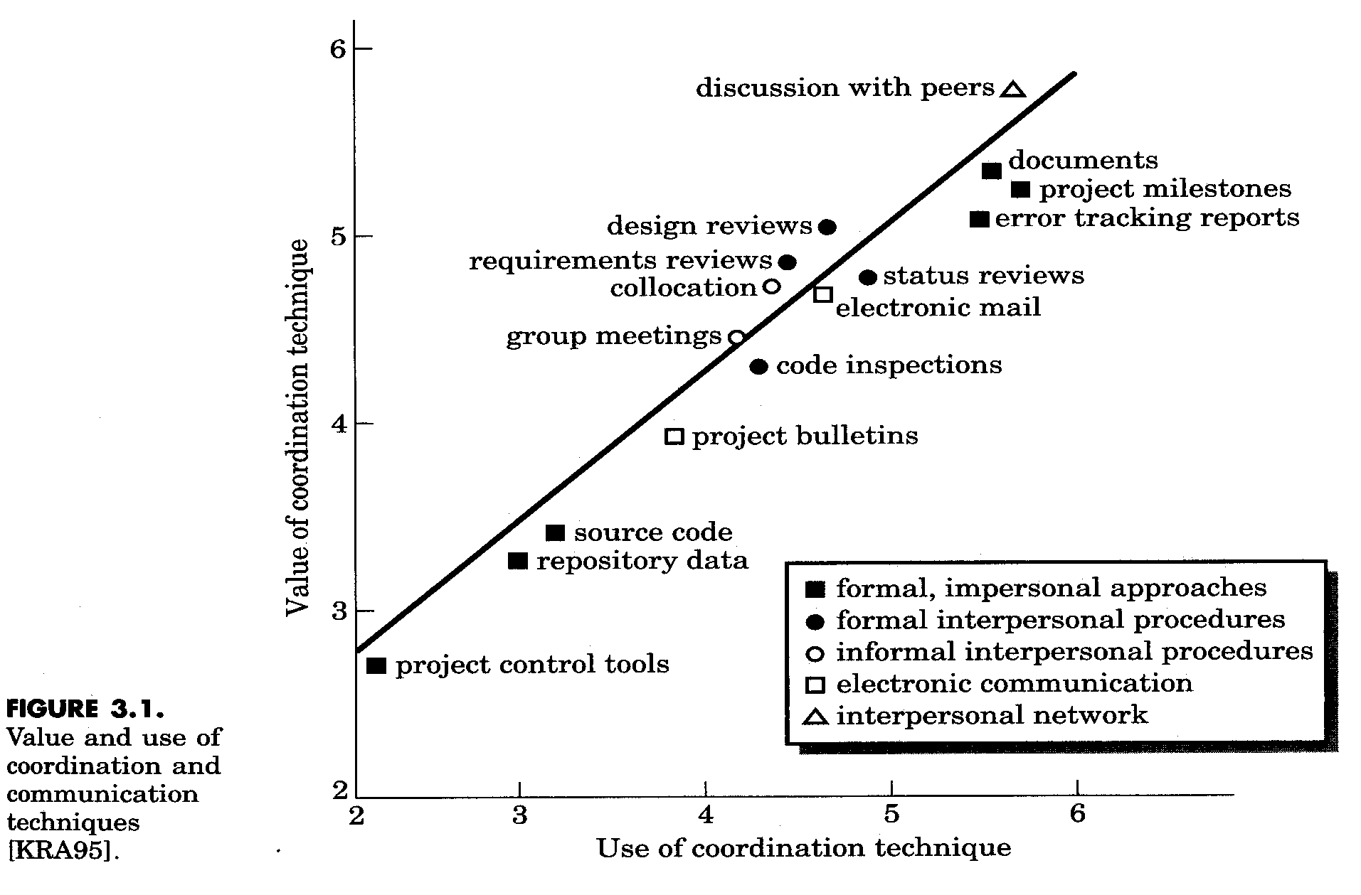
A Study on the Impact of Coordination Techniques

Slide 22
The Product
Must first determine project scope.
    Context - How does this software to be built fit into the larger system? What constraints are imposed as a result of this?
    Information objectives - What customer-visible objects are produced from the software? What data objects are necessary for input?
    Function and performance - What functions or actions does the software perform to transform the output?
    Problem decomposition-functionality and process

Slide 23
The Process
Select a software engineering model
  Process framework activities
    Customer communication.
    Planning -- determine resources, time line & other info
    Risk analysis -- assess technical and management risks
    Engineering -- build one or more representations of the product.
    Construction and release -- construct, test, install and provide user support.
    Customer evaluation -- obtain feedback on product

Slide 24
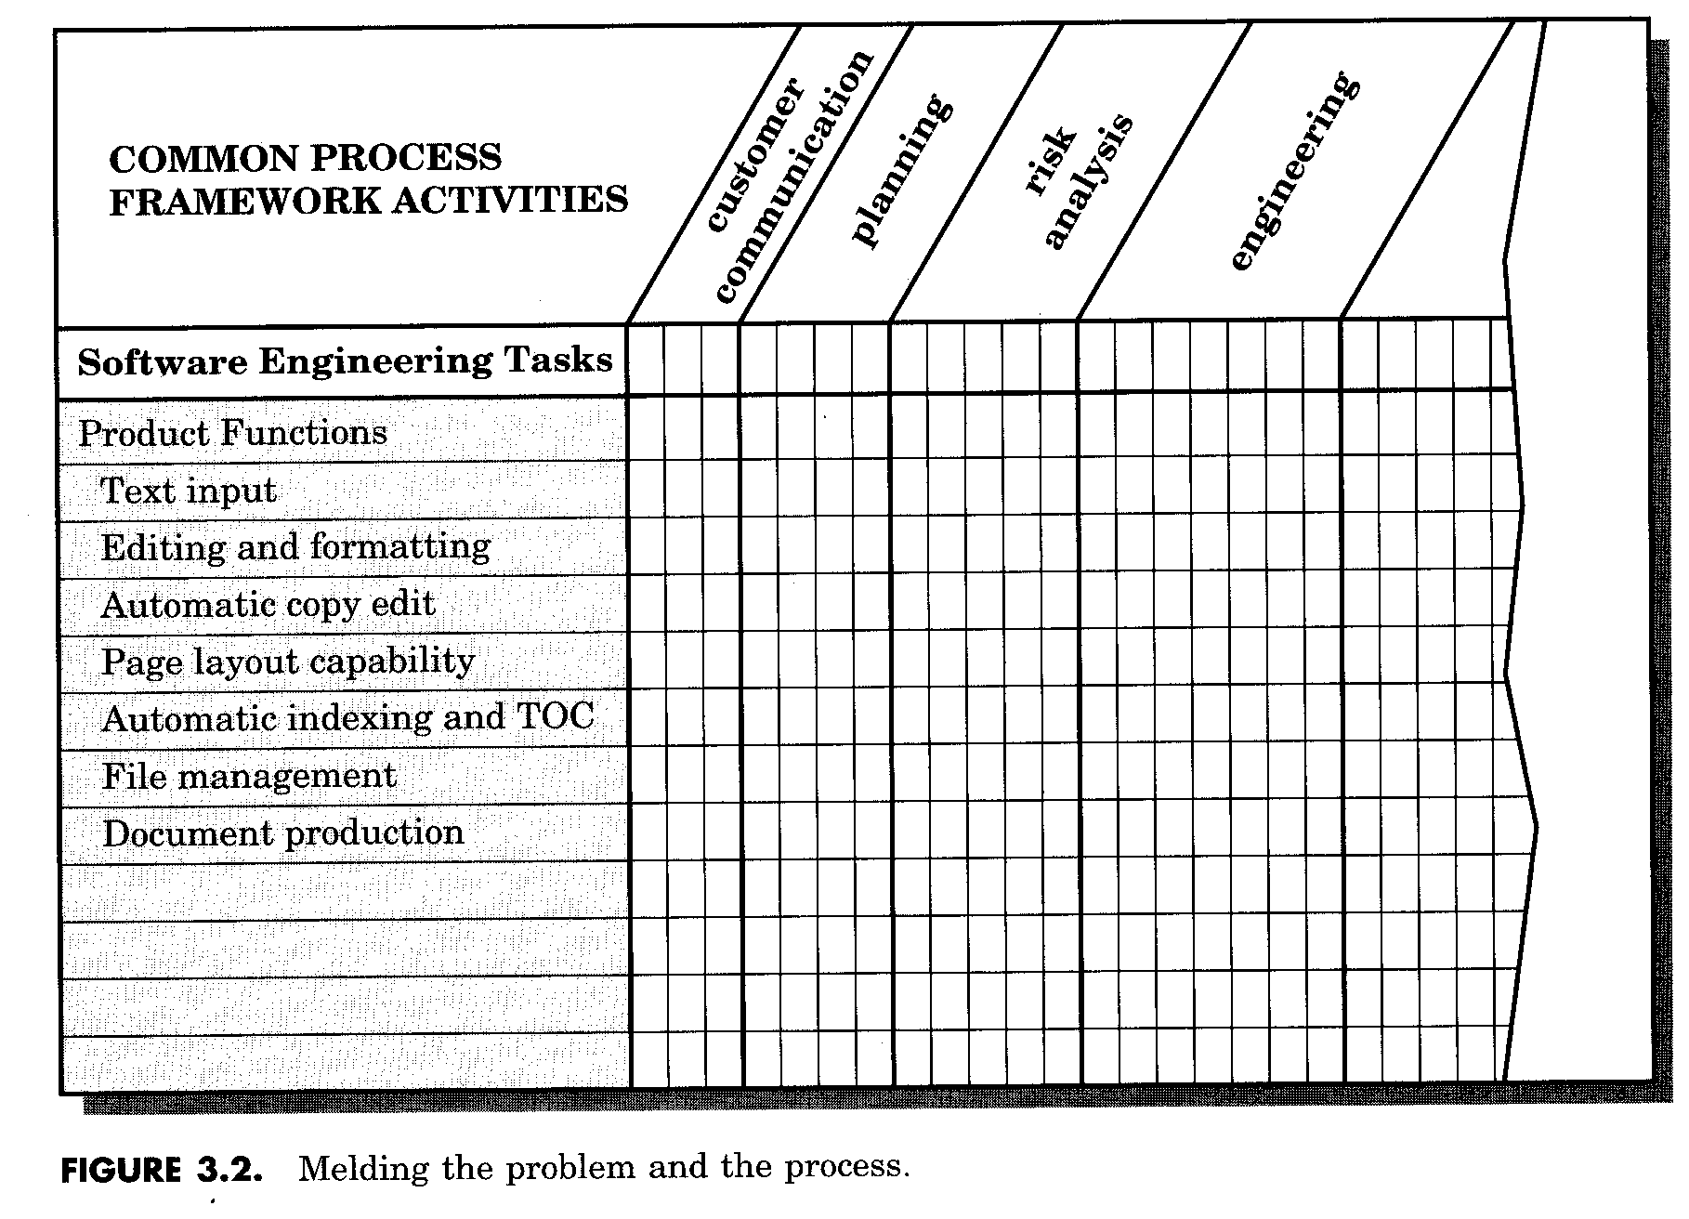
Common Process Framework Activities

Slide 25
Process Decomposition
Typical activities
  Review the customer request.
  Plan and schedule a formal, facilitated meeting with the customer.
  Conduct research to define proposed solutions.
  Prepare a “working document” and meeting agenda.
  Conduct meeting with customer.
  Jointly develop mini-specs for the product.
  Review each mini-spec for correctness, lack of ambiguity.
  Assemble the mini-specs into a scoping document.
  Review the scoping document with all concerned.
  Modify the scoping document as required.

Slide 26
The Project
In order to manage a successful SW project, we must understand what can go wrong
Start on the right foot: working very hard to understand the problem
Maintain momentum: give incentives and maintains quality
Track progress: In quality assurance activities
Make smart decisions: keep it simple
Conduct a postmortem analysis: Establish a consistent mechanism for extracting lessons learnt

Slide 27
W5HH principal (Define Characteristics and help making project plan)
Why is the system being developed? Business reason
What will be done, when? project schedule and tasks
Who is responsible for a function? members role definition
Where are they organizationally located? outsiders role
How will the job be done technically and managerially
How much of each resource needed? estimates

Slide 28
Summary
Software project management is an umbrella activity that continues throughout the life cycle of the system.
Software management includes people, the problem, and the process.
The most critical element in all software system projects is the people. The team can have an number of structures that effect the way work is accomplished.
However, complete, consistent problem definition and an effective process are also essential ingredients.

