Slide 1

Software Engineering and Information System
Lecture 07:
Design Representation Schemes
Md. Al-Hasan
Department of Computer Science & Engineering (CSE)
Bangladesh Army University of Science & Technology (BAUST)
Software Engineering: Design, Reliability, and Management By Martin L. Shooman

Slide 2
Design Representation Schemes
Code Listing
Table of Attributes
Pseudo-code
Flowchart
Structured Flowchart
Control Graph
Structure Chart
HIPO (Hierarchy plus Input-Process-Output) Diagram
Design Tree and Control Graph
Decision Table
Warnier-Orr Diagram
PDL ( Process Design Language)

Slide 3
HIPO Diagram
HIPO: Hierarchy plus Input-Process-Output
A tool for planning and/or documenting a computer program.
It consists of
  a hierarchy chart that graphically represents the program’s control structure (the top-down structure).
  a set of IPO (Input-Process-Output) charts that describe the inputs to, the outputs from, and the functions (or processes) performed by each module on the hierarchy chart.

Slide 4
Strengths, Weaknesses and Limitations
Designers can evaluate and refine a program’s design, and correct flaws prior to implementation.
Given the graphic nature of HIPO, users and managers can easily follow a program’s structure.
The hierarchy chart serves as a useful planning and visualization document for managing the program development process.
The IPO charts define for the programmer each module’s inputs, outputs, and algorithms.
The “text plus flowchart” nature of the IPO charts makes them difficult to maintain.
So the documentation often does not represent the current state of the program.
By its very nature, the HIPO technique is best used to plan and/or document a hierarchically structured program.

Slide 5
An Interactive Inventory Program
Tasks Set
  1.0 Manage inventory
    2.0 Update stock
      2.1 Process sale
      2.2 Process return
      2.3 Process shipment
    3.0 Generate report
      3.1 Respond to query
      3.2 Display status report
    4.0 Maintain inventory data
      4.1 Modify record
      4.2 Add record
      4.3 Delete record

Slide 6
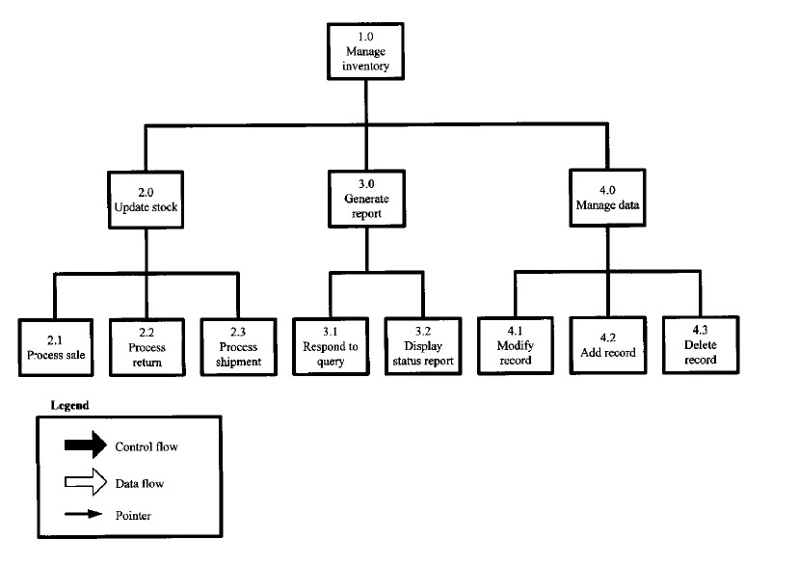
The Hierarchy Chart
Figure 1: A hierarchy chart for an interactive inventory control program.

Slide 7
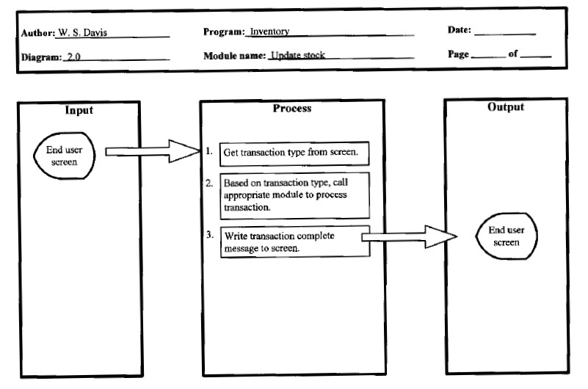
The IPO Charts
Figure 2: An overview diagram for process 2.0.

Slide 8
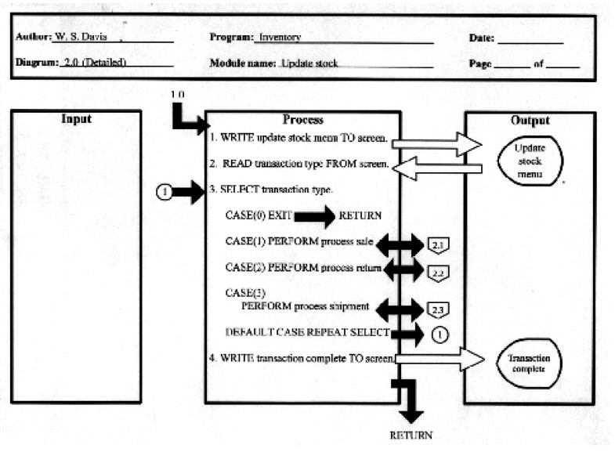
Detail Diagrams
Figure 3: A detail diagram for process 2.0.

Slide 9
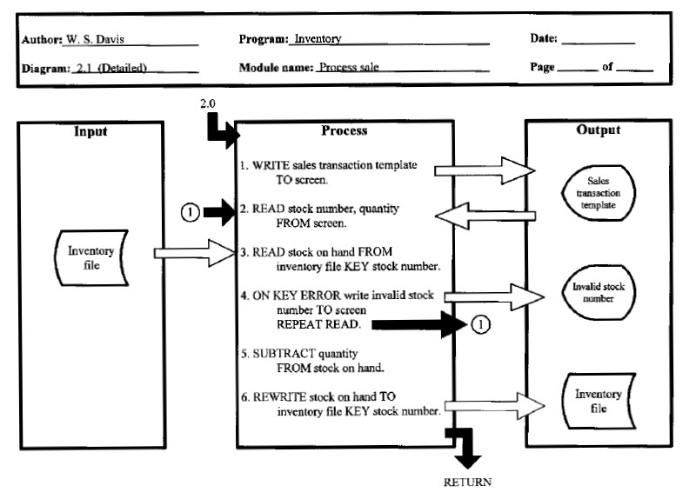
Detail Diagrams
Figure 4: A detail diagram for process 2.1.

Slide 10
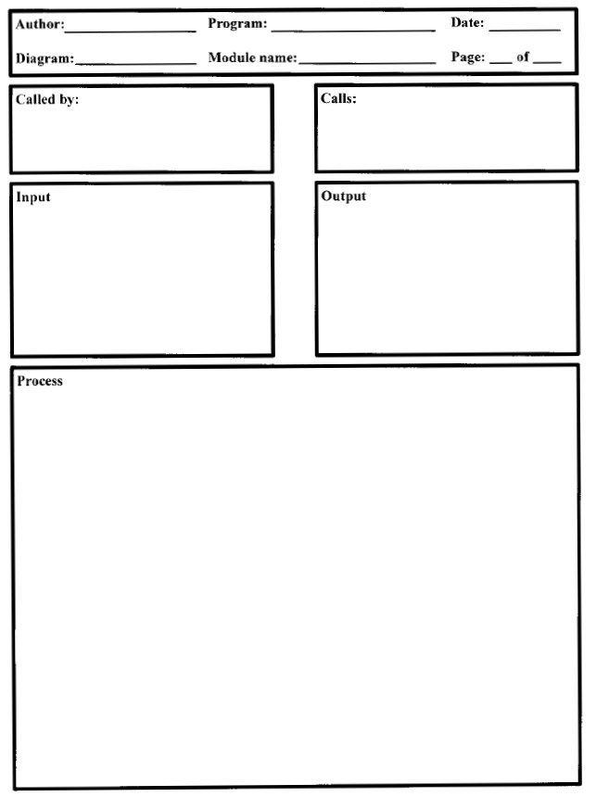
Simplified IPO Charts
Figure 5: A simplified IPO diagram.

Slide 11
Warnier/Orr Diagrams
A Warnier/Orr diagram is a style of diagram which is extremely useful for describing complex processes e.g.,
  computer programs, business processes, instructions and
  objects (e.g., data structures, documents, parts explosions).
It is elegant, easy to understand and easy to create.

Slide 12
Main Elements
Bracket: | A bracket encloses a level of decomposition in a diagram. It reveals what something "consists of" at the next level of detail.
Sequence: | The sequence of events is defined by the top-to-bottom order in a diagram. That is, an event occurs after everything above it in a diagram, but before anything below it.
OR: | You represent choice in a diagram by placing an "OR" operator between the items of a choice. The "OR" operator looks either like or .
AND: | You represent concurrency in a diagram by placing an "AND" operator between the concurrent actions. The "AND" operator looks either like or .
Repetition: | To show that an action repeats (loops), you simply put the number of repetitions of the action in parentheses below the action.

Slide 13
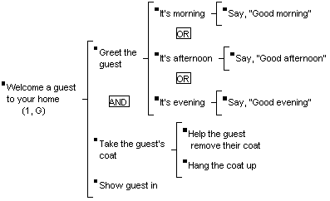
A Simple Process
You could read the diagram like this:
"Welcoming a guest to your home (from 1 to many times) consists of greeting the guest and taking the guest's coat at the same time, then showing the guest in. Greeting a guest consists of saying "Good morning" if it's morning, or saying "Good afternoon" if it's afternoon, or saying "Good evening" if it's evening. Taking the guest's coat consists of helping the guest remove their coat, then hanging the coat up."

Slide 14
Recommended Design-Representation Techniques
An H diagram is drawn and major subprograms are identified.
High-level flowcharts are drawn for the control structure and each major subprogram.
Pseudo-code is written for each flowchart.
The program (code) is written in the source language

Slide 15
Comparison of Design-Representation Techniques
Table 2.8 (Self)

Slide 16
References:
http://www.hit.ac.il/staff/leonidm/information-systems/ch64.html
http://www.hit.ac.il/staff/leonidm/information-systems/ch33.html

Slide 17
Thank You

