Slide 1


DecodeLabs
THE EMPATHY MAP
UI/UX INTERNSHIP
FITNESS APP FOR BUSY OFFICE PROFESSIONALS
Baseerat Ghazanfar
(biyahere5168@gmail.com)

Slide 2

SCENARIO
A new fitness startup wants to launch an app for busy office professionals who struggle to find time for exercise. The goal is to understand user pain points before designing the app.

Slide 3

TARGET AUDIENCE
Demographics
Behaviors
Age Group :
24–40 years
Occupation:
Office workers
Software engineers
Managers
Marketing professionals
Lifestyle:
Busy and fast-paced
Tech Usage
Heavy smartphone and
laptop users
Common Behaviors:
Long sitting hours
Lack of workout time
Work stress
Low energy after office
Fitness Goals:
Stay healthy
Reduce stress
Lose weight
Build routine

Slide 4

USER PERSONA 01
Sarah works in a fast-paced marketing company where she attends meetings, handles campaigns, and manages deadlines. Her busy schedule and mental exhaustion make it difficult to maintain a fitness routine.
Goals:
Stay fit
Reduce stress
Exercise regularly
Improve energy levels
Frustations:
Sarah Khan
No time for gym
Tired after work
Lack of consistency
Low motivation
Age:
28
Occupation:
Marketing Executive
Location:
Lahore
Behaviors:
Uses social media often
Watches quick fitness videos
Prefers home workouts

Slide 5

USER PERSONA 02
Ali works remotely as a software engineer and spends most of his day coding and attending virtual meetings. His sedentary work routine causes back pain and low physical activity.
Goals:
Improve posture
Increase movement
Stay healthy
Reduce back pain
Frustations:
Ali Raza
Long sitting hours
Forgetting exercise breaks
Complicated fitness apps
Low consistency
Age:
34
Occupation:
Software Engineer
Location:
Islamabad
Behaviors:
Works on laptop all day
Rarely moves during work
Prefers simple apps

Slide 6

THINKS
FEELS
“I should exercise more.”
“I don’t have enough time.”
“I need a simple routine.”
“Maybe next week.”
Tired
Guilty
Stressed
Unmotivated
SEES
EMPATHY
MAP
DOES
Fitness ads
Office workload
Colleagues sitting all day
Social media fitness influencers
Skips workouts
Works long hours
Searches quick workout videos
Occasionally walks or stretches

Slide 7
PAIN POINT 1
LACK OF TIME:
PAIN POINT 2
MENTAL EXHAUSTION:
Key
User
Pain
Points
Users cannot dedicate
long hours to exercise.
Work stress reduces motivation.
Pain Point 3
Low Consistency:
PAIN POINT 4
SEDENTARY LIFESTYLE:
Busy routines interrupt workout habits.
Long sitting hours cause fatigue and body pain.

Slide 8
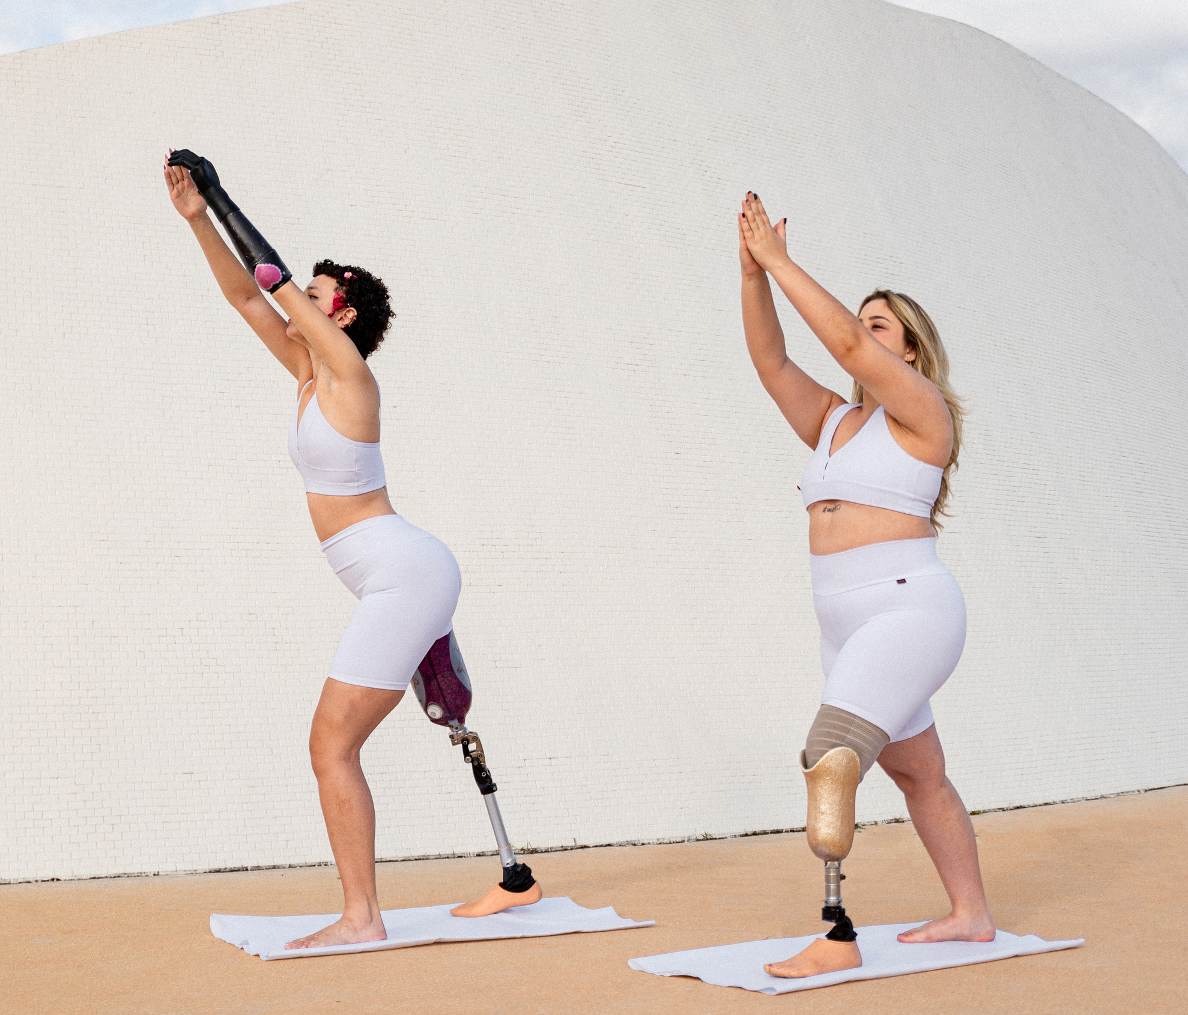
UX
OPPORTUNITIES
The app should include:
5–15 minute workouts
Smart reminders
Office stretch exercises
Beginner-friendly UI
Personalized workout plans
Progress tracking
Motivation rewards

Slide 9


CONCLUSION
This UX research helps the startup understand the real needs, emotions, and behaviors of busy professionals before designing the application. The empathy map ensures the product is user-centered, practical, and easy to use.

