Slide 1

DEPI
Cisco Network Administration
HOSPITAL NETWORK DESIGN
By:
Basel Abouelour & Hadeer Nasser

Slide 2
OBJECTIVES
Introduction
Topology
Redundancy & Availability
Wireless Connectivity
Security
Network Protocols
Packet Tracer Demostration
Qeustions

Slide 3

INTRODUCITON
Purpose
Design reliable network infrastructure for a hospital
Importance
Patient Data management
Medical Devices connectivity
telemedicine
Securing hospital & Patients data

Slide 4
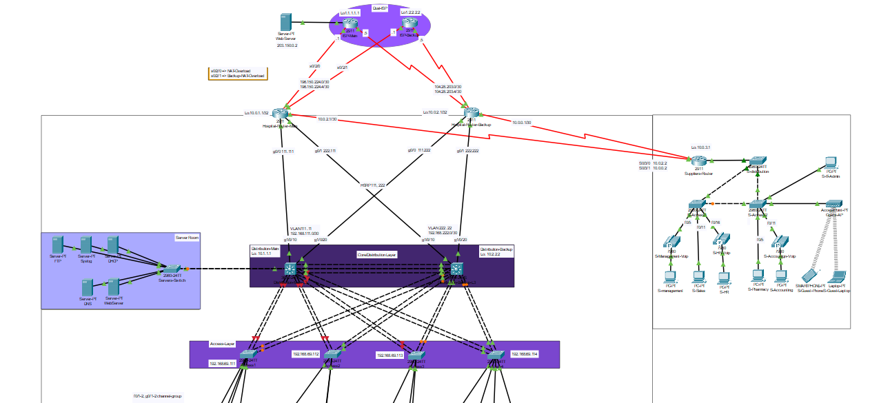
Network Topology

Slide 5

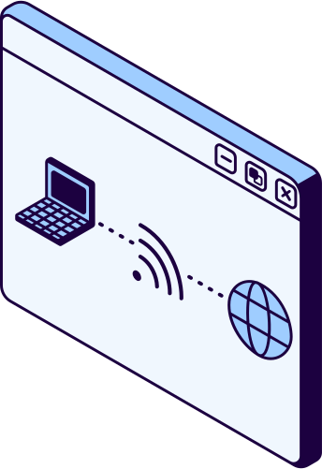
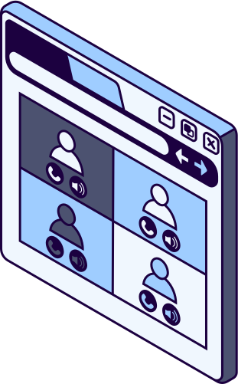
REDUNDANCY & AVAILABLITY
Redundancy ensures backup paths, increasing availability and preventing critical downtime.
Using Dual ISP for insuring constant online status
Two Multilayer Switches for insuring high availability inside the hospital block infrastructure
Using Hot Standby Router Protocol to make sure always on touch with suppliers and the internet

Slide 6
High Range of wireless connectivity for mobility and convenience
Using multiple access points considering non-overlaping 2.4 GHz channels
WIRELESS CONNECTIVITY
WPA2 PSK Security
Roaming Between APs
Wide Coverage range

Slide 7

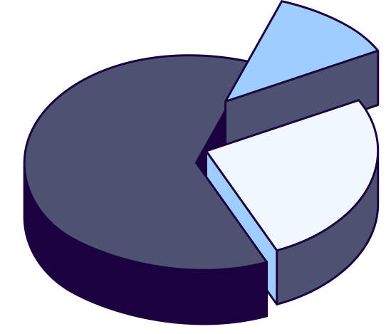

SECURITY
ACLs
Switching Security
VLANs
Using Access Control Lists to control what users can reach
Securing switches against common attacks
Segmentation of LAN to create more control and secuiryt

Slide 8
NETWORK PROTOCOLS
OSPF (Open Shortest Path First):
A link-state routing protocol that uses the Dijkstra algorithm to find the shortest path.
Preferred for larger and more complex networks due to its efficiency.
VLANs (Virtual Local Area Networks):
Used to segment a network into smaller, independent broadcast
domains to increase efficiency and security.

Slide 9
DHCP (Dynamic Host Configuration Protocol):
Automatically assigns IP addresses to devices in the network.
STP (Spanning Tree Protocol):
Prevents network loops when there are multiple paths between switches, ensuring aloop-free topology.
IPsec VPN TUNNEL:
Provides secure, encrypted communication between networks over the internet.

Slide 10
NAT (Network Address Translation):
Translates private IP addresses into public IP addresses for devices to communicate over the internet.
DNS (Domain Name System):
Resolves domain names to IP addresses, making it easier for users to access websites.
EtherChannel:
A technology that combines multiple physical links between switches to increase bandwidth and redundancy.

Slide 11
PACKET TRACER DEMONSTRATION

Slide 12

ANY QUESTIONS

