Slide 1

Finance RAG
Basel Al-Dwairi Orange Jo
Search for Questions using a RAG for financial Institutions with over 1K+ Documents

Slide 2




Every day Challenges
Scattered Information amongst hundreds and thousands of Web pages
Finding the exact information is a time-consuming process
Using conventional general-purpose AI isn’t very reliable and leads to Hallucinations

Slide 3





Retrieval-Augmented Generation - RAG
Question and Answering Model
Customized Answers
Ease of Use and Great UX
Faster Access to information
Easy to implement and Scale

Slide 4






Crawler
Scraper
Cleaning Data
Database
LLM Model
Interface
RAG Pipeline

Slide 5
Data Collection
Python Script
BFT over URLS
Web Scraper
Request and BeautifulSoup
EDA
Clean Data:
Focused Crawler
Input of a base URL of Desired Website
Save all URLs visited and names in a CSV file
Custom scripts and Scalability
Request and BeautifulSoup
Captures HTML Text Data
Saves all Data in a CSV file along with their URLs and Names
Removes Arabic
Removes Repetition
Removes HTML Artifacts
Normalizations
Saves Clean Data in a CSV file along with URLs and Names
Removes Pictures
Removes URLs
Regex and Pandas

Slide 6

RAG architecture
LiquidAI/LFM2-2.6B
Sentence transformer
Vector Search
FAISS
Database
MongoDB
Embeddings and Chunking
CSV file and read with Pandas
Clean Retrieve Data
2.6B parameter LLM
Fine-tuned on QA
Store previously asked Questions for faster answers
Self-hosted
Text Splitter
GPU
Linux (Ubuntu)
RTX 4050 and Cuda cores

Slide 7
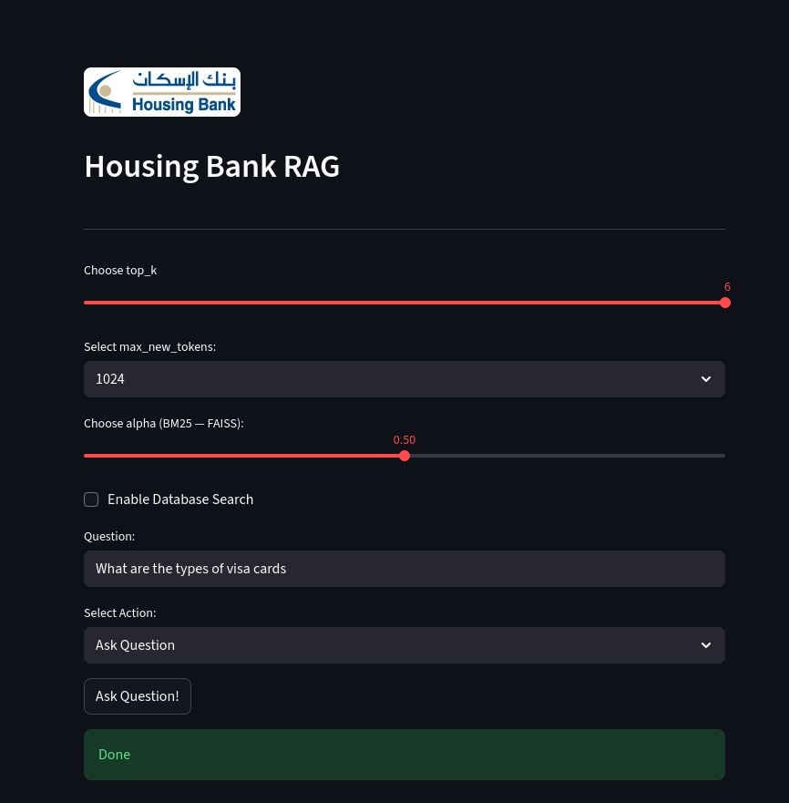
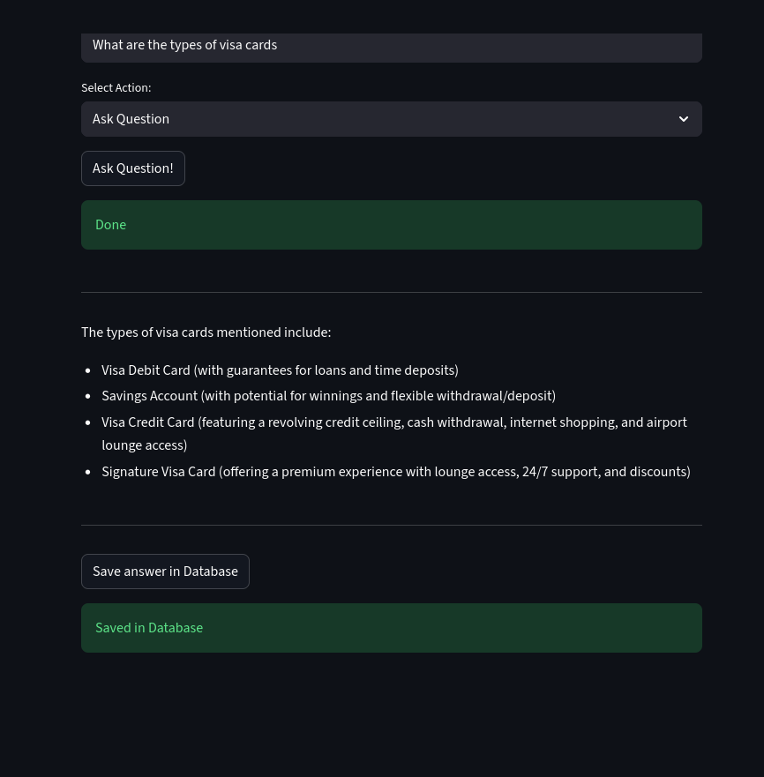
Front-End - Streamlit

Slide 8
How is it Special
Custom Data collection and cleaning Scripts
Scalable and Cloud Integration
Clean UI/UX
Locally-hosted (1000+ Documents)

Slide 9
Live Demo

Slide 10


Challenges & Future
Challenges
Local-hosting limits LLM Selection and top_k retrieval
Unilingual only (English)
Future
Cloud and Scalability
Chance of Scraping sensitive Data
No Image or Video Integration
Use of multiple Financial Institutes
Improved UI/UX
Bigger Databases and Collections

Slide 11
Thank you for Listening

