Slide 1
N-Queens Problem
Backtracking
Backtracking with Forward Checking
Min Conflicts
Image processing
Streamlit UI
Basel Al-Dwiari 2022502065

Slide 2
What is the N-Queens problem
N-Queens problems is a classical AI problem, where there is an N*N chess board grid with N queens.
The queens have to be arranged in a way, so no queens attacks any other queen.
Constraints:
  1 Queens per column
State representation:
  Board → np.array()
  Where board[col] = row, col is queen, and row is the row that queen is on

Slide 3
Why is N-Queens Interesting?
This problems teaches us a lot about how we should approach problem solving in AI
The algorithms tested are the following:
Backtracking
Backtracking with forward checking
Min Conflicts (Local, Heuristic)

Slide 4
What is Backtracking?
Backtracking is testing combinations that start with an empty board, we guess where a queen is placed, and check if this new places satisfies a safety check (Doesn’t attack any previously placed queen)

Slide 5
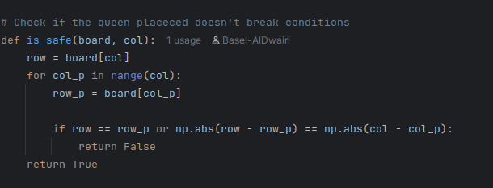
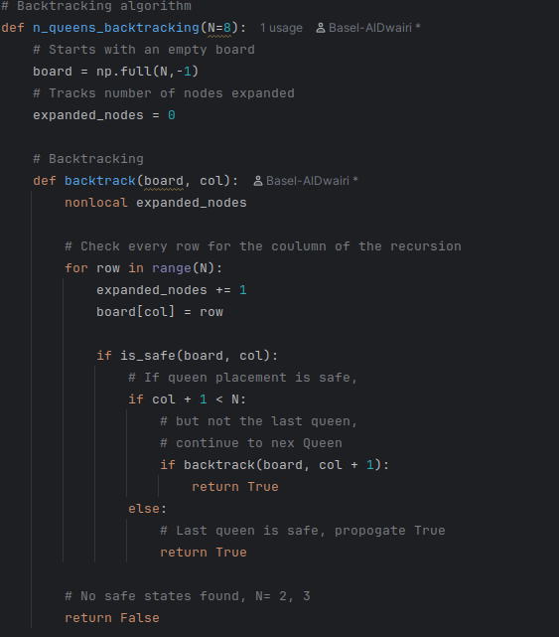
Why is Backtracking?
Safety check Algorithm

Slide 6
What is Backtracking with Forward Checking?
Backtracking with forward checking is searching through a domain, and updating the domains of every queen after the queen placed, to narrow down the search space
Representation:
domain[col] = {row1, row2, …., rowN}
where col is the queen, and set of rows is the domain where the queen meets the constraints

Slide 7
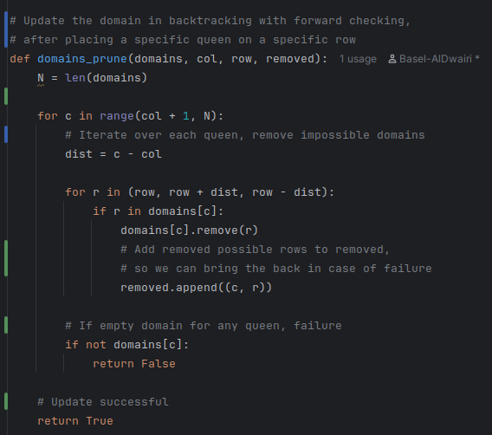
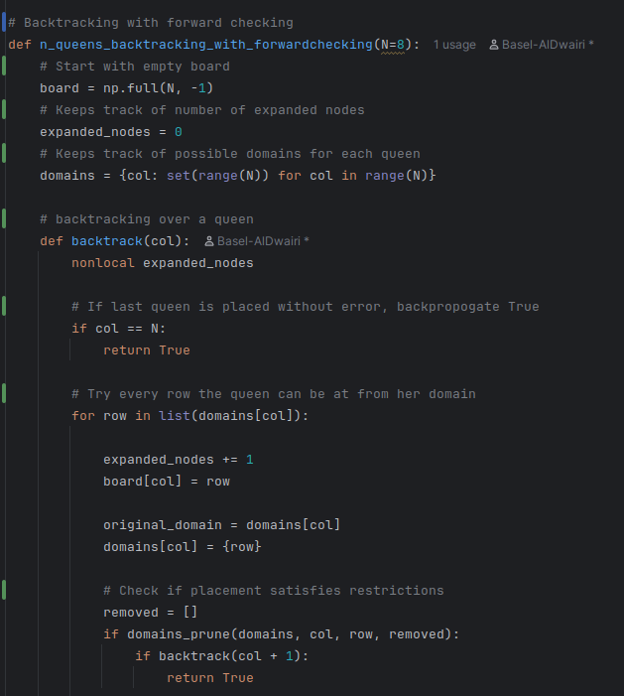
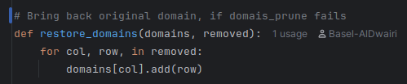
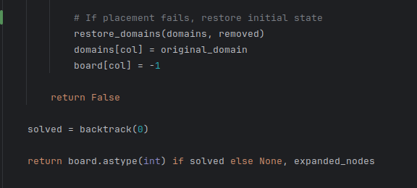
Backtracking with Forward Checking
Update domains Restore Domains Algorithm

Slide 8
What is Min Conflicts?
Min Conflicts is searching the search space with heuristics.
The algorithm starts with a random board, unlike the previous algorithms which start with an empty board
The heuristic used was the amount of attacking pairs of queens for every state.
The algorithm chooses to go to the state with the lowest amount of attacking queens, it randomizes the state that it goes to when more than one state has the same heuristic value, to avoid local minima
Random restarts are used when no solution is found for a given board

Slide 9
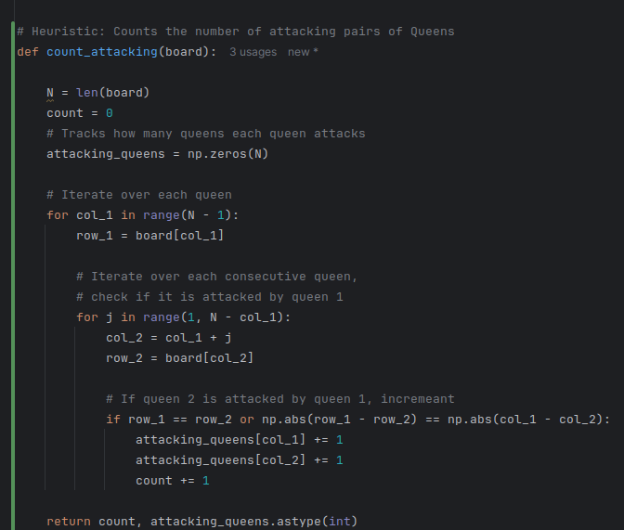
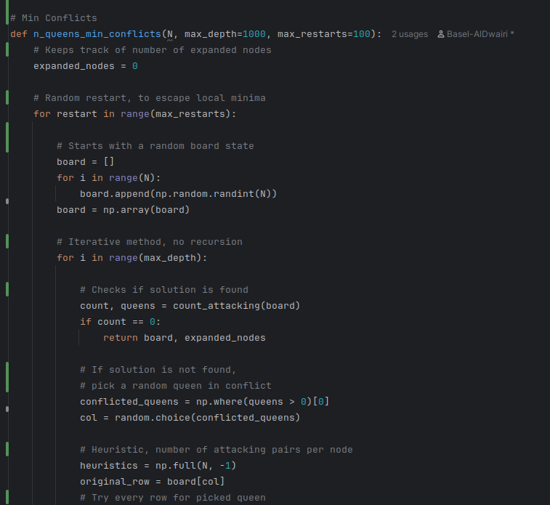
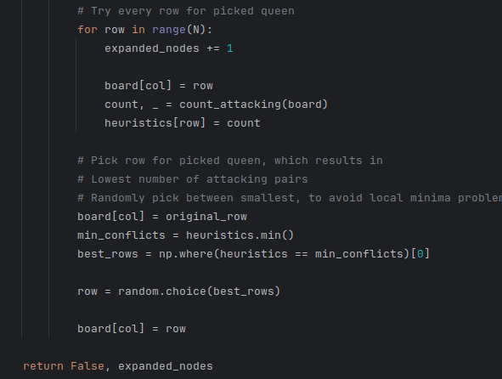
Min Conflicts
Heuristic function Algorithm

Slide 10
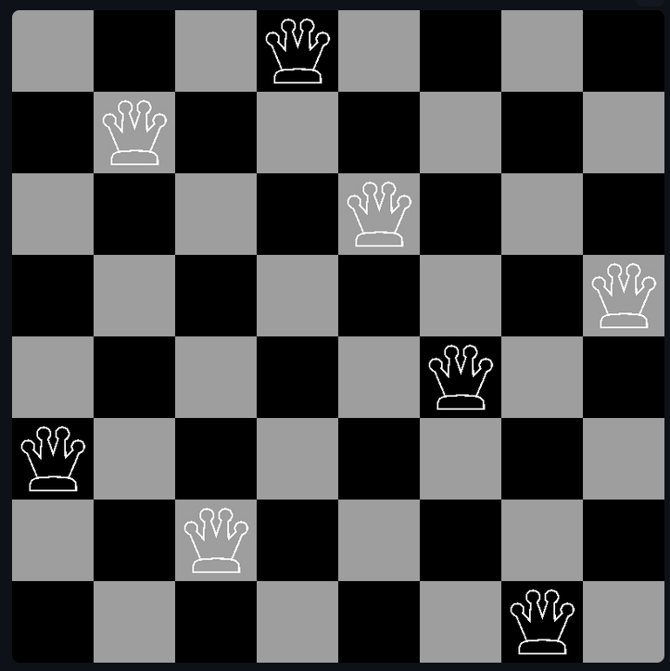
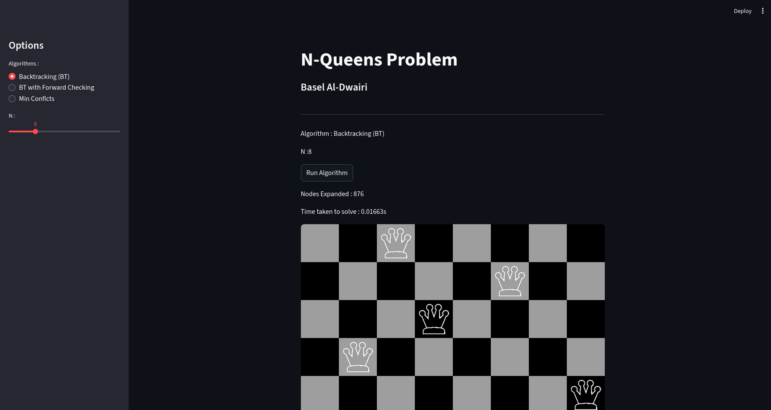
Visualization & UI
Numpy and cv2 were used to create a chessboard to visualize the board state
User Interface was created to help test and present the project, Streamlit was used.

Slide 11
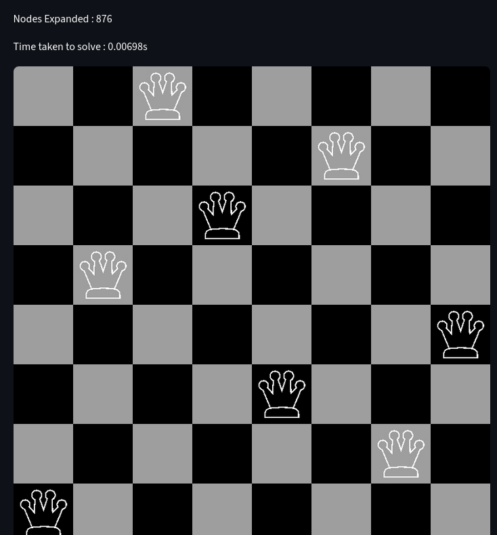
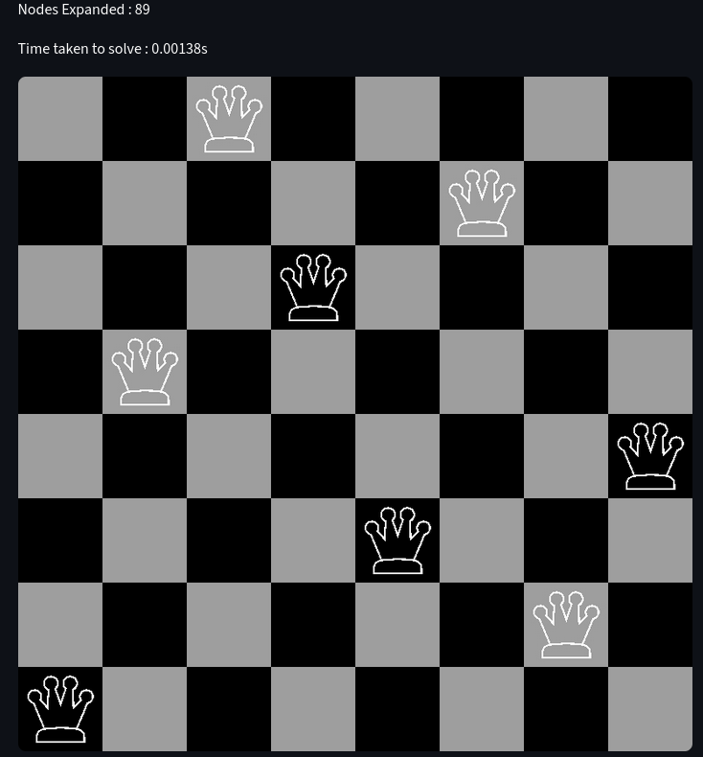
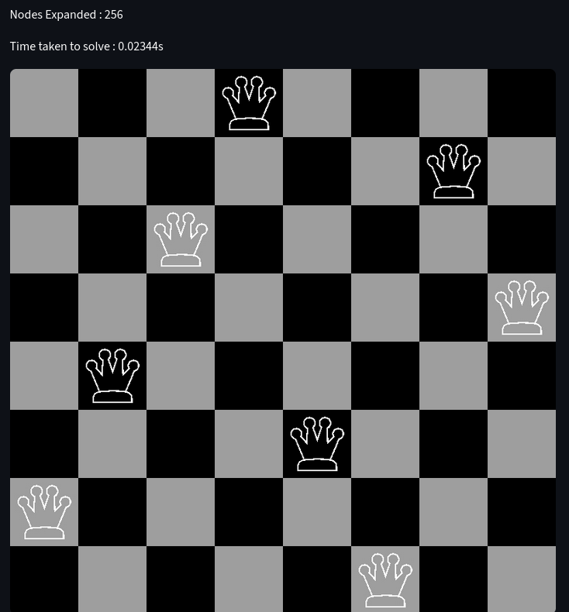
Results N = 8
Backtracking backtracking with Forward Checking Min Conflicts
876 Nodes expanded 89 Nodes expanded 256 Nodes expanded

Slide 12
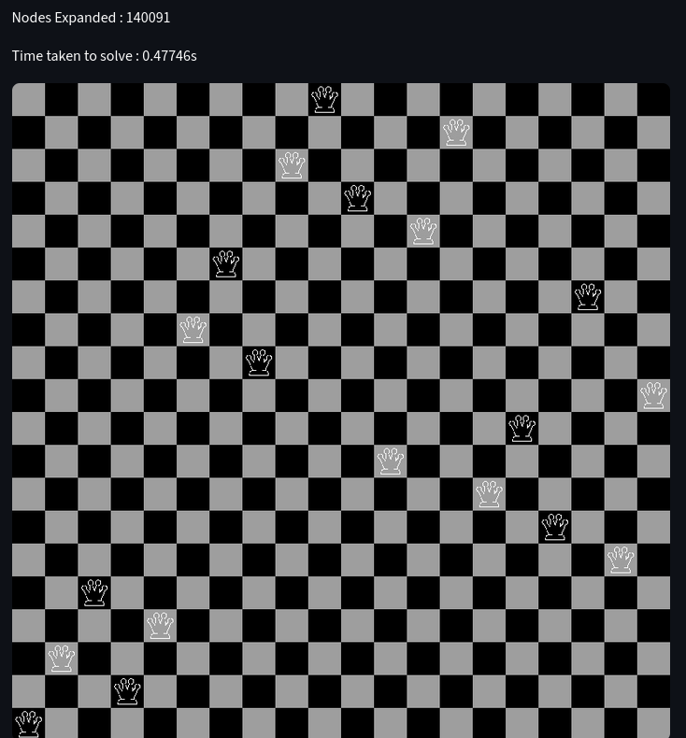
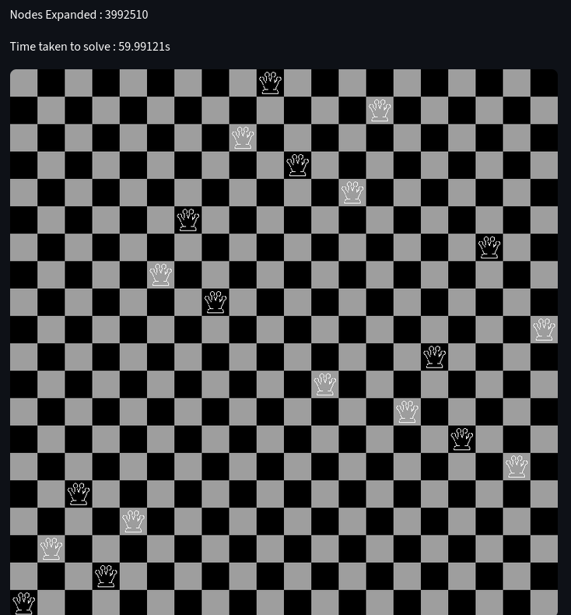
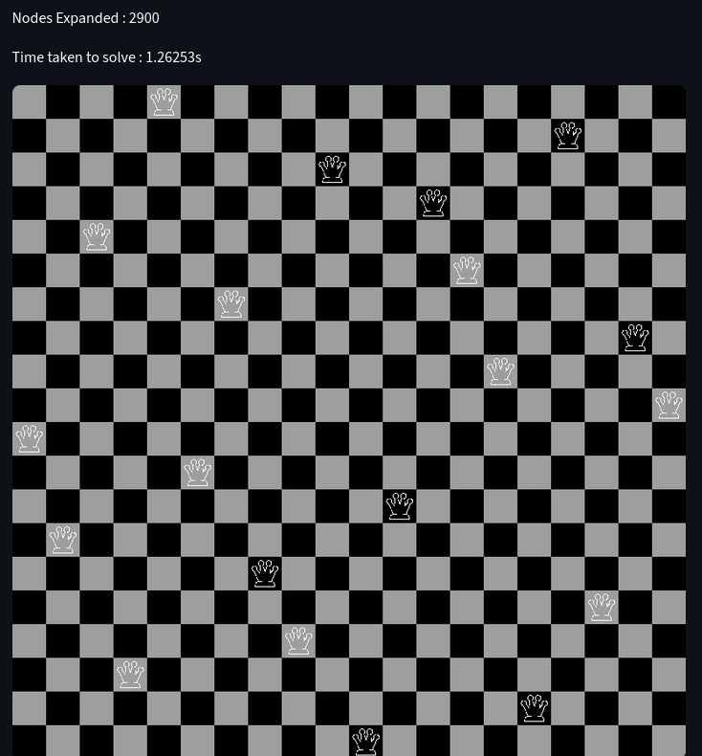
Results N = 20
Backtracking backtracking with Forward Checking Min Conflicts
~4 Million Nodes expanded ~140k Nodes expanded 2900 Nodes expanded

Slide 13
Demonstration
  Live demo and explanation

Slide 14
Conclusion
All three algorithms preformed very well for low N values (N=8)
For larger N, Min Conflicts proved to outmatch the other algorithms, both in number of nodes expanded, and Time taken to complete the algorithm

Slide 15
Thank You
Thank you for listening
Any Questions

