Slide 1
Task One
Personal Profile Website

Slide 2
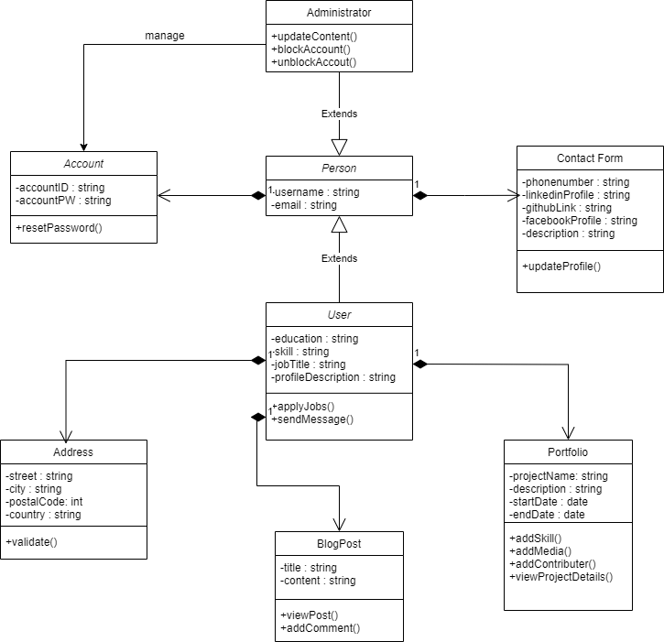
Class Diagram

Slide 3
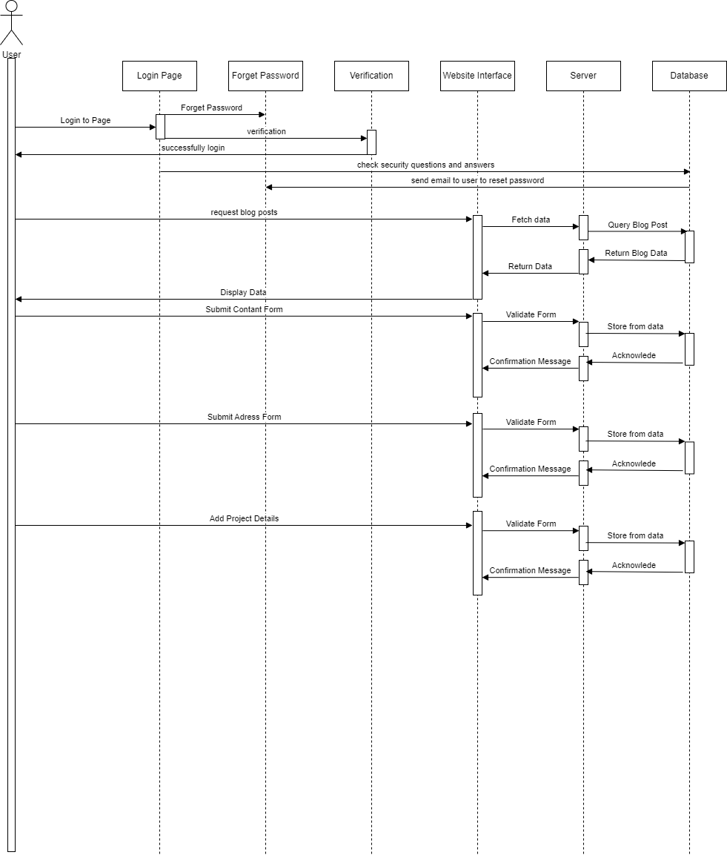
Sequence Diagram

Slide 4
SDLC Phases
1. Planning: Define website objectives, gather requirements, and create a timeline.
2. Design: Develop wireframes, prototypes, and UML diagrams (Class and Sequence).
3. Development: Use HTML/CSS/JavaScript for frontend and Django/Flask for backend.
4. Testing: Perform unit, integration, and user acceptance testing.
5. Maintenance: Regular updates, bug fixes, and performance monitoring

Slide 5
1-Planning Phase
Objective: Define the purpose, goals, and scope of the portfolio website.
Purpose: The website will showcase my personal projects, skills, blog posts, and provide a way for visitors to contact me.
Audience Analysis: Identify target users, such as potential employers, collaborators, or clients.
Feature Planning:
Home page: Overview of skills and a summary of recent projects.
Portfolio section: Detailed descriptions of projects, with images and links.
Blog section: Posts about technical topics or personal experiences.
Contact form: Allow visitors to reach out via email or messages.
Tools and Technology: Choose the tech stack (e.g., HTML/CSS, JavaScript, React, Node.js, etc.).
Budget and Timeline: Set the timeline for project milestones and allocate resources.

