Slide 1

Task 27
REST API Development and Apache Configuration
Name: Basel Amr Barakat
Email: baselamr52@gmail.com

Slide 2
Project Overview
Build a REST API using Flask with GET and Post methods
Handle JSON responses and errors gracefully
Configure Apache Virtual Hosts to serve the API

Slide 3
API Design
/users (GET) : List all users
/users (POST) : Add a new user
/users/<id> (DELETE) : Delete a user
/users (Search) : Search for a user by name or id

Slide 4
API Features
SQLite database integration
Input validation for user data (ID, name, email)
JSON and HTML response handling
Error handling with try-except blocks

Slide 5
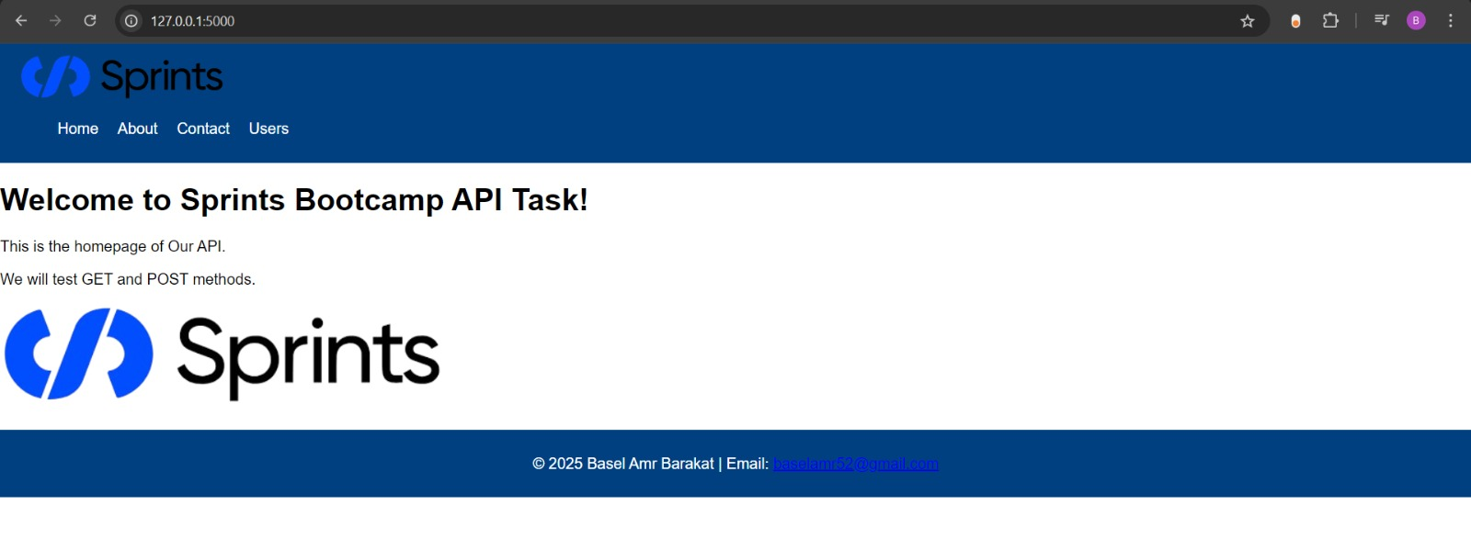
Home Page

Slide 6
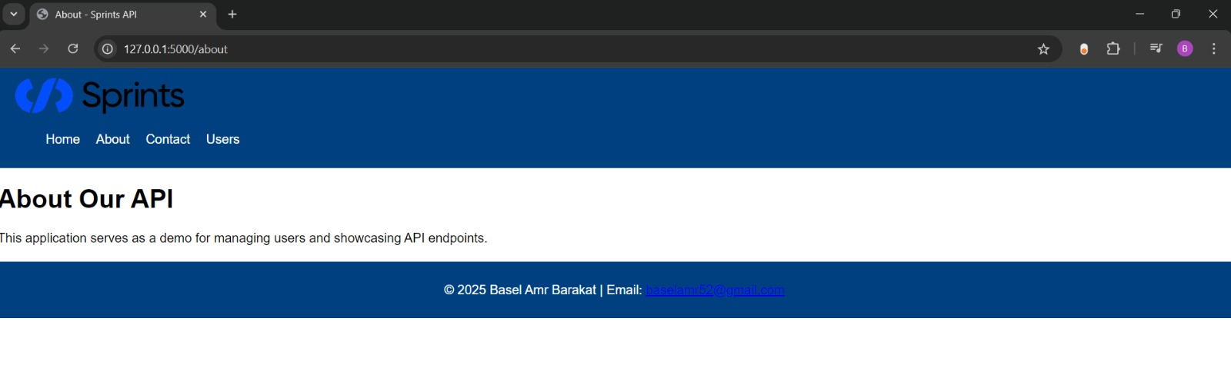
About Page

Slide 7
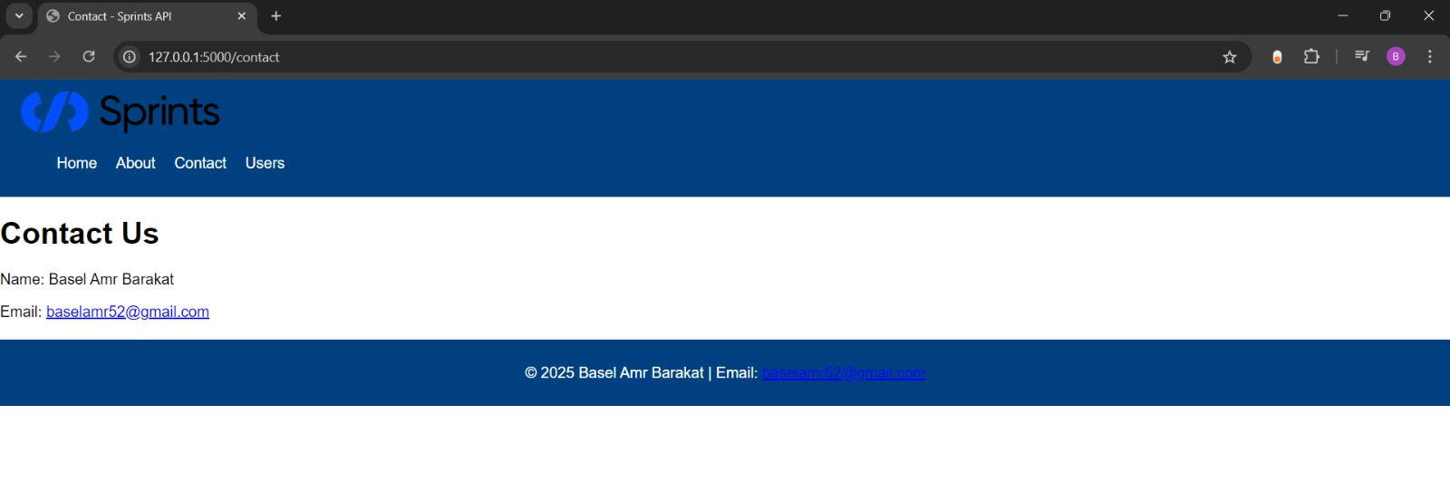
Contact Page

Slide 8
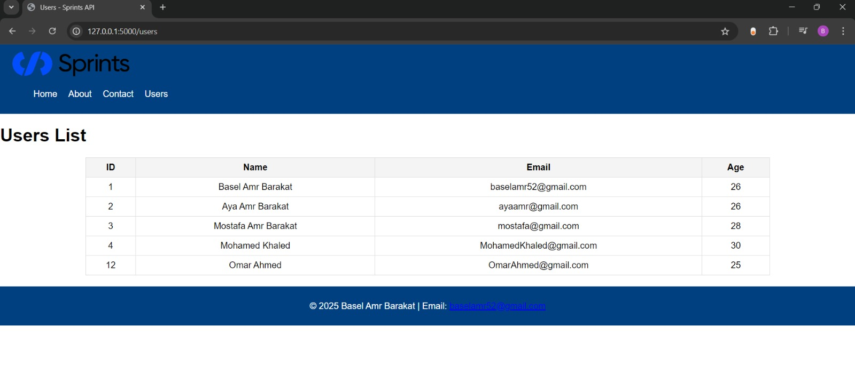
User List Page

Slide 9
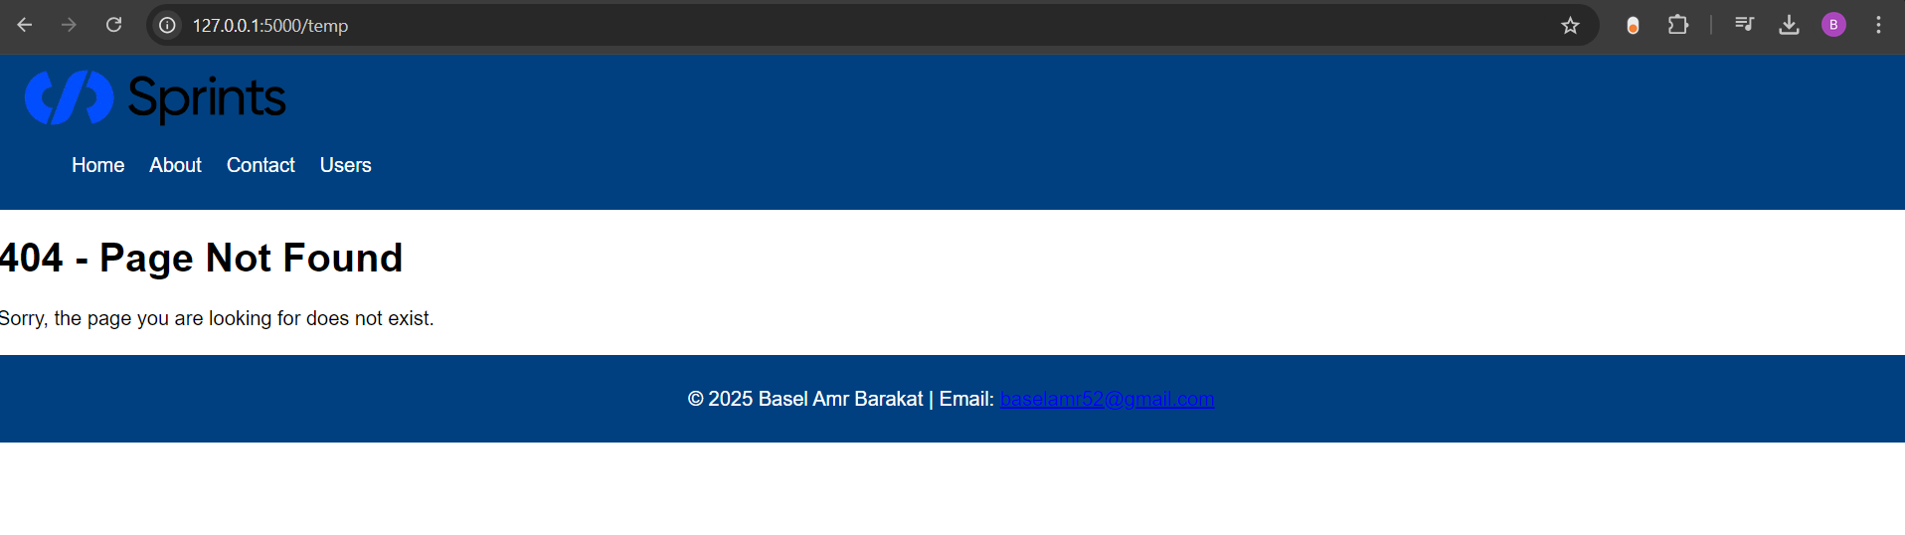
404 Page

Slide 10
Some Code Screen Shoots

Slide 11
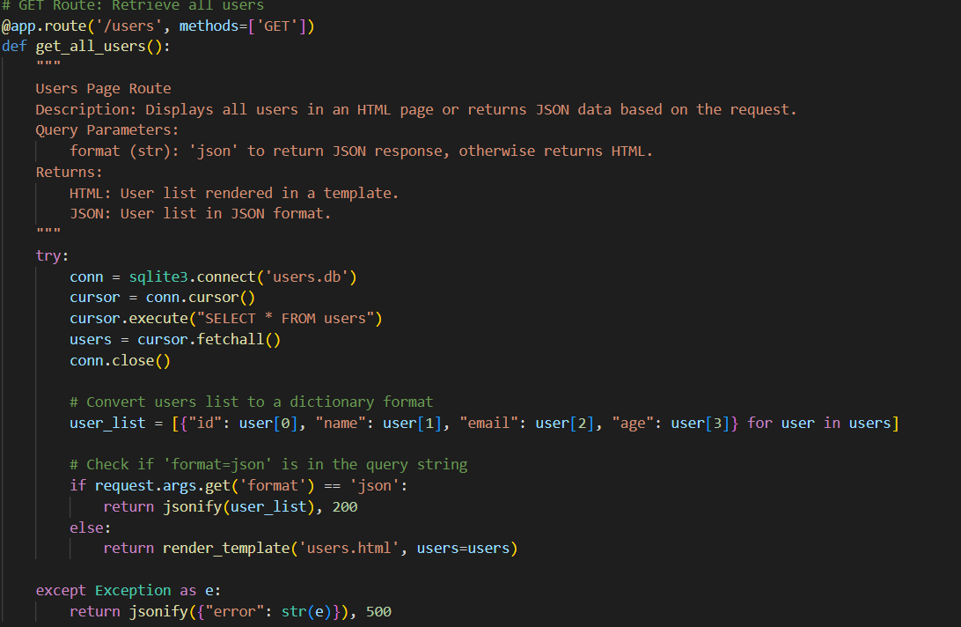
01_Get_All_Users

Slide 12
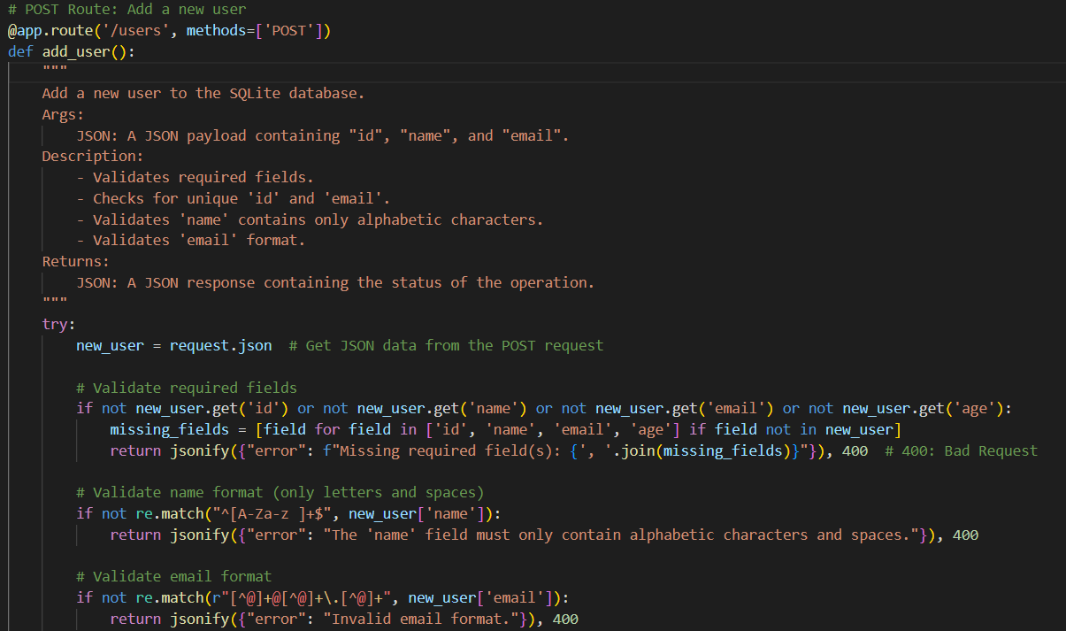
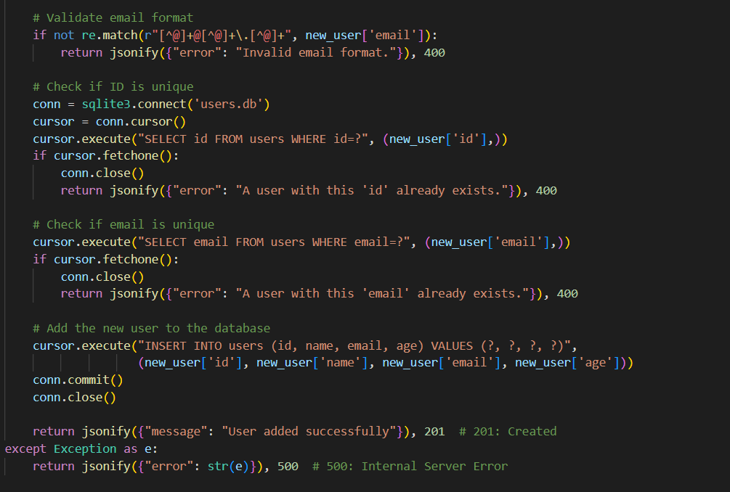
02_Add_User

Slide 13
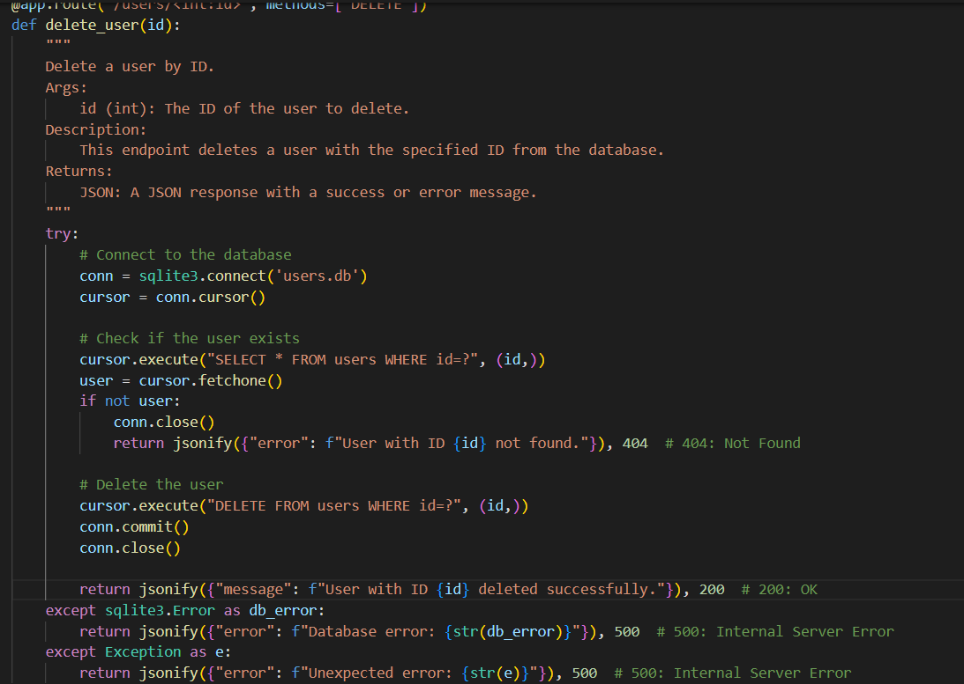
03_Delete_User

Slide 14
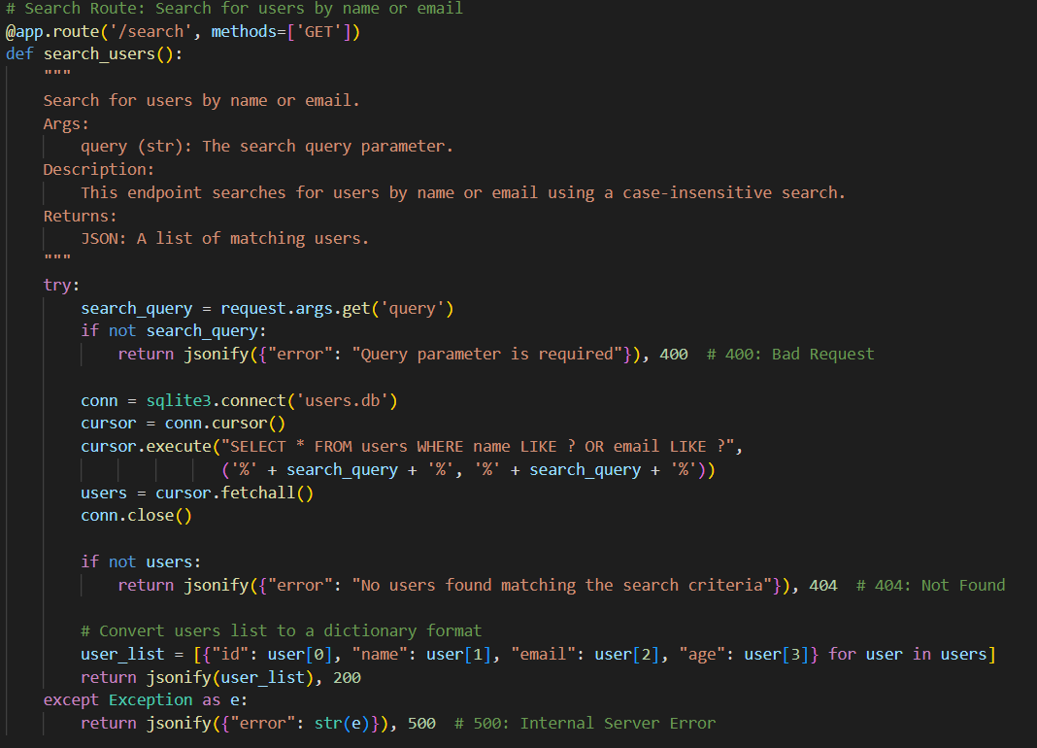
04_SearchUser

Slide 15
Pages Codes

Slide 16
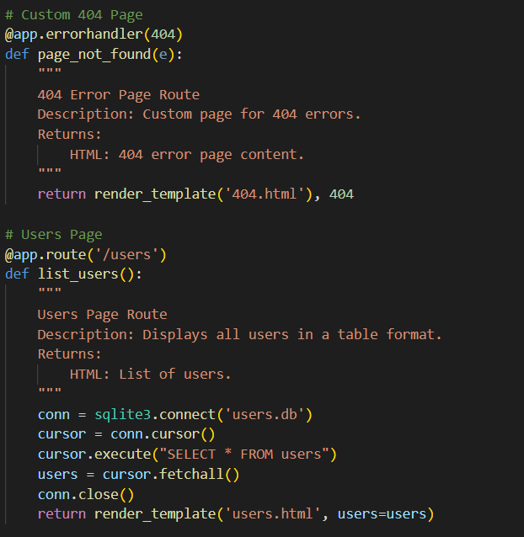
Error and User Pages

Slide 17
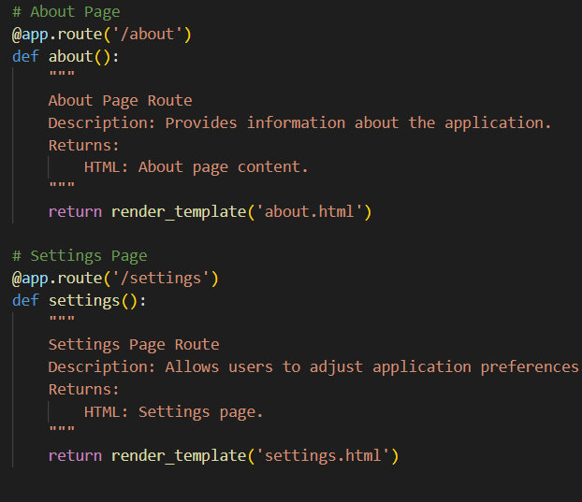
About and Settings Pages

Slide 18
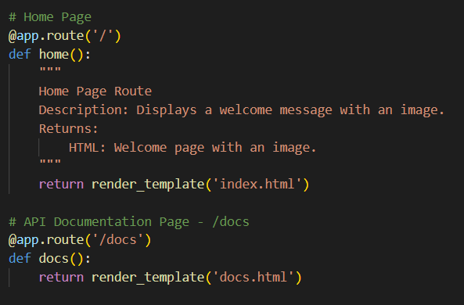
Home and Docs Pages

Slide 19
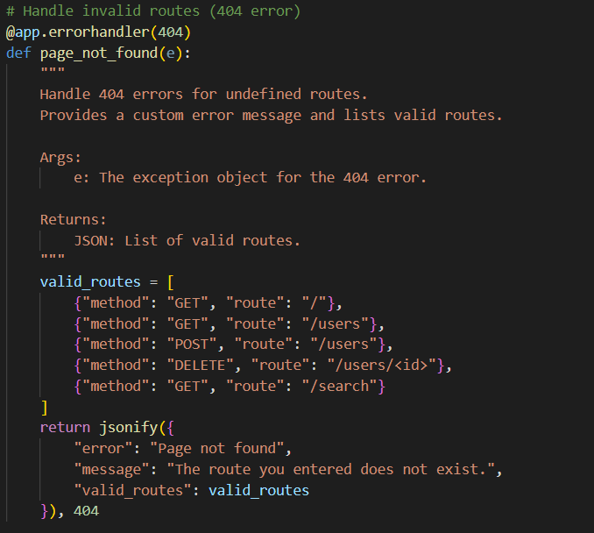
Invalid Pages

Slide 20
Testing GET Method

Slide 21
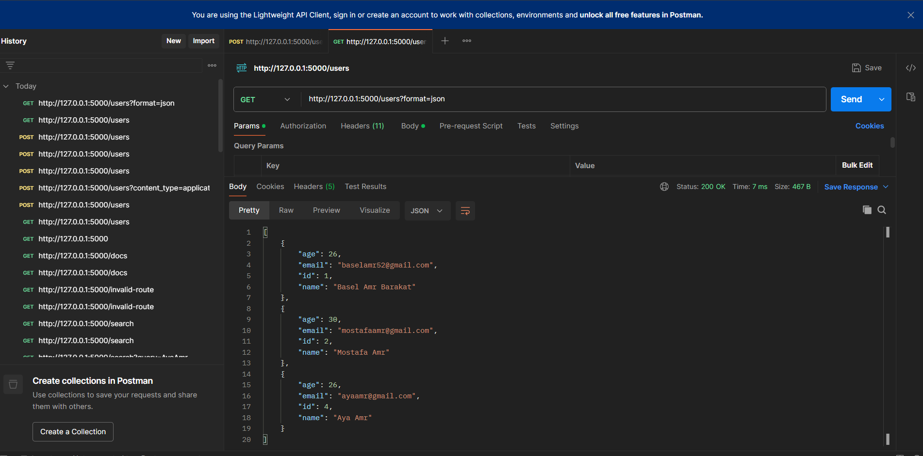
1.1 Successfully Getting All Users Postman

Slide 22
Testing POST Method

Slide 23
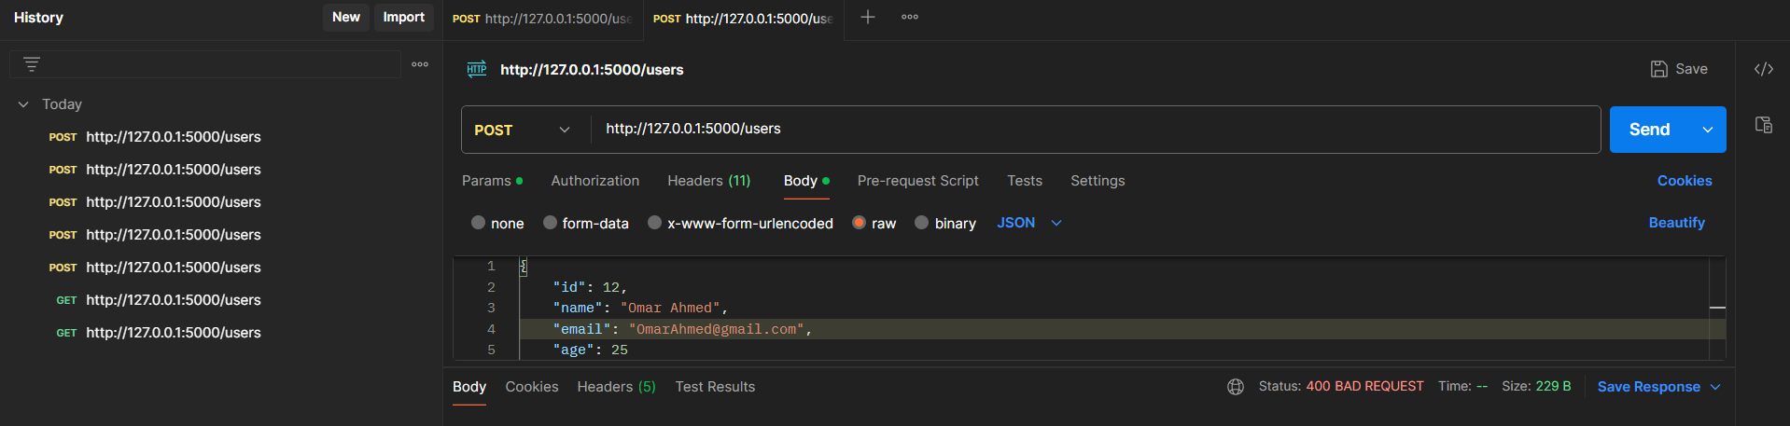
2.1 Successful User Creation

Slide 24
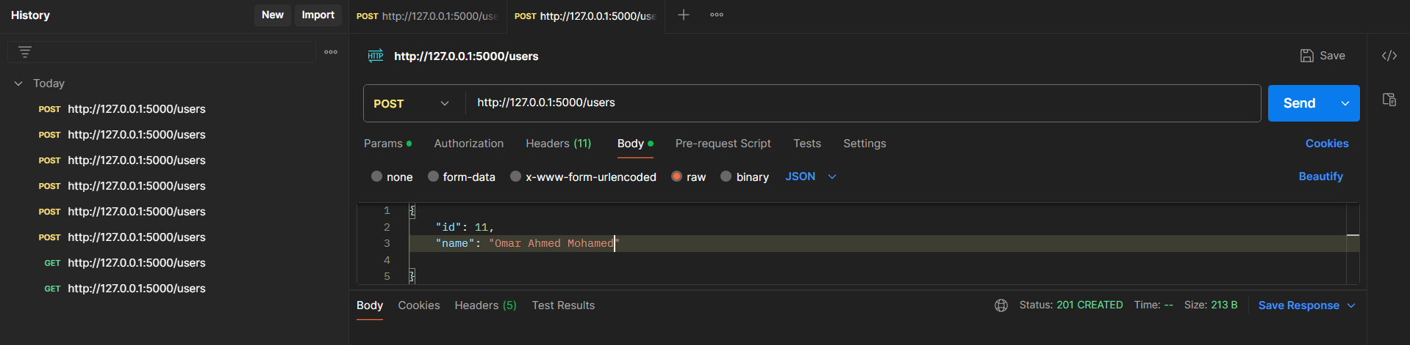
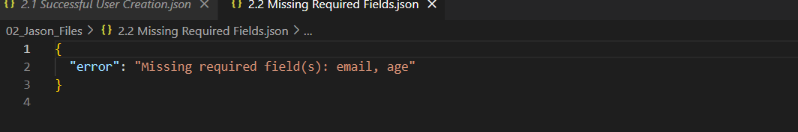
2.2 Missing Required Fields

Slide 25
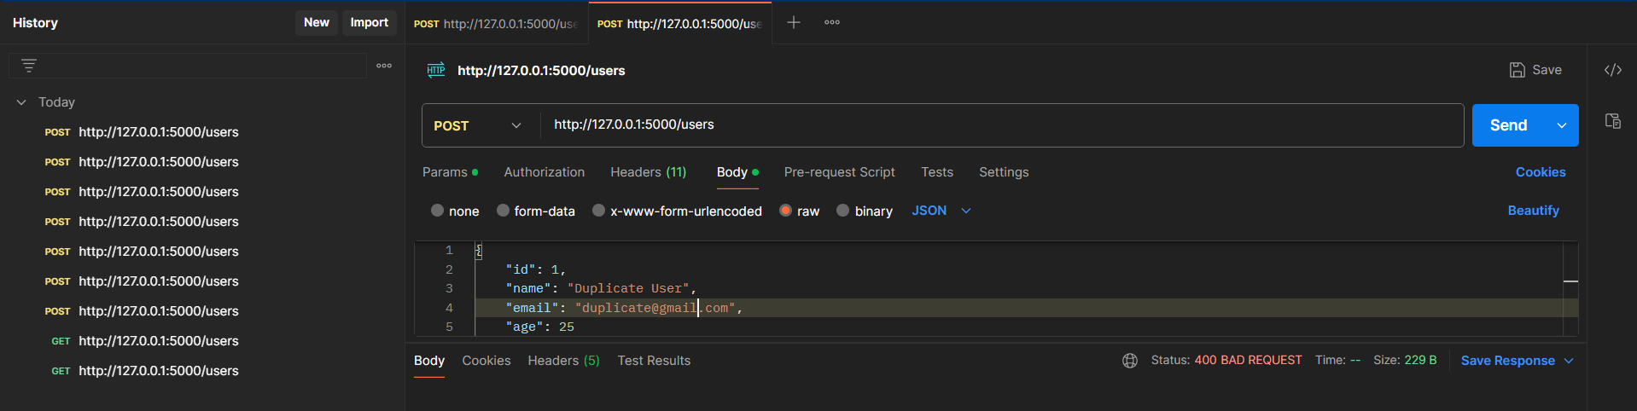
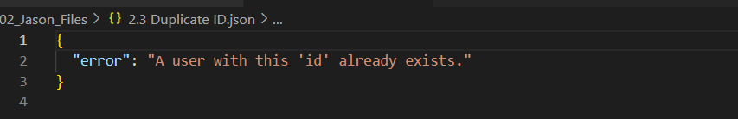
2.3 Duplicate ID

Slide 26
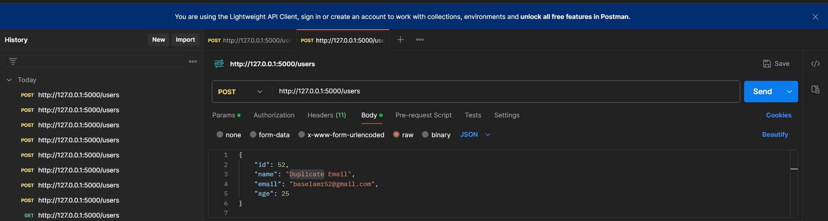
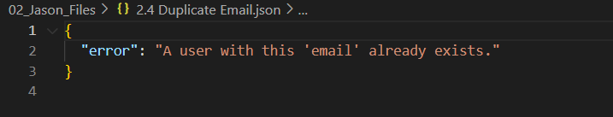
2.4 Duplicate Email

Slide 27
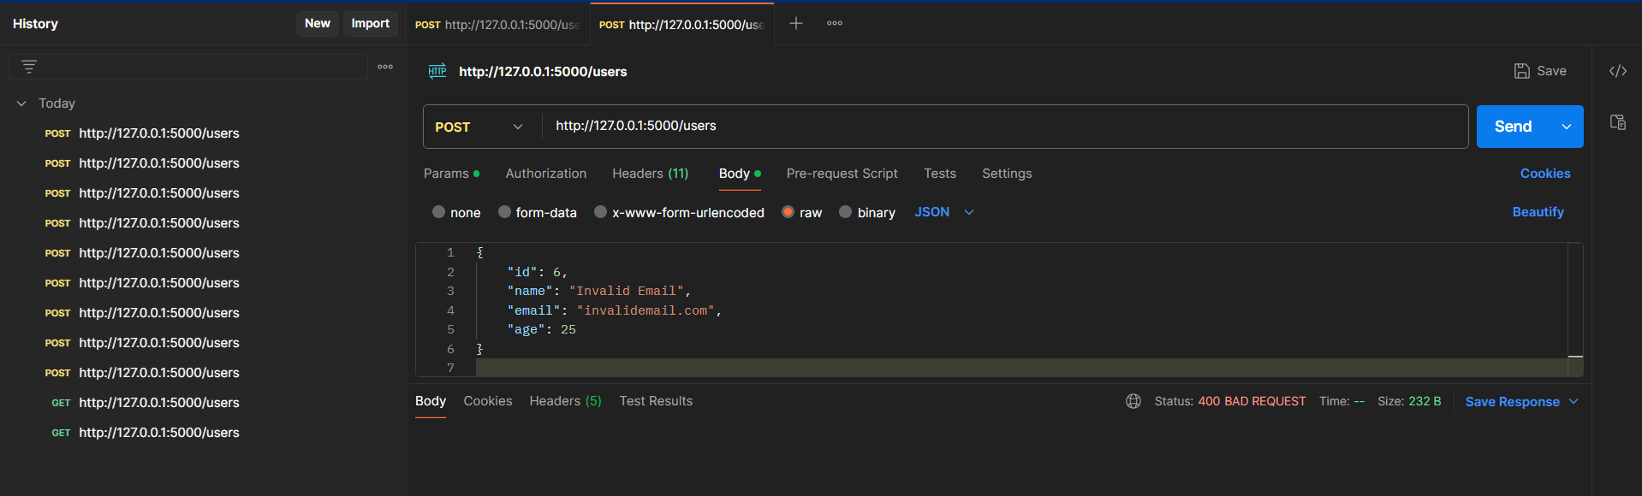
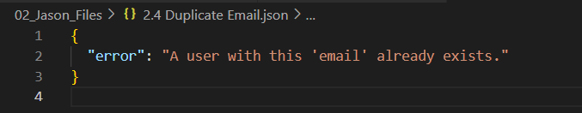
2.5 Invalid Email Format

Slide 28
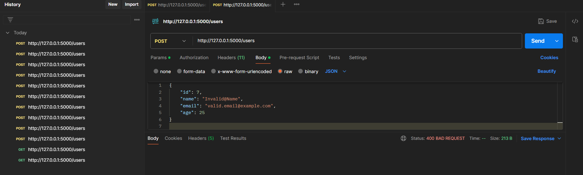
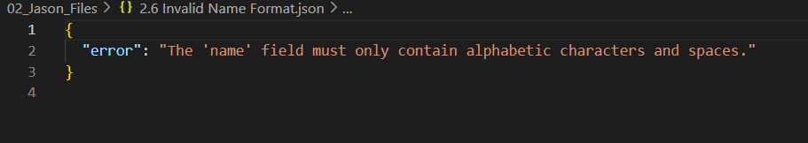
2.6 Invalid Name Format

Slide 29
Testing DELETE Method

Slide 30
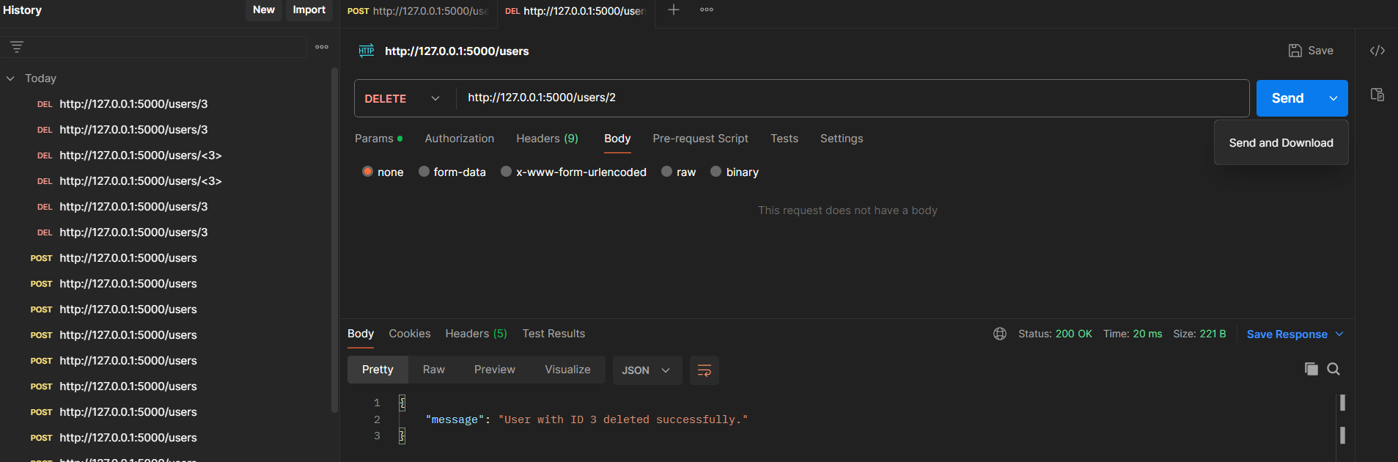
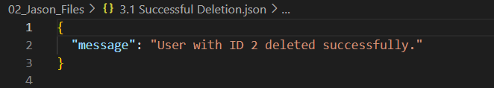
3.1 Successful Deletion

Slide 31
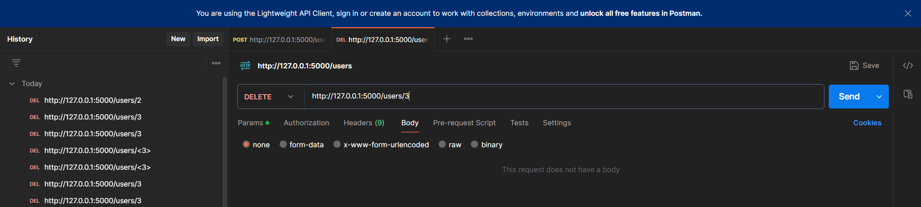
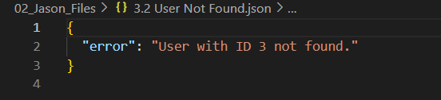
3.2 User Not Found

Slide 32
Testing SEARCH Method

Slide 33
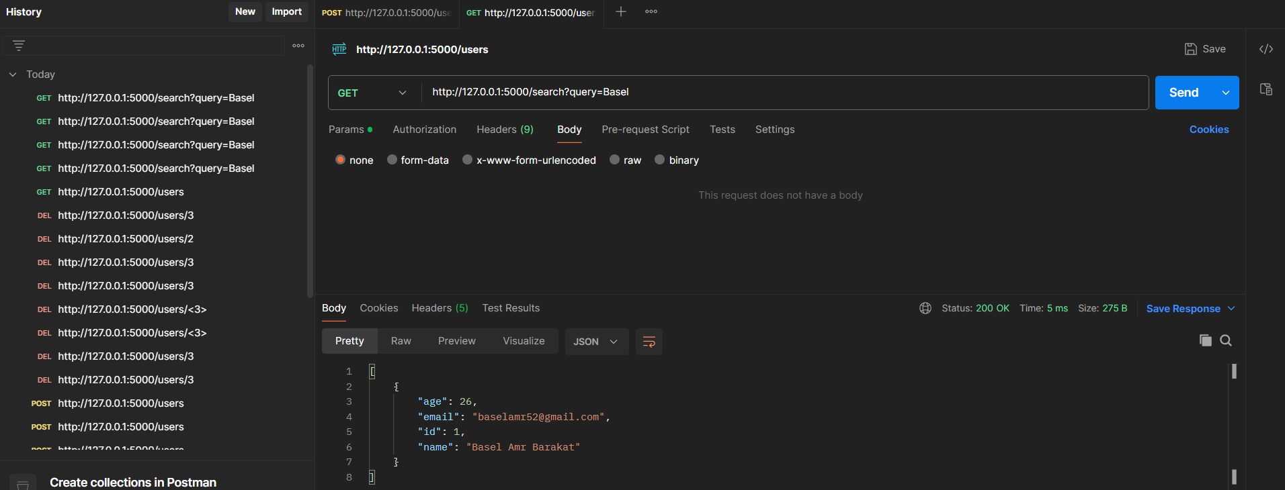
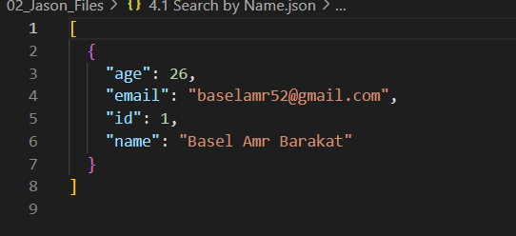
4.1 Search by Name

Slide 34
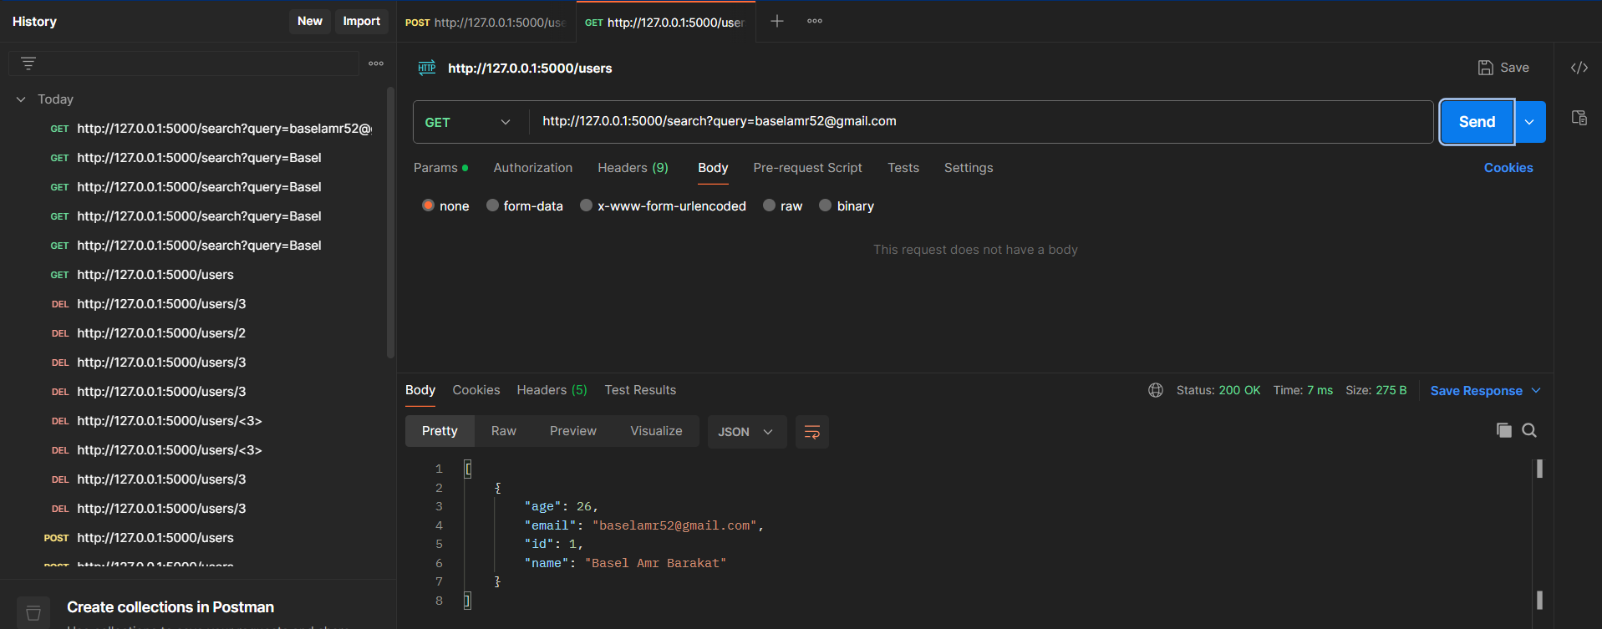
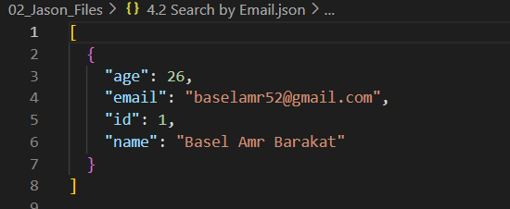
4.2 Search by Email

Slide 35
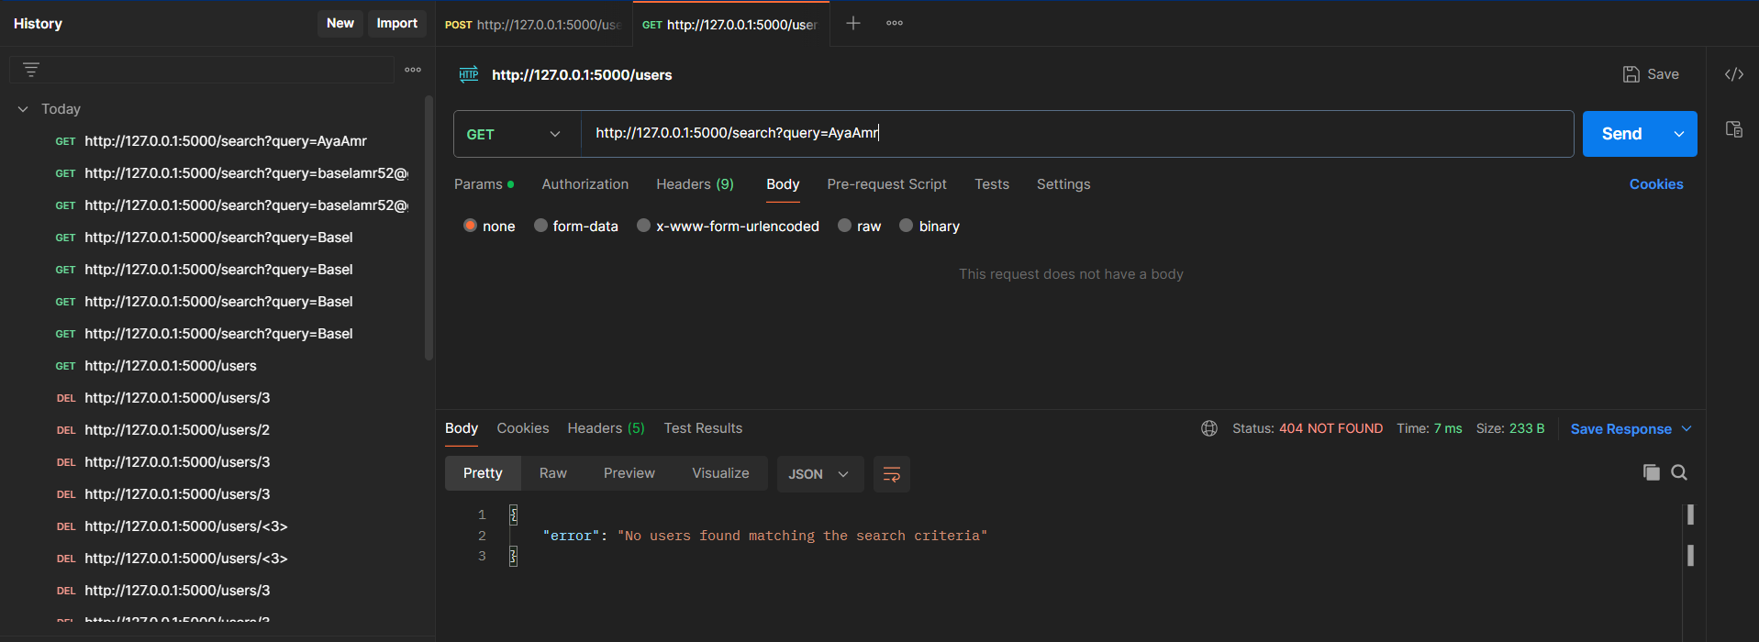
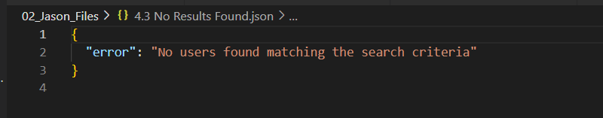
4.3 No Results Found

Slide 36
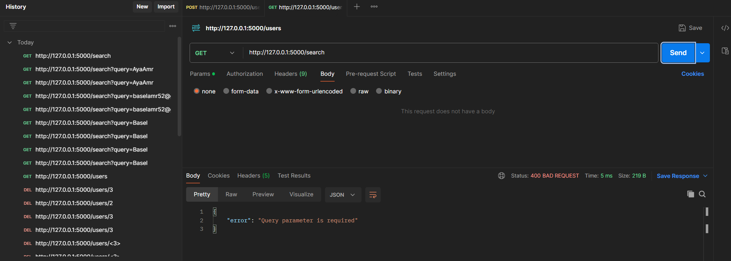
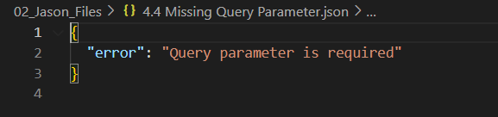
4.4 Missing Query Parameter

Slide 37
4.4 Missing Query Parameter

Slide 38
Invalid Route

Slide 39
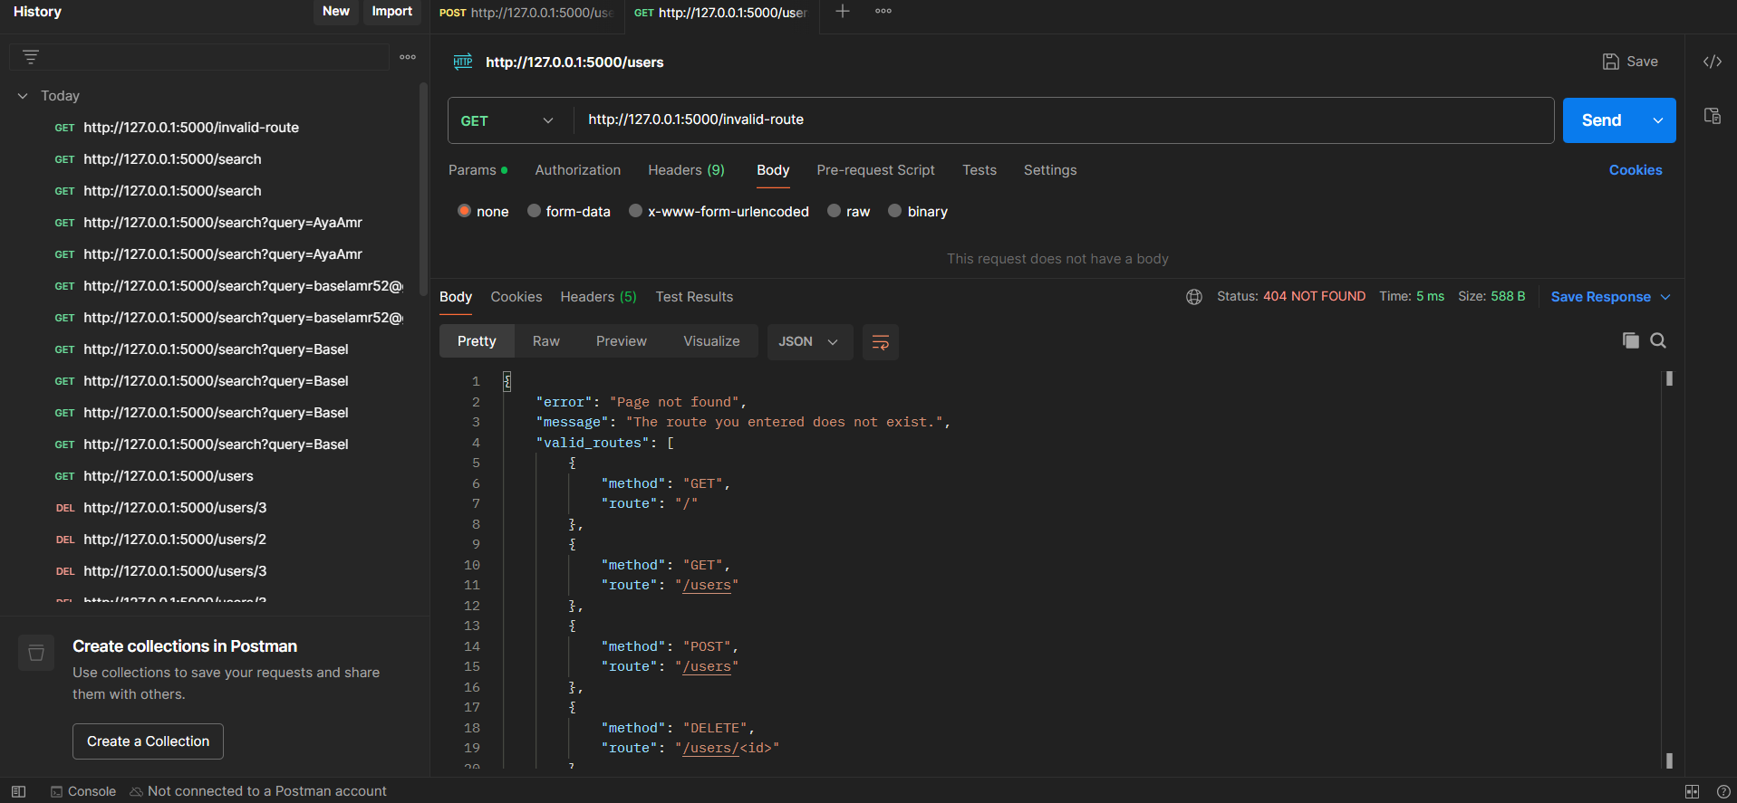
5. Invalid Route (404 Handling)

Slide 40
API Documentation

Slide 41
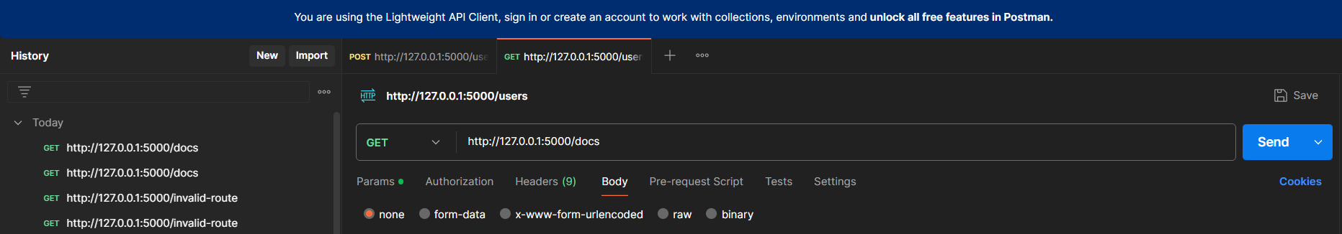
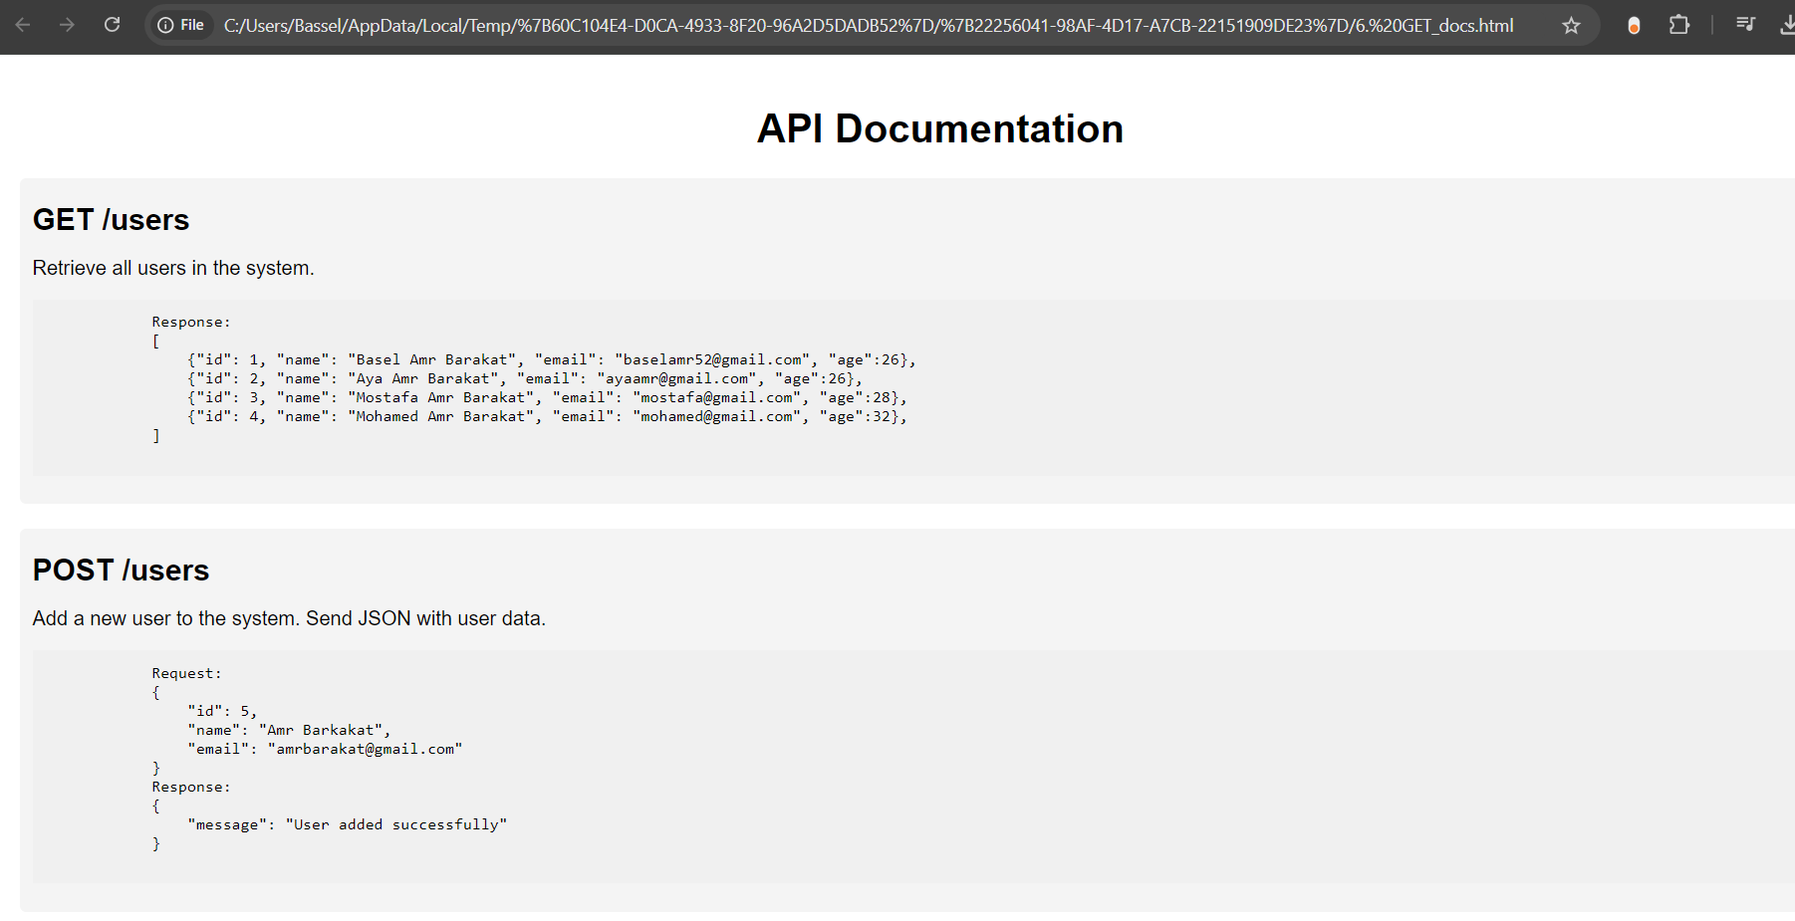
6. GET_docs

Slide 42
Setting up Flask with Apache using WGSI

Slide 43
1. Prerequisites for WSGI Deployment
Install Apache for windows
Install `mod_wsgi` for Apache
Verify installation by checking mod_wsgi version

Slide 44

2. Open the http.conf file located in the conf directory of my Apache installation and add the following lines

Slide 45
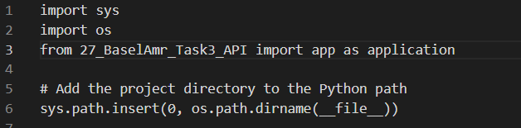
3. Create a WSGI File
1. Create a file named flaskapp.wsgi in the same directory as our api.py file
2. Add the following content

Slide 46
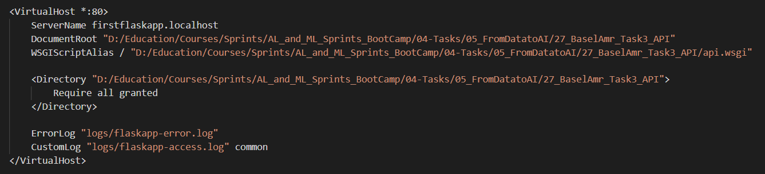
4. Setting Up Apache Virtual Host
1. Open the httpd-vhost-conf file located in the conf/extra directory of our Apache installation
2. Add the following content

Slide 47

5. Updating the host file
1. Open the hosts file with administrative priveleges
2. Add a line to map our hostname to myflask.local

Slide 48
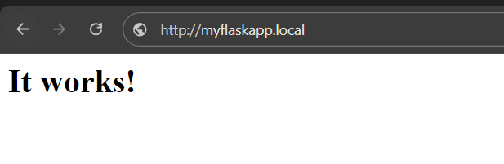
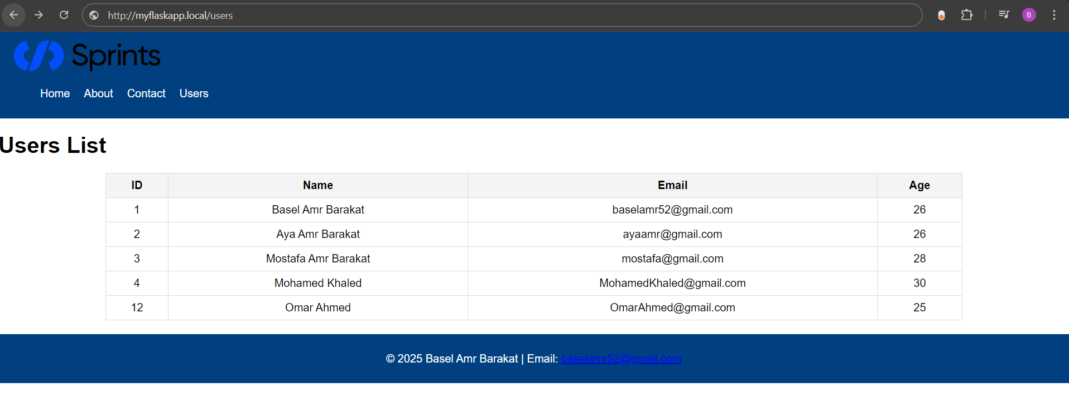
6. Test the hostname by opening the browser and navigation to http://myflaskapp.local
7. Testing Users

