Slide 1

Task Two
Git Project
Name: Basel Amr Barakat
Email: baselamr52@gmail.com

Slide 2
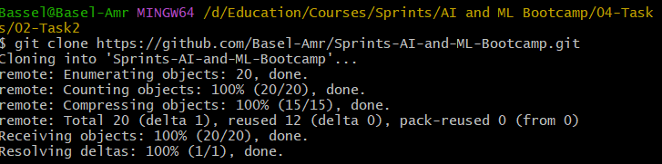
1- Clone Repo
We will clone the repository using the following command
git clone https://github.com/Basel-Amr/Sprints-AI-and-ML-Bootcamp.git

Slide 3
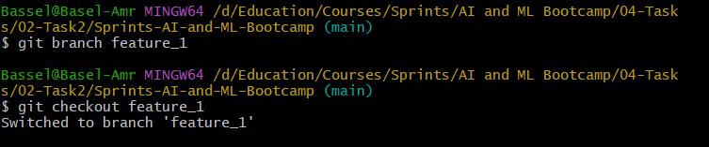
2- Branch for each feature
Create a branch so that I can work on it locally called feature_1
git branch <branch>
git checkout <branch>

Slide 4
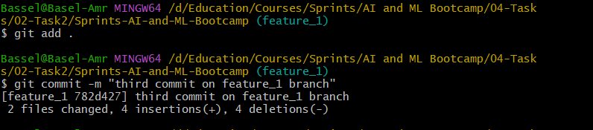
3- Development (EOD)
Make changes in feature_1 branch
Commit the changes in feature
Stage all changes git add .
Commit Changes git commit

Slide 5
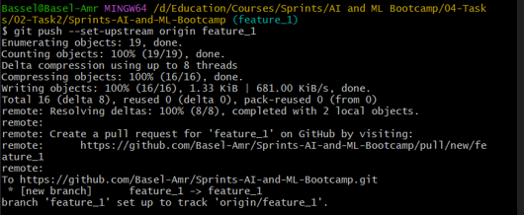
4- Update local master
git push –set-upstream origin feature_1
git push

Slide 6
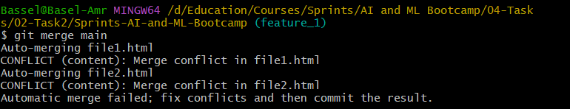
5- Merge local master feature branch(Rebase) to test
Merge with main to check if there is merge conflict or not and solve it if exist
git merge main

Slide 7
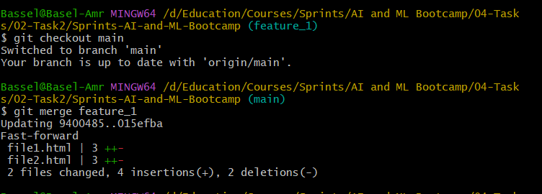
6- Merge feature branch to local master
Switch to master then merge branch to local master
git checkout main
git merge feature_1

Slide 8
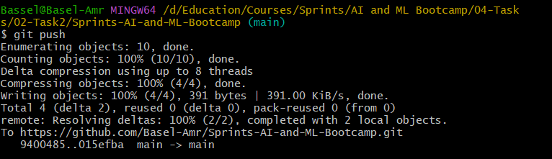
7- Push to cloud
Push your changes to GitHub
$ git push --set-upstream origin feature_1
$ git push

Slide 9
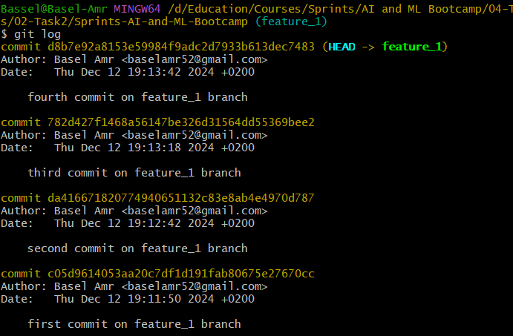
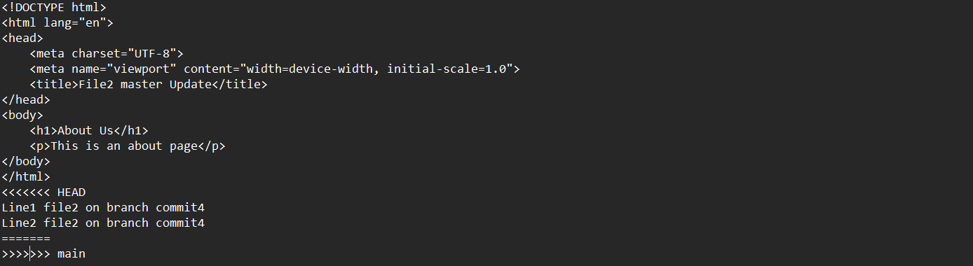
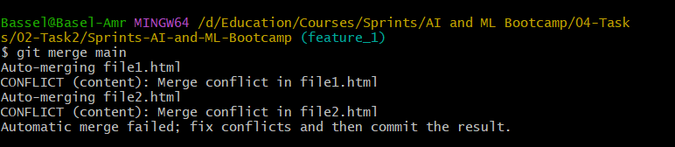
Required Deliverable:
Requirement One “multiple commits”
Requirement Two “merge conflict”
Requirement Three “git branching method”
Requirement Four “GitHub Repo”
https://github.com/Basel-Amr/Sprints-AI-and-ML-Bootcamp.git

