Slide 1
Classification of ADHD vs. Healthy Children Using Pattern Matching on EEG Signals
24-1-R-5
Basel Kabia, Mohammed Khatib
Supervisors: Dr. Anat Dahan, Dr. Samah Idrees-Ghazawi

Slide 2
Introduction
Project Focus
Overview of ADHD Diagnosis
Importance of Accurate Diagnosis
ADHD (Attention-Deficit/Hyperactivity Disorder) affects millions worldwide.
Misdiagnosis can lead to ineffective treatments.
There is a need for more objective, data-driven diagnostic methods.
Utilizing EEG (Electroencephalography) signals for a more accurate ADHD diagnosis, using novel methods of pattern matching.

Slide 3
Current Situation
Existing Diagnostic Methods:
Primarily based on behavioral assessments and questionnaires.
Limited use of neuroimaging or electrophysiological methods.
Challenges:
Subjectivity in assessments.
Variability in symptoms presentation.
Need for Improvement:
More objective, reliable methods to improve diagnostic accuracy.

Slide 4

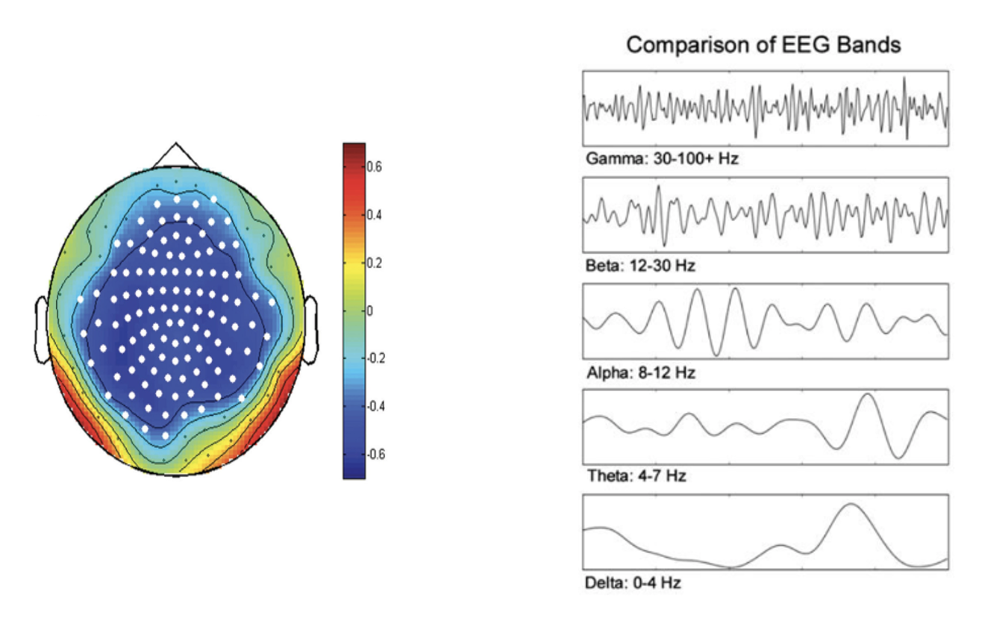
Analysis of EEG Signals
EEG captures electrical rhythms generated by brain neurons.
Decomposition into frequency bands: Delta, Theta, Alpha, Beta, Gamma.
Each frequency band correlates with different cognitive functions.

Slide 5
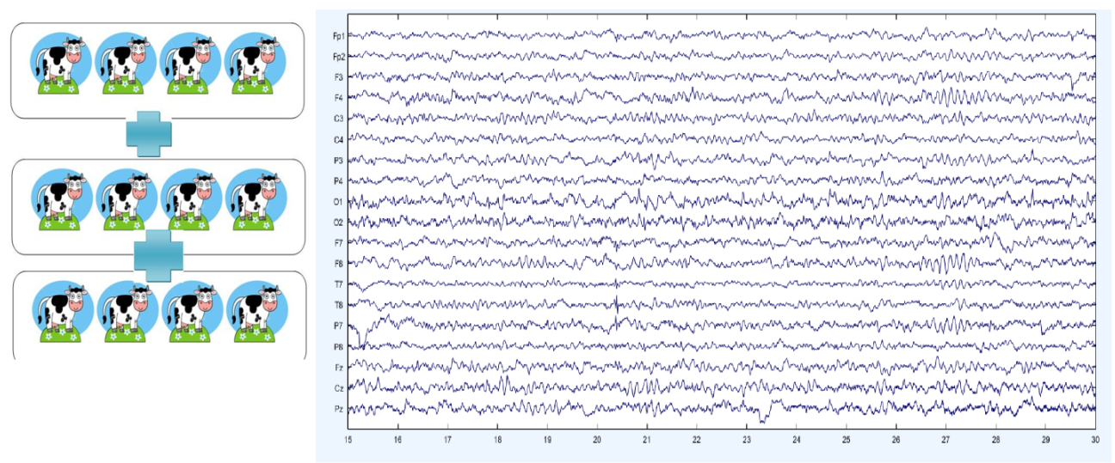
Dataset Overview
61 children with ADHD and 60 healthy controls (ages 7-12) participated.
ADHD diagnosed per DSM-IV and confirmed by a psychiatrist; ADHD group had up to 6 months of Ritalin treatment.
Controls had no psychiatric history, epilepsy, or high-risk behaviors.
EEG used a 19-channel, 10-20 system, 128 Hz sampling rate, with earlobe reference electrodes (A1, A2).
EEG recorded during visual attention tasks involving counting 5-16 cartoon characters.
Task duration adjusted to each child's response speed for clear visibility and accuracy

Slide 6

PREVIUOS WORKS
Dynamic Connectivity and ConvLSTM with Attention:
Analyzes dynamic connectivity patterns between EEG channels.
Uses ConvLSTM with attention to preserve spatial and temporal information and reduce data size.
TMP19 Model Using Ternary Motif Patterns:
Decomposes EEG signals with Tunable Q Wavelet Transform (TQWT).
Extracts features from wavelet subbands and raw EEG using Ternary Motif Patterns.
CNN and Classical Classifiers on Raw EEG:
Trains a CNN on raw EEG data.
Uses CNN-extracted features to train SVM, Logistic Regression, and Random Forest classifiers.
Spectral Dependence Analysis:
Decomposes EEG data into frequency components.
Studies linear and non-linear relationships using coherence and partial coherence measures.
Graph Theory and Directional Information Transfer:
Uses graph theory to analyze EEG brain connectivity.
Constructs weighted directed graphs and calculates connections using Phase Transfer Entropy (PTE).

Slide 7
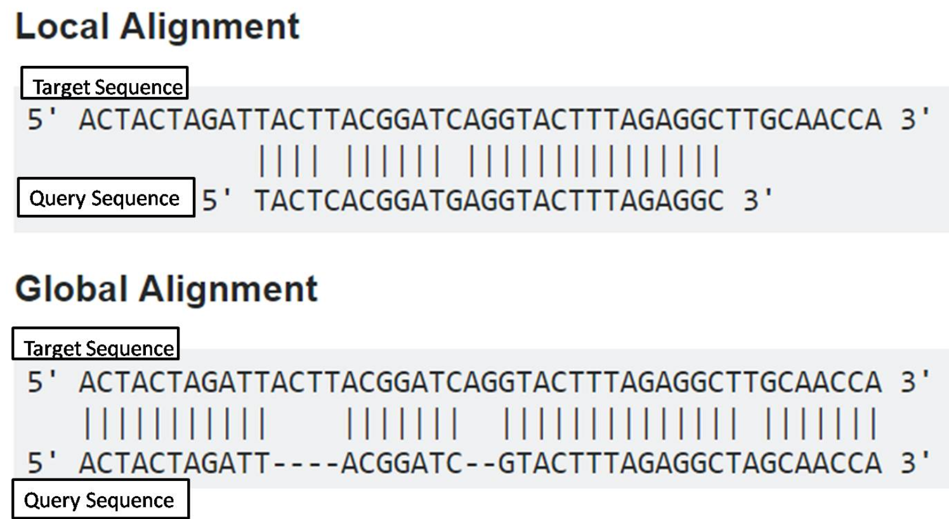
OUR SOLUTION
Our approach uses pattern matching and order-preserving matching algorithms from computational biology to classify EEG signals into ADHD and non-ADHD categories.
Pattern matching algorithms identify ADHD-related patterns in EEG.
Local alignment is a technique that identifies regions of high similarity within two sequences, focusing only on the most similar subsequences.
Global alignment is a technique that aligns two sequences in their entirety, optimizing for the overall similarity across their full lengths.
Order-preserving matching maintains sequence order to capture temporal dynamics.

Slide 8
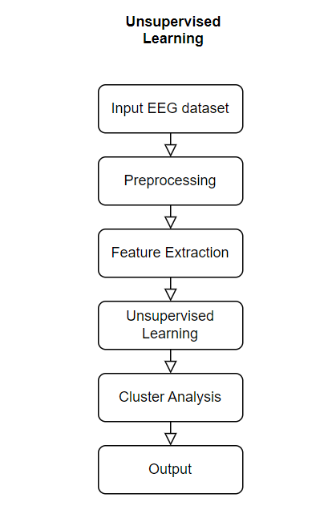
Proposed Research Plan
Pre-Processing with Unsupervised Learning:
Use unsupervised learning techniques to enhance analysis.
Explore data structures and extract relevant features.
Preprocess EEG data by removing noise and artifacts.
Simplify data representation through dimensionality reduction.
Enable comparative analysis between ADHD and control groups.

Slide 9
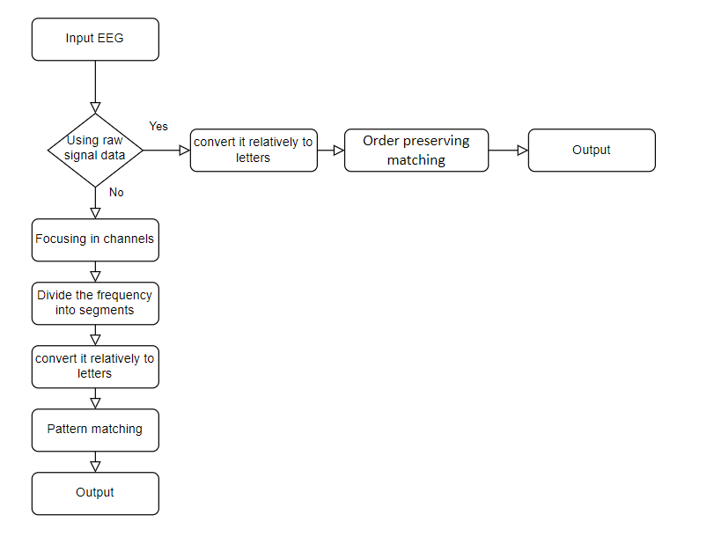
Proposed Research Plan
pre-process of achieving the two different approaches
We employ order-preserving matching, which encompasses the entire raw dataset, contrasting with pattern matching, such as the BLAST algorithm, which focuses on specific segments.

Slide 10
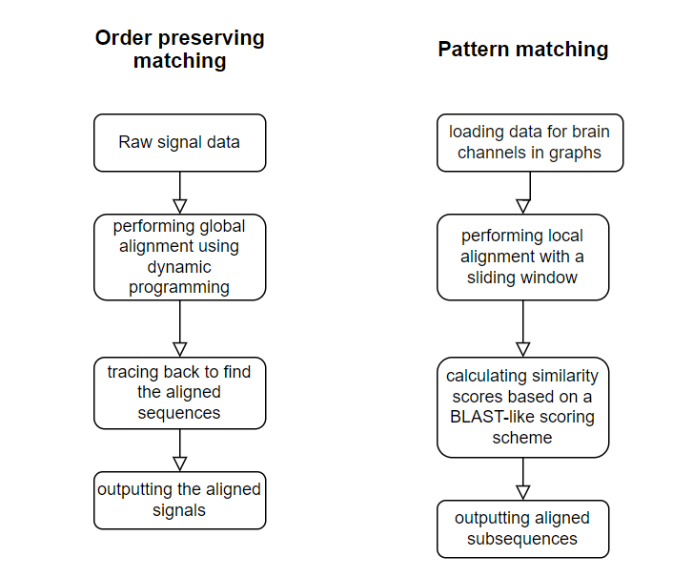
Proposed Research Plan
First Approach: BLAST Algorithm on EEG Dataset
Segmentation of EEG Recordings:
Divide EEG recordings capturing brain electrical activity into smaller segments over time.
Identification of Dominant Frequencies:
Identify the dominant frequency within each segment, representing prevailing electrical signals.
Conversion to Sequence Representation:
Convert dominant frequencies into letters using a predefined mapping scheme.
Sequence Comparison Using BLAST:
Create a sequence representation of EEG data for each individual.
Employ BLAST to compare sequences between normal and ADHD groups.
Detection of Patterns or Distinctions:
Analyze BLAST results to discern any discernible patterns or distinctions
in brain activity between the two groups.

Slide 11
Proposed Research Plan
Second approach: Order-preserving matching for raw signal data
Data Preparation:
Preprocess raw EEG data, ensuring it's clean and segmented.
Representation:
Represent EEG signals as sequential data, preserving their temporal order.
Algorithm Selection:
Choose a suitable order-preserving matching algorithm.
Matching Criteria:
Define criteria for similarity or dissimilarity between EEG sequences.
Analysis:
Implement the algorithm and analyze matched patterns.

Slide 12
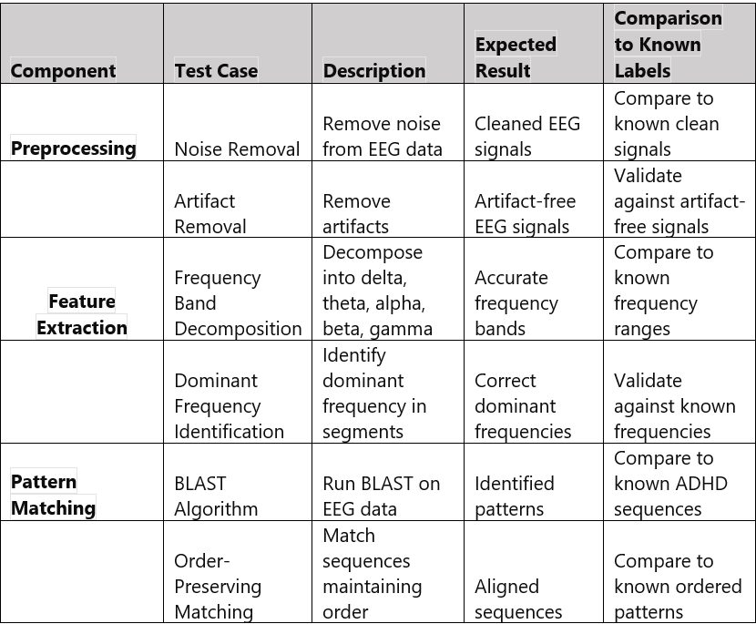
Evaluation Plan
Unit testing for algorithm functionality.
Integration testing for system communication.
Data validation for preprocessing accuracy.
Performance testing for computational efficiency.

Slide 13
Expected Achievements
Accurate differentiation between ADHD and healthy EEG patterns.
Identification of EEG features as potential ADHD biomarkers.
Development of a user-friendly system.
Contribution to ADHD diagnosis and treatment.

Slide 14
References
[1] Centers for Disease Control and Prevention. (n.d.). Facts About ADHD. Retrieved from https://www.cdc.gov/ncbddd/adhd/facts.html
[2] Adamou, M., Fullen, T., & Jones, S. L. (2020). EEG for Diagnosis of Adult ADHD: A Systematic Review With Narrative Analysis. Frontiers in Psychiatry, 11
[3] Manos, M. J., & Short, E. J. (2023). A new paradigm for adult ADHD: A focused strategy to monitor treatment. Cleveland Clinic Journal of Medicine, 90
[4] Mayo Clinic. (2022). EEG (electroencephalogram)
[5] Thakor, N. V., & Sherman, D. L. (2012). EEG Signal Processing: Theory and Applications. In Neural Engineering. SpringerLink.
[6] Bakhtyari, M., & Mirzaei, S. (2022). ADHD detection using dynamic connectivity patterns of EEG data and ConvLSTM with attention framework. Biomedical Signal Processing and Control, 76, 103708 : https://doi.org/10.1016/j.bspc.2022.103708
[7] Barua, P. D., Dogan, S., Baygin, M., Tuncer, T., Palmer, E. E., Ciaccio, E. J., & Acharya, U. R. (2022). TMP19: A Novel Ternary Motif Pattern-Based ADHD Detection Model Using EEG Signals. Diagnostics, 12(10), 2544. https://doi.org/10.3390/diagnostics12102544
[8] TaghiBeyglou, B., Shahbazi, A., Bagheri, F., Akbarian, S., & Jahed, M. (2022). Detection of ADHD cases using CNN and classical classifiers of raw EEG. Computer Methods and Programs in Biomedicine Update, 2, 100080. https://doi.org/10.1016/j.cmpbup.2022.100080
[9] Ombao, H., & Pinto, M. (2022). Spectral dependence. Econometrics and Statistics. https://doi.org/10.1016/j.ecosta.2022.10.005
[10] Ekhlasi, A., Nasrabadi, A. M., & Mohammadi, M. (2023). Analysis of EEG brain connectivity of children with ADHD using graph theory and directional information transfer. Biomedical Engineering/Biomedizinische Technik, 68(2), 133-146. https://doi.org/10.1515/bmt-2022-0100
[11] Computational Biology. Retrieved from: https://en.wikipedia.org/wiki/Computational_biology , https://cbd.cmu.edu/about-us/what-is-computational-biology.html
[12] Pattern Matching. Retrieved from: https://en.wikipedia.org/wiki/Pattern_matching
[13] Kim, J., Eades, P., Fleischer, R., Hong, S. H., Iliopoulos, C. S., Park, K., ... & Tokuyama, T. (2014). Order-preserving matching. Theoretical Computer Science, 525, 68-79. https://www.sciencedirect.com/science/article/pii/S0304397513007585
[14] Exploring Local and Global Multiple Sequence Alignment Methods and Their Applications SpringerLink
[15] differences between global alignment and local alignment. Received from: https://www.majordifferences.com/2016/05/difference-between-global-and-local.html
[16] Altschul, S. F., Gish, W., Miller, W., Myers, E. W., & Lipman, D. J. (1990). Basic local alignment search tool. Journal of molecular biology, 215(3), 403-410. https://www.sciencedirect.com/science/article/abs/pii/S0022283605803602
[17] Bray, N., Dubchak, I., & Pachter, L. (2003). AVID: A global alignment program. Genome research, 13(1), 97-102
.

Slide 15

Thank you!

