Slide 1

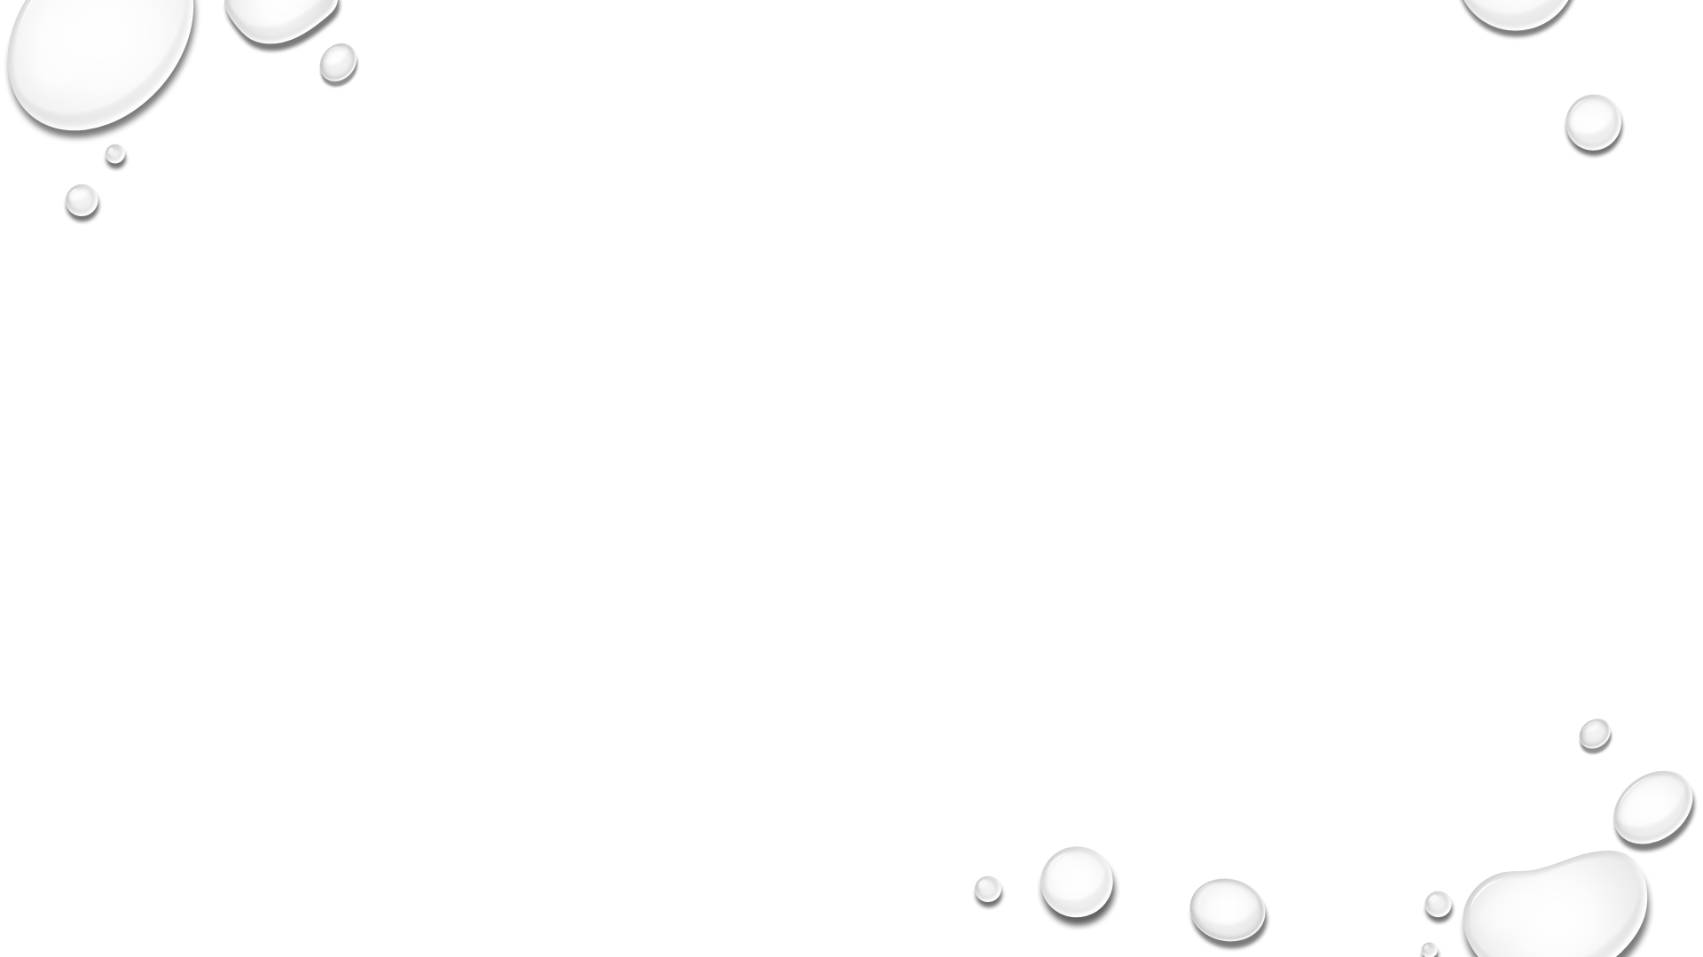
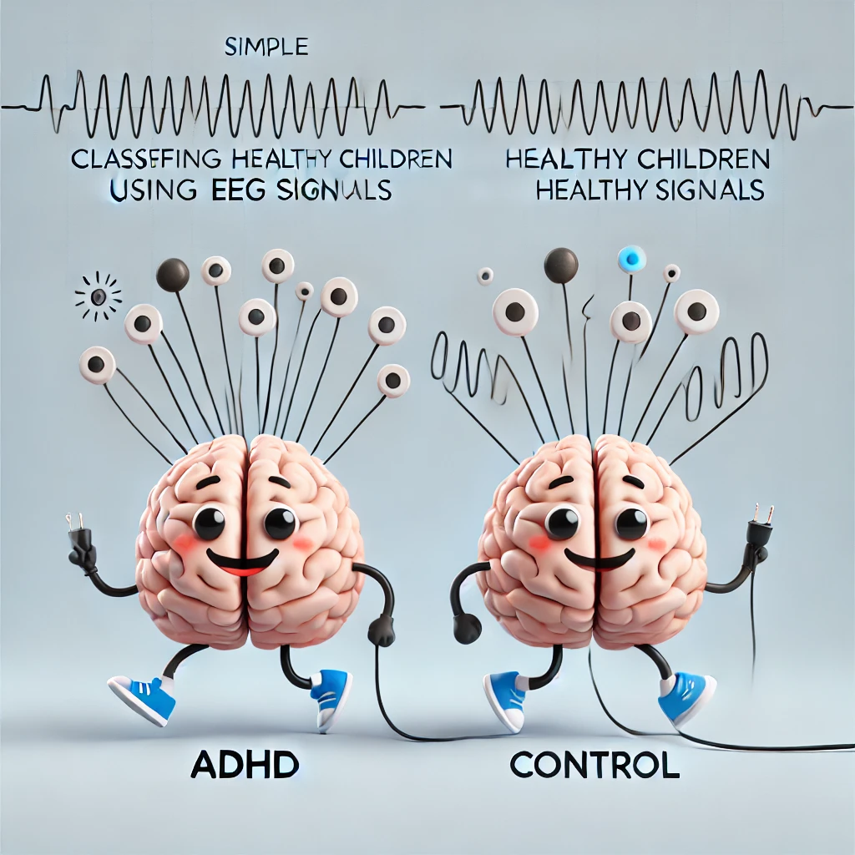

Slide 2


EEG Classification for ADHD
Mohammed Khatib, Basel Kabia
Supervisors: Dr. Anat Dahan, Dr. Samah Idrees-Ghazawi

Slide 3
Current Situation
Existing Diagnostic Methods:
Primarily based on behavioral assessments and questionnaires.
Limited use of neuroimaging or electrophysiological methods.
Challenges:
Subjectivity in assessments.
Variability in symptoms presentation.
Need for Improvement:
More objective, reliable methods to improve diagnostic accuracy.

Slide 4
Key System Requirements
Data Input:
Analysis Methods:
• Raw EEG data in .mat format.
• Labeled with 10-20 electrode system (Fp1, Fp2, etc.).
* 19 channels
• BLAST: Convert EEG to symbolic letter sequences, use BLAST+ for local sequence comparison.
• Order-Preserving Matching: Downsample EEG and apply Needleman-Wunsch algorithm for sequence alignment.
Preprocessing:
Classification:
• Load and process EEG data using scipy.io.
• Apply band-pass filter (0.5-40 Hz) and Independent Component Analysis (ICA) to remove artifacts.
• Identify ADHD or control based on sequence identity percentages, with focus on optimal channels.

Slide 5

Main Goals of the Research
To Improve EEG classification to distinguish ADHD:
• Techniques:
• BLAST
• Order-preserving matching
• Significance:
• Higher accuracy
• Better diagnostics
• Enhanced ADHD understanding
• Impact:
• Effective interventions
• Support for those with ADHD

Slide 6

Methodology Overview
Data Cleaning
Preprocessing Steps
• Storage: EEG data in .mat files.
• Groups: ADHD and controls.
• Automation: Efficient file handling.
• Categorization: Systematic analysis enabled.
• Loading: Used scipy.io.
• Labeling: 10-20 system.
• Filtering: Applied band-pass filter.
• Artifacts: Removed via ICA.
• Accuracy: Data quality improved.

Slide 7
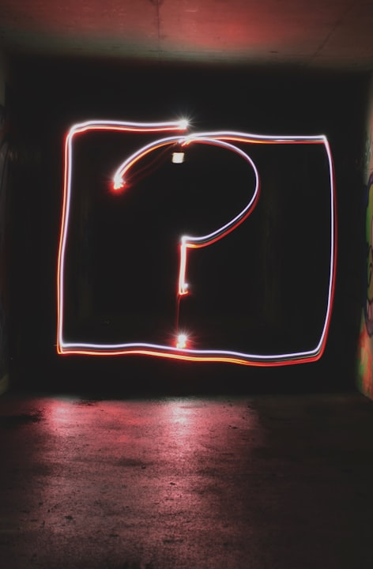
BLAST
Data Conversion Process
Comparison Methodology
• Segmentation: EEG data segmented.
• Dominant Frequencies: Identified using Welch method.
• Letter Mapping: Frequencies mapped to letters (e.g., Delta = ‘A’).
• BLAST Application: Compared EEG letter sequences.
• Analysis Focus: Longest alignments and identity percentage.
• Insights: Revealed brain activity differences between groups.

Slide 8
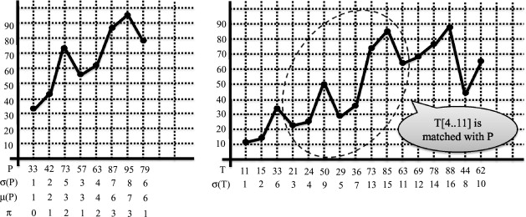
Order-Preserving Matching
Data Reduction Techniques
Pairwise Comparison Method
• Downsampling: Took every 4th EEG sample.
• Purpose: Reduced data size, retained key information.
• Benefit: Enabled efficient processing.
• Symbolic Sequences: EEG channels converted to positive/negative symbols.
• Algorithm Used: Needleman-Wunsch for alignment.
• Analysis: Calculated similarity percentages.
• Insight: Examined distinctions between ADHD and controls.

Slide 9
Classification Methods
BLAST-Based Classification
Order-Preserving Matching
Data Segmentation Techniques
• Analyzed average identity percentages.
• Aligned sequences to classify ADHD vs. controls.
• Evaluated EEG channel similarity percentages.
• High accuracy, especially for controls.
• Time-consuming process.
• Segmented EEG data into optimal time frames.
• Specific durations improved accuracy and efficiency.

Slide 10

Project Metrics and Performance
01
Classification Accuracy
02
Channel Effectiveness
• Goal: High accuracy for ADHD vs. Control classification.
• Result: Achieved 90% accuracy with BLAST and 87/120 correct ADHD classifications with order-preserving matching.
• Goal: Identify the most effective EEG channels.
• Result: ADHD best classified with Channel 16, Control with Channels 19 (1-second) and 11 (2-second).
03
Optimal Time Segment
04
Computational Efficiency
• Goal: Find the best time segment for classification and efficiency.
• Result: 2-second segment provided 90% accuracy with reduced processing time.
• Goal: Ensure practical computational performance.
• Result: BLAST was efficient; order-preserving matching requires further optimization.

Slide 11

Challenges Faced
1. Slow BLAST Processing
Problem: Online BLAST was too slow for EEG comparisons.
Solution: Switched to BLAST+ with a local database, reducing computation time and enhancing efficiency.
2. Adapting BLAST for EEG Data
Problem: BLAST wasn’t designed for EEG sequences.
Solution: Customized letter mapping made EEG data compatible, balancing relevance and performance.
3. Lengthy Global Alignments
Problem: Long EEG sequences hindered alignment efficiency.
Solution: Downsampling shortened sequences, speeding up the alignment process.
4. Inefficient Local Maxima/Minima Method
Problem: Segmenting EEG data with local extrema was too time-consuming.
Solution: Abandoned this method for more efficient and actionable alternatives.

Slide 12
Results: BLAST
Methods | explanation | Time Segments Analyzed
- Longest alignments : | maximum-length sequence of matching elements between two sets of data | 1, 2, 3, 5, 7, 9, 12, 15 seconds
- Highest percentage identity | aligning two sequences in a way that maximizes the proportion of exact matches between them | 1, 2, 3, 5, 7, 9, 12, 15 seconds

Slide 13
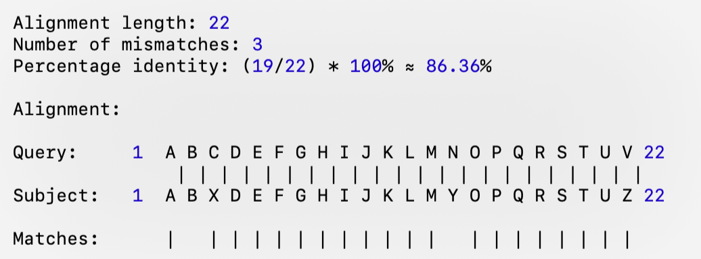
Longest Alignment Example
ADHD (Channel 16) | Control (Channel 16)
ABCDEFGHIJKLMNOPQRSTUV | ABXDEFGHIJKLMYOPQRSTUZ

Slide 14
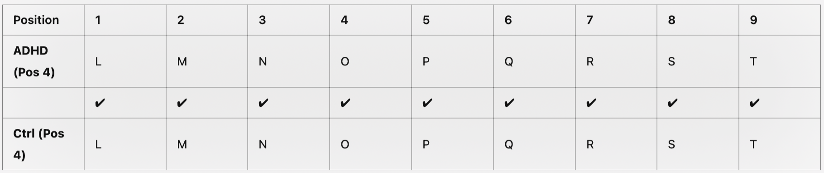
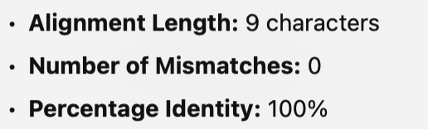
Highest Percentage Identity Example
ADHD (Channel 11) | Control (Channel 11)
L M N O P Q R S T U V | X Y Z L M N O P Q R S

Slide 15
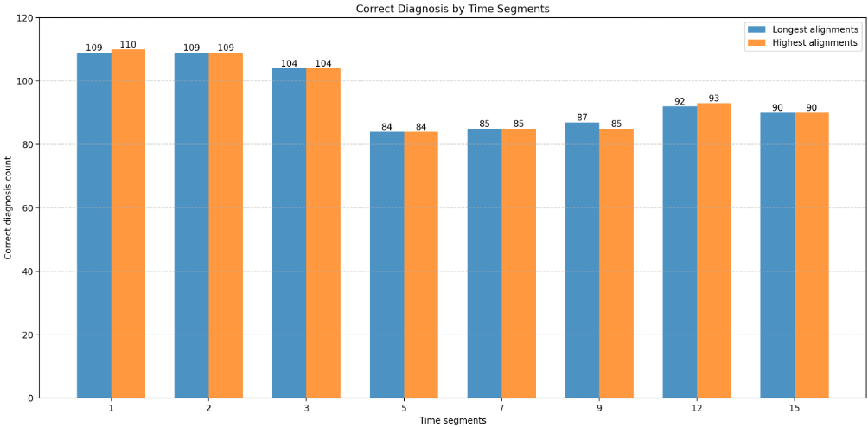
Fig. 1: chart that describe correct diagnosis count for each time segments in both longest and highest alignments.

Slide 16
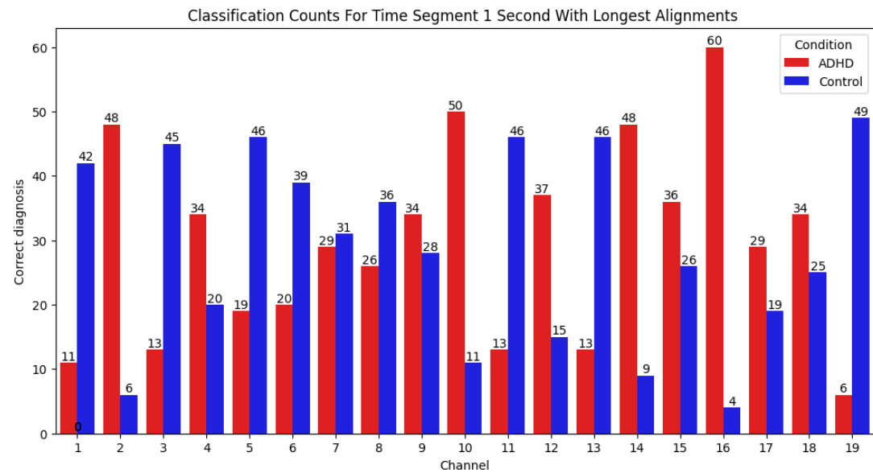
Fig. 2: chart that describe classification Counts by Channel for ADHD and Control in time segments of 1 second with longest alignment.

Slide 17
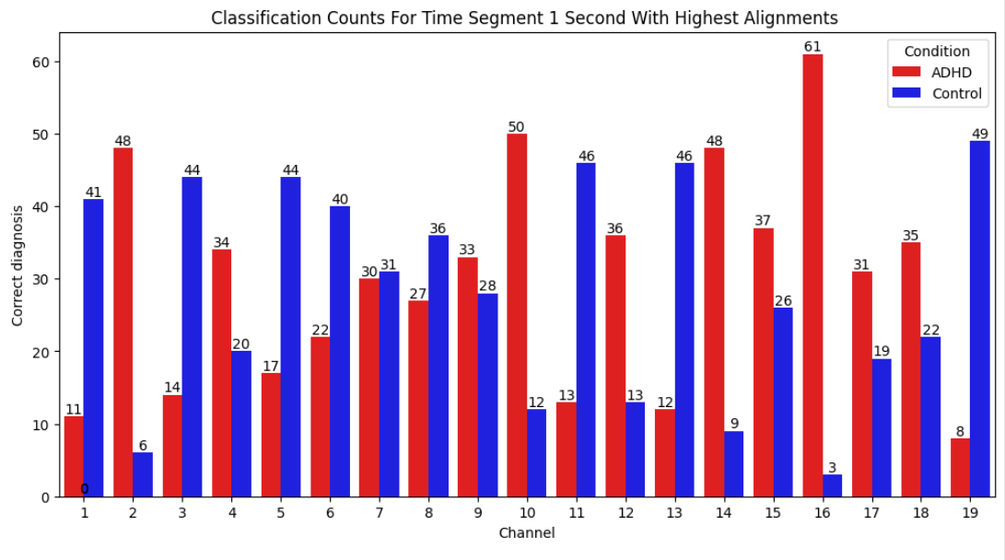
Fig. 3: chart that describe classification Counts by Channel for ADHD and Control in time segments of 1 second with highest alignment.

Slide 18
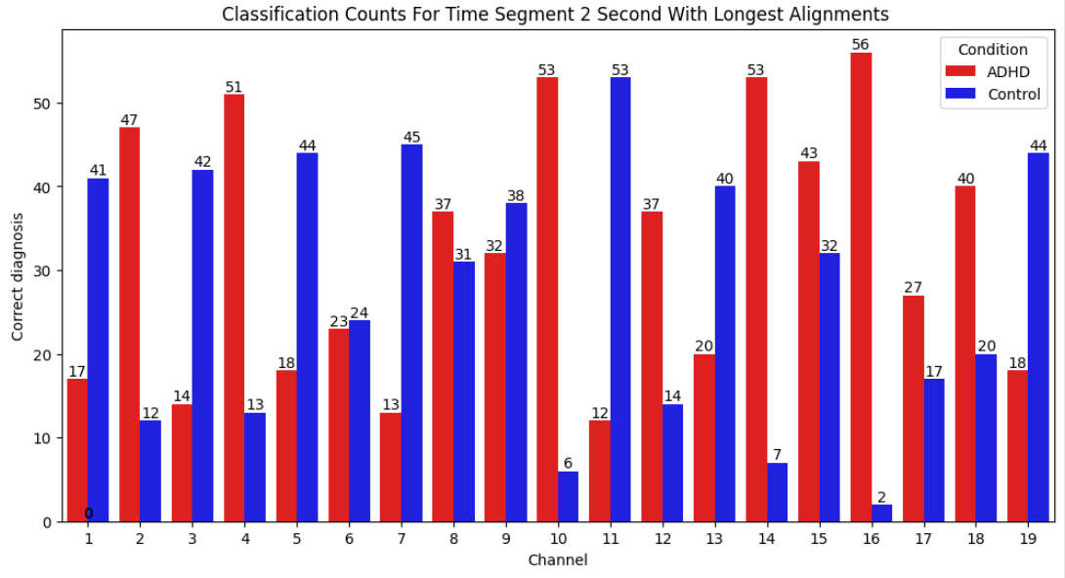
Fig. 4: chart that describe classification Counts by Channel for ADHD and Control in time segments of 2 second with longest alignment.

Slide 19
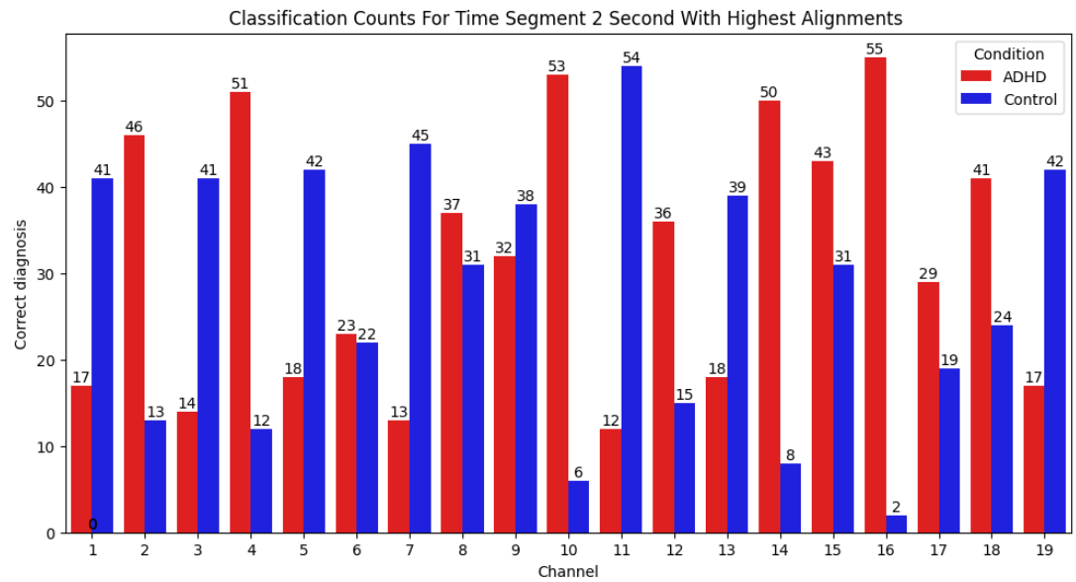
Fig. 5: chart that describe classification Counts by Channel for ADHD and Control in time segments of 2 second with highest alignment.

Slide 20
Results: Comparisons
Channel Performance:
Optimal Time Segments:
• 1-second and 2-second segments provided the highest accuracy.
• 2-second segment was faster and more efficient (16,526 seconds vs. 77,677 seconds for 1-second segment).
• ADHD diagnosis: Channel 16 most effective.
• Control diagnosis: Channel 19 (1-second) and Channel 11 (2-second) were most accurate.

Slide 21
Results: Order-Preserving Matching
Processing Time
Accuracy:
• Total time: 180,345.48 seconds (~50 hours).
• ADHD Classification: 87 out of 120 correct diagnoses.
• Control Classification: 59 out of 59 correct diagnoses (perfect accuracy).

Slide 22
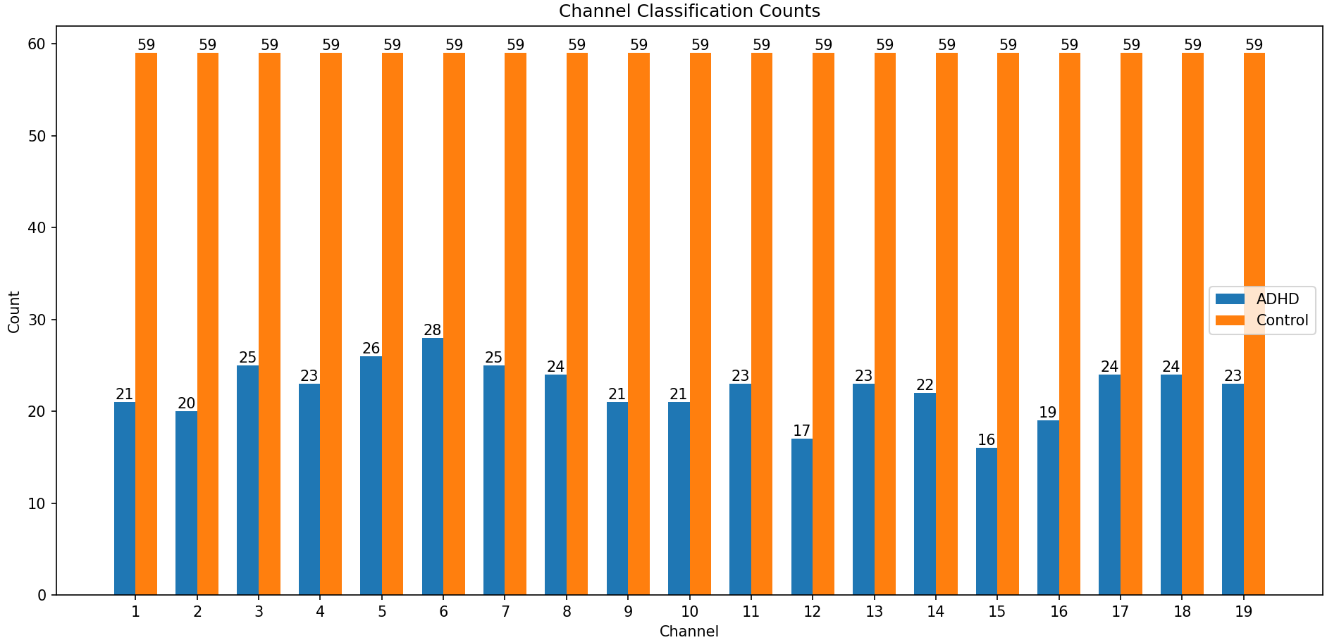
Fig. 6: chart that describe correct diagnosis count for order-preserving matching.

Slide 23
Conclusions
• BLAST with 2-second segments provided the best balance of accuracy and processing efficiency.
• Order-preserving matching, while accurate, required too much time for practical use.
• ADHD best classified using Channel 16.
• Control best classified with Channels 19 and 11, depending on time segment.

Slide 24
Future Work
Enhance Accuracy of BLAST Analysis:
Explore Alternative Methods:
Optimize Runtime of Order-Preserving Matching:
• Use efficient algorithms or parallel computing.
• Apply data compression to reduce processing load.
• Refine frequency-to-letter mapping for subtle EEG patterns.
• Adjust BLAST parameters and scoring matrices.
• Investigate machine learning models (e.g., neural networks, SVMs).
• Utilize advanced signal processing like wavelet transforms.

Slide 25

We are open to any questions or further discussion. thank you for listening
Photos provided by Unsplash

