Slide 1

TOR
Browse Privately.
Explore Freely.
Defend yourself against tracking and surveillance. Circumvent censorship.

Slide 2
TOR Features:
BLOCK TRACKERS:
Tor Browser isolates each website you visit so third-party trackers and ads can't follow you. Any cookies automatically clear when you're done browsing. So will your browsing history.
DEFEND AGAINST SURVEILLANCE
Tor Browser prevents someone watching your connection from knowing what websites you visit. All anyone monitoring your browsing habits can see is that you're using Tor.

Slide 3
TOR Features:
RESIST FINGERPRINTING
Tor Browser aims to make all users look the same, making it difficult for you to be fingerprinted based on your browser and device information.
MULTI-LAYERED ENCRYPTION
Your traffic is relayed and encrypted three times as it passes over the Tor network. The network is comprised of thousands of volunteer-run servers known as Tor relays.
BROWSE FREELY
With Tor Browser, you are free to access sites your home network may have blocked.

Slide 4
TOR Features:
Get connected
If you are in a country where Tor is blocked, you can configure Tor to connect to a bridge during the setup process.
Select "Tor Network Settings" and "Use a bridge".
If Tor is not censored, one of the most common reasons Tor won't connect is an incorrect system clock. Please make sure it's set correctly.
Stay safe
Please do not torrent over Tor.
Tor Browser will block browser plugins such as Flash, RealPlayer, QuickTime, and others: they can be manipulated into revealing your IP address.
We do not recommend installing additional add-ons or plugins into Tor Browser
Plugins or addons may bypass Tor or compromise your privacy. Tor Browser already comes with HTTPS Everywhere, NoScript, and other patches to protect your privacy and security.

Slide 5
TOR History:
The Tor Project, Inc, became a 501(c)(3) nonprofit in 2006, but the idea of "onion routing" began in the mid 1990s.
Just like Tor users, the developers, researchers, and founders who've made Tor possible are a diverse group of people. But all of the people who have been involved in Tor are united by a common belief: internet users should have private access to an uncensored web.
In the 1990s, the lack of security on the internet and its ability to be used for tracking and surveillance was becoming clear, and in 1995, David Goldschlag, Mike Reed, and Paul Syverson at the U.S. Naval Research Lab (NRL) asked themselves if there was a way to create internet connections that don't reveal who is talking to whom, even to someone monitoring the network. Their answer was to create and deploy the first research designs and prototypes of onion routing.

Slide 6
TOR History:
The goal of onion routing was to have a way to use the internet with as much privacy as possible, and the idea was to route traffic through multiple servers and encrypt it each step of the way. This is still a simple explanation for how Tor works today.
From its inception in the 1990s, onion routing was conceived to rely on a decentralized network. The network needed to be operated by entities with diverse interests and trust assumptions, and the software needed to be free and open to maximize transparency and decentralization. That's why in October 2002 when the Tor network was initially deployed, its code was released under a free and open software license. By the end of 2003, the network had about a dozen volunteer nodes, mostly in the U.S., plus one in Germany.
In 2007, the organization began developing bridges to the Tor network to address censorship, such as the need to get around government firewalls, in order for its users to access the open web.

Slide 7
TOR History:
With Tor Browser having made Tor more accessible to everyday internet users and activists, Tor was an instrumental tool during the Arab Spring beginning in late 2010. It not only protected people's identity online but also allowed them to access critical resources, social media, and websites which were blocked.
The need for tools safeguarding against mass surveillance became a mainstream concern thanks to the Snowden revelations in 2013. Not only was Tor instrumental to Snowden's whistleblowing, but content of the documents also upheld assurances that, at that time, Tor could not be cracked.

Slide 8
TOR Distribution
The Tor software is free software. This means we give you the rights to redistribute the Tor software, either modified or unmodified, either for a fee or gratis. You don't have to ask us for specific permission.
However, if you want to redistribute the Tor software you must follow our LICENSE. Essentially this means that you need to include our LICENSE file along with whatever part of the Tor software you're distributing.

Slide 9
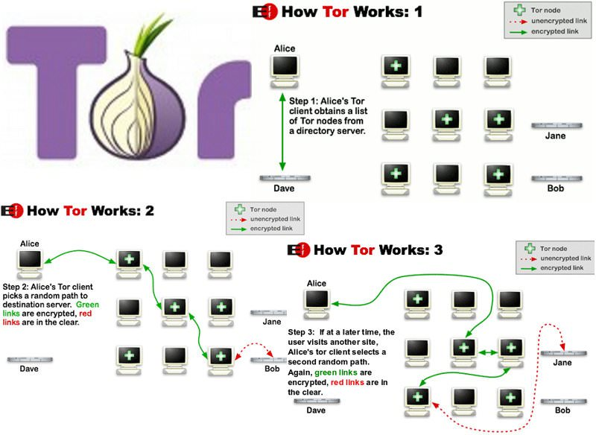

Slide 10
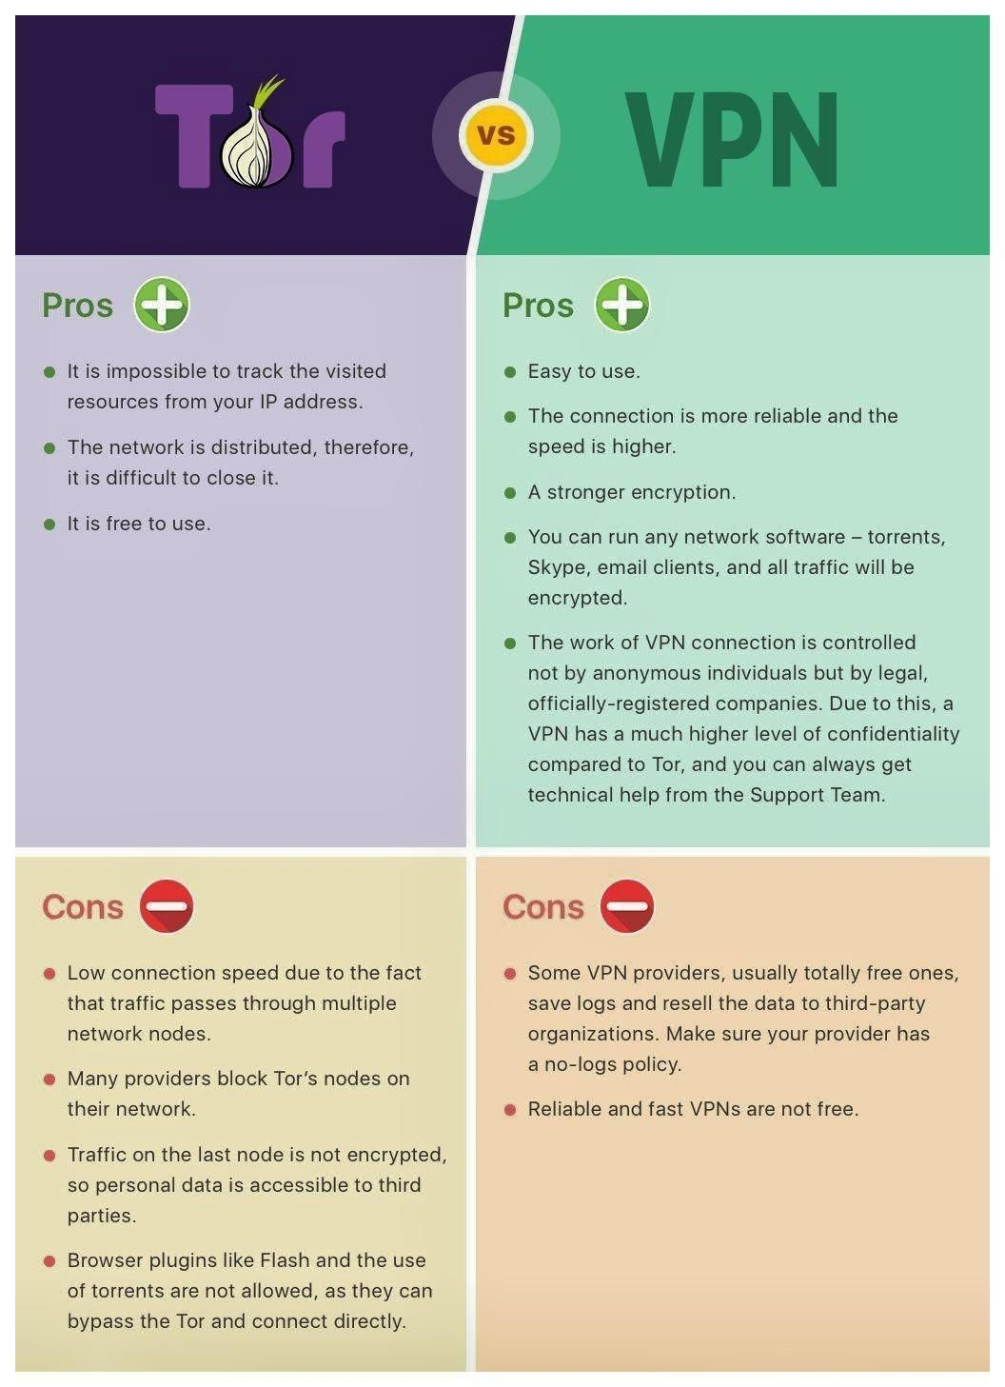

Slide 11
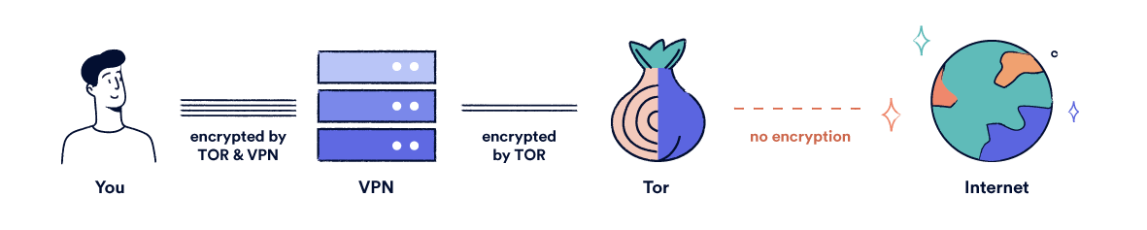
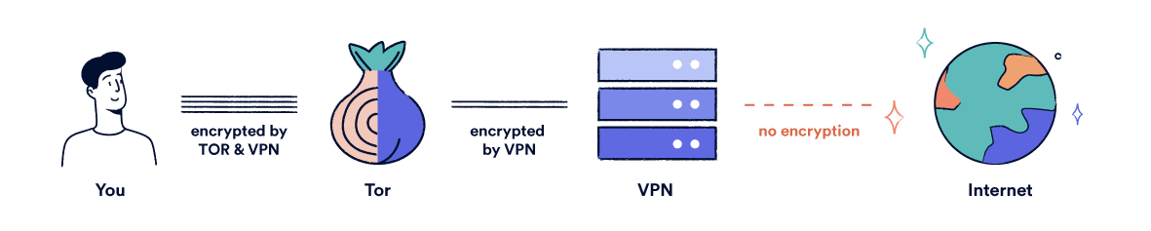
Tor over VPN
VPN over Tor

Slide 12
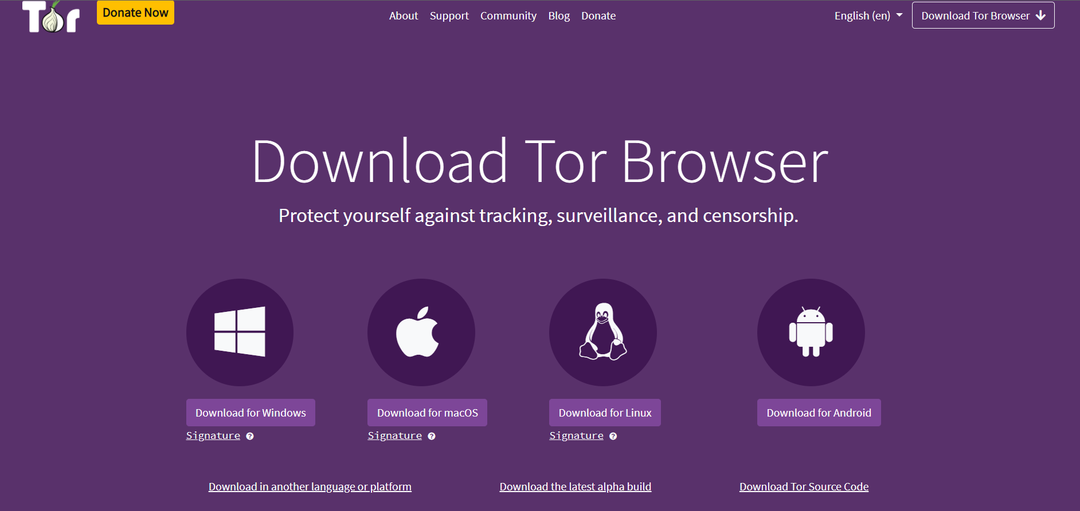

Slide 13
TOR Browser difference between ‘incognito mode’ or ‘private tabs?
While the names may imply otherwise, 'Incognito mode' and 'private tabs' do not make you anonymous on the Internet. They erase all the information on your machine relating to the browsing session after they are closed, but have no measures in place to hide your activity or digital fingerprint online. This means that an observer can collect your traffic just as easily as any regular browser.
Tor Browser offers all the amnesic features of private tabs while also hiding the source IP, browsing habits and details about a device that can be used to fingerprint activity across the web, allowing for a truly private browsing session that's fully obfuscated from end-to-end.
For more information regarding the limitations of Incognito mode and private tabs, see Mozilla's article on Common Myths about Private Browsing.

Slide 14
Why is TOR Browser built from Firefox
Tor Browser is a modified version of Firefox specifically designed for use with Tor. A lot of work has been put into making the Tor Browser, including the use of extra patches to enhance privacy and security. While it is technically possible to use Tor with other browsers, you may open yourself up to potential attacks or information leakage, so we strongly discourage it. Learn more about the design of Tor Browser.

Slide 15
TOR connections
circuit
A path through the Tor network built by clients consisting of randomly selected nodes. The circuit begins with either a bridge or a guard. Most circuits consist of three nodes - a guard or bridge, a middle relay, and an exit. Most onion services use six hops in a circuit (with the exception of single onion services), and never an exit node. You can view your current Tor circuit by clicking on the [i] on the URL bar.
bridge
Like ordinary Tor relays, bridges are run by volunteers; unlike ordinary relays, however, they are not listed publicly, so an adversary cannot identify them easily. Pluggable transports are a type of bridge that helps disguise the fact that you are using Tor.

Slide 16
TOR connections
relay
A publicly-listed node in the Tor network that forwards traffic on behalf of clients, and that registers itself with the directory authorities.
pluggable transports
Tools that Tor can use to disguise the traffic it sends out. This can be useful in situations where an Internet Service Provider (ISP) or other authority is actively blocking connections to the Tor network.
guard
The first relay in the Tor circuit, unless using a bridge. When using a bridge, the bridge takes the place of the guard.

