Slide 1
ARX

Slide 2

1
Let’s start with the first set of slides

Slide 3

ARX is an open source tool for transforming structured (i.e. tabular) personal data using selected methods from the broad areas of data anonymization and statistical disclosure control.

Slide 4
It supports transforming datasets in ways that make sure that they adhere to user-specified privacy models and risk thresholds that mitigate attacks that may lead to privacy breaches. ARX can be used to remove direct identifiers (e.g. names) from datasets and to enforce further constraints on indirect identifiers.

Slide 5
Indirect identifiers (or quasi-identifiers, or keys) are attributes that do not directly identify an individual but may together with other indirect identifiers form an identifier that can be used for linkage attacks. It is typically assumed that information about indirect identifiers is available to the attacker (in some form of background knowledge) and that they cannot simply be removed from the dataset (e.g. because they are required later for analyses).

Slide 6
ARX also supports methods for protecting sensitive attributes from disclosure and semantic privacy models, which require fewer assumptions to be made about the goals and the background knowledge of attackers.

Slide 7
ARX supports (almost) arbitrary combinations the following privacy models:
Syntactic privacy models.
Statistical privacy model.
Semantic privacy models.

Slide 8
Example of privacy model
Syntactic privacy models :
k-anonymity 2. l-diversity 3. t-closeness
4. β-likeness and δ-presence
Statistical privacy model:
k-map
Semantic privacy models:
(ε, δ)-differential privacy

Slide 9
ARX supports (almost) arbitrary combinations of the following data transformation models:
Global and local transformation schemes
Random sampling
Generalization
Record, attribute and cell suppression
Microaggregation
Top- and bottom-coding
Categorization

Slide 10
Supported data quality models and objective functions include:
Cell-oriented models.
Attribute-oriented models .
Record-oriented general-purpose models.
Workload-aware models

Slide 11
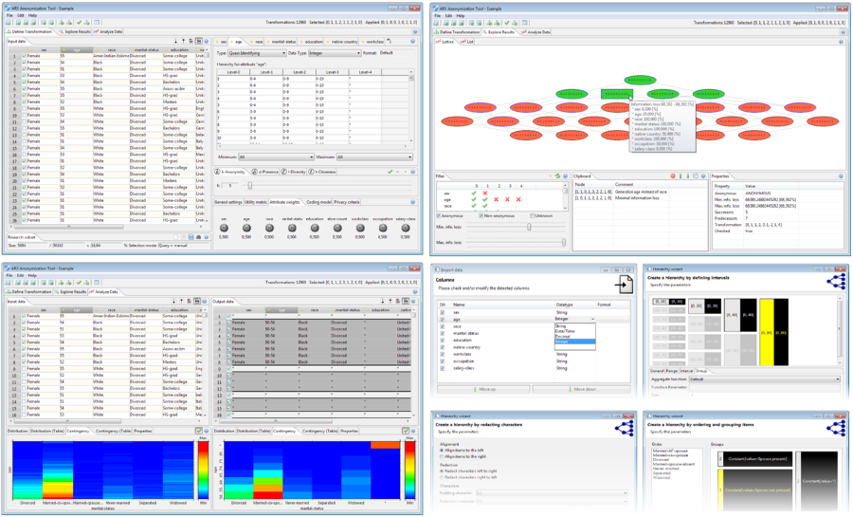
The graphical frontend of ARX provides an intuitive interface and provides various visualizations, wizards and a context-sensitive help.

Slide 12
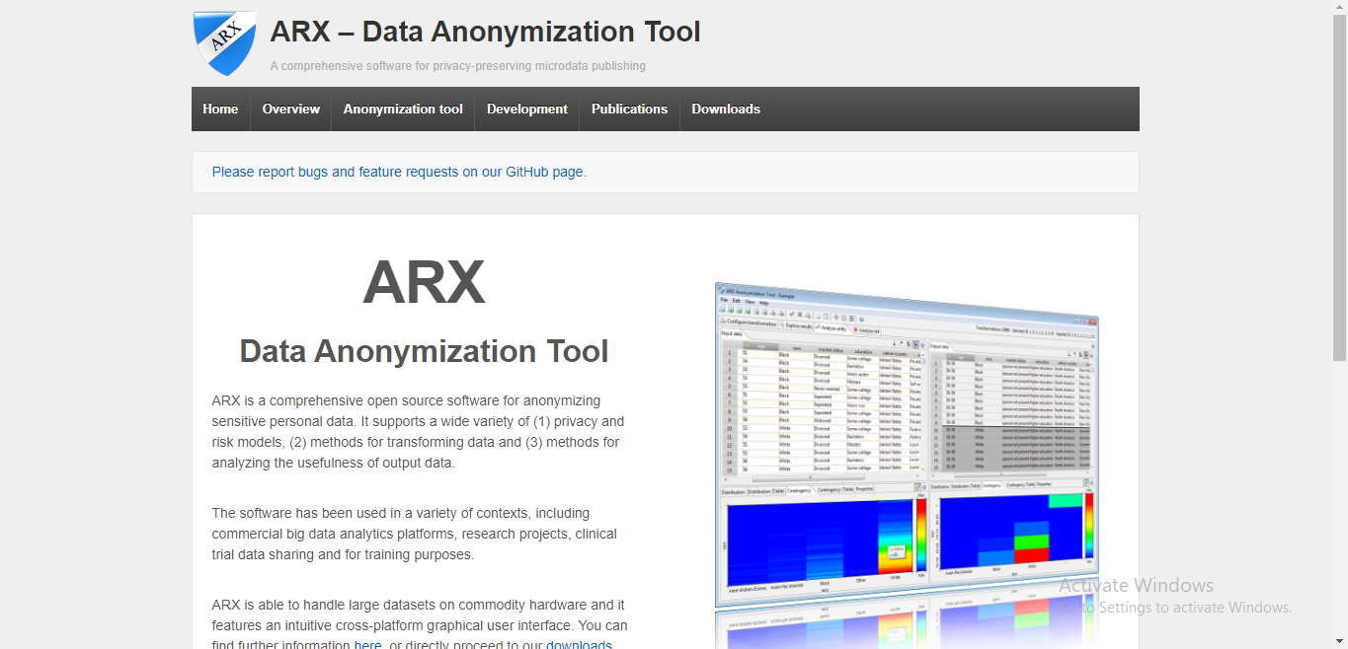
The official website of ARX

Slide 13
THANKS!
Jehad mashal
Basel alzyoud

