Slide 1
Assembly LC-3 program
dr ahmed

Slide 2
Link to download the program
https://hackmd.io/@kIKuOG-cRvKPOEH2Mg2QtQ/HkYVXl4Mh

Slide 3
ISA
In computer science and engineering, ISA stands for Instruction Set Architecture. It serves as the interface between software and hardware components of a computer system
The ISA defines the set of instructions that a processor can execute, along with the format of those instructions,

Slide 4
LC-3 Assembly Language Instruction
Each instruction >> LABEL OPCODE OPERANDS ; COMMENT
LABEL:
This is an optional segment, preceding the opcode, that designates a symbolic name for the instruction. It serves as a reference point within the program. The label is terminated by a colon ":” example: Addition:
OPCODE:
This is a mandatory element, indicating the operation code of the instruction. It determines the specific task that the LC-3 processor will execute, such as arithmetic operations, data handling, or control flow commands. example: ADD

Slide 5
LC-3 Assembly Language Instruction
Each instruction >> LABEL OPCODE OPERANDS ; COMMENT
OPERANDS:
These are optional constituents, following the opcode, which provide supplementary information or data required by the instruction. Depending on the opcode, an instruction might necessitate zero, one, or multiple operands. Operands can encompass memory addresses, register identifiers, or immediate values.
COMMENTS:
This is an optional section, denoted by a semicolon ";" and located after the operands (if present), that offers human-readable elucidation or annotations regarding the instruction. Comments are disregarded by the assembler during the translation of code into machine language.

Slide 6
EXAMPLE
LOOP: ADD R1, R2, R3 ; Add contents of R2 and R3, storing the result in R1
LABEL
OPCODE
OPERANDS
COMMENT

Slide 7
Data Directives in LC-3
.FILL
Stores one value in memory, ex: NUM .FILL #10
.BLKW
Reserves (allocates) a block of memory, ex: ARRAY .BLKW 5
Allocates 5 memory locations
.STRINGZ
stores a string of characters
Automatically adds a null terminator (0) at the end
ex: MSG .STRINGZ "Hello"

Slide 8
Data Directives in LC-3
.ORIG
Specifies the starting address of the program
ex: .ORIG x3000
.END
Marks the end of the program

Slide 9
instruction lc3
ADD R1, R2, R3 ; Add the contents of R2 and R3, store the result in R1.
AND R1, R2, R3 ; Perform bitwise AND on the contents of R2 and R3, store the result in R1
LD R1, OFFSET ; Load the contents of memory location OFFSET into R1.
ST R1, OFFSET ; Store the contents of R1 into memory location OFFSET.
BRz LABEL ; Branch to LABEL if the result is zero

Slide 10
BRp means "Branch if Positive."
N (Negative) if the result is negative BRn
Z (Zero) if the result is zero BRz
P (Positive) if the result is positive BRp

Slide 11
Small Program
.ORIG x3000
AND R0, R0, #0
ADD R0, R0, #5
HALT
.END
Notes:
11111 AND 00000=== 00000

Slide 12
page 7-11 pdf
.ORIG x3000 ; Start at address x3000
LD R0, NUM1 ; Load number 1 into R0
LD R1, NUM2 ; Load number 2 into R1
ADD R2, R0, R1 ; Add R0 and R1, store in R2
HALT ; Stop the program
NUM1 .FILL #3 ; First number (3)
NUM2 .FILL #4 ; Second number (4)
.END ; End of program

Slide 13
Task
Task: LC-3 Assembly Programming
Write an LC-3 assembly program that performs the following steps:
Load a value from memory into a register.
Add 2 to the value.
Store the updated value back into a result variable in memory.

Slide 14
Description of SUB Operation in LC-3
Subtraction in LC-3 is performed using 2’s complement.
To compute: A - B
we convert B to its negative using:
NOT (bitwise inversion)
ADD #1 (to complete 2’s complement)
Then we add it to A: A + (-B)
NOT R2, R2
ADD R2, R2, #1
ADD R3, R1, R2
This sequence subtracts the value in R2 from R1 and stores the result in R3.

Slide 15
Full subtraction program
.ORIG x3000
LD R1, NUM1
LD R2, NUM2
AND R3,R3,#0
NOT R2, R2
ADD R2,R2,#1
ADD R3,R1,R2
HALT
NUM1 .FILL x000D >> number 13
NUM2 .FILL x0005
.END
NOT = 2’s complement
NOT(R2) + 1 = -R2

Slide 16
IF statement in LC-3
Use BRnzp , BRn, BRz, BRp
BRnzp >> the branch is taken If any of these flags are set (n , z, p).
BRn >> branch if the result is negative.
BRz >> branch if the result is negative zero.
BRp >> branch if the result positive.

Slide 17
IF example
Write a short LC-3 program that Subtracts two numbers and save the result to R5. .ORIG x3000
As C++ program:
int x=1;
int y=2;
if(x==y) cout<<”0”;
elseif(x>y) cout<<”1”;
else cout<<”-1”;

Slide 18
Write a short LC-3 program that compares the two
numbers in R1 and R2 and puts in R0 the following:
• 0 if R1 = R2,
• 1 if R1 > R2, and
• −1 if R1 < R2

Slide 19
R1 R2
10 10 10-10= 0(zero)
11 10 11-10=1 (pos)
10 11 10-11=-1 (neg)

Slide 20
.ORIG x3000
LD R1, NUMBER1
LD R2, NUMBER2
AND R0,R0,#0
NOT R2, R2
ADD R2,R2,#1
ADD R4, R2, R1
2’s complement of the second
substract result

Slide 21
BRz Equals ; if zero -> Equal
BRp Case1 ; if pos -> case 1
BRn Case2 ; if Neg -> case 2
Equals
AND R0, R0, #0
BRnzp Done

Slide 22
Case1
ADD R0, R0, #1
BRnzp Done
Case2
ADD R0, R0, #-1
Done
HALT
NUMBER1 .FILL #10
NUMBER2 .FILL #10
.END

Slide 23
Loops:
; initialize
LOOP ; do something
; update
BRcondition LOOP [BRn, BRz, BRp ]

Slide 24
LOOP: Compute 4*5
R1 = 5
R2 = 4
R3 = 5 + 5 + 5 + 5 = 20

Slide 25
.ORIG x3000
LD R1, lbl_Five
LD R2, lbl_Four
AND R3, R3, #0 ; Clear R3. It will contain the product.
; The inner loop
AGAIN ADD R3, R3, R1
ADD R2, R2, #-1 ; R1 keeps track of
BRp AGAIN ;If R2 > 0, go back to AGAIN and repeat the loop.
HALT
lbl_Four .FILL x0004
lbl_Five .FILL x0005
.END

Slide 26
Convert this program to LC-3
#include <iostream>
using namespace std;
int main() {
int sum = 0;
// For loop to add numbers from 1 to 5
for (int i = 1; i <= 5; i++) {
sum += i; //sum=sum+i;
}
cout << "The sum is: " << sum << endl;
return 0;
}

Slide 27
.ORIG x3000 ; Start at address x3000
AND R0, R0, #0 ; Clear R0 (sum = 0)
AND R1, R1, #0 ; Clear R1 (i = 0)
ADD R1, R1, # 5 ; Set R1 (i) to 1
LOOP ADD R0, R0, R1 ; sum += i (R0 = R0 + R1)
ADD R1, R1, #-1 ; Increment i (i++)
BRp LOOP ; If i > 0, continue looping
HALT ; Stop the program
.END ; End of program

Slide 28
LC-3 can access memory in three different ways, using different addressing modes to: - Load addresses (LEA) - Store or fetch values using base registers (STR)/ LDR - Follow pointers stored in memory (LDI)
Three address modes

Slide 29
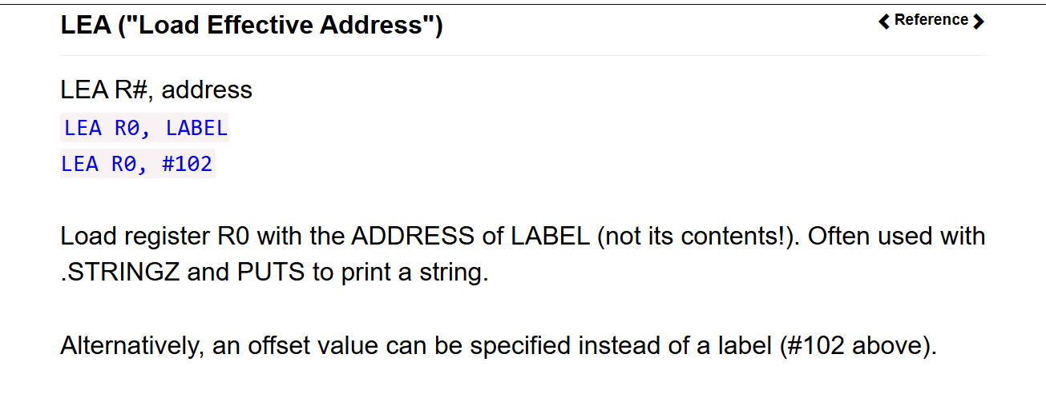
Notes:
Used if I need to declar pointer point to data

Slide 30
Printing in LC3
.ORIG x3000
LEA R0, HI ; load the address of the "HI" label
PUTS ; Write a string of characters to the console from
R0 register. Start with the character at the
address contained in R0.
HALT
HI .STRINGZ "Hello World!\n" ; your message
.END ; code end

Slide 31
LDR ("Load relative")
Load the VALUE from the ADDRESS specified by (R# + OFFSET) into register DR.
So, in the example above, get the value of R1, add decimal 4 to produce an address. THAT'S where you will read the value and store it into R2.
LDR destination, base register, offset.
LDR DR, R#, offset
LDR R2, R1, #4

Slide 32
STR ("Store relative")
Store the VALUE from register SR to the ADDRESS specified by (R# + OFFSET).
in the example above, get the value of R1, add decimal 4 to produce an address. THAT'S where you will store the contents of R0.
STR source, base register, offset
STR SR, R#, address
STR R0, R1, #4

Slide 33
Arrays
.ORIG x3000
LEA R1, ARR ; R1 = address of first element
LDR R2, R1, #0 ; R2 = ARR[0] (first element).
LDR R3, R1, #1 ; R2 = ARR[1] (second element)
LDR R4, R1, #2 ; R2 = ARR[1] (third element)
HALT
ARR .FILL #5
.FILL #10
.FILL #15
.END

Slide 34
LDI (Load Indirect Address)
Get the address that is stored at LABEL (or an offset), and then get the VALUE at THAT address (this is the indirect part).
R# = Mem[ Mem[address] ]
LDI R#, address
.ORIG x3000 LDI R0, PTR HALT PTR .FILL x4000 ; فيه عنوان .END
>> x4000 .FILL #10 <<<

Slide 35
LDI (example)
.ORIG x3000
LDI R1, PTR ; load indirectly
HALT
PTR .FILL DATA ; PTR contains address of DATA
DATA .FILL #7 ; actual value
.END

Slide 36
Super program ☺
Suppose we know that the 12 locations x3100
to x310B contain integers, and we wish to
compute the sum of these 12 integers.

Slide 37
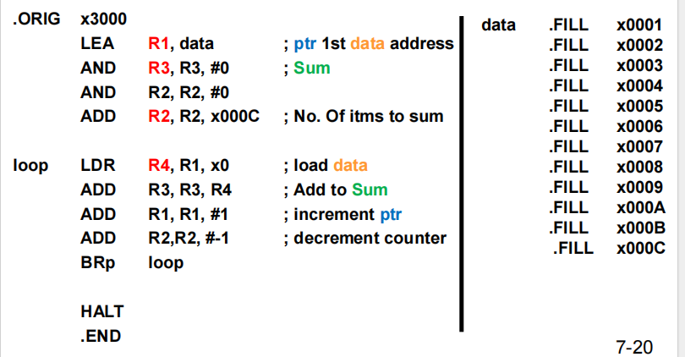
ADD R1, R1, x0 ; Increment pointer to next data item

