Slide 1
GLASNO O NOVCU BOOTCAMP
Welcome to the
Glasno o novcu Bootcamp
Day 1 · Session 1 — Introductions & Personality Profiling

Slide 2
CONTEXT
Why we're here
Financial literacy is one of the most underdeveloped life skills in our region — and one of the most needed.
The mission
Build a campaign that makes personal finance accessible, engaging, and real.
The platform
"Glasno o novcu" — a hub for education, interactive tools, and community.
The bootcamp
5 days to understand the problem, form teams, and build real campaign components.

Slide 3
DAY 1 · SESSION 1
Today's agenda
01
Self-introductions
02
About this bootcamp
Each person shares their name, background, and one skill
Overview of the 5-day structure and project components
03
Personality assessment
04
Results debrief
Complete the DISC-style test (approx. 15 minutes)
Facilitator maps profiles and opens group discussion
05
Build the profile wall
Your profile card stays up for the whole bootcamp

Slide 4
ACTIVITY
Your 2-minute introduction
Each person introduces themselves in 2 minutes. Cover these four points:
1
Your name and where you're from
2
Your background or field of study/work
3
One skill you're bringing to this bootcamp
4
One thing you hope to learn or create here

Slide 5
PERSONALITY ASSESSMENT
Understanding how we work — DISC
DISC is a simple behavioural model that describes four working styles. There is no right or wrong type — each brings distinct strengths to a team.
Dominant
Influential
D
I
Direct, results-driven, decisive. Thrives on challenges and action.
Enthusiastic, collaborative, persuasive. Thrives on connection.
Steady
Conscientious
S
C
Patient, reliable, empathetic. Thrives on consistency and support.
Analytical, precise, detail-oriented. Thrives on accuracy.

Slide 6
INSTRUCTIONS
Taking the assessment
Open the link below (or use the printed sheets) and complete the assessment.
1
Read each statement and rate how well it describes you: 1 (not at all) to 5 (very much so)
2
Answer instinctively — there are no correct or incorrect answers
3
Consider how you behave at work or in group settings, not how you wish you behaved
4
Complete all 24 statements (approx. 12–15 minutes)
⏱ 15 minutes — the facilitator will give you a 5-minute warning

Slide 7
DEBRIEF
What your profile means for your team
Different profiles create stronger teams. Here's what each type contributes to a digital campaign project:
D — Dominant | Drives the project forward, makes fast decisions under pressure, owns deadlines
I — Influential | Champions ideas, builds energy within the team, connects with audiences
S — Steady | Keeps the team cohesive, spots risks early, ensures nothing falls through the cracks
C — Conscientious | Ensures quality, checks details, documents decisions and processes

Slide 8
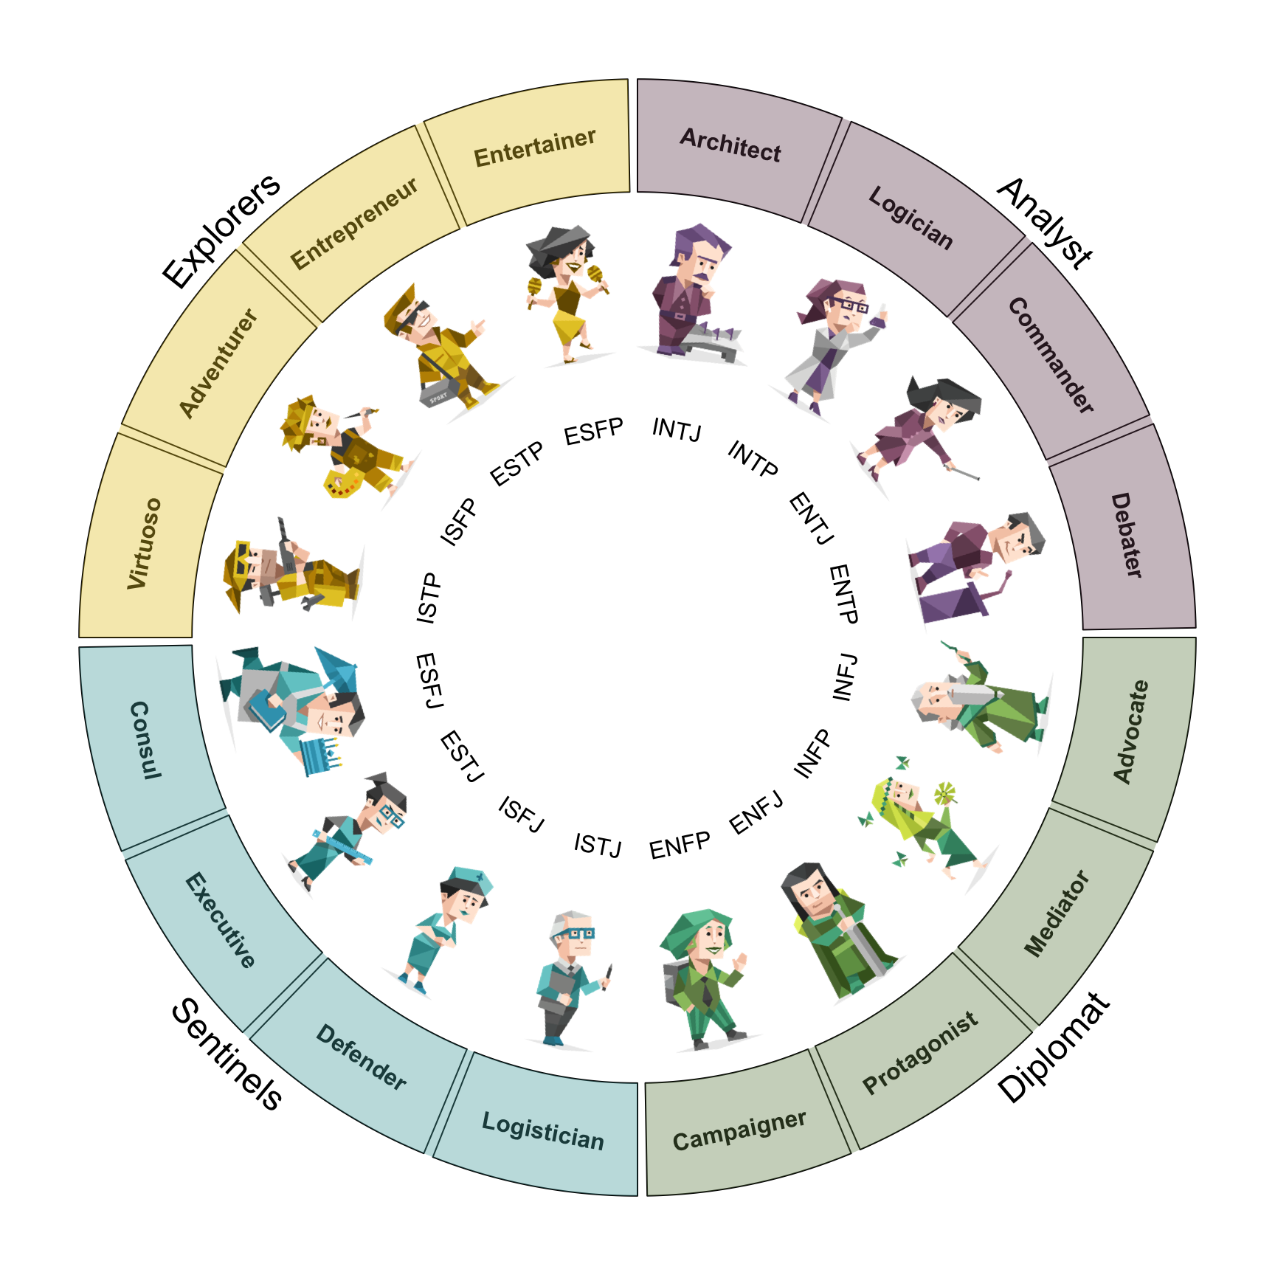
DEBRIEF
16 Personalities Test
Do the 16 personalities test and report and read more about your personality
https://www.16personalities.com/

Slide 9
ACTIVITY
Building the profile wall
Your profile card stays visible throughout the entire bootcamp.
Name & background
Your DISC type
So everyone knows who you are at a glance
So teams can balance profiles when forming groups
Your top skill
One learning goal
So we can match skills to component needs
So you can check in with yourself on Day 5

Slide 10
Up next
Team Building Activity
& Team Formation
Day 1 · Session 2 — This afternoon

