Slide 1
Benchmarking and refining a general workflow for the analysis of scRNASeq data: Key challenges and conclusions
CBT- CBTi
Rebekka Wegmann
Marilisa Neri, Caroline Gubser Keller, Sven Schuierer, Guglielmo Roma
M&B: Single-cell RNASeq, 25. January 2018

Slide 2

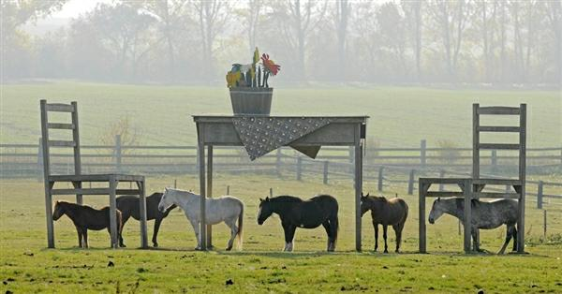
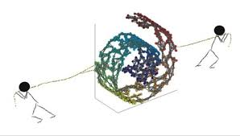



Goal Refinement & benchmarking of analysis workflow
Genes and cells quality control
Data Normalization and
transformation
Selection of the most informative genes
to reduce the high dimensionality
Identification and characterization
of rare cell types
Identification of subpopulations
of cells and markers
Clustering

Slide 3
Experimental design Human cell line mixture
scRNASeq data from a total of 8 human cell lines, sequenced in 4 batches of ~3000 cells each:
Batch 1: K562 (55%), Jurkat (40%), Ramos (5%)
Batch 2: IMR90 (50%), HCT116 (50%)
Batch 3: A549 (50%), Ramos (50%)
Batch 4: HEK293 (50%), H1437 (50%)
Platform: 10X chromium v2
Bulk-RNASeq data of each cell line is available and is used to annotate cell types
Cell types are assigned based on correlation with bulk data. A cell is not assigned to any type if max(corr) < 0.2 or if the second highest correlation is within 5% of the highest.
Data were generated by the group of Guglielmo Roma

Slide 4
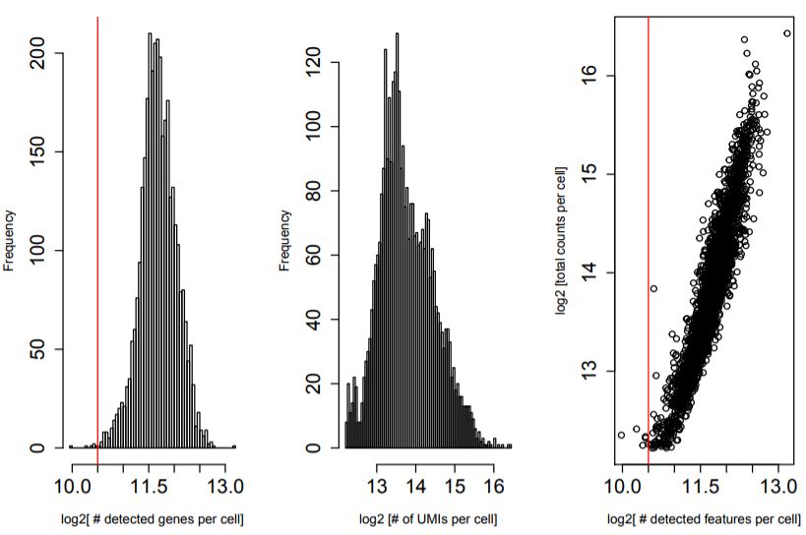
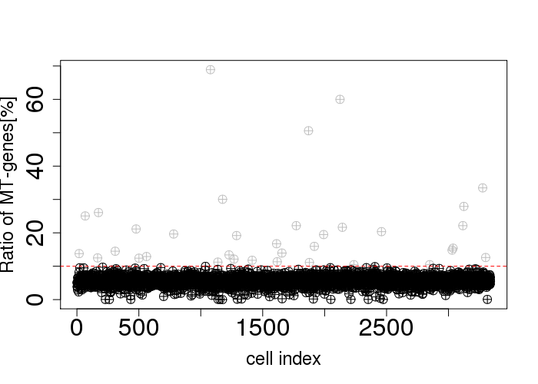
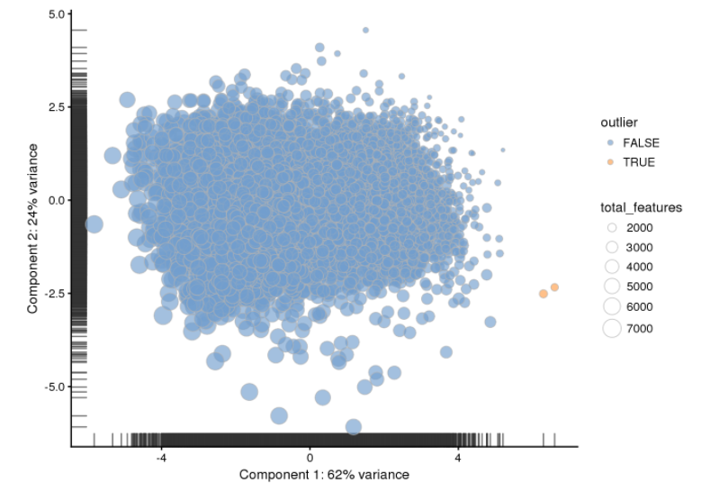
Quality control Summary
Cell QC (for each batch separately):
Removed cells with low RNA content (min 1450 detected genes and 4096 total UMI counts) or high mitochondrial gene content (higher than 10%)
Automatic outlier detection based on a combination of QC metrics (scater)
Gene QC:
Removed all genes not expressed at a count of 3 in at least 1 cell
Remaining dataset: 12718 genes x 11678 cells
#genes / cell #UMI / cell #UMI vs #genes
Mitochondrial gene content / cell
Automatic outlier detection

Slide 5
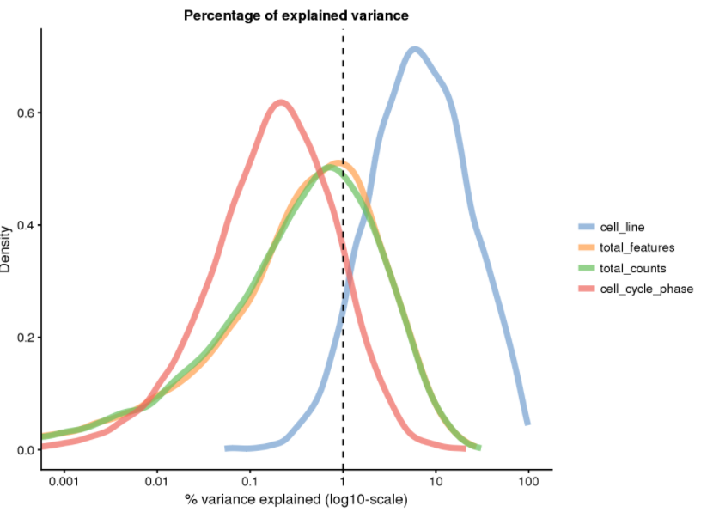
Quality control Identifying sources of variance (scater)
Percentage of variance explained by the predictor “cell_line” across all genes, shown as a probability density
Peak is at ~10% -> for roughly half the genes, “cell_line” explains less than 10% of the total variance
Possible predictors of gene expression (can be continuous or discrete)

Slide 6
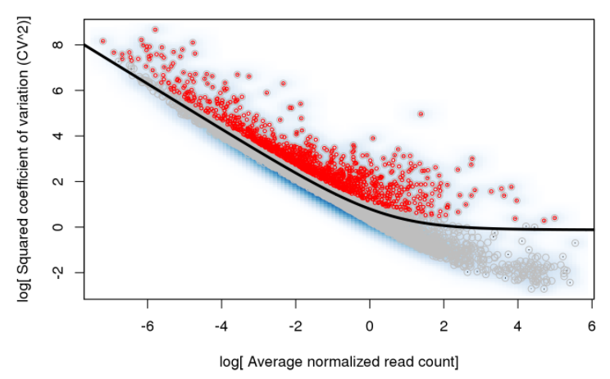
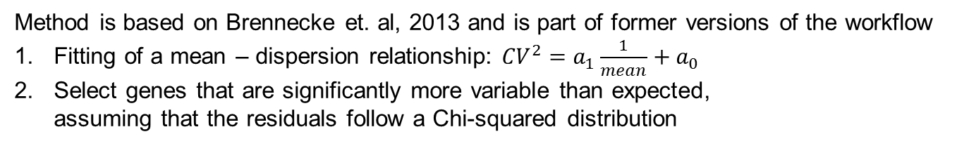
Feature selection Finding highly variable genes
Method is based on Brennecke et. al, 2013 and is part of former versions of the workflow
Fitting of a mean – dispersion relationship: ${CV}^{2}=a_{1}\frac{1}{mean}+a_{0}$
Select genes that are significantly more variable than expected, assuming that the residuals follow a Chi-squared distribution

Slide 7
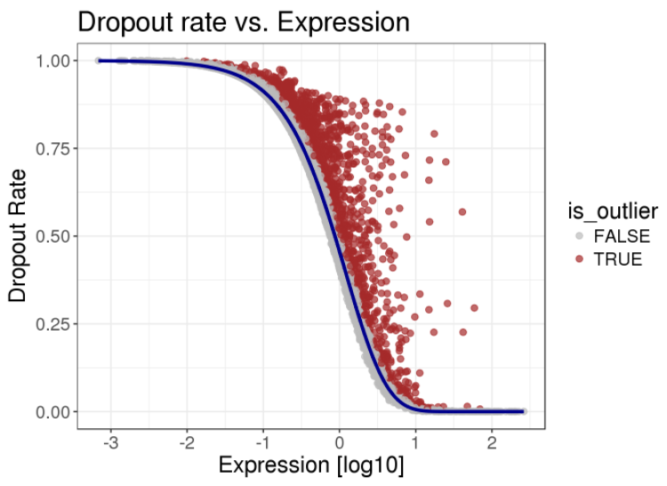
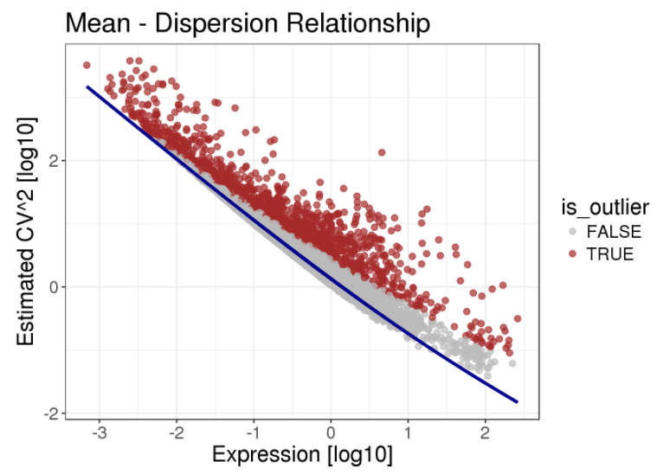
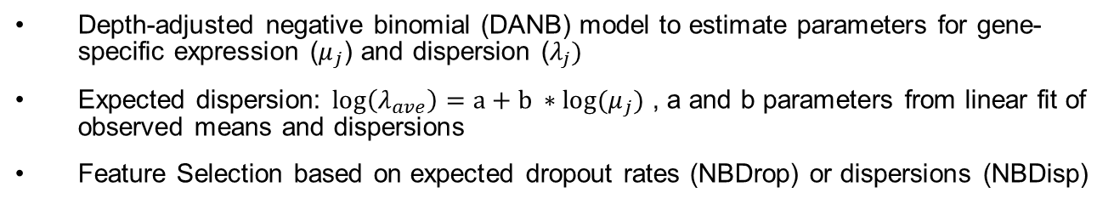
Feature selection DANB (M3Drop)
Depth-adjusted negative binomial (DANB) model to estimate parameters for gene-specific expression ($μ_{j}$) and dispersion ($λ_{j})$
Expected dispersion: $\log\left(λ_{ave}\right)=a+b ∗log(μ_{j})$ , a and b parameters from linear fit of observed means and dispersions
Feature Selection based on expected dropout rates (NBDrop) or dispersions (NBDisp)
M3Drop paper:
Andrews and Hemberg, preprint: https://www.biorxiv.org/content/biorxiv/early/2017/05/25/065094.full.pdf

Slide 8
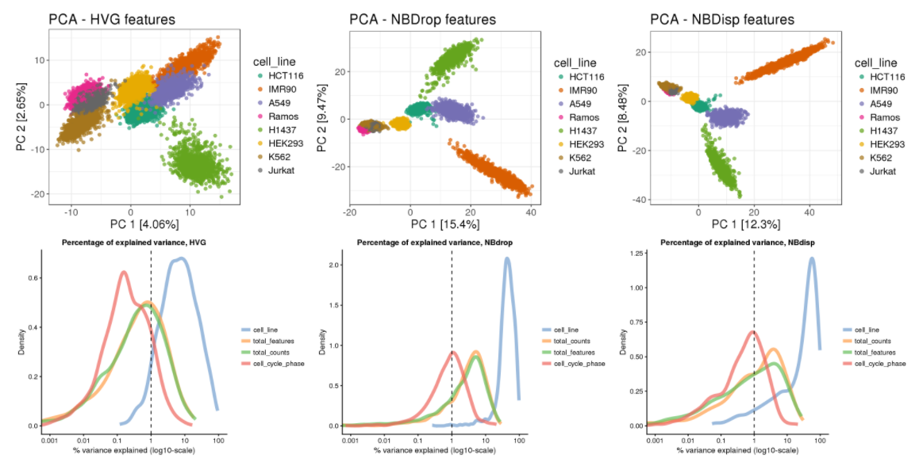
Feature selection Influence on downstream analysis

Slide 9
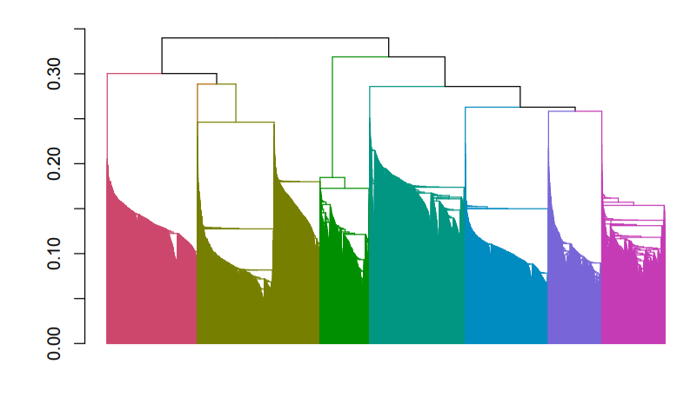
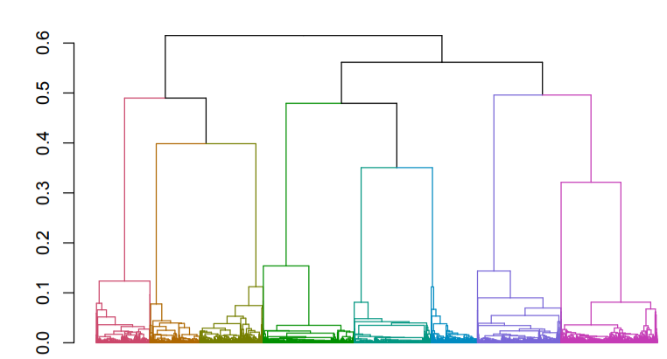
Clustering Choosing a clustering algorithm
General considerations for each method:
Run time and memory requirement
Underlying assumptions (e.g. cluster size and shape)
Reproducibility and robustness
A note on distance measures:
Curse of dimensionality: distances in high-dimensional space are all very large and very similar
Clustering often benefits from initial dimensionality reduction and calculating distances in low-dimensional space (i.e. replacing the gene expression values by PC scores / “meta-genes”)
High-dimensional space
Low-dimensional space

Slide 10
Clustering Benchmarking available methods
Method | Unsupervised # clusters? | Input | Underlying model | Required cluster shape and size | Run time (12k cells)
SC3 | Yes | Normalized data, distances and transformations are calculated internally | K-means clustering on various distances & transformations, hierarchical clustering of consensus matrix | Spherical, equal sizes | 35 min
Hclust + dynamic tree cut | No | Distance matrix, usually pearson or euclidean distance in PCA space | Agglomerative clustering | None | 1 min
pcaReduce | No | Normalized data, PCA is performed internally | K-means + hierarchical clustering | Spherical, equal sizes | 3 min
Seurat | Yes | Principal component scores, are internally converted to a graph | Graph based | None | 9 min
MCL | Yes | Distance matrix, usually pearson or euclidean distance in PCA space | Graph based | None | Build graph: >1h Run MCL: 7 min
mclust | Yes (via cross-validation or BIC) | Principal component scores | Gaussian mixture model | Ellipsoid, size can vary | 6 min
DBScan | Yes | Distance matrix, usually pearson or euclidean distance in PCA space | Clusters are defined as regions of high density separated by regions of low density | None, but clusters have to be compact and clearly disconnected | 2 min

Slide 11
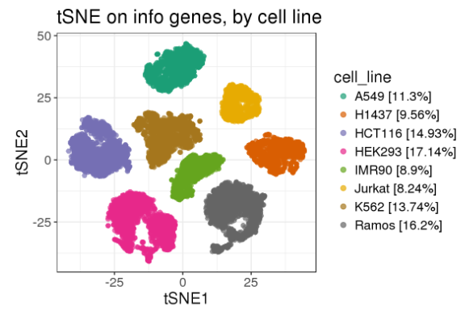
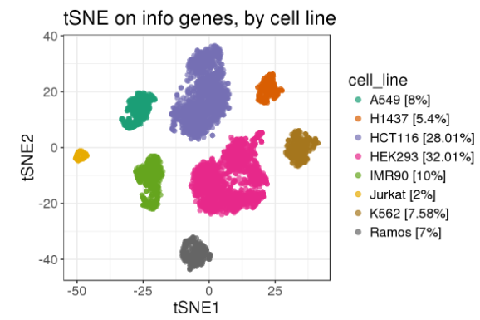
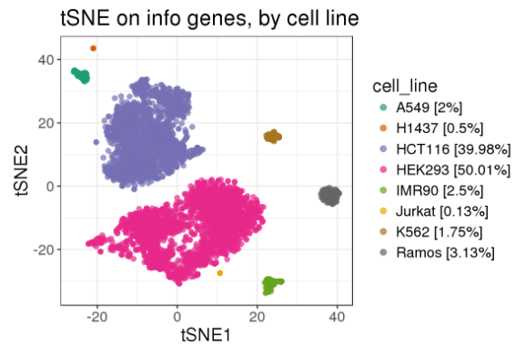
Clustering Benchmarking available methods
3 mixtures with different proportions of 8 cell lines created in silico
If possible, the number of clusters is forced to be 8
Goodness of clustering assessed by adjusted rand index (ARI)
Stochastic methods are run 25 times
Mix 1: All proportions
are roughly equal
Mix 2: Unequal proportions,
No very rare cell types
Mix 3: Unequal proportions with very abundant and
very rare cell types

Slide 12
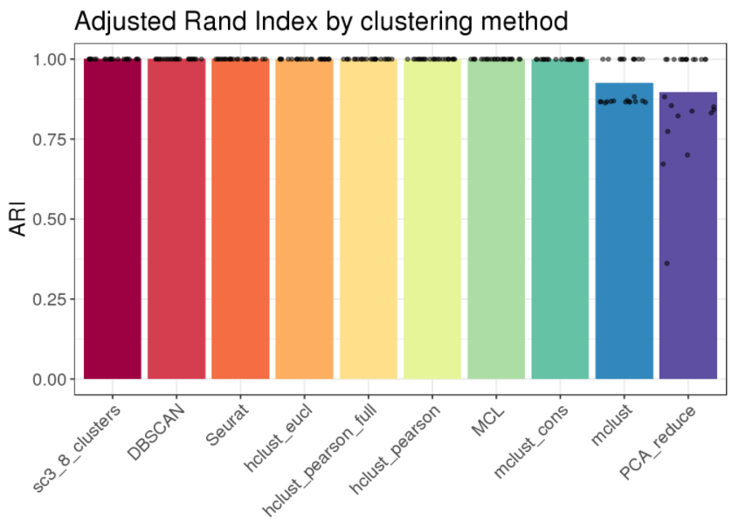
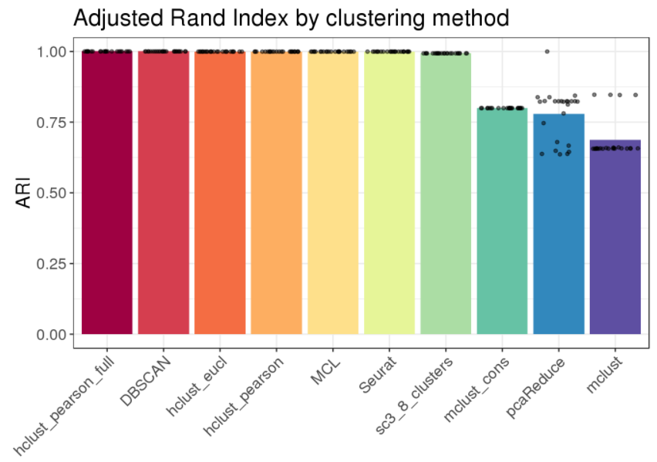
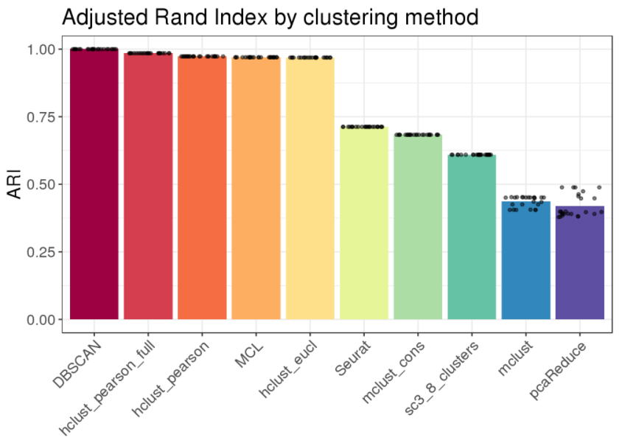
Clustering Benchmarking available methods
Mix1: Equal cluster sizes
Mix2: Unequal cluster sizes
Mix3: Extremely unequal cluster sizes
On the full dataset, any method produces a perfect clustering.
As cluster sizes change, especially methods that expect a certein cluster shape or size start failing
Note: DBScan classifies very small populations as outliers, while all other methods merge them with the closest bigger cluster

Slide 13
Clustering: Conclusion
If clear clusters are present in the data, any algorithm will find them, provided the underlying assumptions are fulfilled and a meaningful input was chosen.
There is most likely no global best option for clustering.
All methods struggle with very imbalanced cluster sizes.
Incompatible with assumptions (e.g. for k-means)
Misclassification of a small group of cells does not greatly affect overall likelihood of model (e.g. for EM algorithm in mclust)
Feature selection and/or additional dimensionality reduction might result in loss of the weak signal from a very small subpopulation of cells
Proposed workaround: 2-step approach
Initial clustering to capture large groups / global structure
Re-run analysis on a subset of cells
Identify rare cell types with characteristic gene expression signatures

Slide 14
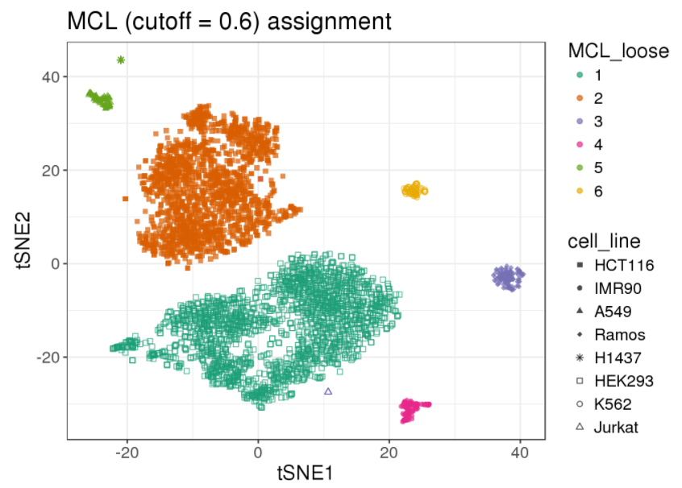
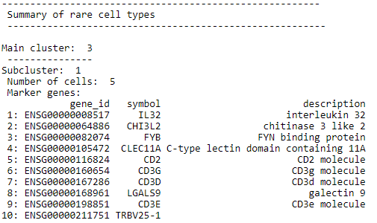
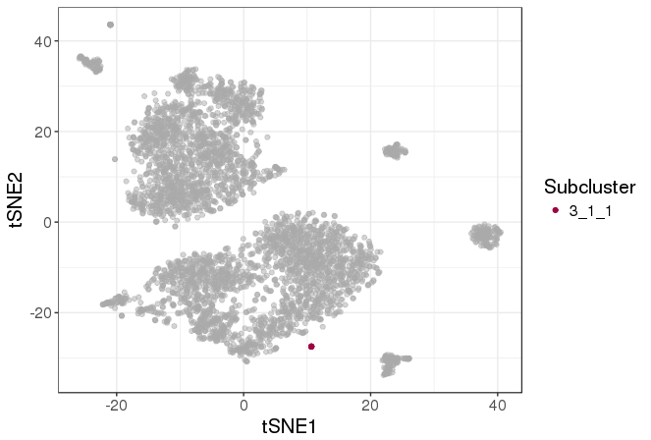
Rare cell types Application to cell line data: Cluster 3
We identify the 5 Jurkat cells correctly
Consistent with Jurkat being derived from T-cell lymphoma, we find CD3 subunits among the marker genes.
Subcluster 1:
5 Jurkat cells

Slide 15
Summary & Outlook
Summary:
Goal: Establish a general workflow for scRNASeq data analysis in R using several available packages
We use scRNASeq data of known cell types (cell lines, well studied cells like PBMCs) to benchmark the different methods
All code and a detailed description / guided analysis of a test dataset are available within NIBR (publication is planned)
Next steps:
Test on other datasets
What happens if the cell type proportions are different?
What needs to be changed for extremely large datasets (up to 100’000 cells)?
Include methods for trajectory analysis
Update to new bioconductor version

Slide 16
Acknowledgements
CBTi
Florian Nigsch
Christian Hauer
Shola Richards
Giovanni d’ Ario
CBT
Rachel Cuttat
Annick Waldt
Walter Carbone
John Reece-Hoyes
Kushal Joshi
FMI
Michael Stadler
Pan Papasaikas

Slide 17
Appendix

Slide 18
Quality control Summary of QC metrics per batch
 | Batch 1: K562, Jurkat, Ramos (DA234) | Batch 2: IMR90, HCT116 (DA272) | Batch 3: A549, Ramos (DA272) | Batch 4: HEK293, H1437 (DA272)
Reads / cell [mean] | 36’236 | 37’756 | 38’602 | 33’589
UMI / cell [min, 1st,2nd and 3rd quartile, max] | 1009, 8896, 16600, 23824, 78355 | 4569,14224,17869 23196, 64864 | 4377, 9774, 13543, 22310, 56086 | 4774, 9844, 12960, 19469 88332
Genes / cell [min, 1st,2nd and 3rd quartile, max] | 168 ,2550, 3652, 4357 6852 | 900, 3166, 3646 4200, 7344 | 1303, 2556, 3142, 4004 6608 | 1010, 2838, 3278, 3870, 9211
Filter thresholds | Min_UMI: 2^12 Min_genes: 2^10.5 Max_pct_mt: 10 | Min_UMI: 2^13 Min_genes: 2^11 Max_pct_mt: 10 | Min_UMI: 2^12 Min_genes: 2^10.5 Max_pct_mt: 10 | Min_UMI: 2^12 Min_genes: 2^10.5 Max_pct_mt: 10
% cells removed by RNA content filter | 3 | 6 | < 1 | < 1
% cells removed by mt genes filter | < 1 | 4 | < 1 | < 1
Total % cells removed | 3 | 9 | < 1 | < 1
Number of genes x cells passing QC | 8727 x 2701 | 9452 x 2823 | 9290 x 3118 | 9858 x 3274

Slide 19
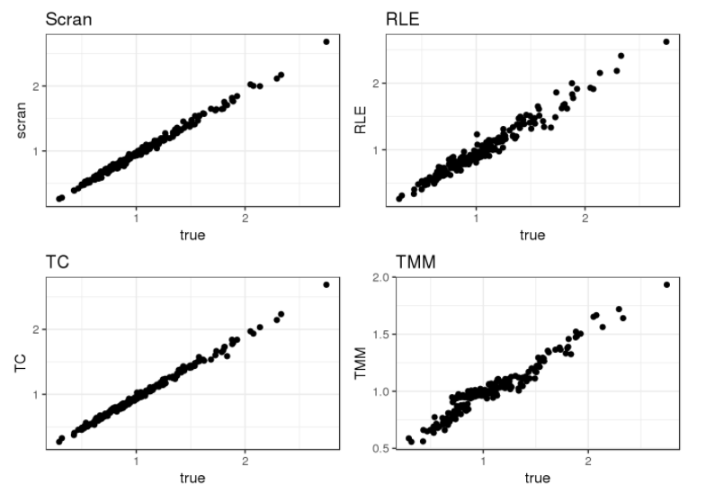
Normalizations Comparing size factors on simulated data

Slide 20
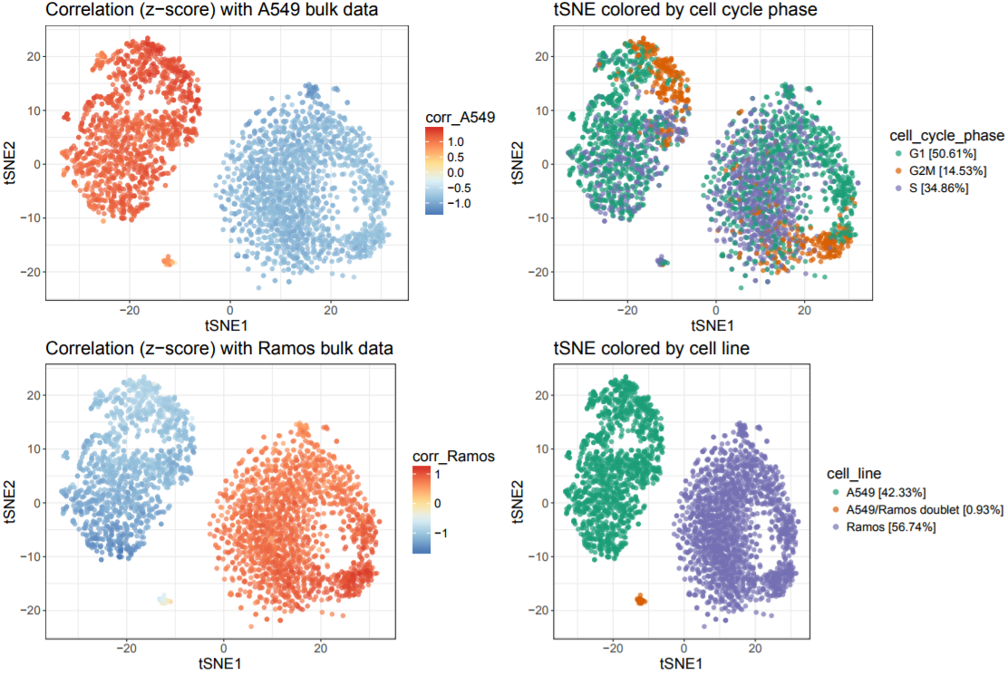
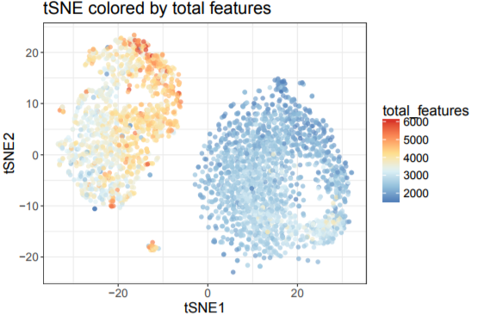
Annotating cell lines Example: Batch 3 (A549 + Ramos mix)
Here, tSNE projection shows ordering of cells along cell cycle
Cell cycle progression
Cell doublets
Total features vary between cell types! Total detected features has both biological origin and can be a confounding factor
Cell doublets

Slide 21
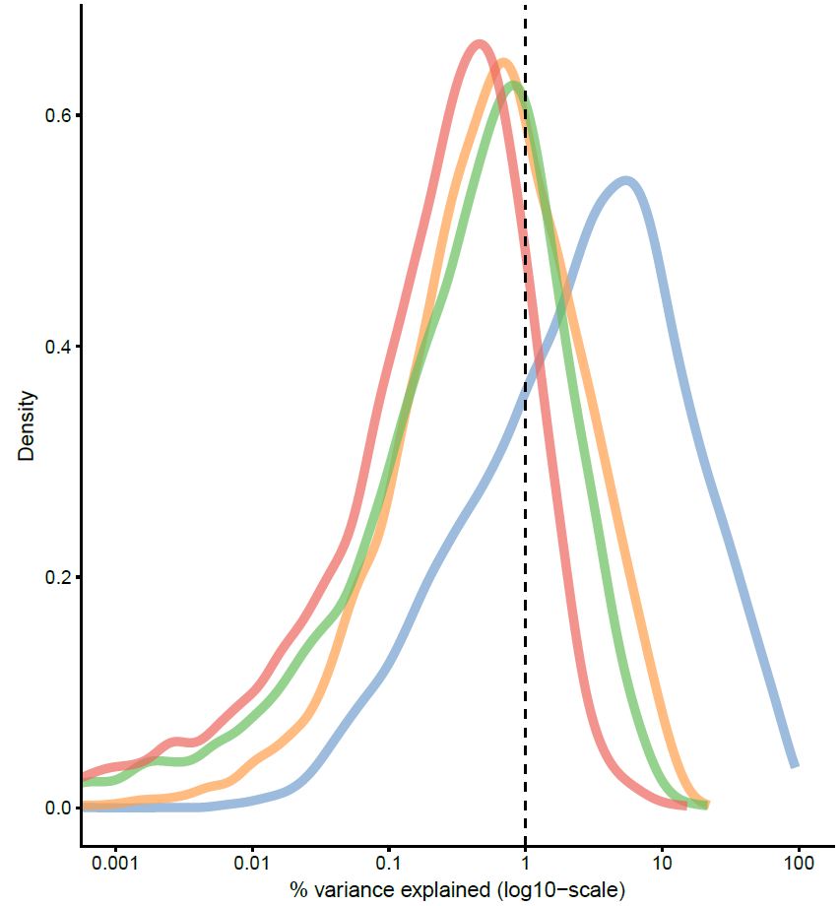
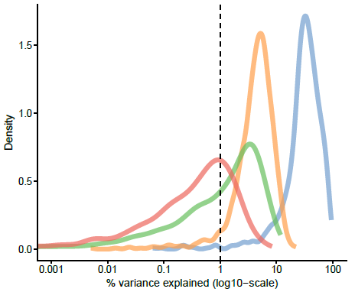
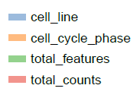
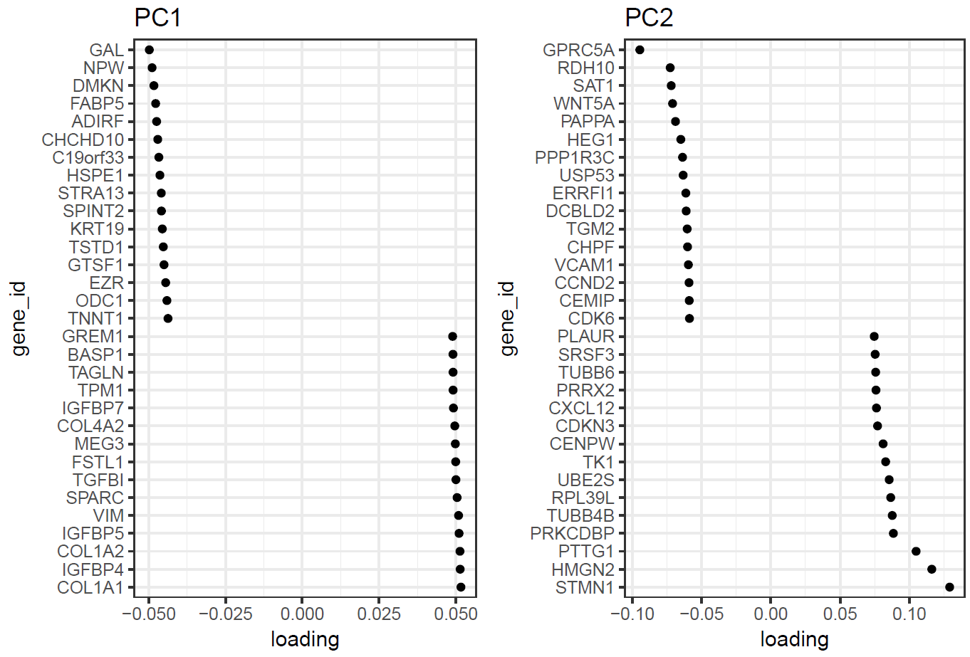
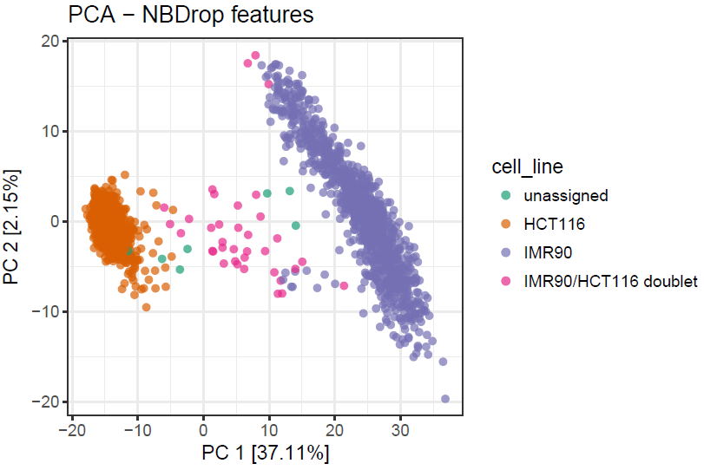
Annotating cell lines Sources of variance (IMR90 + HCT116 mix)
Distribution of the percentage of variance explained by different variables
No feature selection
With feature selection
After feature selection, “cell line” explains ~ 50% of total variance
Analysis of PCA loadings confirms this notion: PC1 [40% variance] is loaded by cell-line specific genes. PC2 is dominated by cell-cycle related genes.
Highest loadings on PC1 and PC2

Slide 22
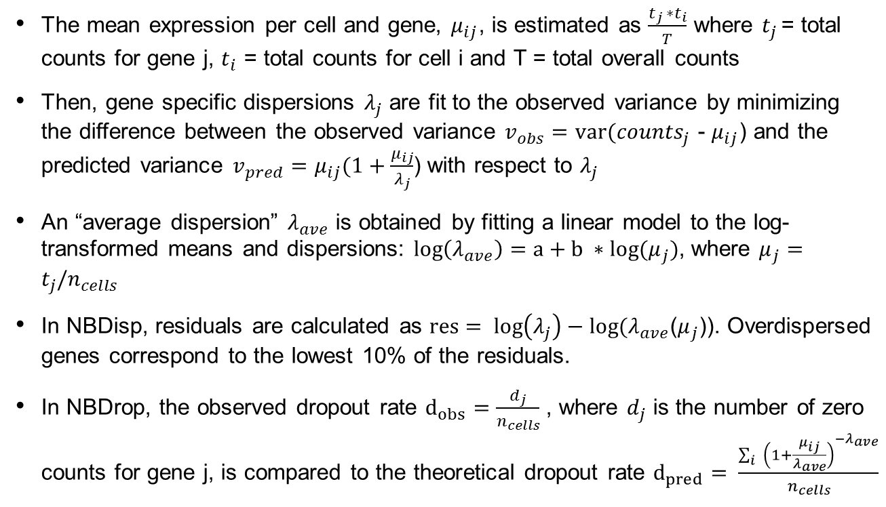
Feature selection DANB: Detailed procedure (Andrews et. al, 2017)
The mean expression per cell and gene, $μ_{ij}$, is estimated as $\frac{t_{j }∗t_{i}}{T}$ where $t_{j }$= total counts for gene j, $t_{i}$ = total counts for cell i and T = total overall counts
Then, gene specific dispersions $λ_{j}$ are fit to the observed variance by minimizing the difference between the observed variance $v_{obs}=var({counts}_{j}$ - $μ_{ij}$) and the predicted variance $v_{pred}=μ_{ij}(1+\frac{μ_{ij}}{λ_{j}}$) with respect to $λ_{j}$
An “average dispersion” $λ_{ave}$ is obtained by fitting a linear model to the log-transformed means and dispersions: $\log\left(λ_{ave}\right)=a+b ∗log(μ_{j})$, where $μ_{j}=t_{j}/n_{cells}$
In NBDisp, residuals are calculated as $res= log\left(λ_{j}\right)−log(λ_{ave}$($μ_{j}$)). Overdispersed genes correspond to the lowest 10% of the residuals.
In NBDrop, the observed dropout rate $d_{obs}=\frac{d_{j}}{n_{cells}}$ , where $d_{j}$ is the number of zero counts for gene j, is compared to the theoretical dropout rate $d_{pred}= \frac{\sum_{i}{{\left(1+\frac{μ_{ij}}{λ_{ave}}\right)}^{−λ_{ave}}}}{n_{cells}}$
M3Drop paper:
Andrews and Hemberg, preprint: https://www.biorxiv.org/content/biorxiv/early/2017/05/25/065094.full.pdf

Slide 23
Workflow Overview
Quality Control
Scater is used for calculation and visualization of QC metrics. Manual filtering of cells based on total counts, total detected genes and percentage of mitochondrial genes is retained from previous workflow
Marker identification
Identification and characterization of rare cell types
Clustering
Feature selection (informative genes)
Data normalization and transformation
Scran for normalization of sc-RNASeq data
Normalized counts are log2 transformed
Unsupervised: Variance (HVG, previous versions), dispersion / dropouts (DANB, new)
Supervised: GO term annotation
Additional methods: SC3, Seurat, dbscan, mclust, pcaReduce
Comparison of DE methods: Soneson and Robinson, 2017
Limma-trend and MAST as flexible, fast and robust methods
Algorithm by Marilisa Neri (adapted from previous versions of workflow)
MCL and hclust (previous workflow) can benefit from dimensionality reduction before calculating distance matrices
SC3 includes a method for easy identification and visualization of a small set of markers

