Slide 1
BaselHack 2021
Product Search
«Easy Grocery Shopping»

Slide 2
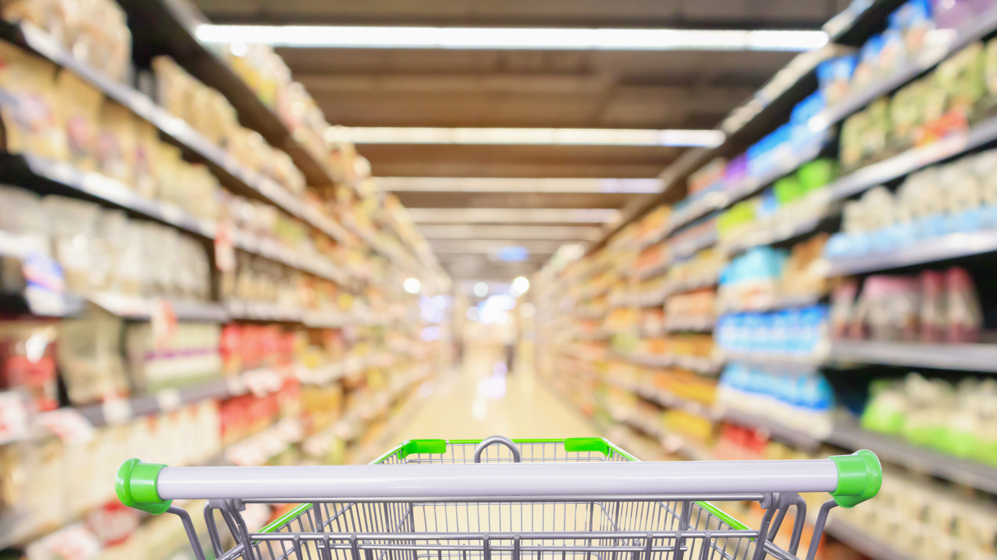
Short Sketch
Avoid to go shopping

Slide 3
Troubel

Slide 4
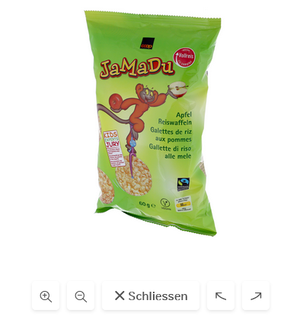
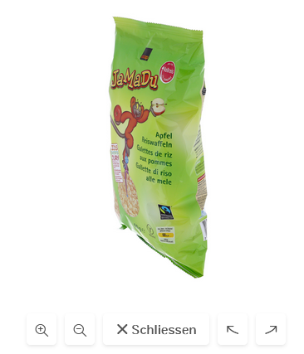
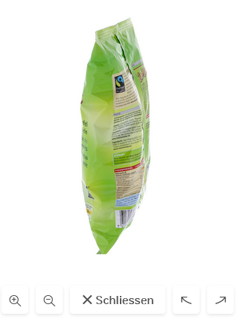
Stock Picture
Upload pictures to google cloud
Train vision API with it

Slide 5
Search for Picture
Front-End:
Simple Angular Material App
Back-End
Nodejs express server
API call to vison API wit Base64 Picture
Hosted on the cloud

Slide 6
Vision
Multi Product Detection
Integration into Online Shop
Visual Checkout
counter

Slide 7
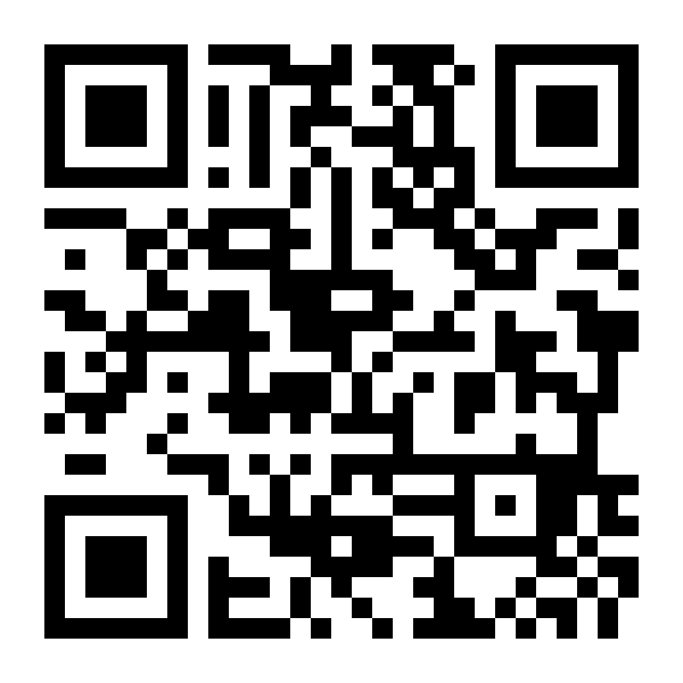
Try it out / Demo

Slide 8
Technical implementation
Cloud Vision API Google
Send picture
User
Annotated stock pictures
train
get infos

