Slide 1
Product Search
BaselHack 2021
«Product Search with Pictures
using Google Vision API»

Slide 2
Product Search - Task

Slide 3
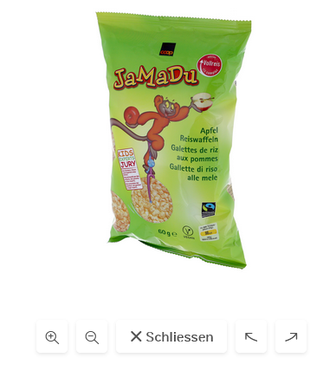
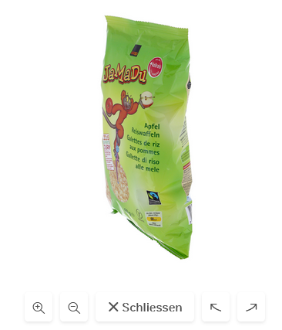
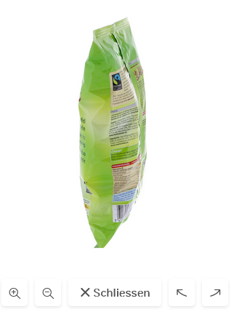
Product Search - Task
I have a web shop with many pictures of my product:

Slide 4
Product Search - Task
I send my pictures to Google Cloud Vision API Product Search.
I label them with tags and a link to my web shop and train the system.

Slide 5
Product Search - Task
If a user takes a picture of a product, the application can show the correct product in the web shop.
(example image)

Slide 6
Product Search - Demo
Demo application ...

Slide 7
Product Search - Conclusion
Lessons learned ...

