Slide 1
BaselHack 2021
Product Search
«Easy Grocery Shopping»

Slide 2
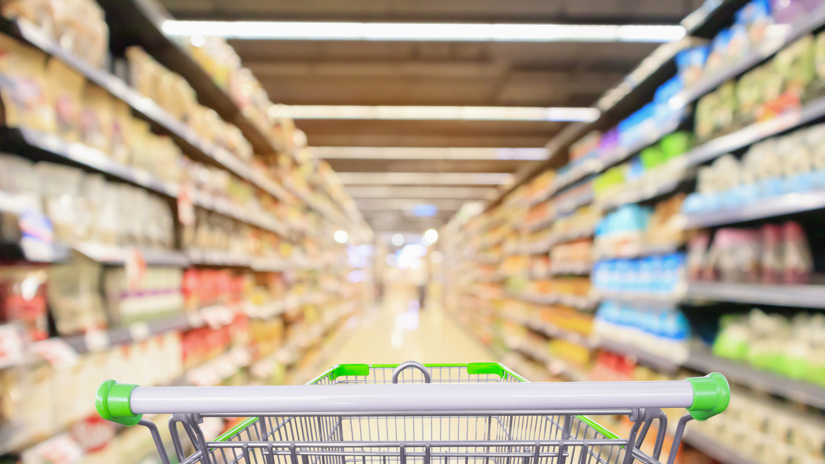
Short Sketch
Avoid to go shopping

Slide 3
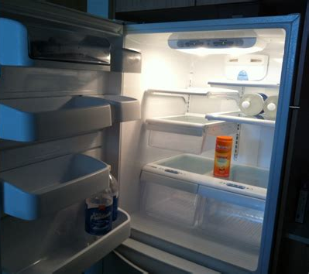
Trouble
Replace Household stock

Slide 4
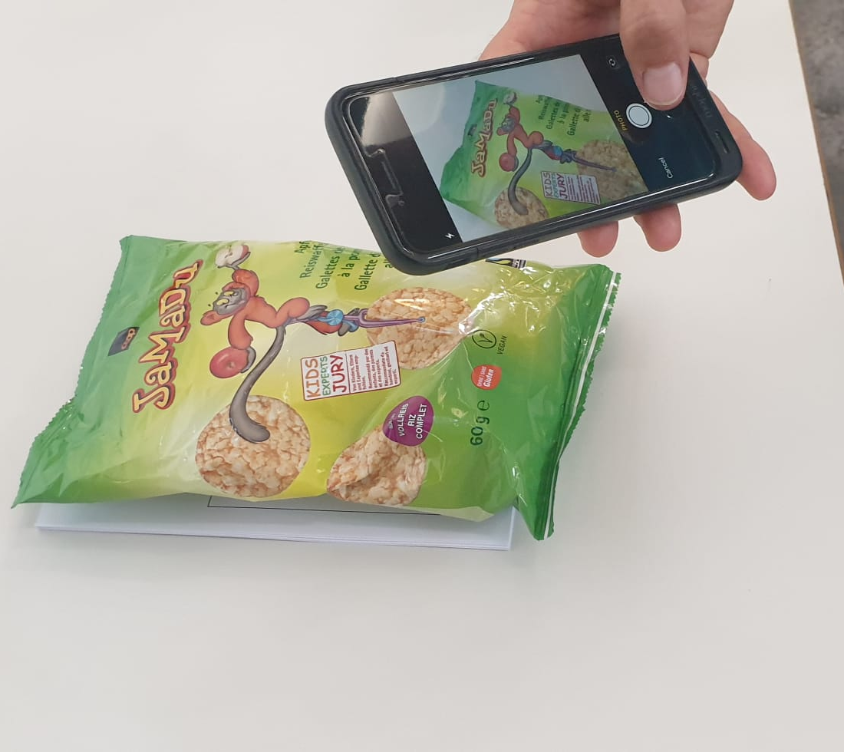
Solution
Simplify Shopping by Smartphone

Slide 5
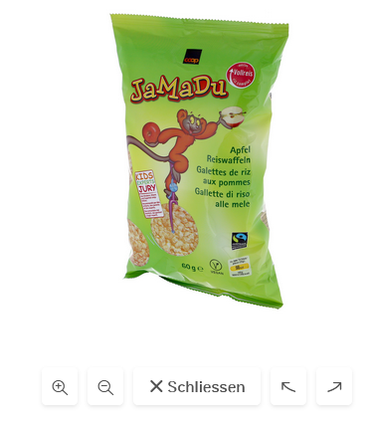
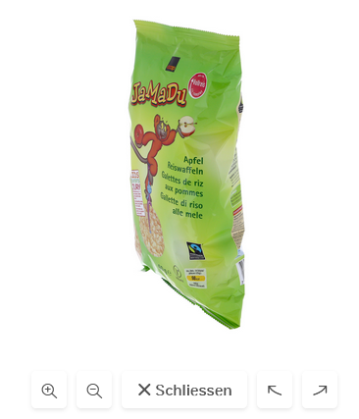
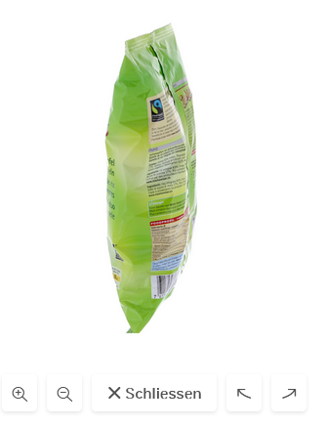
How it’s done

Slide 6
Technical implementation
Cloud Vision API Google
Send picture
User
Annotated stock pictures
train
get infos

Slide 7
Vision
Multi Product Detection
Integration into Online Shop
Visual Checkout
counter

Slide 8
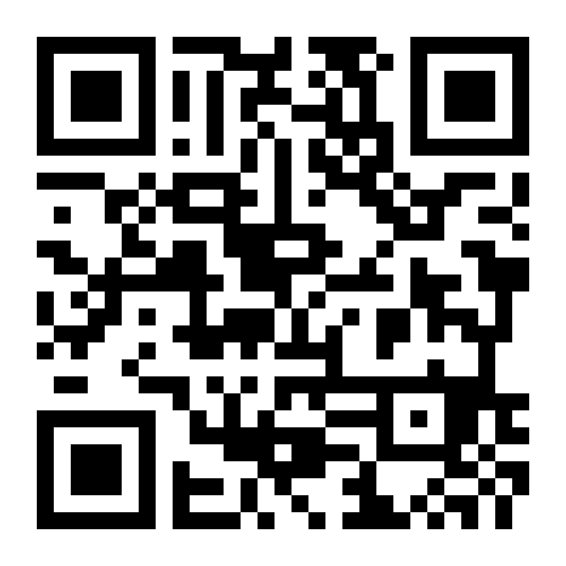
Try it out / Demo

