Slide 1
Product Search
BaselHack 2021
«Easy Grocery Shopping»

Slide 2
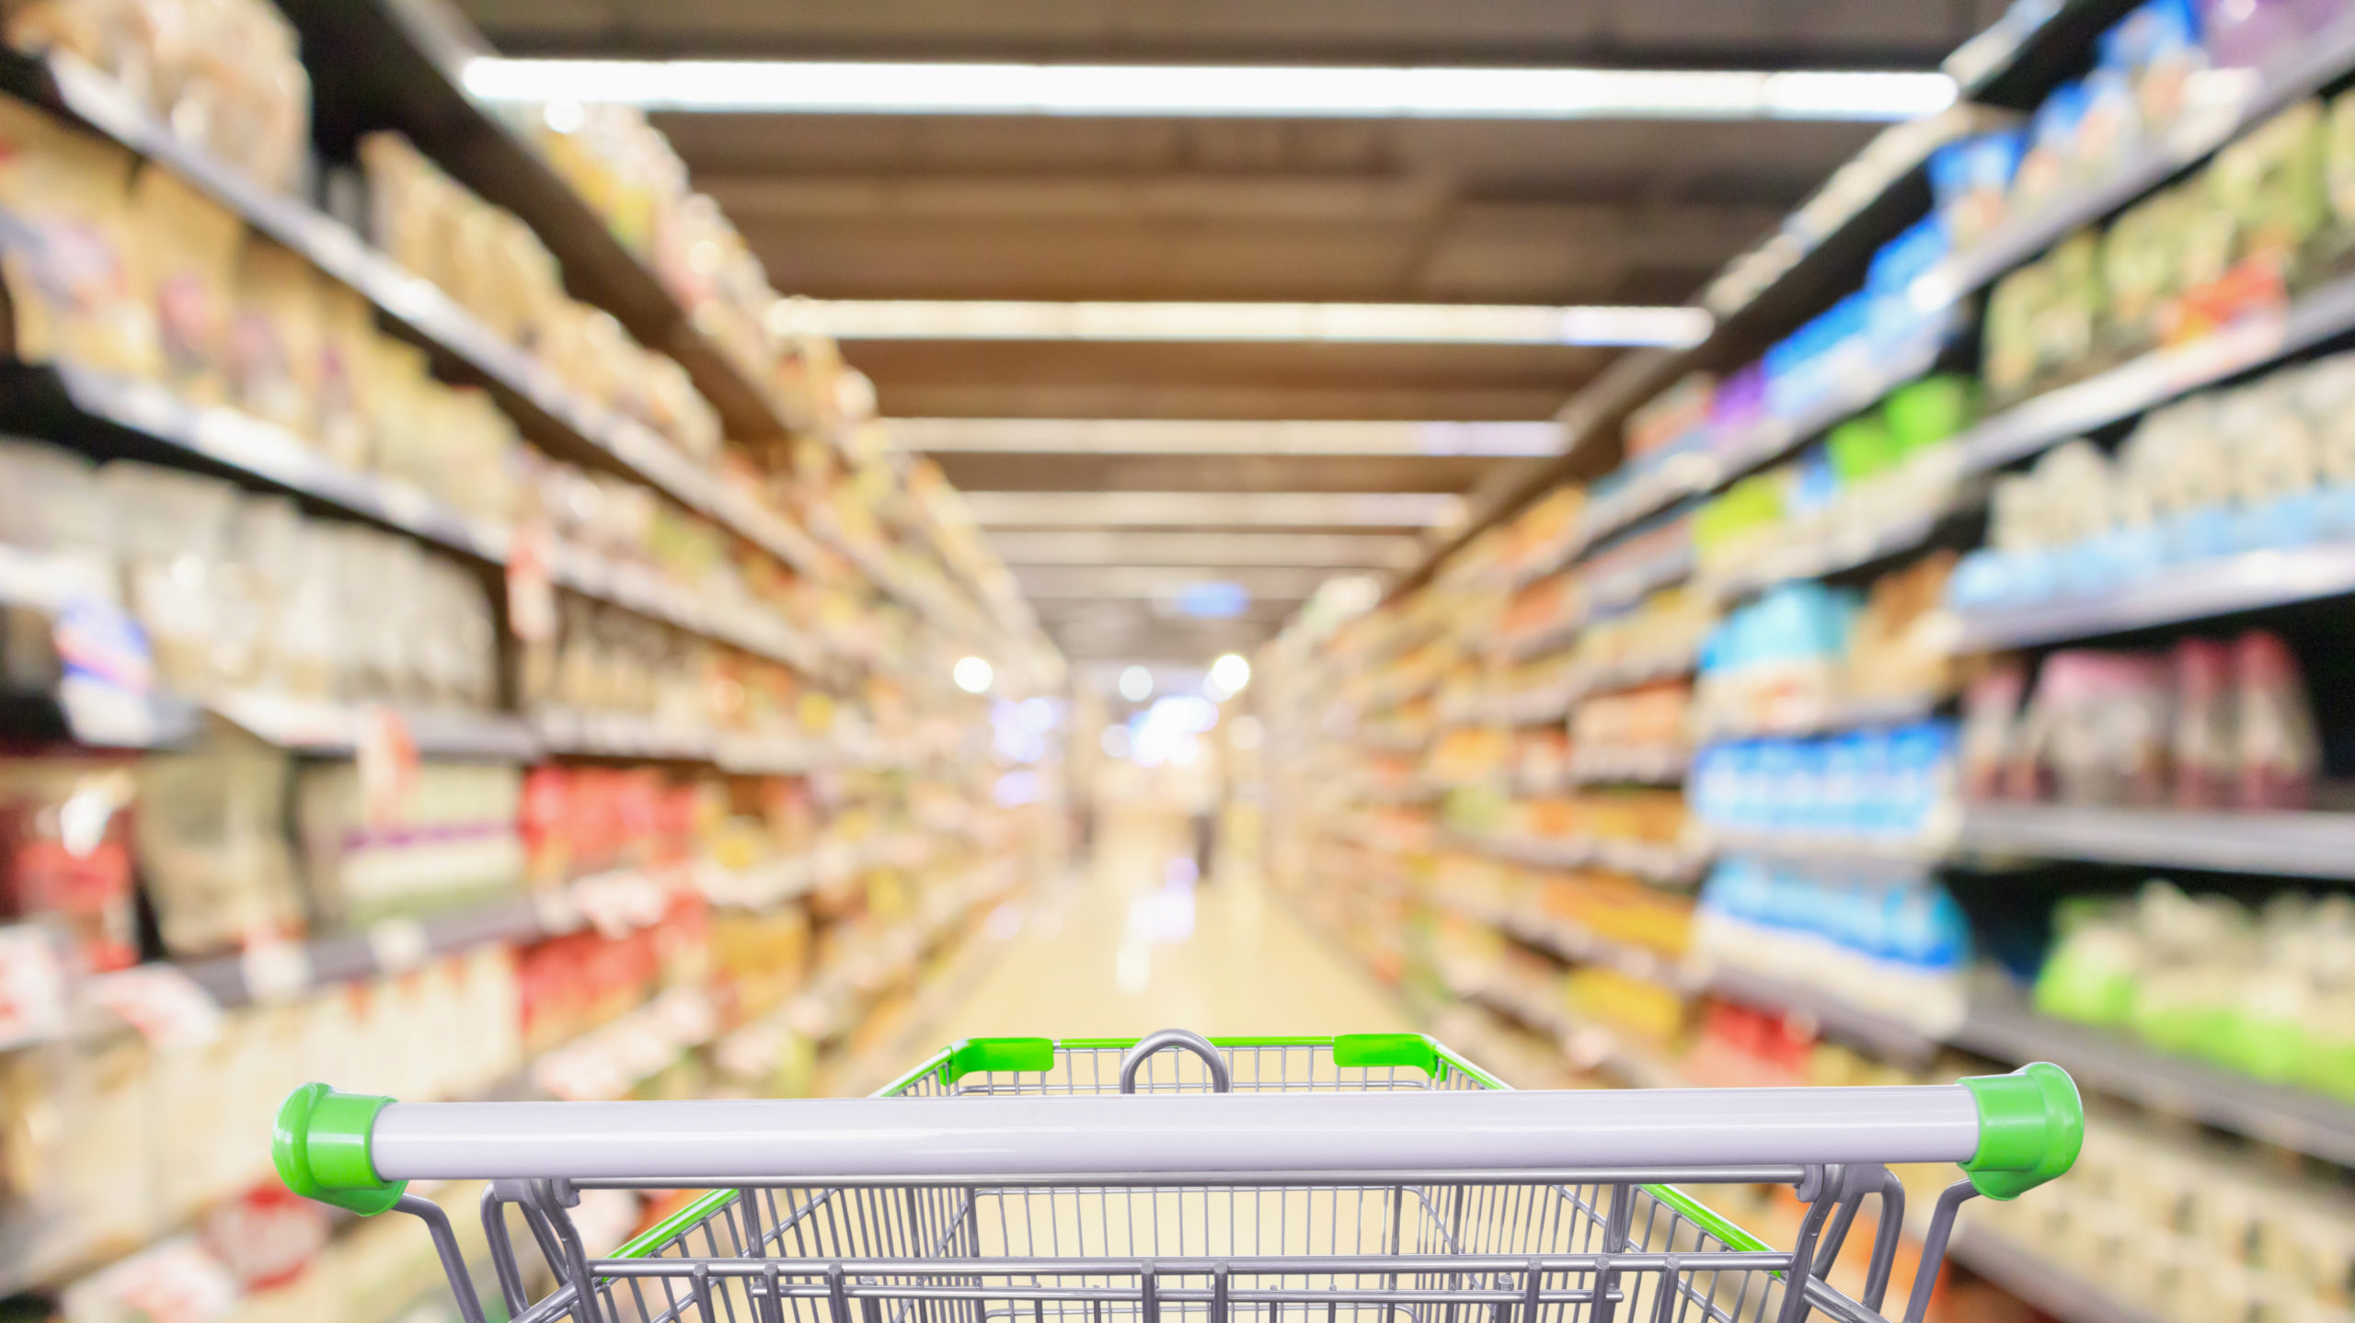
Short Sketch
Avoid to go shopping

Slide 3
Technical implementation
Cloud Vision API Google
Send picture
User
Annotated stock pictures
train
get infos

Slide 4
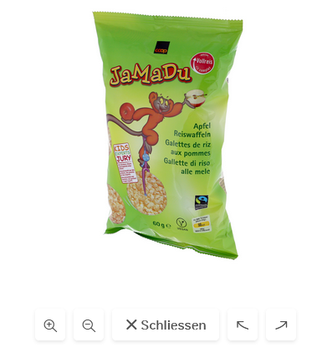
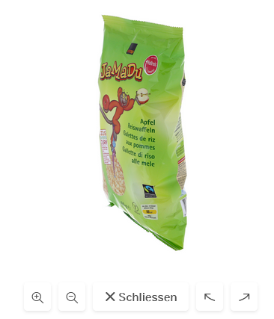
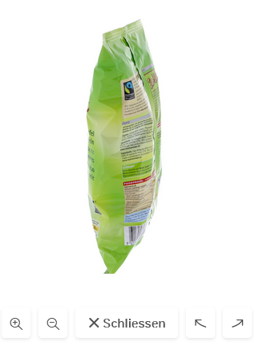
Product Search - Task
I have a web shop with many pictures of my product:

Slide 5
Product Search - Task
I send my pictures to Google Cloud Vision API Product Search.
I label them with tags and a link to my web shop and train the system.

Slide 6
Product Search - Task
If a user takes a picture of a product, the application can show the correct product in the web shop.
(example image)

Slide 7
Product Search - Demo
Demo application ...

Slide 8
Product Search - Conclusion
Lessons learned ...

