Slide 1

My Side Effects
Because each patient is special
Notes:
We are My Side Effects, personalizing side effects for each patient, because each patient is special.

Slide 2
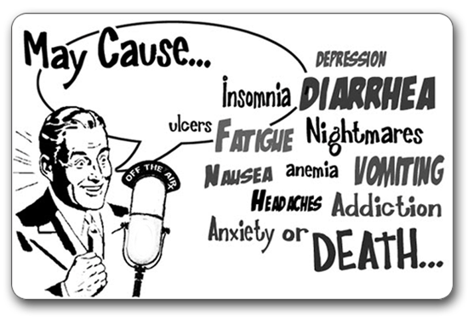
The same story for each patient…
Notes:
Imagine this, you are choosing a drug, lets say ibuprofen, do you ever look at the label for the adverse events? Do you compare side effects profiles between two drugs?
Probably not, the information is not presented in a useful manner, often there are just a list of potential side effects – but how do you know if this is relevant for you?
The same problem is faced by the physician, insurance agency and the pharma industry – what adverse events are relevant for a specific patient?
In total monetary terms, according to an OECD report the hospitals spend 15% of their total expenditure just on managing side effects. What a waste…

Slide 3


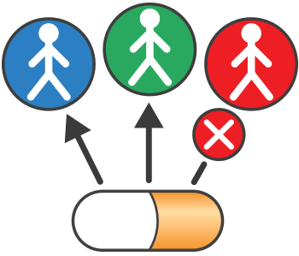
Personalizing the choice of treatment for each patient based on their characteristics
Profile
Treatment
Personalized side effects
Enter your characteristics
(e.g. age, weight, race)
Pick your medicine
Receive a personalized side effect profile
Notes:
This is the problem our solution is solving, we are personalizing Side Effects to each patient.
It is very simple, a patient logs onto our service and enters their details, they then choose which drug they are considering and our service provides them with a personalized overview of what side effects they might encounter while taking this treatment. This also allows them to compare side effect profiles, personalized for themselves, between different potential drugs. For example ibuprofen and paracetamol.
Nothing like this currently exists on the market today, the ability to get a personalized side effect report for a treatment has not been done before.

Slide 4

Our solution improves the life of each patient
Facilitates a better discussion with the physician
More informed choice of treatment
Higher engagement in treatment
Decreased stress due to better understanding and expectations
Lower cost through faster response to adverse events
Patient
Notes:
The benefits for the patient specifically is huge:
A more informed patient allows for better discussions with the physician
Empowerment in their own treatment
Less stress and better managed expectations
And also lower costs and better quality of life as they can pick the efficacy and side effect profile that best fits their life.
The benefits don’t stop there, taking a wider lens looking at the whole healthcare industry.

Slide 5



A more personalized approach benefits all stakeholders within the healthcare system
Healthcare system
Physician
Reduced waste due to improved transparency of actual treatment benefits
Improved treatment decisions
Industry
Patient
Improved outcome based reimbursement
Decreased cost due to managing adverse events
Payer
Notes:
We can see enormous benefits all across the system, from:
Helping physicians provide better treatment decisions
Decreasing the cost of side effects as we are able to minimize side effects given the patient we are treating
Improve accuracy of reimbursement as we have a better understanding of the cost of treatment
Reduce waste in the interaction between industry and physician with better transparency on what patient subgroups should be treated with this drug.

Slide 6
Team Journey
2. What problem are we solving ?
4. Form teams – backend, frontend, design, data
1. Team Forms and get to know each other and skills
6. Identify and understand data
3. Decide who we are solving it for . Patient, Physician, Manufacturer?
7. Design flow of app and start building
5. Collaboration tools – slack, git, wooho
8. Refine concept to marry available data and patient needs
12. Finish !!! Yippee !!
11. Will we make it to demo ?
Lets (re) prioritize
10. Build Some more !!!
9. Build !!!
11. Start presentation build

