Slide 1

My Side Effects
Because each patient is special

Slide 2
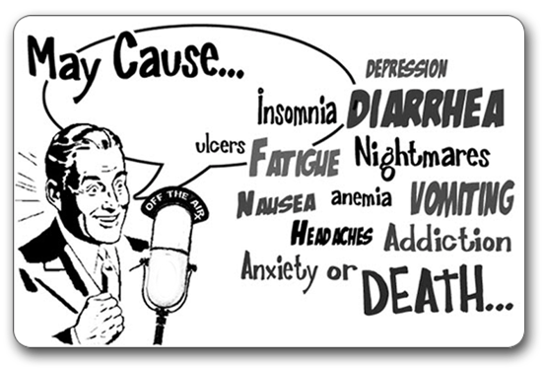
The same story for each patient…

Slide 3


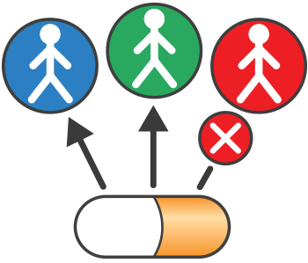
Personalizing the choice of treatment for each patient based on their characteristics
Profile
Treatment
Personalized side effects
Enter your characteristics
(e.g. age, weight, race)
Pick your medicine
Receive a personalized side effect profile

Slide 4

Our solution improves the life of each patient
Facilitates a better discussion with the physician
More informed choice of treatment
Higher engagement in treatment
Decreased stress due to better understanding and expectations
Lower cost through faster response to adverse events
Patient

Slide 5



A more personalized approach benefits all stakeholders within the healthcare system
Healthcare system
Physician
Reduced waste due to improved transparency of actual treatment benefits
Improved treatment decisions
Industry
Patient
Improved outcome based reimbursement
Decreased cost due to managing adverse events
Payer

Slide 6
Team Journey
2. What problem are we solving ?
4. Form teams – backend, frontend, design, data
1. Team Forms and get to know each other and skills
6. Identify and understand data
3. Decide who we are solving it for . Patient, Physician, Manufacturer?
7. Design flow of app and start building
5. Collaboration tools – slack, git, wooho
8. Refine concept to marry available data and patient needs
12. Finish !!! Yippee !!
11. Will we make it to demo ?
Lets (re) prioritize
10. Build Some more !!!
9. Build !!!
11. Start presentation build

