Slide 1


Slide 2
Agenda
A few words about our sponsors
BPUG introduction
2 Sessions:
  Incredible easy DSC using OMS – Part1
  Incredible easy DSC using OMS – Part2
Organisation

Slide 3
A few words on our Sponsors

Slide 4


Sponsors

Slide 5
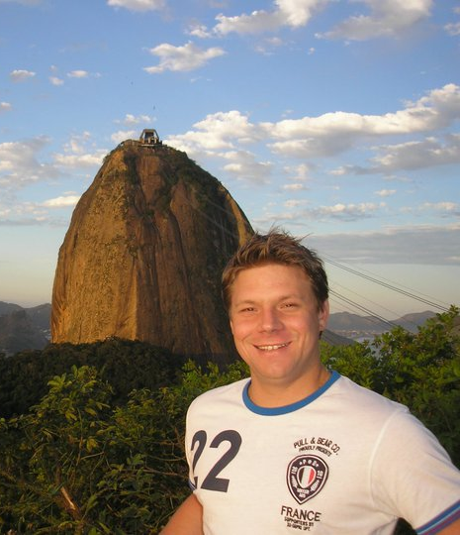



Stephane van Gulick
Stephane van Gulick
Microsoft MVP, PowerShell Hero, Founder of the Basel PowerShell User group (BPUG) , Co-founder of the FRPSUG
Twitter: http://twitter/stephanevg
Blog: http://PowerShellDistrict.com
PowerShell Hero
Microsoft PowerShell MVP
http://PowerShellDistrict.com

Slide 6

FRPSUG
French Speaking Powershell UserGroup
OnLine event in Français only!
http://www.meetup.com/FrenchPSUG/
We are Searching for:
Speakers
Any help you can offer (Creating a logo, Website etc..)
Wine

Slide 7

BPUG Introduction
Bringing PowerShell enthousiasts together in the region of Switzerland!
Twitter: @stephanevg and/or @bpug_ and/or #bpug
WebSite: http://www.bpug.ch/
Blog: http://powershelldistrict.com/category/bpug
Facebook (Group): https://www.facebook.com/groups/710700082312102/
Facebook (Page): https://www.facebook.com/PowerShellDistrict
Github: https://github.com/BaselPowerShell/

